Slide 1

University of Aberdeen logo

Slide 2
Sustainability at the University of Aberdeen
Karl Leydecker
Senior Vice-Principal
18 January 2023
Notes:
Chancellor, colleagues and distinguished guests

Slide 3
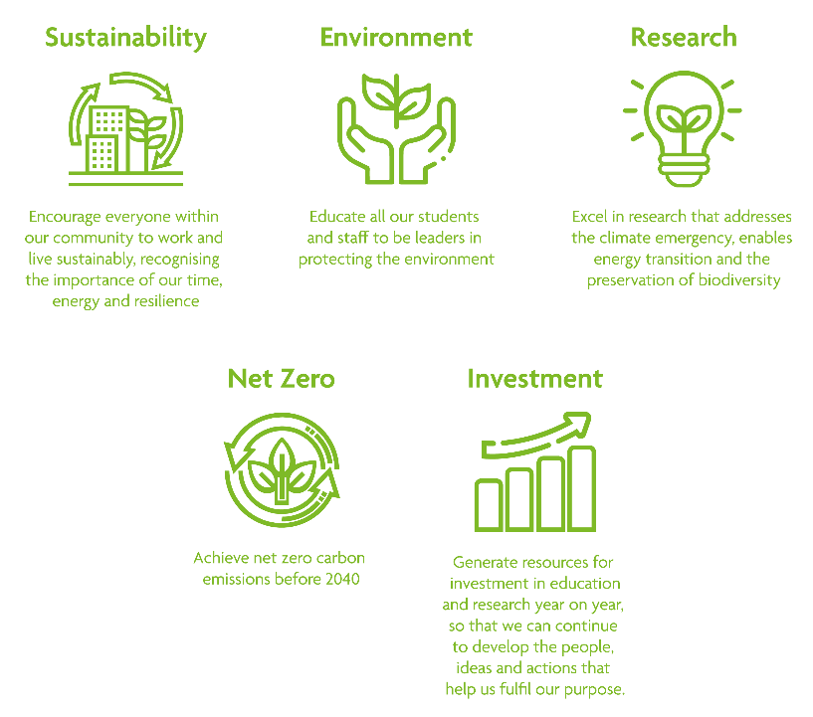
Aberdeen 2040 Sustainability Commitments
Notes:
Our Aberdeen 2040 strategy places sustainability at the heart of our long-term mission – with four of the twenty headline commitments relating to environmental sustainability.
They include the institutional aim to be net zero before 2040 and the ongoing commitment to produce excellent, impactful research.
But they also highlight the importance of engaging our staff and student communities, encouraging them to live and work sustainably and to take a lead in protecting the environment.

Slide 4

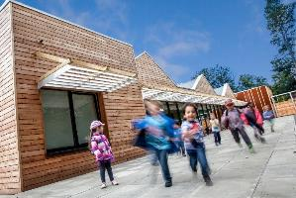
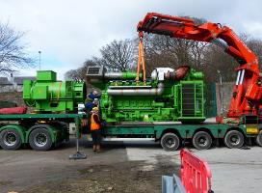
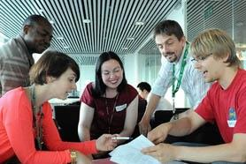
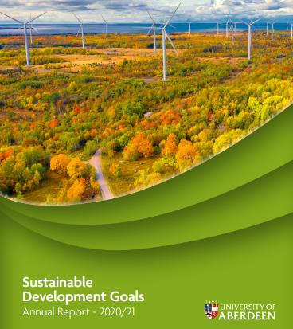
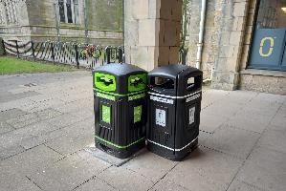
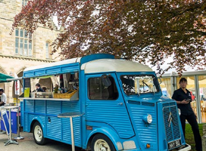
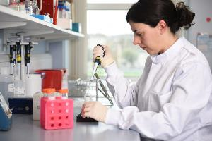
Addressing sustainability involves …
BUILDINGS
ENERGY USE
WASTE MANAGEMENT
TRANSPORT
Acknowledging and managing the negative environmental and emissions impact of our operations …
… while celebrating the positive contribution of our educational, research, and community activities.
Notes:
In taking those commitments forward we are adopting a whole institution approach.
That means managing the negative impacts associated with operational activities such as waste production, energy use, and travel.
But it also means focusing on the societal contribution of our world class research, the positive benefits of our community and public engagement activities, and the influence our curriculum has on the next generation of global citizens.

Slide 5


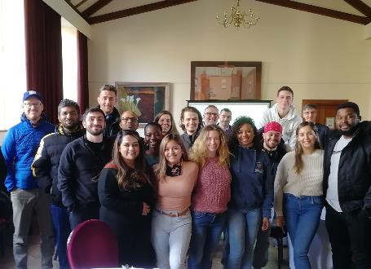
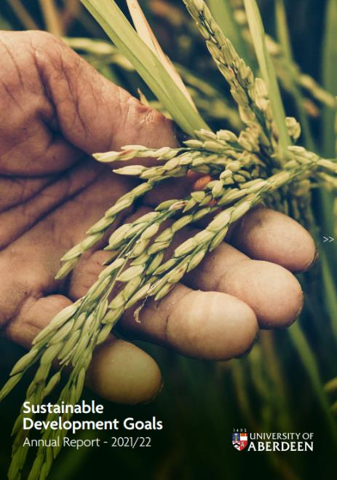
UN Sustainable Development Goals
MSc Sustainability Transitions
SDGs emerge from Aberdeen 2040 consultation.
Annual Reports ‘21 & ‘22 + QS and THE ‘Impact’ Rankings
Awareness growing e.g. mapping of research & case studies
Embedding in our teaching & curriculum.
Notes:
In recent years the United Nations Sustainable Development Goals have emerged as an important proxy for the articulation of those positive impacts.
The Goals increasingly inform league table performance, from the Times Higher Impact Ranking, to the new QS Sustainability ranking where we ranked 2nd in the UK and 13th globally for sustainable education.
For the past two years we have produced stand-alone SDG Reports that showcase the breadth of incredibly impactful work our colleagues are involved in.
Looking ahead, we will continue embedding the SDGs more widely, including ensuring that our curriculum reflects the Goals, and that sustainability is at the heart of the skills and competences our graduates leave the University with.

Slide 6


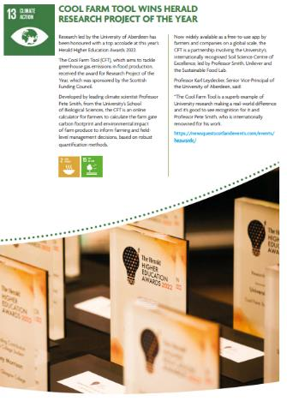

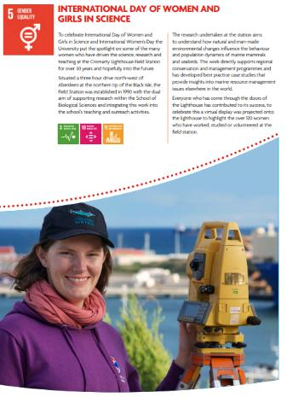

Research with Impact
SDGs now routinely mapped against our research
Colleagues' research being recognised for its impact
SDG Report highlights breadth of impact
SDGs highlight intersecting environmental and social issues
Notes:
We’ve done a great deal of work in mapping our research against the Goals, from research on climate change mitigation and adaptation, to medical breakthroughs, and research that tackles deep-seated societal problems in areas such as poverty and inequality.
Examples include Professor Pete Smith’s work that contributed to the development of the multiple award-winning Cool Farm Tool app which helps farmers calculate and tackle their emissions.
Social issues are to the fore in Professor Aziz Islam’s work on the Bangladeshi garment industry, which won a Scottish Fair Trade award last year.
The SDGs also allow us to celebrate the equalities work we do, including the launch of our anti-racism strategy last year.

Slide 7

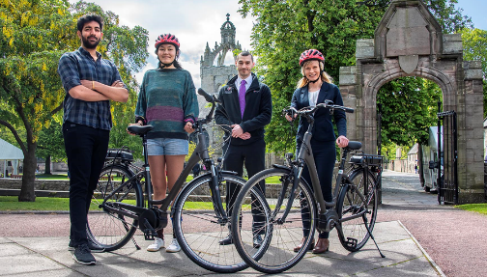

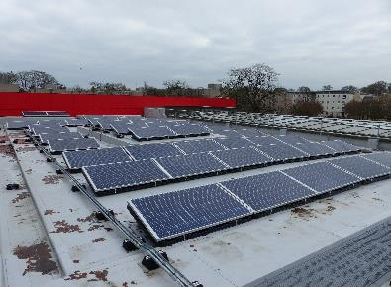
Operational Impacts
Developing our net-zero project and investment strategy
Decarbonising heat the immediate focus
Calculating and tackling supply chain and travel emissions a huge challenge
Ensuring a sense of shared responsibility will be critical
Involving the community in developing solutions e.g. via climate assemblies
Notes:
While we are rightly proud of the positive impacts of our academic work, we are also mindful of the negative environmental impacts associated with operating a modern University.
We are very aware of the need to reduce those impacts and, as with the rest of the sector, are getting to grips with the development of long-term net-zero implementation plans.
We need to ensure that all colleagues share a sense of responsibility, and recognise the urgency, in tackling these issues.
In February we will hold the first of a planned series of climate assemblies to involve our campus community directly in co-creating solutions.

Slide 8
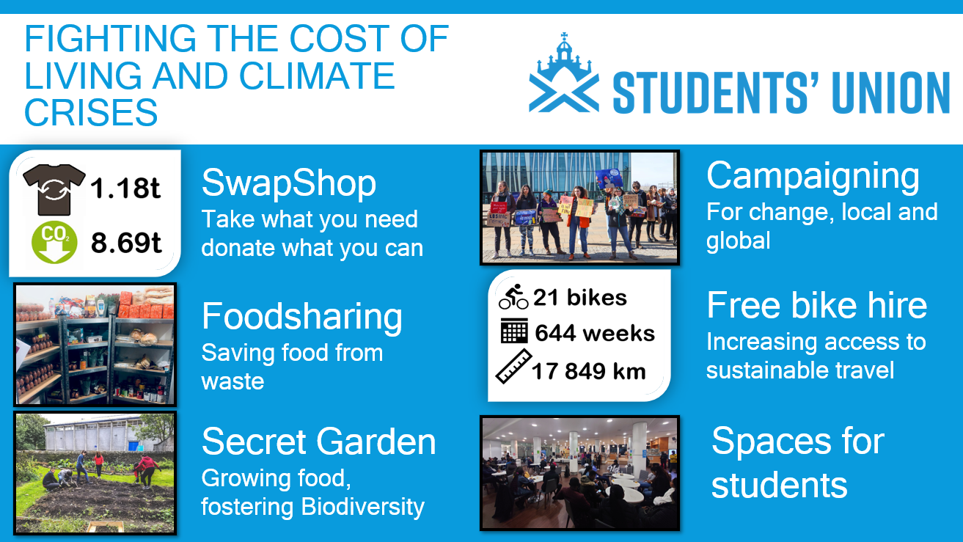
Fighting the cost of Living and Climate Crises by the Students’ Union
Notes:
Alongside the work of the University, our Students’ Union and student groups have set up numerous sustainability initiatives across campus.
From schemes that prevent food and other waste, to community growing and cost of living projects – these student-led initiatives are coming together not only to cut carbon and protect the natural environment, but also to help support students through the cost-of-living crisis.

Slide 9
Sustainability at the University of Aberdeen
18 January 2023
Notes:
Whether it is through our world leading research and education, the management and minimisation of operational impacts, or the powerful role of our students as activists and campaigners, we see the sustainability challenges we face as requiring collaborative input and commitment from us all.
Chancellor, in a moment you will meet with some of the colleagues and students leading our work on sustainability.

Slide 10
University of Aberdeen logo

