Slide 1
Early hours of Sunday morning, 9th December 2018
David accidentally fell from a nightclub balcony in Inverness

Slide 2
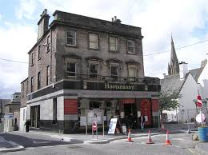
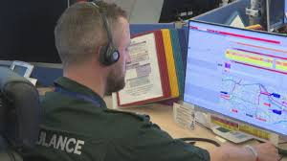
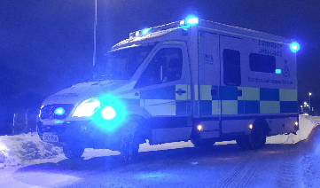
Date: 09/12/2018
Location: Hootanannays, Inverness
999 Call : 02:46
Ambulance on scene: 02:50
Ambulance leaves scene: 03:00
Arrival at Raigmore Hosp: 03:04
Notes:
Play call 3 mins 50 secs.
Briefly explain call – need to confirm address, breathing assessment tool, caller advice.

Slide 3
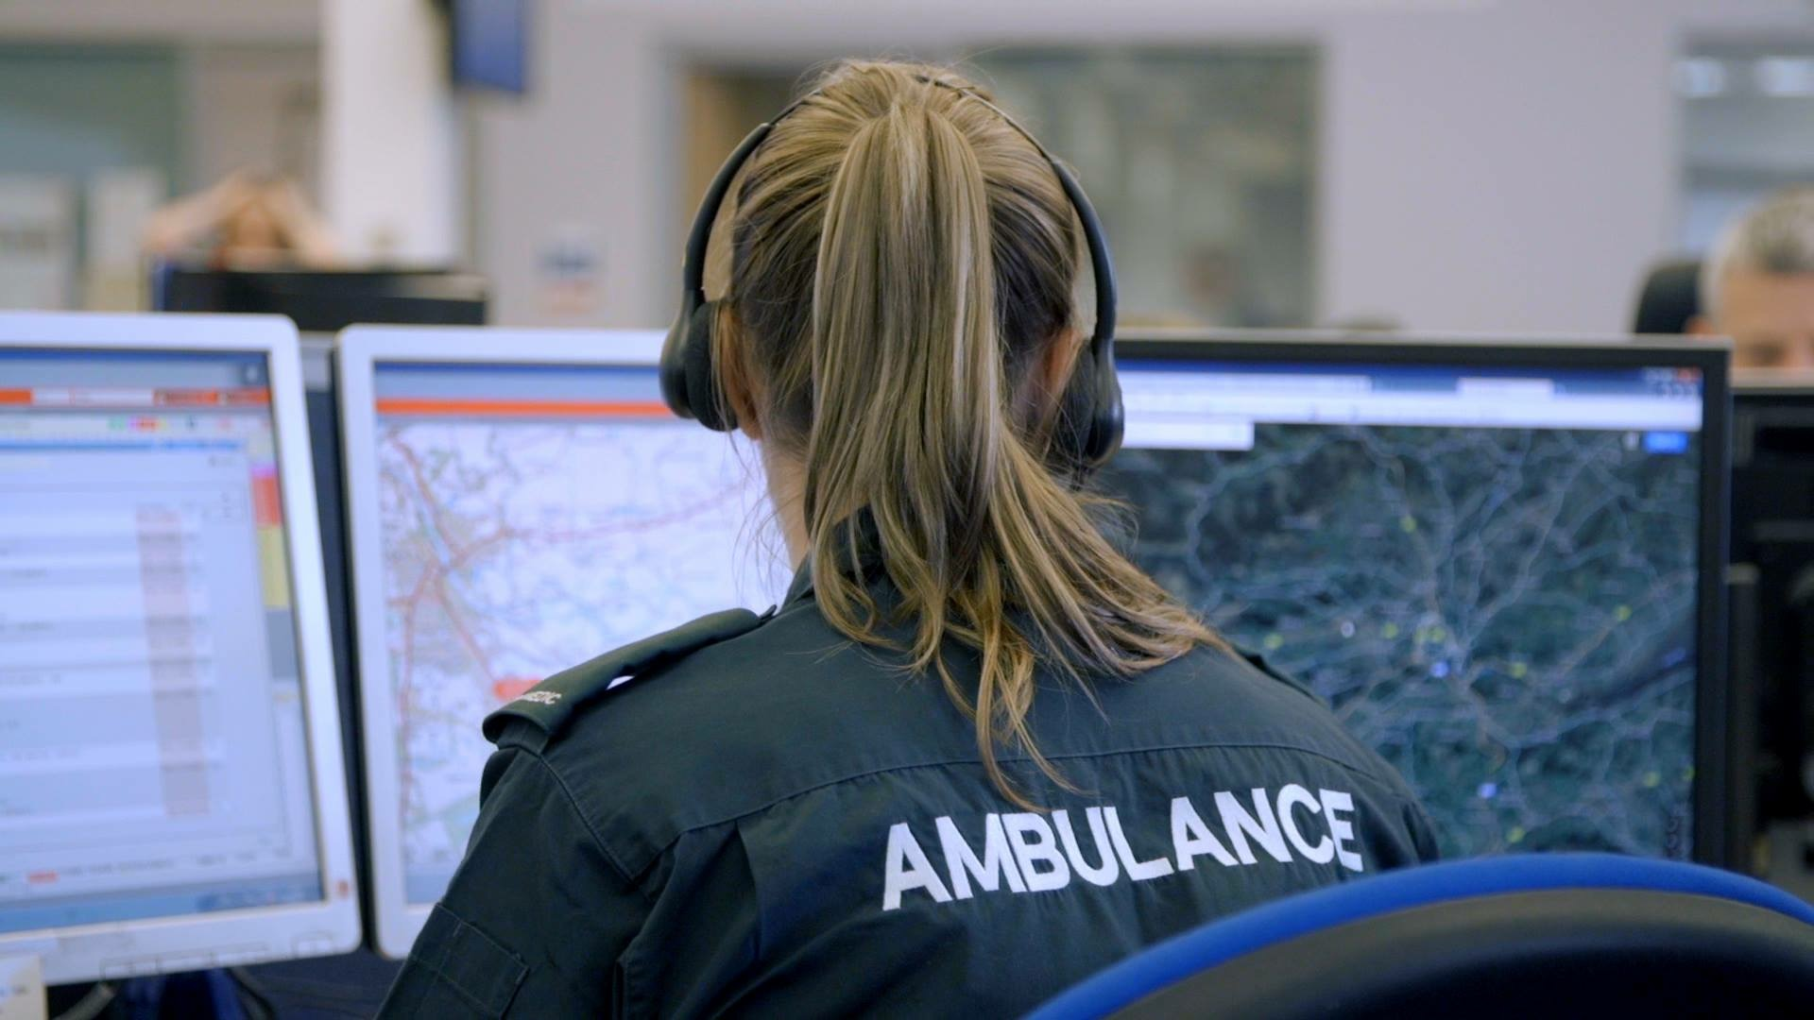
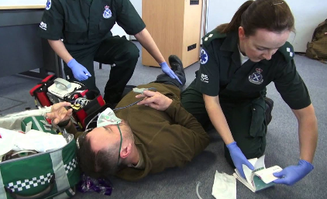
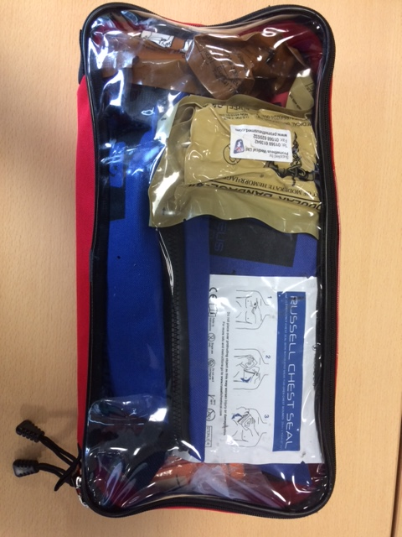
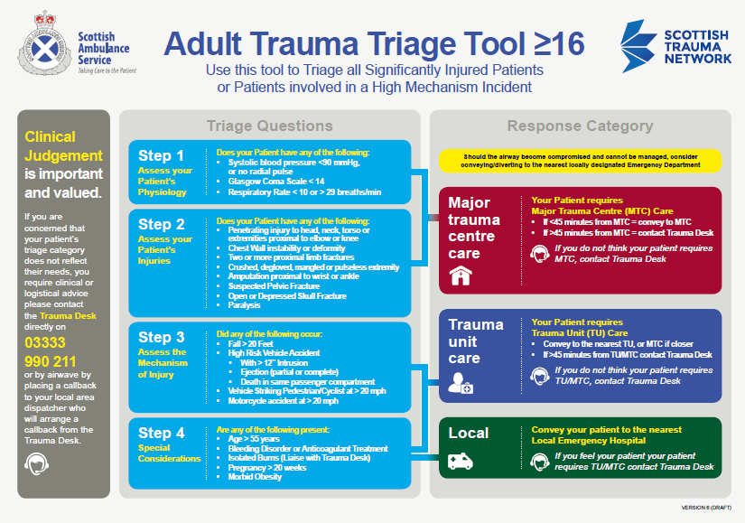
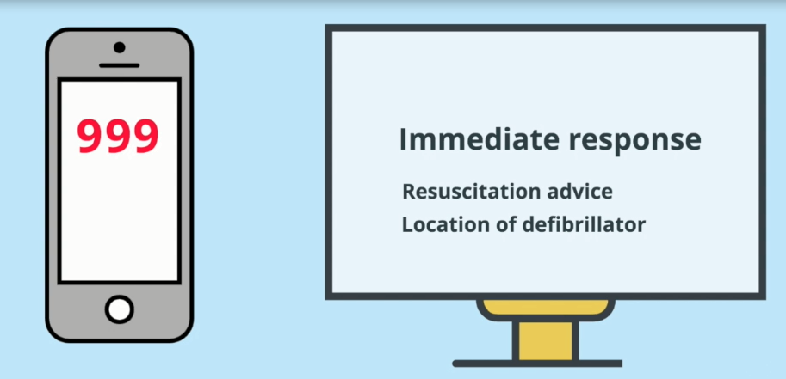
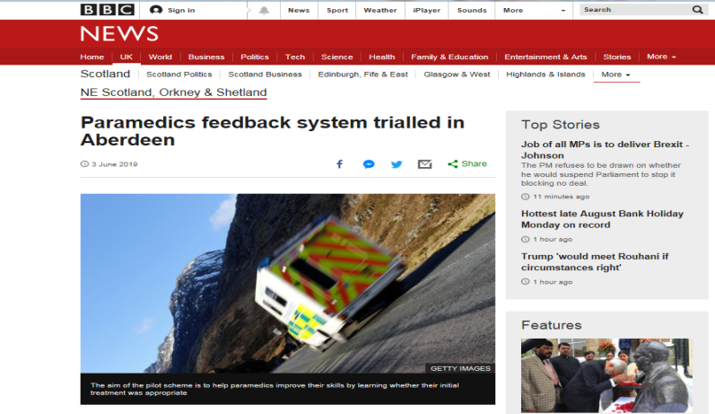

Slide 4
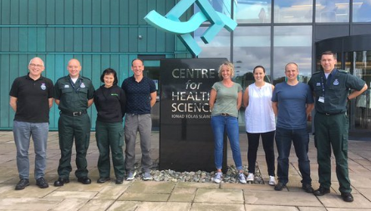
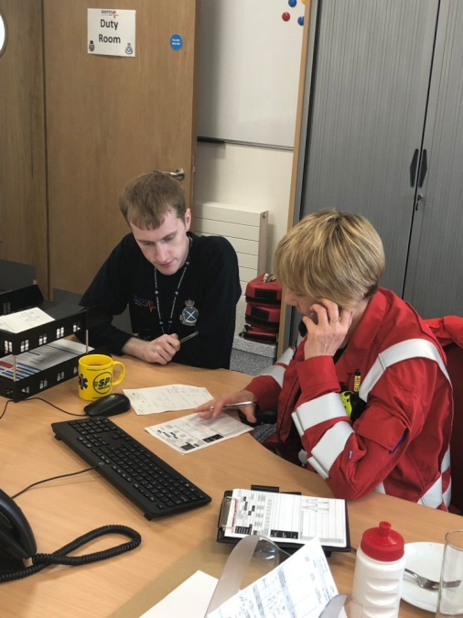

Slide 5
Date: 09/12/2018
Location: Hootanannays, Inverness
999 Call : 02:46
Ambulance on scene: 02:50
Ambulance leaves scene: 03:00
Arrival at Raigmore Hosp: 03:04

Slide 6
3:04 David arrives in the Emergency Department at Raigmore Hospital by ambulance

Slide 7
Film Number 2

Slide 8
3:04 David arrives in the Emergency Department at Raigmore Hospital by ambulance

Slide 9
Film Number 3

Slide 10
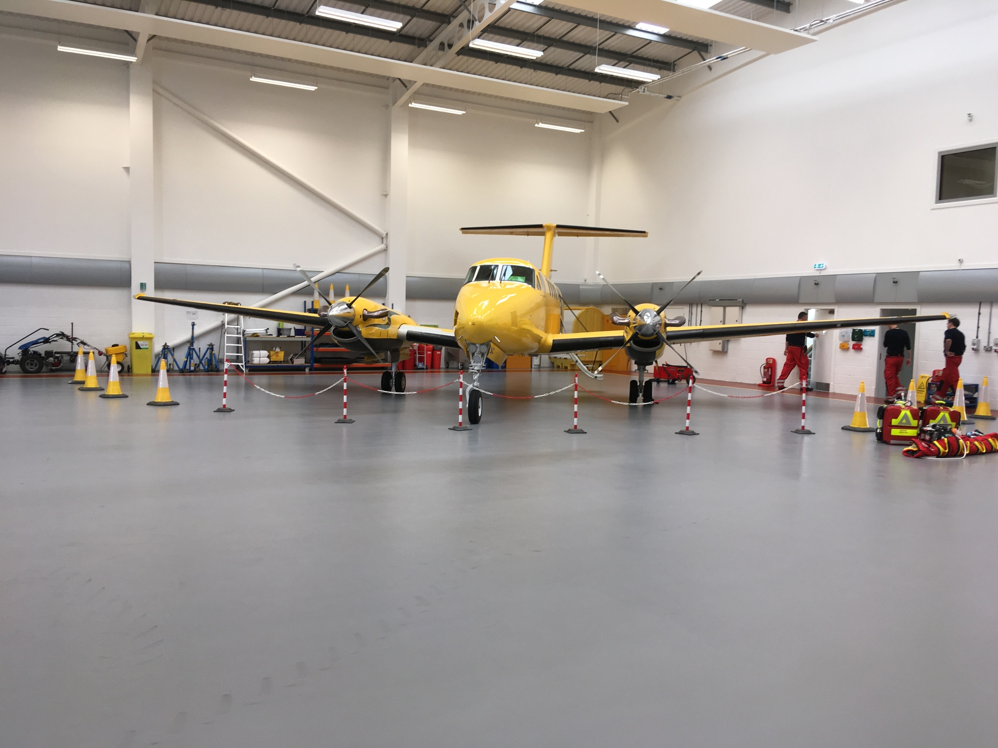
EMRS North
Provide “Red” pre-hospital interventions
Provide enhanced access to consultant level critical care transfers & advice from North base
Major Incident Response

Slide 11
Significant gains already
Will continue to evolve
More in my talk later.............

Slide 12
17:00 David is taken to Aberdeen Royal Infirmary by ambulance and is admitted to ICU

Slide 13
Film Number 4

Slide 14
Admission to Intensive Care
Neurocritical care
Intracrainial Pressure monitor
Sedated and ventilated
Increasingly unstable
CT Scan

Slide 15
CT result

Slide 16
Intensive Care
Theatre
Repair of small bowel perforation
Returned to ICU
24hrs to stabilise, reducing organ support
Extubated
Discharged from ICU to Major Trauma Ward

Slide 17
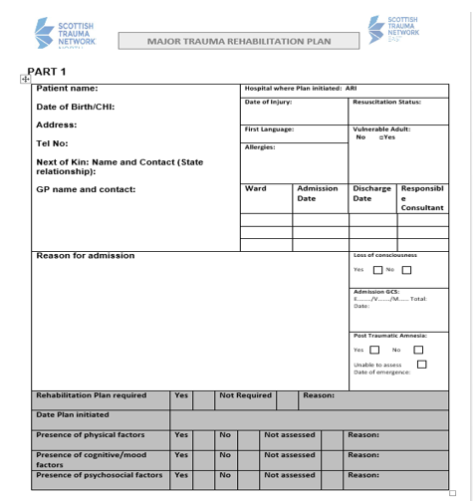
Point of contact for patient and family from early admission until patient goals are achieved.
Key performance indicator. Assessment of rehab needs within 72 hours of hospital admission
Identify rehab needs throughout patient pathway
Single continuous document, throughout patients pathway.
Ensure patient is receiving the right care, in the right place, at the right time. Including timely repatriation if required.
Completed in conjunction with MDT

Slide 18
9th December 2018 – 21st December 2018 David stayed in ICU for 8 days and 4 days in the Polytrauma Ward

Slide 19
Film Number 5

Slide 20
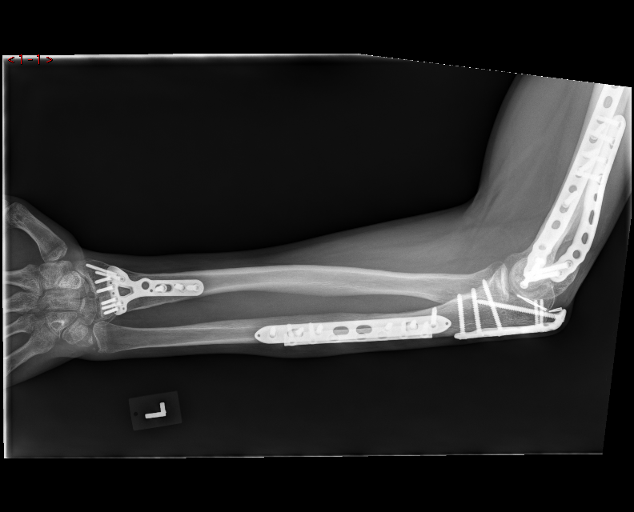
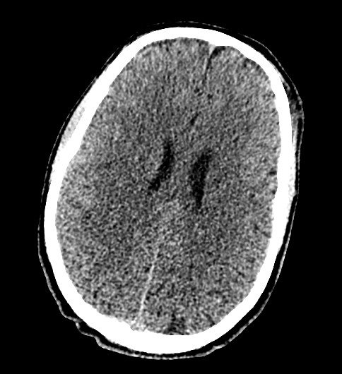

Slide 21
21st December 2018 – 12 days since the accident David is discharged from the Polytrauma Ward and is repatriated to the Neurorehabilitation Ward at Raigmore Hospital

Slide 22
Film Number 6

Slide 23
PATIENT JOURNEY – REHABILITATION AND BEYOND
DISCHARGE
FORMAL REFERRAL
COMMUNICATION MTC - TU
REHAB PLAN
SPECIALIST REVIEW
PT, OT, DIETICIAN
MDT UPDATES
REHAB PLAN
DISCHARGE
REFERRAL
TRANSFER
IN PATIENT
REHAB
OUT
PATIENT REHAB
COMMUNICATION WITH FAMILY
ORIENTATION TO WARD AND TEAM
REHAB PLAN
OUTPATIENT PT
PHONE CALL FOLLOW UP
REHAB PLAN

Slide 24
15th January 2019 – 36 days since the accident David is discharged home

Slide 25
Film Number 7

Slide 26
David is back to work and rehabilitation is ongoing

