Slide 1
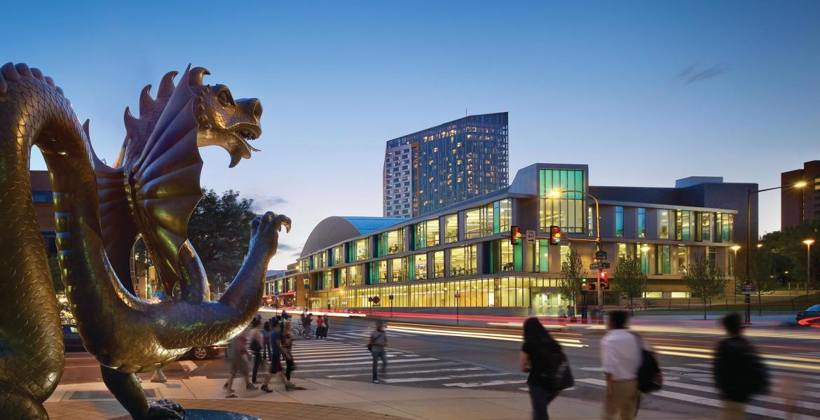

Exchange Student Resources

Slide 2

A City of Brotherly Love: Philadelphia
https://www.youtube.com/watch?v=tbgn2mojEOE

Slide 3

The Moment: Drexel University
https://www.youtube.com/watch?v=XVRULseiGXE

Slide 4
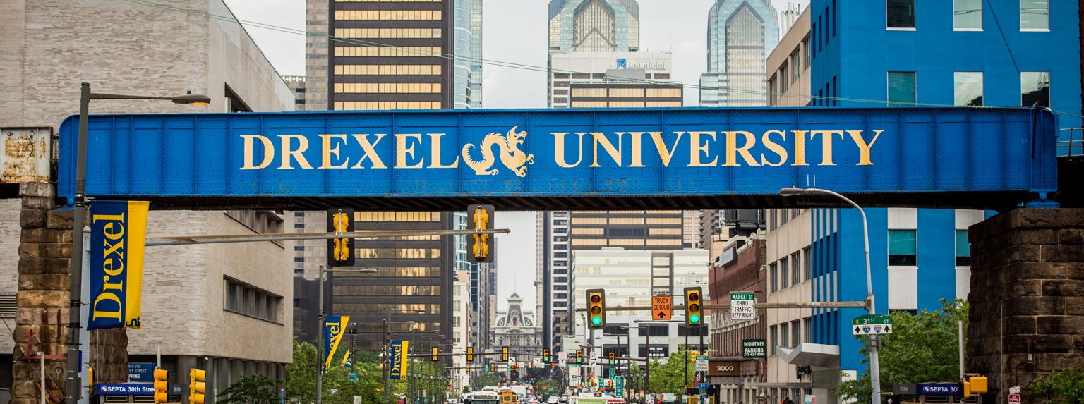
Website Resources
Exchange & Visiting Students: Overview
Campus Philly
U Wish U Nu Philadelphia
Drexel Magazine
Drexel Now

Slide 5

You’re Invited!
Virtual Global Exchange Series
Interested? Register to join our community classroom, where you’ll receive regular updates here.

Slide 6
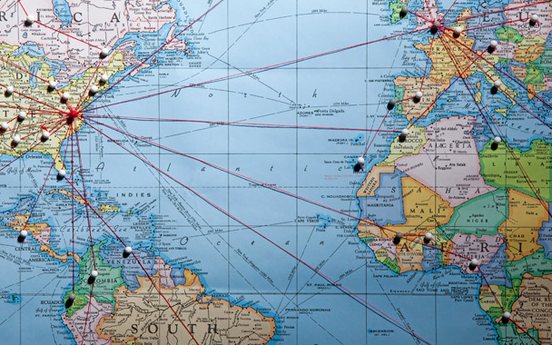


Contact Information
Office of Global Engagement
Drexel University
Academic Building
101 N. 33rd Street, Suite 201
Philadelphia, PA 19104
inboundexchange@drexel.edu
Follow us!
Facebook
Instagram

