Slide 1
Open Science & Reproducibility
Jess Butler
University of Aberdeen
Centre for Health Data Science

Slide 2
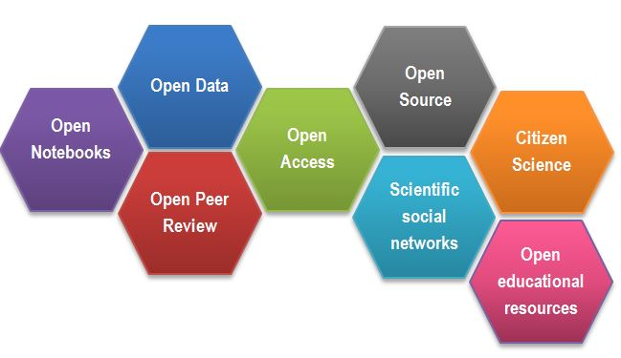
Open Science: what is it?
Open Science means that scientific knowledge, research data, and publications should be openly shared.
This includes:
measured and observational data,
experimental setups and workflows,
analysis scripts and tools,
analysed data,
metadata and provenance data,
published manuscripts
https://www.fosteropenscience.eu/content/what-open-science-introduction
https://en.wikipedia.org/wiki/Open_science

Slide 3
Open Science: why bother?
Research data created through public funds should be freely available for public exploitation

Slide 4
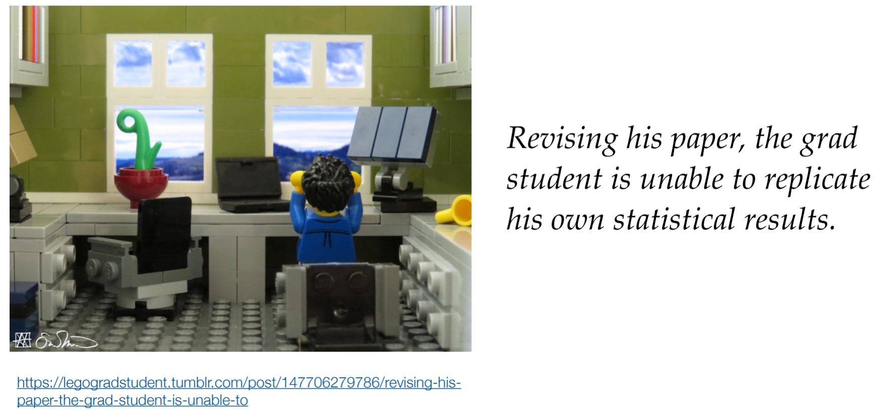

Open Science: why bother?

Slide 5

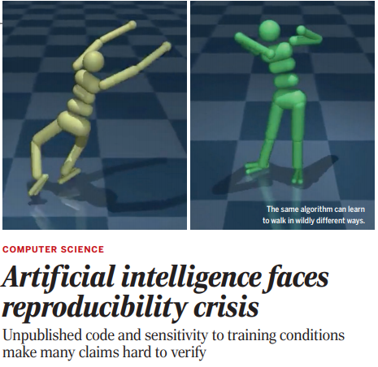

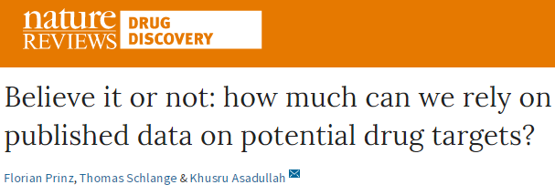
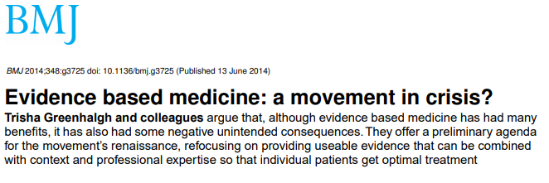
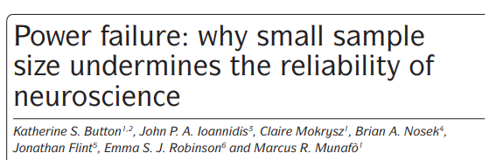
Open Science: why bother?

Slide 6
The Scientific Research Cycle
Generate and specify hypotheses
Publish or Conduct next experiment
Interpret data
Design study
Analyse data
Test hypotheses
Collect data
Chris Chambers
osf.io/dfr85

Slide 7
The Scientific Research Cycle: why it goes wrong
Don’t touch THIS
The results
The Results
But make sure THIS is amazing
The results
The Results
Chris Chambers
osf.io/svf98

Slide 8
The Scientific Research Cycle: where it goes wrong
Publication bias
Lack of data sharing
Failure to control for bias
Lack of replication
Generate and specify hypotheses
Publish or Conduct next experiment
Changing the hypothesis
Interpret data
Design study
Low statistical power
P-hacking
Analyse data
Test hypotheses
Collect data
Chris Chambers
osf.io/dfr85
Poor measurement
Poor quality control

Slide 9
~92% positive Fanelli (2010)
Publication bias
Lack of data sharing
Failure to control for bias
Lack of replication
Generate and specify hypotheses
Publish or Conduct next experiment
1 in 1000 papers
Makel et al (2012)
~70% failure
Wicherts et al (2006)
Changing the hypothesis
~50-90% prevalence
John et al (2012)
Kerr (1998)
Interpret data
Design study
Low statistical power
~50% chance to detect medium effects
Cohen (1962); Sedlmeier and Gigerenzer (1989); Bezeau and Graves (2001)
P-hacking
~50-100% prevalence
John et al (2012)
Analyse data
Test hypotheses
Collect data
Poor measurement
Poor quality control
Chris Chambers
osf.io/dfr85

Slide 10
Open Science: how?
Imagine you had to show a complete trail of the provenance of the figures and tables in one of your papers
Where is the research?
Why might it be hard to replicate?
What resources would make this easier?

Slide 11
Open Science: how?
Imagine you have to prove to reviewers/funders that you didn’t torture your data and get a random “significant” result
How would you convince them?
What would it look like if you had?
What resources would make this easier to prove?

Slide 12
Open Science: how?
Imagine you want a big promotion or a new job
How would you show you worked to a high standard?
Is this way of working rewarded?
What resources would make this easier?

Slide 13
Open Science: how?
Preregistration
Researcher blinding
Open code
Open metadata
Open data
Reporting guidelines
Journal blinding (registered reports)
Preprints
Validation studies
Replication studies
abdn.ac.uk/iahs/research/profiles/jessicabutler

Slide 14
Open Science: how?
Imagine you want to work this way but find it terrifying and/or wildly unlikely to succeed in the academic system as it is?
What resources would make this easier?

Slide 15
Open Science: help!
UK Open Research Working Groups Objectives
Build a Community
To share experiences about open science, including opportunities, challenges, and tools
Raise Awareness
To raise awareness about the benefits of open science practices for research and researchers
Education
To generate tools for helping researchers use open practices
Internal Promotion
To lobby for policy reforms within our departments, colleges and universities
External Promotion
To drive forward open science policies in journals, funders, public bodies and learned societies
osf.io/vgt3x

Slide 16
Open Science: organise
Join the UK Reproducibility Network Open Science Foundation UK ORWG
Survey department/school/university on interests and needs in open science
Talk by mentor from UKRN
Organise workshop on pre-registration and registered reports
Organise training for working reproducibly in R
Advertise/join collaborative research projects
Start a ReproducibiliTea club
Identify resource needs for teaching open science practices
Get open practices rewarded in recruitment and promotion

Slide 17







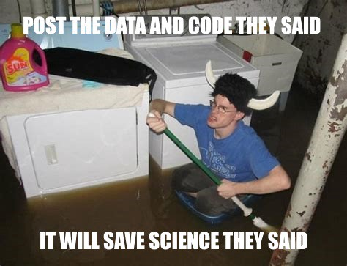
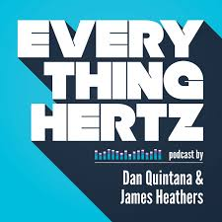



Slide 18
Jess Butler
University of Aberdeen
Centre for Health Data Science
Slides at: https://osf.io/q86y2/
@jebs284
jessicabutler@abdn.ac.uk

