Slide 1
Additional slides that may be useful

Slide 2








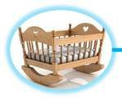





















Your changing income needs
When working
Housing Raising family Entertainment Food and drink Savings
Utility / insurance Holidays / travel Commuting Clothing
Health
In retirement Holidays / travel Supporting family
Health needs Utility bills / insurance Recreation & culture
Housing
Food and drink Commuting Savings Clothing
28

Slide 3





Why join the pension scheme?
Exempt
Exempt Taxed
Tax efficient
Employer pays
Other benefits
Security for you and your dependents

Slide 4
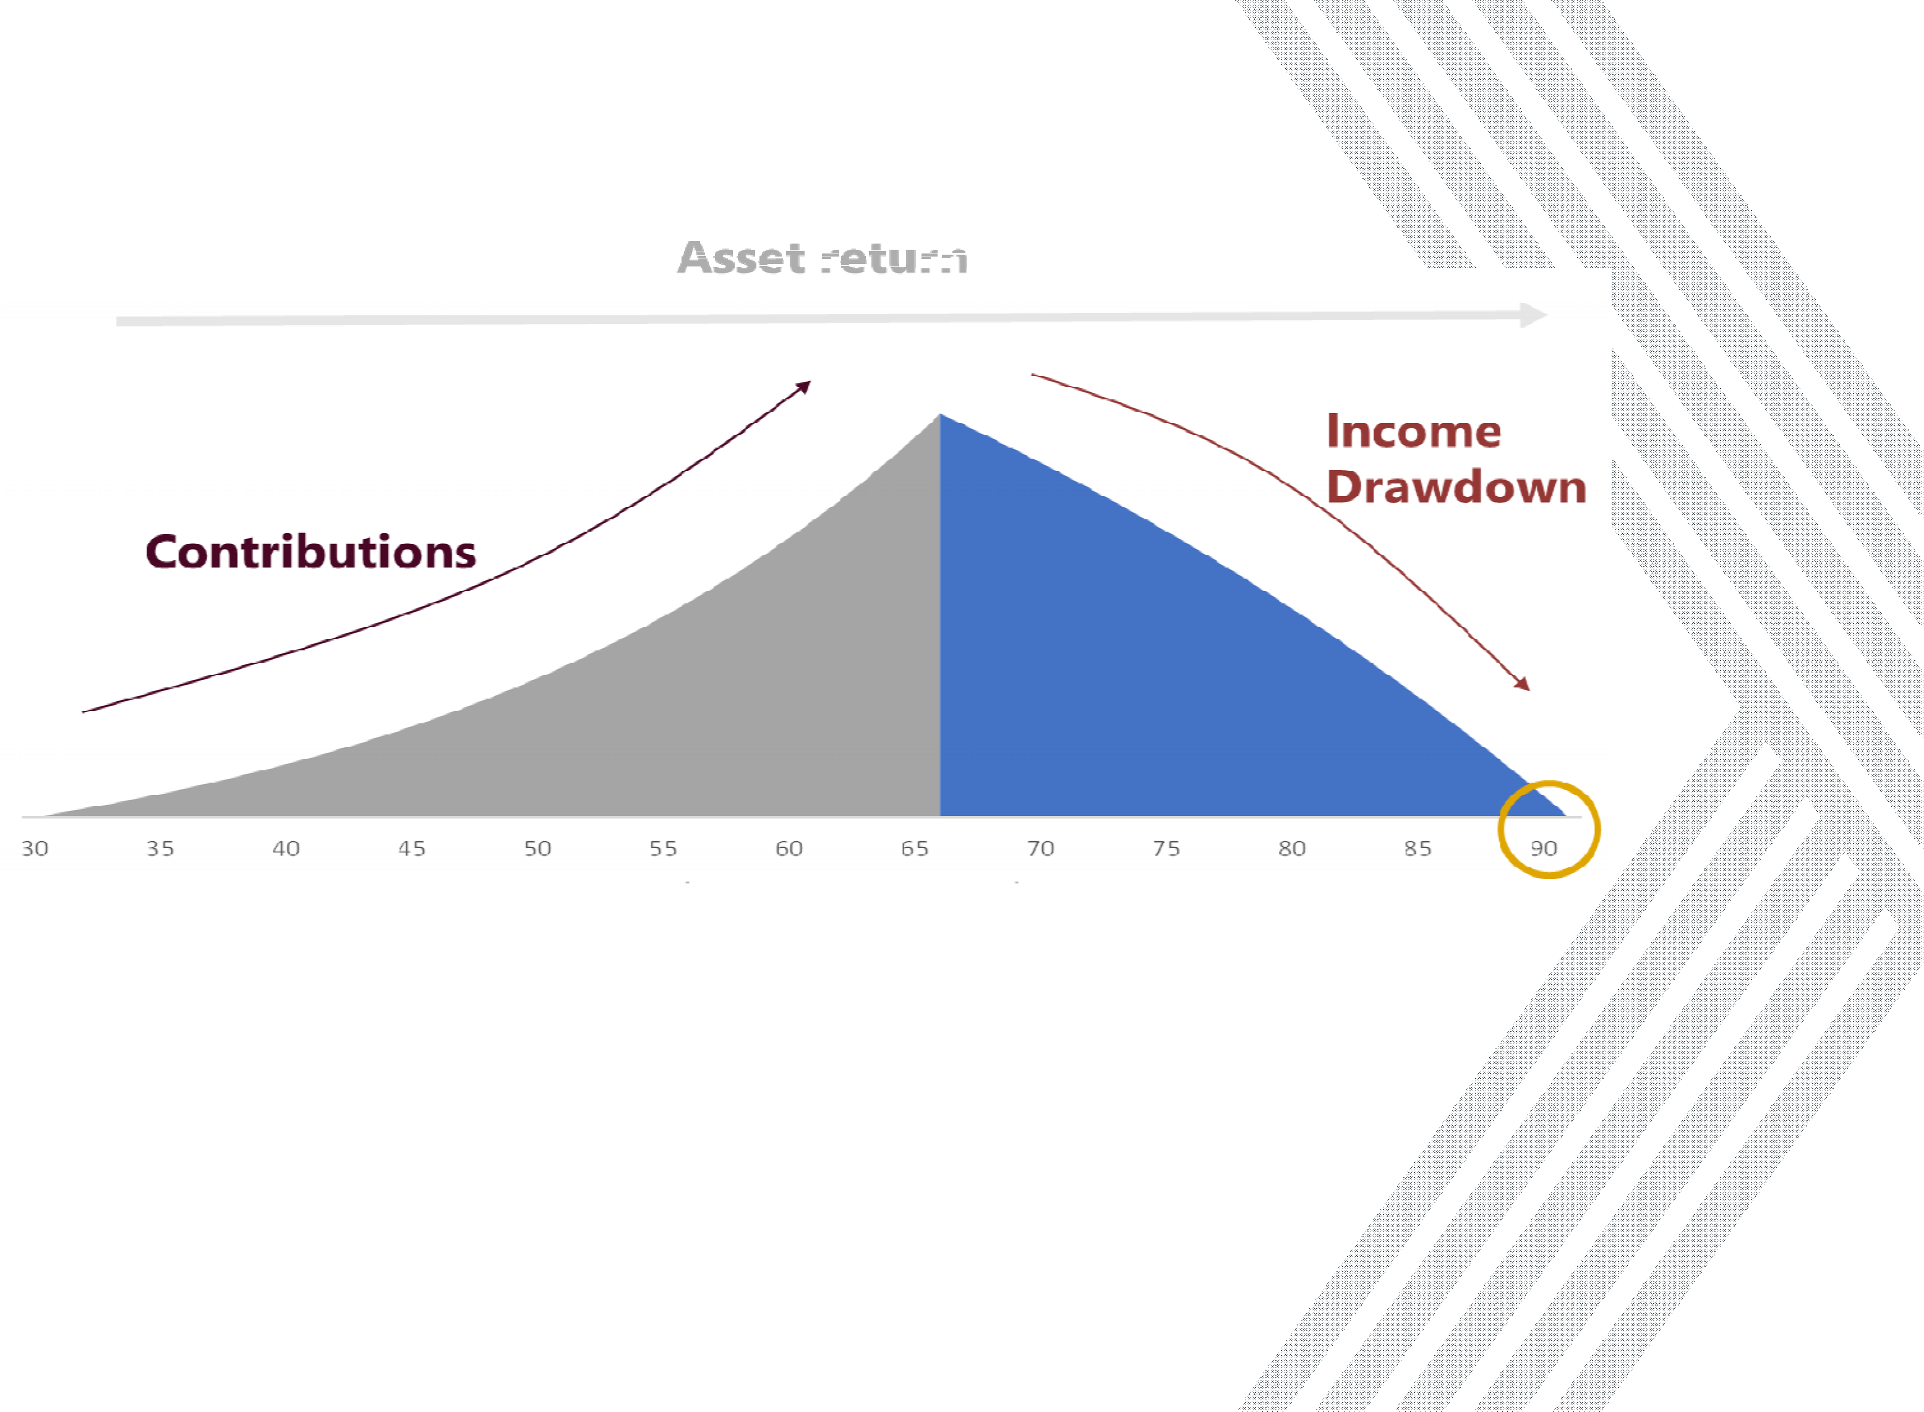



Defined Contribution (DC) pension schemes
Grow your pension pot
Spend your pension pot
The income you receive in retirement is based on the amount you save and investment returns.
There is no guaranteed pension promise

Slide 5


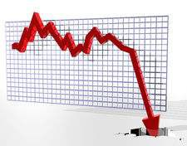







Risks in DB Schemes

Slide 6

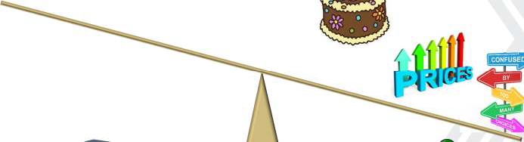
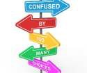

Risks in DC Schemes

Slide 7




Accessing your DC pension savings
DC members can tailor the shape of their pension income to suit needs in retirement
Annuity
Guaranteed income Choose form of income Expensive
Cash out
Instant access Complete flexibility Large tax bill
May run out of cash in retirement
No guaranteed income
Drawdown
Flexible access Fund remains invested Careful planning during
retirement
No guaranteed income
These options were not available before 2015

Slide 8









DB to DC transfers – key considerations
Know what you are giving up
Choice of receiving vehicle
Level and form of pension / dependants’ benefits Health status (loss of pension savings in DB Scheme) Advice requirements (if CETV over £30k)
Other sources of income Risk appetite
Understand fees payable to advisors
At present, you have an ‘all or nothing’ decision to make – to transfer or not to transfer
34

