Slide 1

1495
ResearchBite –
Realising your Research Impact, now and for the future
Aberdeen
Grants
Academy
Research &
Innovation
Dr Ruth Banks & Dr Jude Bain
Impact and Knowledge Exchange Team
Research And Innovation

Slide 2
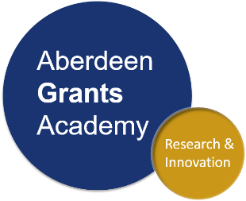

Welcome – ResearchBite Realising impact
What is impact?
Explore how impact fits into the research cycle
Steps to building an impact plan: best practice guide
A demonstration of tools available to help you plan your first steps towards creating an impact
Aberdeen Grants Academy
Follow us on Twitter
@UoAResInnov

Slide 3
Aberdeen Grants Academy
Impact
Aberdeen Grants Academy supports researchers pursuing external funding.
In partnership with Schools we provide support and guidance from the conception of ideas and good practice through development and refinement of an application, to delivery of the project and realising the impact.
For more information please contact us at: grantsacademy@abdn.ac.uk
Outcome
Idea Preparation
Submission
Application Development
Application Refinement
Aberdeen Grants Academy
Follow us on Twitter
@UoAResInnov

Slide 4
Grants Academy
Offer a comprehensive programme of development, directly linked to UoA strategic objectives
Significantly enhance our research environment
Enhance career prospects of all researchers, but particularly those at earlier career stages who may need more assistance to build their external research grant portfolio
Offer the ability to be better prepared for opportunities and enhance our ability to respond to calls
Aberdeen Grants Academy
Follow us on Twitter
@UoAResInnov

Slide 5



How the Grants Academy Works
Developed as a series of interwoven elements including sandpit events to support the development of ideas and projects, grant writing workshops, rebuttal support, support for delivery of outcomes and outcomes management and much more
Relevant to our session today, supports:
Effective horizon scanning
Facilitation of early ideas development
Identifying your research partners/users
Mapping your route to impact
Aberdeen Grants Academy
Follow us on Twitter
@UoAResInnov

Slide 6
Group Poll/whiteboard session:
Answer the questions below:
What does ‘impact’ mean to you?
Think about your research experience to date – what do you see as barriers to creating impact?
Aberdeen Grants Academy
Follow us on Twitter
@UoAResInnov

Slide 7
Impact at University of Aberdeen
The value of impact is increasingly recognised across the academic sector
R&I teams are helping to showcase impact success stories to inspire and guide students and staff across the University and have been working with senior academics to get a sense of what impact means to them
https://www.abdn.ac.uk/research/impact/

Slide 8
Video – Impact at Aberdeen
https://www.youtube-nocookie.com/embed/cwjfLaA1LLY
Aberdeen Grants Academy
Follow us on Twitter
@UoAResInnov

Slide 9
Impact Case - Dr Jude Bain
Advice from a postdoc in an impact role

Slide 10
“The University of Aberdeen is a world-leading research institution renowned for innovation, collaboration and international reach.
Find out how our interdisciplinary, award-winning research makes an impact locally and around the world.”
Aberdeen Grants Academy
Follow us on Twitter
@UoAResInnov

Slide 11
Lay of the land: impact definitions in focus
Research Excellence Framework (REF)
Economic
Health
Environmental
Cultural
Social
Policy
Commercial
UoA
Academic
[PURE: web-based system]
[impact case studies]
UKRI
& other funding bodies
Aberdeen Grants Academy
Follow us on Twitter
@UoAResInnov
Notes:
REF = retrospective analysis of the success of your approach to impact; scoping exercise

Slide 12


Government funding: strategic calls
https://www.researchconnect.eu/
https://www.ukri.org
Aberdeen Grants Academy
Follow us on Twitter
@UoAResInnov

Slide 13

Strategic Priorities

Slide 14
UKRI mission
“…is to be a trusted partner and to ensure research and innovation continues to flourish in the UK. We will support and help connect the best researchers and innovators with customers, users and the public. We will invest every pound of taxpayers’ money wisely in a way that maximises impact for citizens, in the UK and across the world.
We will be measured by the impact we deliver, and this will have three elements:
We will push the frontiers of human knowledge and understanding
We will deliver economic impact and social prosperity
We will create social and cultural impact by supporting our society and others to become enriched, healthier, more resilient and sustainable.”
Aberdeen Grants Academy
Follow us on Twitter
@UoAResInnov

Slide 15
UKRI removed “Pathways to Impact” and “Impact Summary” sections from grant applications from March 2020
“The impact agenda is vital - UK Research and Innovation exists to fund the researchers who generate the knowledge that society needs, and the innovators who can turn this knowledge into public benefit.
‘Pathways to Impact’ has been in place for over a decade and we recognise the research and innovation landscape has changed since its implementation. Impact is now a core consideration throughout the grant application process.”
Aberdeen Grants Academy
Follow us on Twitter
@UoAResInnov

Slide 16
Other Funders
Charity funding and independent funding calls may infer a link to impact by requesting how you would ‘widen reach’, ‘encourage research uptake’, ‘increase awareness’ or ‘create substantial change’.
Your impact statement is your charity’s short story, it allows them to understand what’s being done with their donation
Aberdeen Grants Academy
Follow us on Twitter
@UoAResInnov

Slide 17










Examples of Charity Research Support

Slide 18
Incorporating impact plans to grant applications
Determine the weight of impact focus needed, depending on the call. If the call has a strong element of impact, weave this throughout the case for support:
Introduction: make a statement on the societal need in relation to the call; work with potential beneficiaries to define your research questions
Objectives section: outline your research goals and impact goals – weighting these according to the weight of impact implied in the call.
Methods section: incorporate the pathways to achieve and measure impact along the way, alongside research methods. Ensure the pathway maps to the beneficiaries and goals set out.
Aberdeen Grants Academy
Follow us on Twitter
@UoAResInnov

Slide 19
Things to keep in mind
Try to be as specific as you can regarding possible beneficiaries or users of your research.
Write about the routes to impact you intend to use, where appropriate show that you consider them to be a process of knowledge exchange
Make sure your planned routes to impact are well-informed and developed for your relevant beneficiaries/audience.
Consider a timescale for impact (when you might undertake activities and who will be responsible for organising them)
Include the costings for routes to impact. If possible mention how you intend to monitor, evaluate and gather evidence of impact.
Aberdeen Grants Academy
Follow us on Twitter
@UoAResInnov

Slide 20
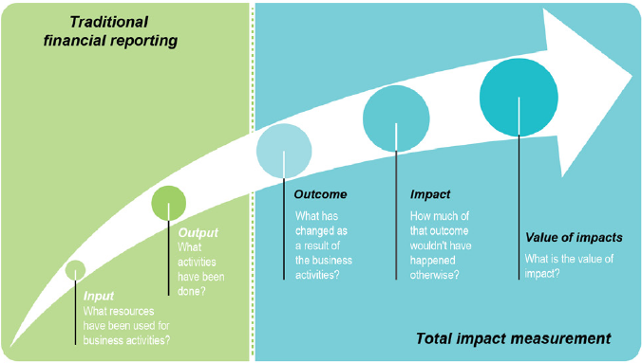
Planning your route to impact
Project activities
Effects caused by the project
What has happened as a result of your research? (NB: Often a pre-defined measurement of a change resulting from research input)
What are the broader, substantive or long-term changes brought about by your research?
What research activities do you plan to carry out?
Quantify/ qualify impact to assess value of research – raise profile & inform reporting
What resources are you requesting for your proposal?
Source: The Travel Foundation
Aberdeen Grants Academy
Follow us on Twitter
@UoAResInnov

Slide 21

How to build impact into your research proposal
Define your ‘problem statement’
What part of the problem do you want to tackle?
Think about who or what is affected
What are the (known) consequences of the problem?
…
• What are the (known) causes of the problem?
Focus on specific cases to draw out examples of those affected
Think about organisations or groups or communities affected
Relate these to infrastructure systems – policies, rules and regulations or public opinion
…
Identify the barriers to change and opportunities to overcome these barriers
Who are the relevant groups/organisations/individuals working to tackle the issue?
Where are the gaps in current knowledge or capabilities?

Slide 22

Understand your target groups
Who are the groups you can help or influence your research or those who can inform your research?
It’s important to identify, prioritise and understand your target groups (stakeholders or beneficiaries)
Early communication with stakeholders can improve the quality of your project
Build understanding – grasp the scale of the problem and effects your research may have on your target groups
Anticipate and predict the action of key target groups – this gives you ability to put in place alternative plans

Slide 23
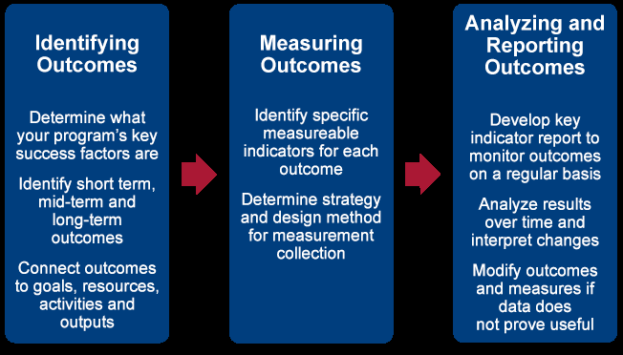
Define and map your outcomes
Act as helpful internal indicators; used to determine whether a project is on course
Establish a baseline – compare before v after
Project
Output
Short/mid term Outcome
Long term Outcome
Children and Malaria in India – can bed nets intervene?
Qualitative report: socio-economic factors
Lowered Malaria outbreaks, increasing life expectancy and quality of life for affected children
Supplied 2,000 bed nets to families in rural India

Slide 24
Impact is the long term change you want to see
What is the long term goal of your research? How will you know if you’ve achieved it?
How will you embed impact that helps to build capacity in order to sustain change?
Think of impact in terms of reach and significance
Project
Output
Short term Outcome
Long term Outcome
Children and Malaria in India – can bed nets intervene?
Qualitative report: socio-economic factors
Lowered Malaria outbreaks, increasing life expectancy and quality of life for affected children
Supplied 2,000 bed nets to families in rural India
Communicate, monitor, stakeholders
Measure
Impact
Outcomes inform local school education programme; NGOs get involved and increase capacity; programme becomes effort across region; bed nets supplied as govt policy
Hypothetical case study: A brief example of a project where the research aims to understand the effect of malaria on children in a region of India, in particular the value of bed nets as an intervention strategy. The first issue for the researcher that they don’t fully understand the ins and outs of the problem – what are the socio-economic effects at play? How do they affect children and households? Let’s say the researcher uses their skills to make contact with organisations on the ground and send out a survey in order to better understand the problem. What the researcher learns is that % of children in poor income households are more vulnerable – they use this information to inform my strategy. They publish a qualitative report and work with partners to supply bed nets to these vulnerable households; these are my key stakeholders. This is the first outcome. The researcher uses this baseline information to build on their understanding of the problem and use it to inform the next outcome – effects on rates of infection and quality of life. The researcher works with partners to measure instance of infection and over time see increases in life expectancy and quality of life – this is the long term outcome in this scenario. So now the researcher wants to know when or where they might be having impact. My long term outcome becomes my focus – they have a baseline, they’ve measured change and look at building capacity within my networks, They increase use knowledge exchange opportunities to extent their communication network and reassess their stakeholder priorities. Now they’ve identified my key stakeholders have changed; they should focus on schools and teachers – they create a local school education programme, get local NGOs involves and upscale the intervention. As the programme becomes scaled up, they reassess my stakeholders; build in ways to monitor each strategy and develop a new communication strategy that takes into account the reach of their project. Policymakers get involved, because the comprehensive roadmap produced is persuasive and informed, progressive monitoring and evaluation of the outcomes compared to the baseline ensure that the researcher can make a compelling case and has identified ways to measure the changes so far and effectively communicate the impact that they’ve had.

Slide 25
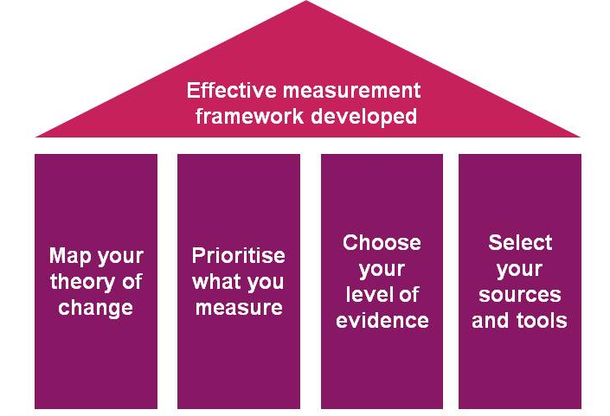
Impact: as much about the journey as the destination
Be ambitious but think realistically about how much change you can achieve at this point and who your key beneficiaries are likely to be
Evaluation is important throughout a project, but don’t disregard something that does not led itself to being ‘measureable’ - be adaptable to how you measure evidence, you never know how valuable something or someone can be
A road map can be used as a tool to fit your needs and to help structure your thinking
Create your road
map

Slide 26
Making it happen: knowledge exchange
Knowledge exchange (KE) is not a form of impact, but it is critical to enable impact creation
KE includes any activity that involves researchers and non-academic partners, users or stakeholders sharing the knowledge produced by research
Aberdeen Grants Academy
Follow us on Twitter
@UoAResInnov

Slide 27

Public engagement
Public engagement (PE) is also a valuable route to impact:
PE is a form of dissemination (and in some cases knowledge exchange)
Areas of the public sector may be one or more of your beneficiaries
PE increases exposure of your research and increases its relevance to public sector
PE is a form of accountability (transparency in research process)
peru@abdn.ac.uk
www.abdn.ac.uk/engage
Aberdeen Grants Academy
Follow us on Twitter
@UoAResInnov

Slide 28
Examples of engagement
Identification of potential stakeholders (clinicians/patient group, industrial link/business, public sector group, GCHQ etc.)
Developing relations with industry partners for commercial development and exploitation (build on links your department/university already has if you are unsure)
Stakeholder engagement (e.g. workshop at start of project scoping views/needs, followed by update meetings and ending with dissemination event – make sure to include evaluation)
Advisory group/panel of potential beneficiaries to periodically review and advise on research direction
Secondments to companies/ exchange
Policy briefings or other activities to influence policy e.g. evidence-giving to Select Committees
Websites/webpages/wikis and interactive media that engage the public
Create a brand: media/Social Media/ (e.g. books, blogs, Twitter, webinars, radio interviews, TV appearances, podcasts)
Running training seminars (to PhD/PDRA audience, or audience of people outside of area of research), public lectures, online forums, ‘Conversations On’
Public engagement/ road shows/ science festivals (should be specific to your research, not generic)
Workshops/ non-academic conferences (for those not directly in area of research)
Software development
Articles in professional newsletters/magazines
Exhibitions/ artwork etc.
Aberdeen Grants Academy
Follow us on Twitter
@UoAResInnov

Slide 29
Knowing your stakeholders
Beneficiary: people, groups, communities or nations who will benefit from the impact of your research
End users: groups, people or companies who will take up your research and use it to bring about change
Stakeholders: Anybody who has a stake in the outcome of your research – perhaps because it will benefit them, or because they are involved in up-taking, using or translating the research into a real- world outcome
Aberdeen Grants Academy
Follow us on Twitter
@UoAResInnov

Slide 30
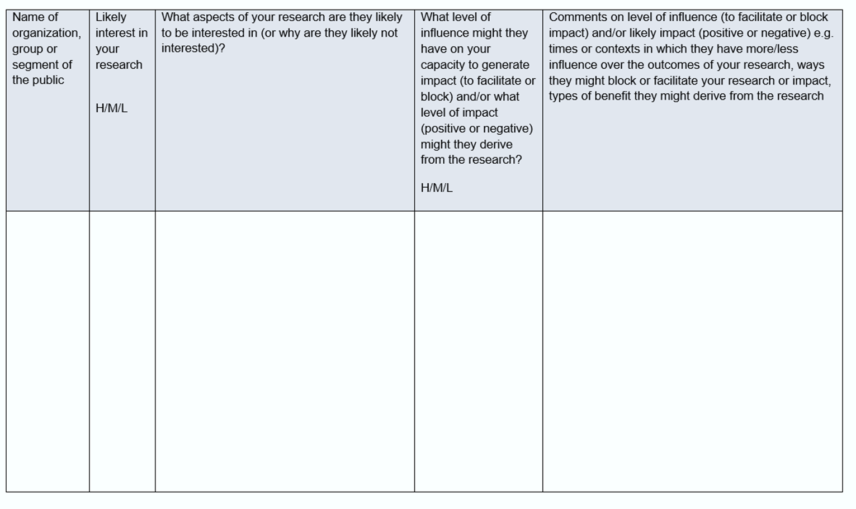
Stakeholder analysis: who are your key target groups?
Aberdeen Grants Academy
Follow us on Twitter
@UoAResInnov

Slide 31
Example stakeholder activity using whiteboard

Slide 32
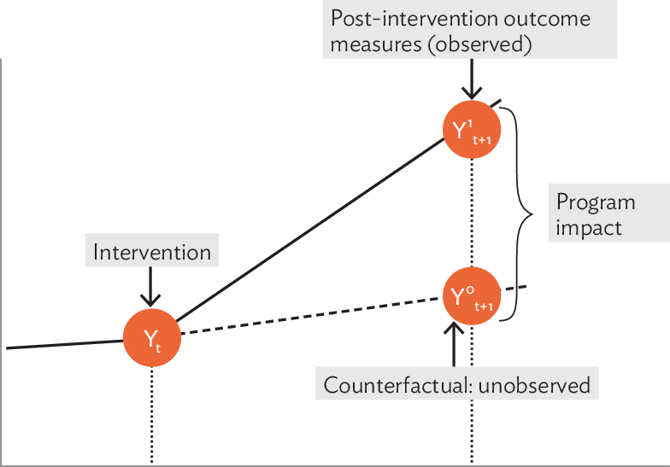
Establishing a baseline
Measured outcomes (taken at mid-point or end of research project)
Impact happens
here
Change/ time
Writing research proposal, identifying problem statement (baseline measurement)
Your project’s impact can be found when you compare your project outcomes to the baseline. This is why it’s important to establish how you plan to measure effects or changes that have occurred
Metric/ descriptor

Slide 33
The public affairs team manages the University’s relationships with policymakers on a UK, national, and regional level. The team can help to maximise the policy impact of your research by securing influencing opportunities, including:
Securing opportunities on government working groups, which feeds into policy formation
Submissions to government consultations on relevant policy area
Briefings for MPs / MSPs ahead of relevant parliamentary debates
Meetings with stakeholders relevant to policy area – e.g. policy officials, special advisers, elected representatives
Submissions to parliamentary committee inquiries
Visits and events involving political stakeholders
Contact:
Angela Michael, Head of Public Affairs and Stakeholder Engagement – angela.michael@abdn.ac.uk
Alex Ross, Public Affairs Officer – alexander.ross3@abdn.ac.uk
Aberdeen Grants Academy
Follow us on Twitter
@UoAResInnov

Slide 34
Discussion and Questions
Aberdeen Grants Academy
Follow us on Twitter
@UoAResInnov

Slide 35
Summary
Impact is a measureable change resulting from your research contribution - it’s reach, scope and nature is based on the research outcomes
Knowledge exchange is a key route to impact
Dissemination is one-way communication – you don’t learn by always doing the talking!
Knowing who your beneficiaries and stakeholders are at the beginning of the impact planning process is crucial
Your stakeholders may change as the project continues so stay flexible
Focus on setting realistic targets
Effective measurement and evaluation are key (mixed qualitative & quantitative)
Aberdeen Grants Academy
Follow us on Twitter
@UoAResInnov

Slide 36
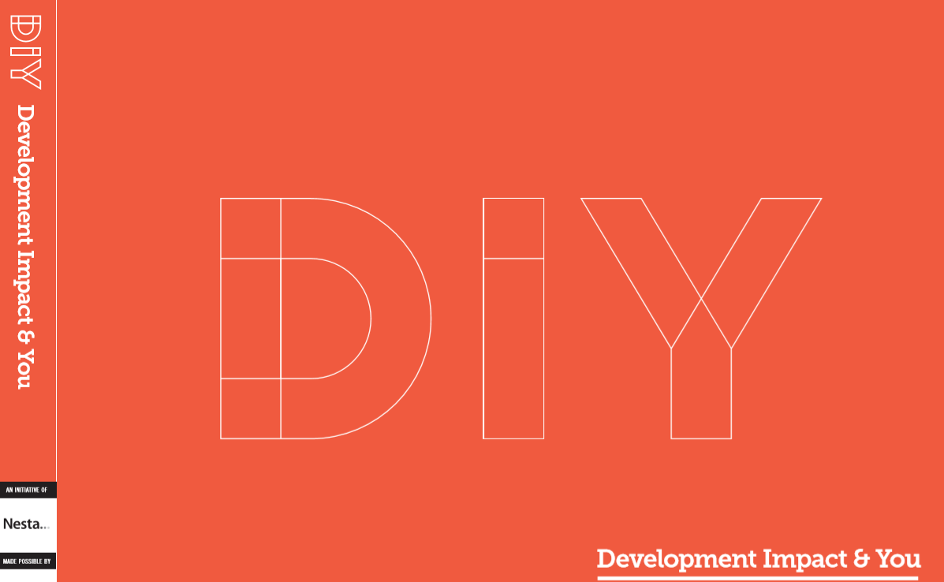
Nesta tools can be found here: https://diytoolkit.org/media/DIY-Toolkit-Full-Download-A4-Size.pdf

Slide 37








Business Engagement
Policy Engagement
Public Engagement
https://interface-online.org.uk/
https://spice-spotlight.scot/
https://spre.scot/
https://www.sgsss.ac.uk/
https://twitter.com/post_uk?lang=en
https://www.abdn.ac.uk/engage/
Aberdeen Grants Academy
Follow us on Twitter
@UoAResInnov

Slide 38
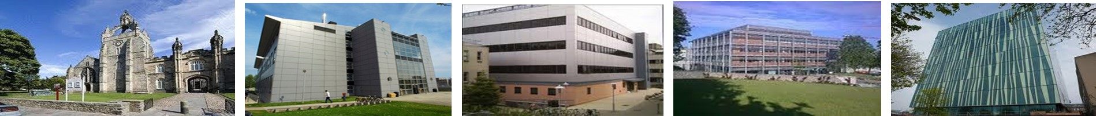
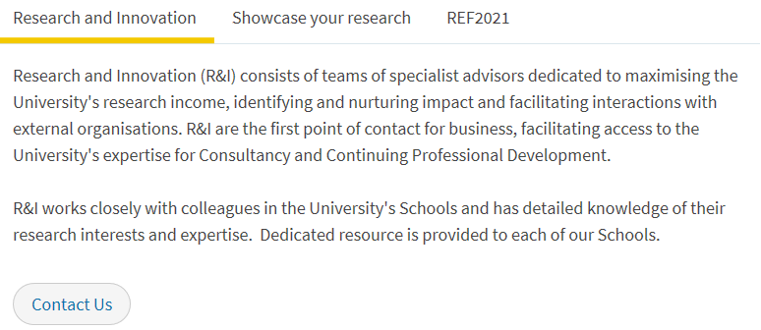
Contact Information
1495
Dr Ruth Banks
Impact Manager ruthbanks@abdn.ac.uk
Dr Jude Bain
Impact Officer
jude.bain@abdn.ac.uk
Aberdeen Grants Academy
Follow us on Twitter
@UoAResInnov

Slide 39
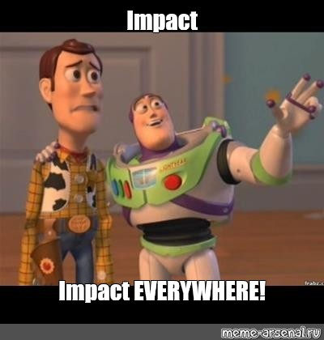
Thanks for listening!

