Slide 1

1495
ResearchBite –NERC Responsive Mode Demand Management
Professor Stuart Piertney School Research Director
Dr Andrew Phillips Research And Innovation
Aberdeen
Grants
Academy
Research &
Innovation

Slide 2


Outline for today’s ResearchBite
1495
The Demand Management measures imposed by NERC and how these are managed within the University.
The pipeline of support, mentoring and coaching available to applicants during bid development.
NERC process for selecting projects for funding.
Identifying funding opportunities and the process for submitting funding applications.
Aberdeen Grants Academy
Follow us on Twitter
@UoAResInnov

Slide 3
Goals of the Grants Academy
1495
https://www.abdn.ac.uk/grantsacademy
Impact
Support at ALL STAGES of the research grant life cycle: conception of ideas, through development and refinement of an application, to research delivery and realising impact of the research we undertake.
Measureable increase in the quality and quantity of research grant applications.
Sharing best practice and training.
Outcome
Idea Preparation
Submission
Application Development
Application Refinement
Aberdeen Grants Academy
Follow us on Twitter
@UoAResInnov

Slide 4

UKRI
1495
https://www.ukri.org/about-us/our-councils/
Aberdeen Grants Academy
Follow us on Twitter
@UoAResInnov

Slide 5

NERC
1495
https://nerc.ukri.org/
The Natural Environment Research Council is the UK's largest funder of independent environmental science, training and innovation, delivered through universities and research centres.
NERC funds world-leading basic, strategic and applied research, survey and long-term environmental observation and monitoring of the whole Earth system.
Physical, chemical and biological processes on which our planet and life itself depends, from pole to pole, from the deep Earth and oceans to the atmosphere and space.
Research is increasingly multi- and interdisciplinary, designed, supported and delivered in partnership with other research funders and research users.
Aberdeen Grants Academy
Follow us on Twitter
@UoAResInnov

Slide 6
NERC’s Discovery Science (Responsive Mode)
1495
https://nerc.ukri.org/funding/available/researchgrants/
Supports excellent curiosity-driven environmental research.
Asking fundamental questions on how the world works often has wide-ranging social and economic benefits.
Discovery science can support pure, applied, technology-led or policy-driven research, but it must address - or provide the means to address - clearly-defined scientific questions.
Adventurous research, multidisciplinary research and collaborations with international and non-academic partners are encouraged.
NERC's research grant schemes provide financial support for environmental scientists to carry out research projects of international quality at UK universities and other approved research institutions.
Types of research grant
Our grants fall into three main categories:
  Standard research grants (including New Investigator grants).
  Large research grants, intended to support complex, large-scale research.
  Urgency grants, for work that exploits unexpected and short-lived research opportunities, such as those offered by natural events like earthquakes or volcanic eruptions.
Aberdeen Grants Academy
Follow us on Twitter
@UoAResInnov

Slide 7
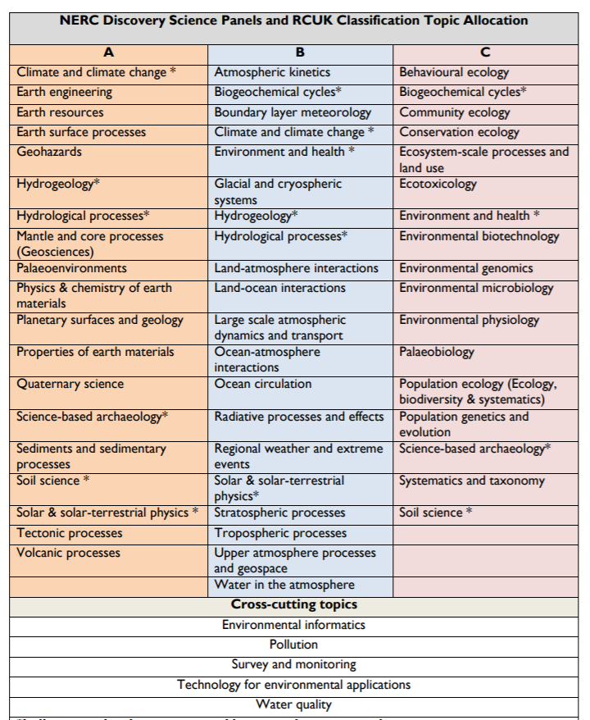
NERC’s Discovery Science Panels
1495
NERC uses a three panel structure to manage the assessment of all discovery science Standard / Standard New Investigator and Fellowship calls.
The three panel portfolio areas are designed to cover the full NERC remit N.B. many science topics cover a range of research and map to multiple panel areas.
The panel can be selected via the 'panel areas' section on the Je-S proposal form. NERC reserves the right to change the panel allocation of applications post-submission, but applicants will be informed if this happens.
Aberdeen Grants Academy

Slide 8
1495
NERC Demand Management Measures
https://nerc.ukri.org/funding/available/researchgrants/demand/
In 2015 NERC implemented measures designed to raise discovery science standard grant success rates.
To reduce the number and size of applications from research organisations for NERC's discovery science standard grant scheme and to ensure research excellence, efficiency and value for money.
Based on historic application and award data.
Where an organisation fails to meet a 20% success rate the number of applications an individual research organisation can make is limited.
The data is re-calculated annually using the six most recent grant rounds.
Aberdeen Grants Academy
Follow us on Twitter
@UoAResInnov

Slide 9
1495
Impact of quota on Aberdeen
Quota year | Closing date |  | Six round data used | Submitted | Funded | Success Rate | Number of Award * 5 / 6 | Cap
2015-16 | JULY15, JAN16 |  | JULY11, DEC11, JULY12, DEC12, JULY13, JAN14 | 39 | 5 | 12.82 | 4.17 | 4
2016-17 | JULY16, JAN17 |  | JULY12, DEC12, JULY13, JAN14, JULY14, JAN15 | 44 | 6 | 13.64 | 5.00 | 5
2017-18 | JULY17, JAN18 |  | JULY13, JAN14, JULY14, JAN15, JULY15, JAN16 | 38 | 7 | 18.42 | 5.83 | 6
2018-19 | JULY18, JAN19 |  | JULY14, JAN15, JULY15, JAN16, JULY16, JAN17 | 28 | 7 | 25.00 | No CAP | No CAP
2019-20 | JULY19, JAN20 |  | JULY15, JAN16, JULY16, JAN17,JULY17, JAN18 | 20 | 4 | 20.00 | No CAP | No CAP
2020-21 | JULY 20, JAN 21 |  | JULY16, JAN17,JULY17, JAN18, JULY18, JAN19 | 17 | 2 | 11.76 | CAP | 2
Aberdeen Grants Academy
Follow us on Twitter
@UoAResInnov

Slide 10
1495
Additional information on NERC DMM
This only applies to NERC's discovery science standard grant scheme.
If time-limited nature to the research perhaps consider NERC urgency grant call, which is not impacted by our institutional quota.
The cap only applies where we submit a composite JES form.
NERC has incorporate the new “Pushing the Frontiers” scheme as part of the discovery science route so subject to DMM.
Very strict guidelines on the mechanically checks for the bid ie font size and margins. NERC can and will reject a bid for a minor infringement.
Aberdeen Grants Academy
Follow us on Twitter
@UoAResInnov

Slide 11
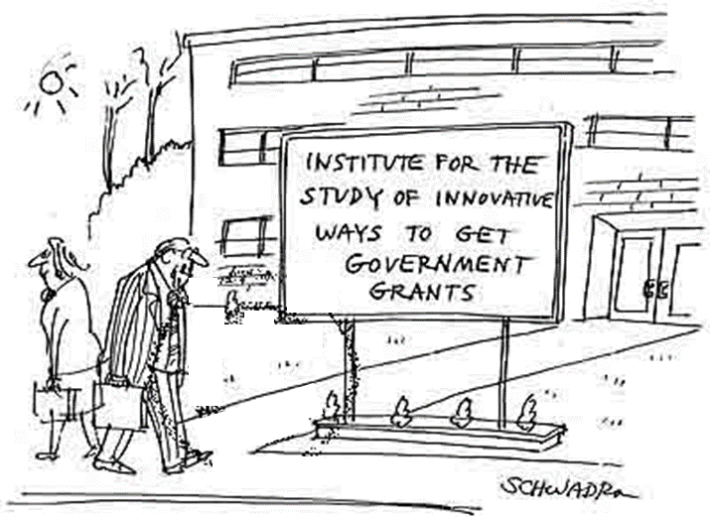
To consider before seeking funding?
1495
Pipeline, Intention to Submit and
Bid Development Support
What’s the big question?
Why is it important?
Does it fit UKRI (or charity) strategy?
Why are you the person(s) to address it?
Why should it be done now?
Do you have a research strategy?
What is novel?
What will the impact be?
Aberdeen Grants Academy
Follow us on Twitter
@UoAResInnov

Slide 12
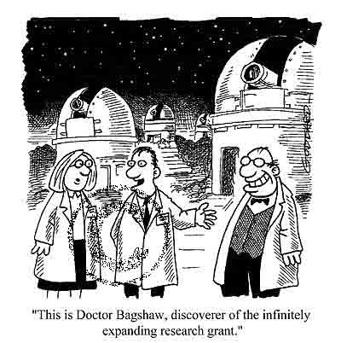
Establishing credibility (risk reduction)
1495
Track record
  previous grants
  publications
Pilot study
  existing research projects
  summer students
  honor's students projects
  appendices
Compete or collaborate?
  letters of support
  offers of materials
  offers of expertise
Aberdeen Grants Academy
Follow us on Twitter
@UoAResInnov

Slide 13


Pipeline, Intention to Submit and
Bid Development Support
1495
This is a pipeline approach – what do we mean by this? Starts in schools.
Stage 1 – applicants should complete the internal NERC pro-forma.
The panel will review the pro-formas and shortlist candidates for Stage 2.
Candidates not shortlisted will be given appropriate feedback and guidance.
Stage 2 – shortlisted candidates will be asked to present to the panel.
A designated member of the panel will be assigned to each shortlisted
principal investigator to provide expert guidance as the bid develops.
This is in addition to the two internal peer reviewers that normally provide
the academic guidance on the crafting of the bid.
Aberdeen Grants Academy
Follow us on Twitter
@UoAResInnov

Slide 14
Pipeline, Intention to Submit and
Bid Development Support
1495
Stage 3 – the shortlisted candidates will be asked to send their full applications to the panel in the weeks leading up to submission so that comprehensive feedback can be received for incorporation into the final bid prior to submission before the external deadline.
This process is designed to be supportive and nurturing and is not intended to block initiative or impact negatively on research careers.
We must be mindful of the fact that this cap is imposed on the university and we therefore have to ensure we select the bids with the best chance of securing the funding on offer by NERC.
Aberdeen Grants Academy
Follow us on Twitter
@UoAResInnov

Slide 15
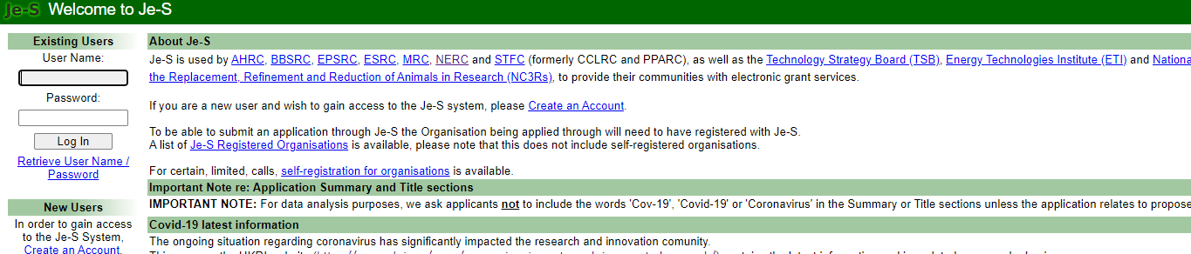
Additional points to consider
1495
Please note this selection process applies to the bids that Aberdeen will lead on AND where we are submitting an Aberdeen composite Je-S form on a partner‘s bid.
If you are planning on being a co-applicant on a single Je-S form where the bid is led by another organisation then this internal selection process will NOT apply to you.
Aberdeen Grants Academy
Follow us on Twitter
@UoAResInnov

Slide 16
Current Internal Panel
1495
Chair – Mirela Delibegovic
R&I – Liz Rattray, June Middleton, Andrew Phillips
SBS: Stuart Piertney (School Director of Research), Justin Travis, Cecile Rangin, Lesley Lancaster.
Geosciences: Chris Soulsby (School Director of Research) Dave Healy, Brice Rea, and Dmitri Mauquoy.
For more information on NERC’s Demand Management Measures - http://www.nerc.ac.uk/funding/available/researchgrants/demand/
Aberdeen Grants Academy
Follow us on Twitter
@UoAResInnov

Slide 17
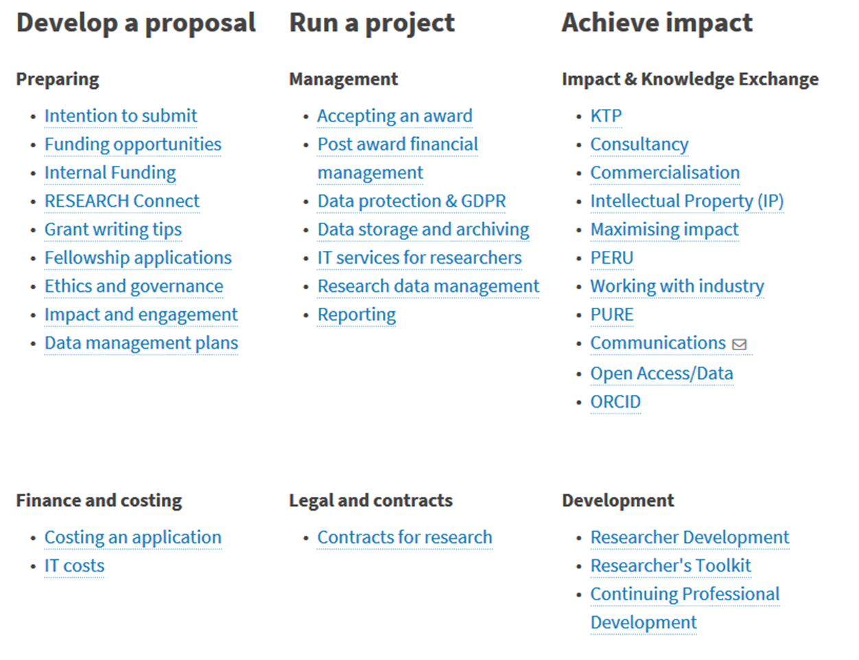

Research and Innovation
1495
https://www.abdn.ac.uk/staffnet/research/
Aberdeen Grants Academy
Follow us on Twitter
@UoAResInnov

Slide 18
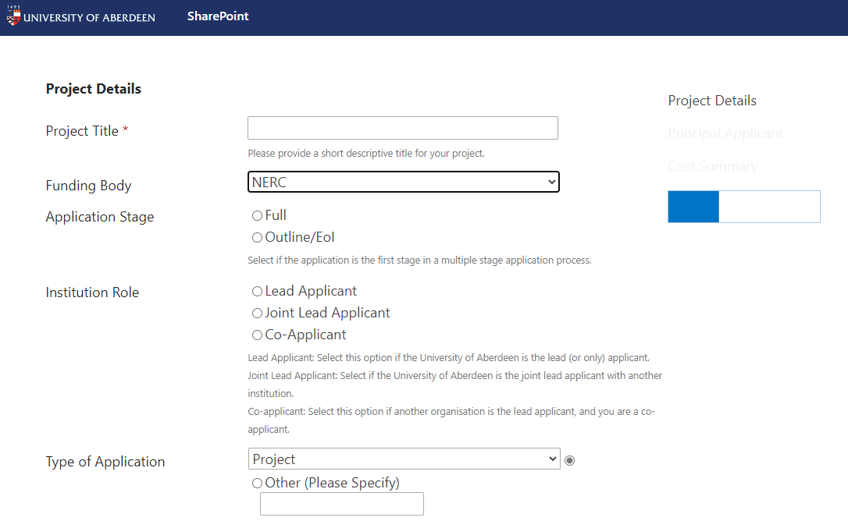
Research and Innovation
1495
https://www.abdn.ac.uk/eaap/
eAAP is an electronic system for submitting a request for internal approval to submit an application for external research funding.
Aberdeen Grants Academy
Follow us on Twitter
@UoAResInnov

Slide 19
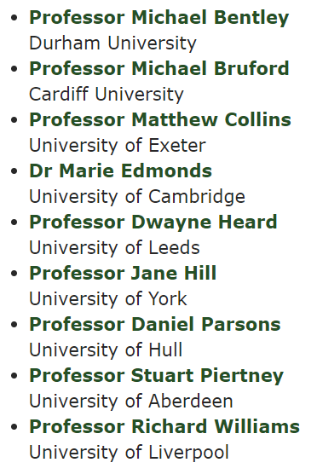
External Grant Review Process
1495
Peer Review College
Paul Hallett | University of Aberdeen | Biological and Environmental Sci
Adrian Hartley | University of Aberdeen | Geology and Petroleum
David Healy | University of Aberdeen | Geosciences
Frithjof Kuepper | University of Aberdeen | Biological and Environmental Sci
Lesley Lancaster | University of Aberdeen | Biological and Environmental Sci
David Macdonald | University of Aberdeen | Geosciences
Dmitri Mauquoy | University of Aberdeen | Geosciences
Timothy Mighall | University of Aberdeen | Geography and Environment
Brice Rea | University of Aberdeen | Geosciences
Steve Redpath | University of Aberdeen | Biological and Environmental Sci
Justin Travis | University of Aberdeen | Biological and Environmental Sci
Aberdeen Grants Academy
Follow us on Twitter
@UoAResInnov

Slide 20
External Grant Review Process
1495
UoA internal process
Two introducers & two readers
Moderation only
Scores (1-10)
Agreed score (HML)
No change
Ranking within each category
Wash-up across Panels
Deadline Jan/July
External/PRC reviews
~Four scores of 1-6
Rebuttal (days!)
Pre-sift by Panel (1-10)
Panel meeting
Aberdeen Grants Academy
Follow us on Twitter
@UoAResInnov

Slide 21
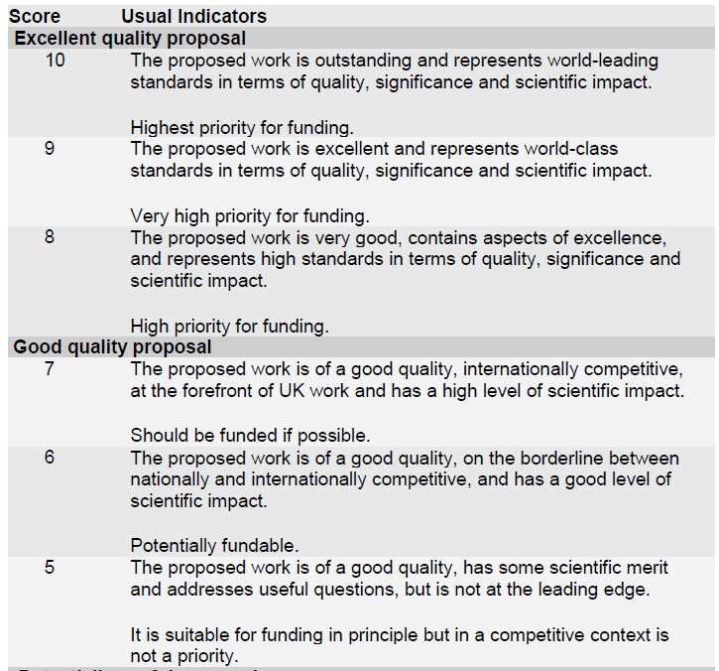
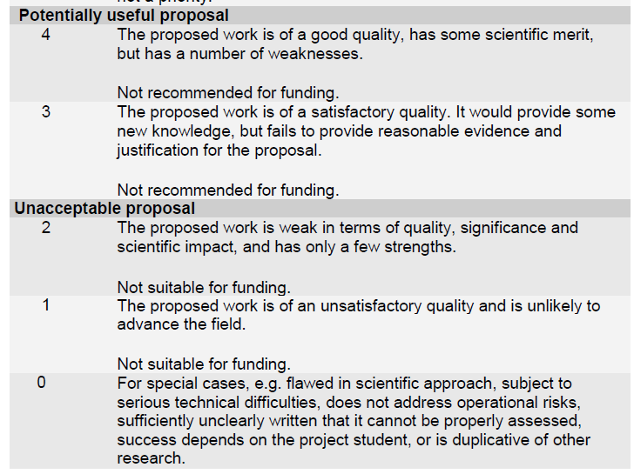
1495
Aberdeen Grants Academy

Slide 22
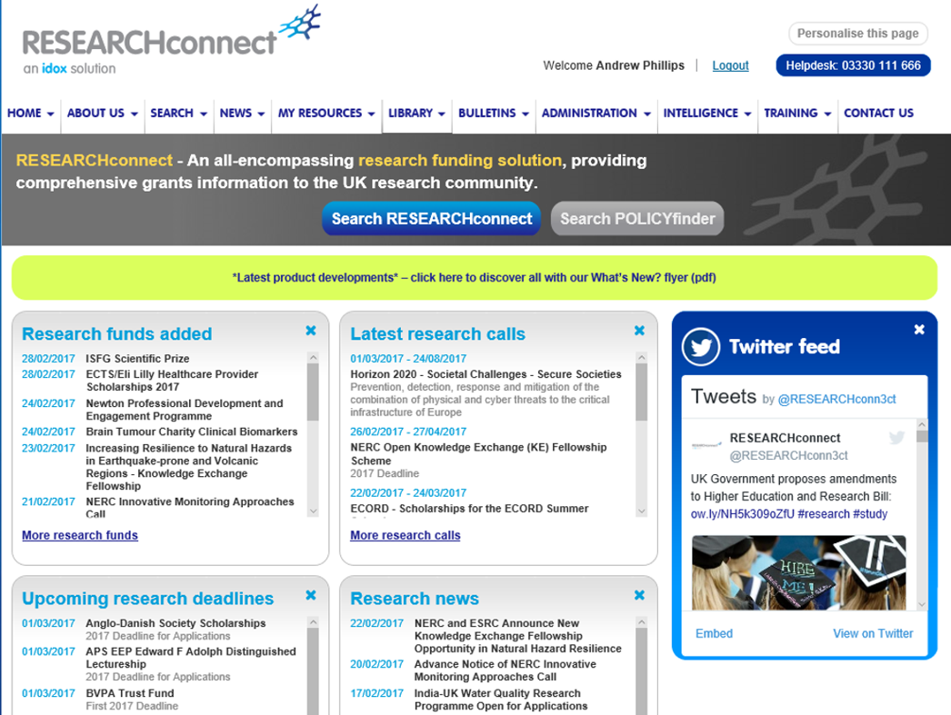

Promote Use of RESEARCHconnect
1495
https://www.researchconnect.co.uk
Aberdeen Grants Academy
Follow us on Twitter
@UoAResInnov

Slide 23
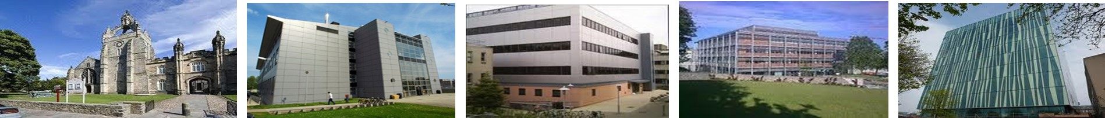
Questions and Contact Information
1495
Prof Stuart Piertney
School Director of Research
s.piertney@abdn.ac.uk
Prof Chris Soulsby
School Director of Research
c.soulsby@abdn.ac.uk
Dr Andrew Phillips
Business Development Officer andrew.phillips@abdn.ac.uk
June Middleton
Business Development Officer june.middleton@abdn.ac.uk
Aberdeen Grants Academy
Follow us on Twitter
@UoAResInnov

