Slide 1

Assessment of work-based learning: mapping UK Higher Education approaches – a recent SMMSN Summer Teaching Development Project
Dr Heather May Morgan
Lecturer (Scholarship) in Applied Health Sciences
@hm_morgan
27 October 2021

Slide 2
With thanks to Lara Parienti, who enthusiastically and methodically undertook the data collection and organisation for this project and shared valuable insights, supported by a SMMSN Summer Teaching Development bursary

Slide 3
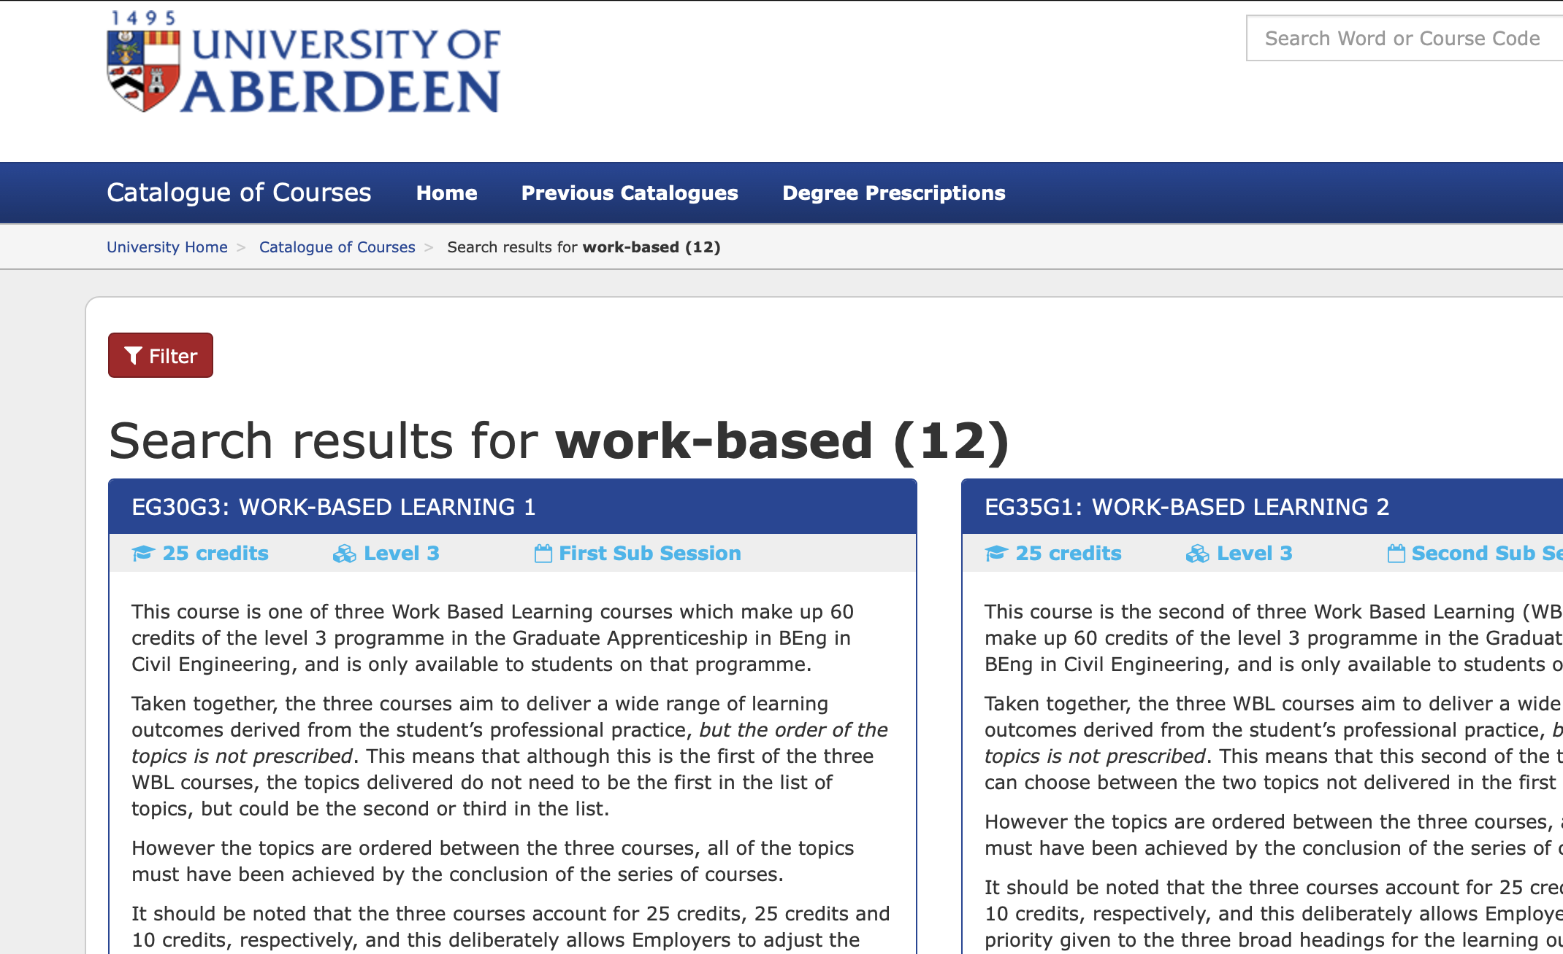
Work-based learning in UKHE
Work-based placements offered during University degrees to enhance student experiences and boost graduate employability are not uncommon across UK Higher Education (UKHE) institutions (Pokorny and Warren, 2021).
At the University of Aberdeen, we offer many such courses and are constantly expanding our provision across both undergraduate and postgraduate programmes.

Slide 4
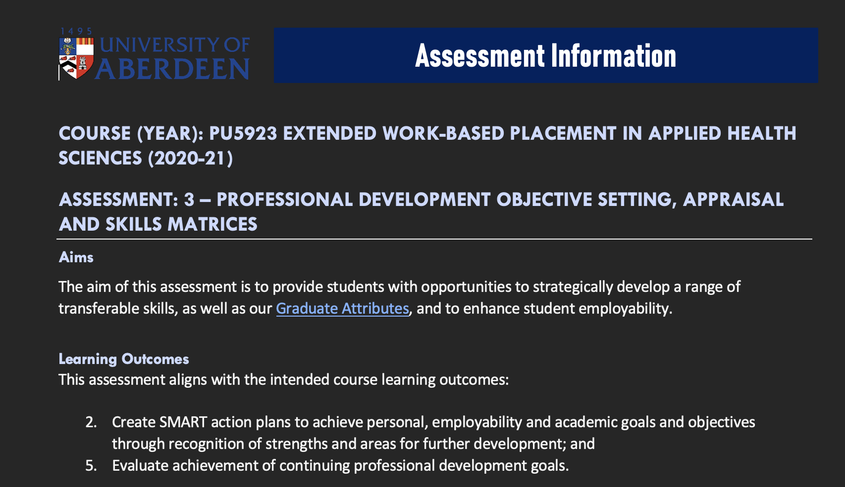
Assessment of work-based learning
Assessment of work-based learning tends to favour traditional scholarly formats (e.g. essays and presentations) for pragmatic reasons. However, these may not reflect real-world work delivery and feedback processes (Carlos, 2021).
I have recently developed and introduced a novel professional development plan, skills audit and appraisal assessment for the postgraduate work-based placements in applied health sciences that I run (PU5548 and PU5923), this is still University-led.

Slide 5
Employer involvement in assessment
Evidence suggests that, to develop a well-prepared future work force, host employers or their staff should be actively involved in designing and grading authentic assessments that will genuinely improve students’ experiences and enhance employability, as well as benefiting their own organisations through direct participation in these activities (Woolf and Yorke, 2010).
However, barriers to integrating employer-led assessments within University courses persist (Brodie and Irving, 2007).

Slide 6
Aim
The aim of this project was to map UK Higher Education approaches to assessment of work-based learning to:
inform our own University of Aberdeen practices and their development; and
to contribute to the field of pedagogical research in work-based learning.

Slide 7
Objectives
To visit the websites of all UK Higher Education institutions, specifically their course catalogues;
To check what work-based learning courses are offered at undergraduate and postgraduate levels;
To record the existence and characteristics of these courses (level, discipline, credit-weighting, ILOs, assessment types, COVID-19 adaptations/innovations re digital learning/creative solutions in pre-COVID-19 and during-COVID-19 iterations of the course, etc.);
To classify the assessment formats used; and
To prepare a written summary/visual representation of the data.

Slide 8
Methods – me
I had already prepared a list of UK Higher Education institutions, links to their main webpages and, for some, specific links to their course catalogues
I had also created an Excel spreadsheet for recording work-based courses offered at undergraduate and postgraduate levels, and the characteristics of those courses, including assessment formats, and had begun to extract and tabulate data for some institutions…

Slide 9
Methods – Lara Parienti
Systematically extract data from UKHE course catalogues
Freedom of Information (FOI) requests:
1. Could you list the disciplines in which you offer work-based learning (i.e. work placements) in both undergraduate and postgraduate taught courses?
2. Could you provide the list of work placement modules that you offer, ideally with placement years in a separate list, to differentiate them from shorter placements?
3. Could you give an indication of the range of assessment methods used in these placement modules, and whether or not they involve university only, university-employer, or employer only?
NSS data
Employment stats

Slide 10
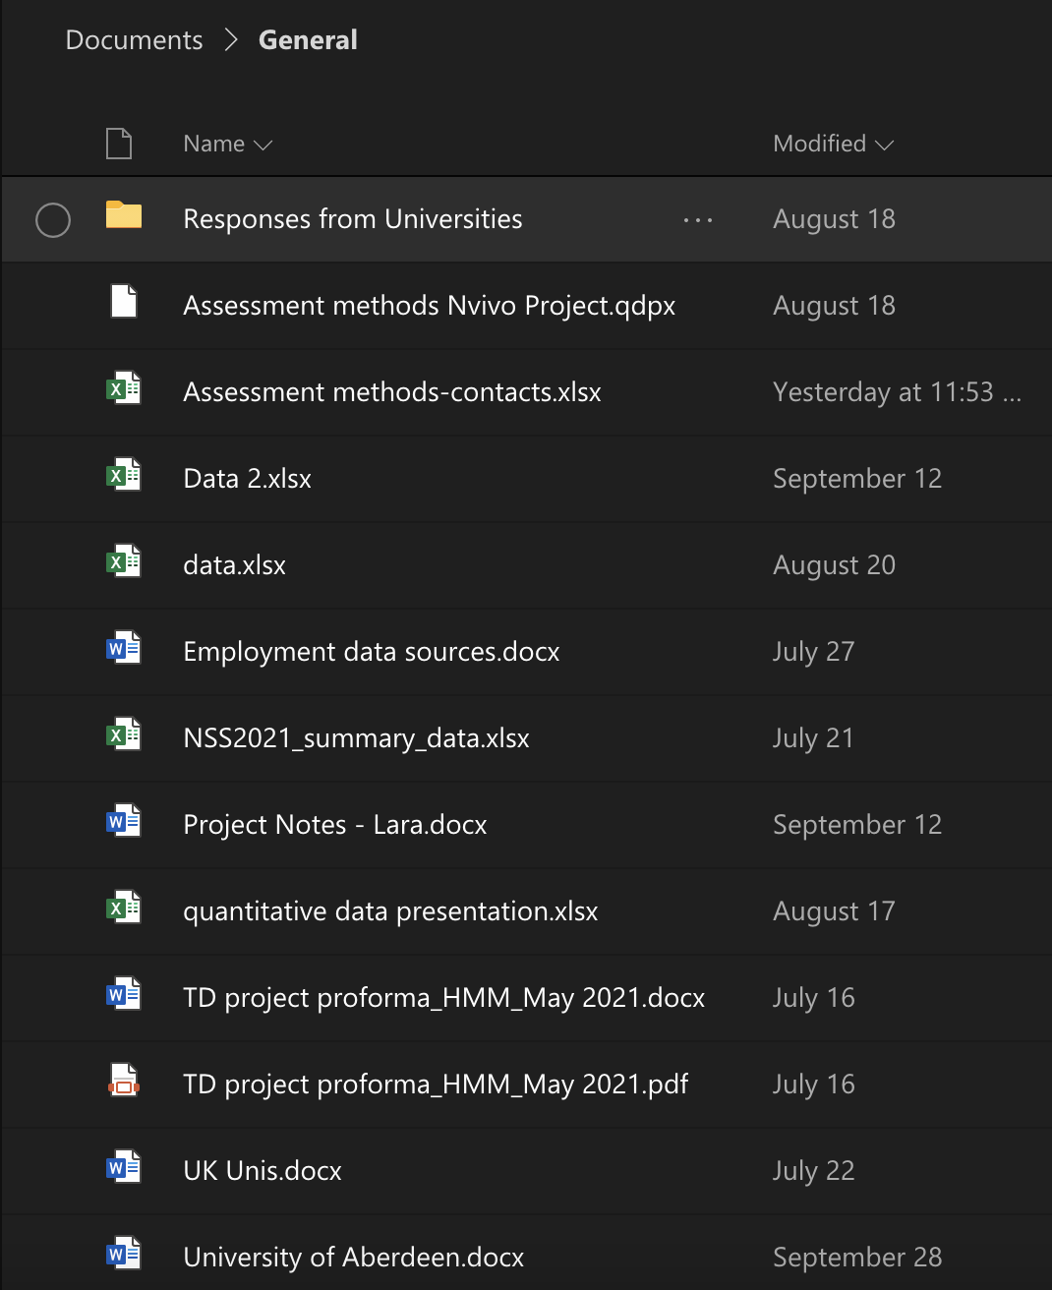
Findings

Slide 11
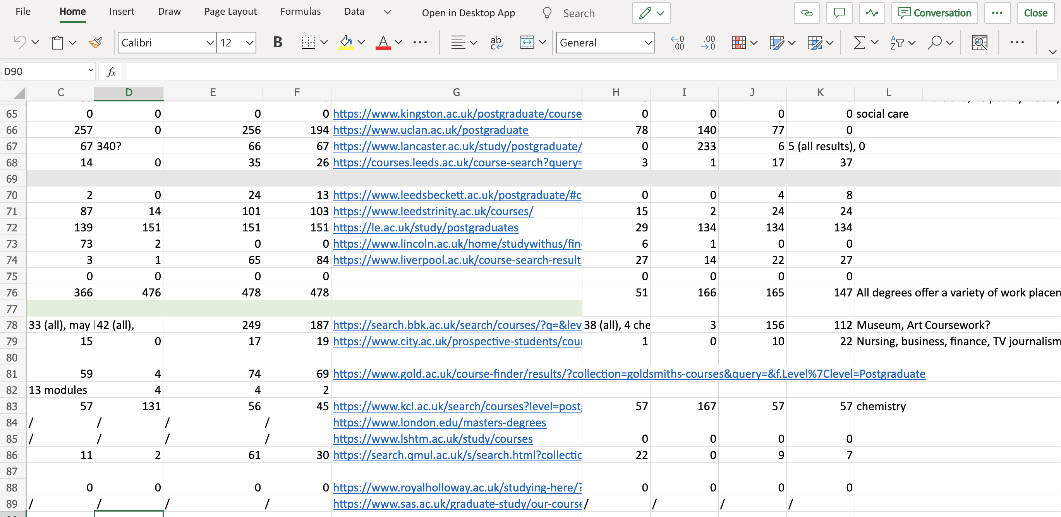
UKHE course catalogues

Slide 12
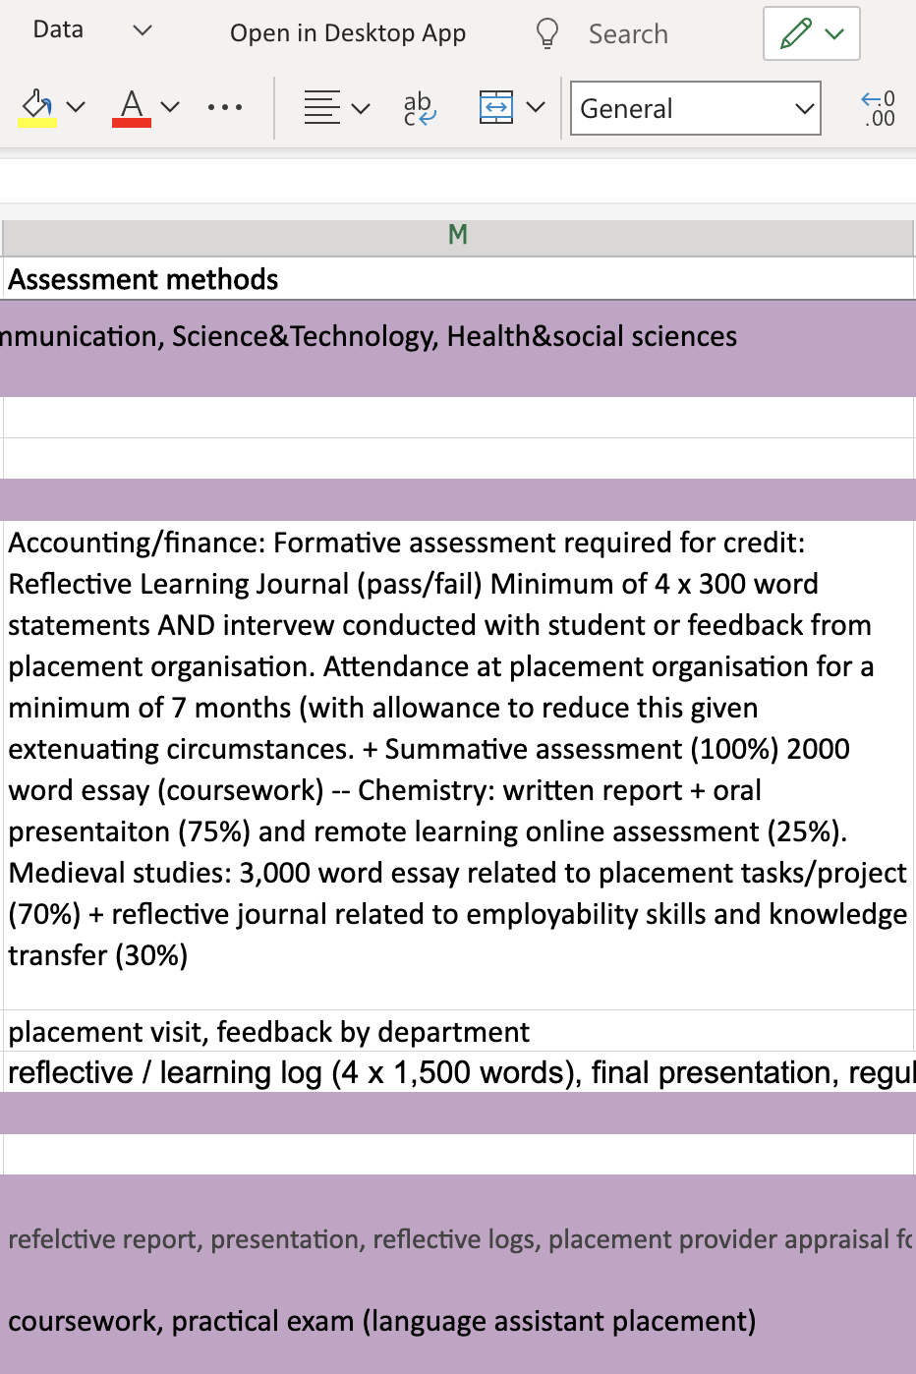
→ Assessment methods

Slide 13
Insights/limitations 1
Unless the search engine accurately filters course descriptions, or the course title contains the specific keyword searched, the keywords won’t bring up accurate results
Overlap between keywords
Some university websites did not have a search bar so quantitative data could not be obtained
Some search engines did not automatically give the number of results and it was therefore either calculated manually (when possible) or not recorded (when the number of results was too large)

Slide 14
Insights/limitations 2
In some cases, ‘work-based’ means “flexible study while in work”, in which case was not relevant
Keywords containing multiple words bring up all results containing each word individually (depending on search engine), which may lead to an overestimation
Some engines, but not all, filter between academic years, so some results will include multiple academic years and therefore the results may include the same course/module counted multiple times

Slide 15
FOIs
Email addresses were collected for each institution: General enquiry, admissions/recruitment, or Freedom of Information departments when no other email address could be obtained online
Online form request when no appropriate email address was found
Number of email sent: 134
Number of online forms filled out: 9
Total number of universities contacted: 143
Number of responses: 56 (colour coded in spreadsheet)
Number of responses that answered all questions: 33 (green)
Number of responses that answered partially: 8 (orange)

Slide 16

e.g. Bath Spa

Slide 17
Insights/limitations 3
Not precise nor exhaustive, relied on trends observed while searching course catalogues (except for those universities where a fully comprehensive answer to question 1 was provided)
For universities that did not provide an answer to question 3, non-exhaustive and approximate notes made from online information found on a few degrees picked at random (from the list of results brought up by the catalogue search) when information regarding assessment methods was provided

Slide 18
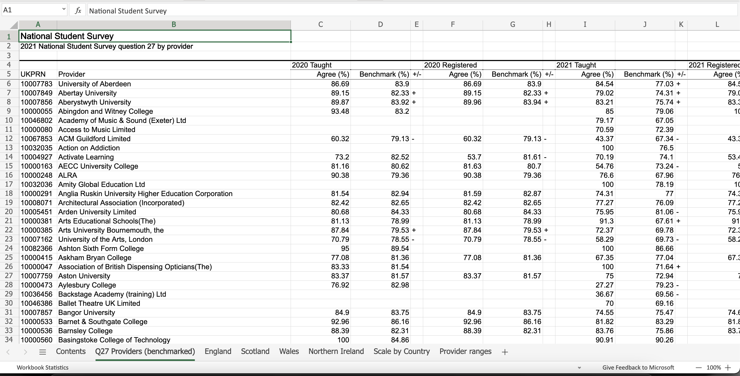
NSS data

Slide 19
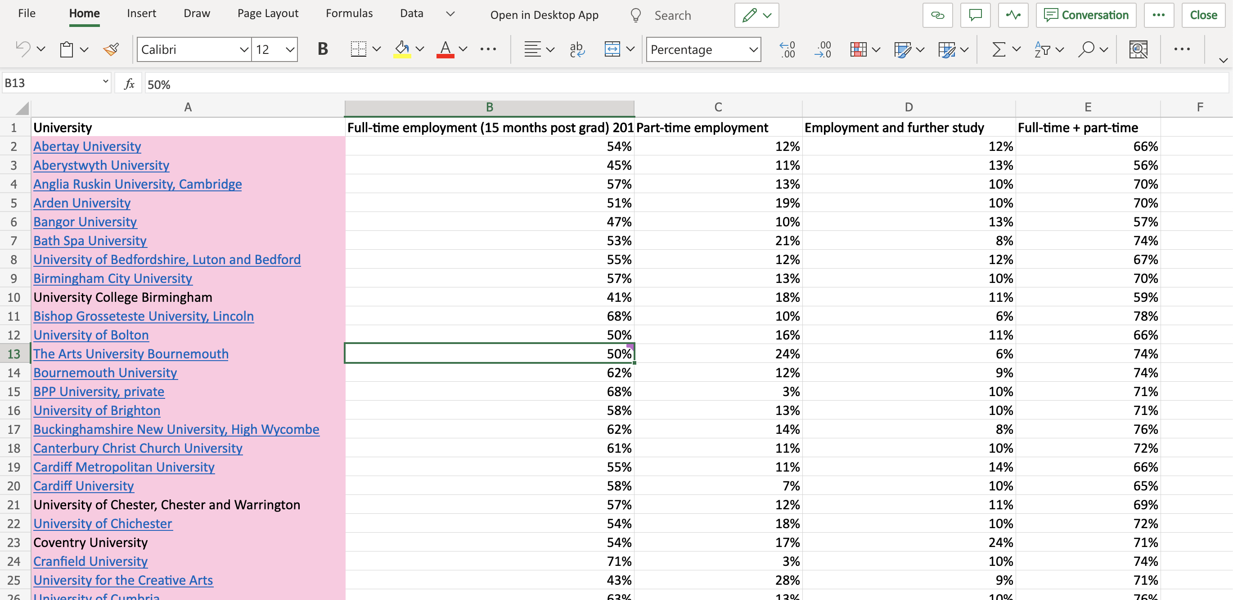
Employment stats

Slide 20
Objectives – met?
To visit the websites of all UK Higher Education institutions, specifically their course catalogues;
To check what work-based learning courses are offered at undergraduate and postgraduate levels;
To record the existence and characteristics of these courses (level, discipline, credit-weighting, ILOs, assessment types, COVID-19 adaptations/innovations re digital learning/creative solutions in pre-COVID-19 and during-COVID-19 iterations of the course, etc.);
To classify the assessment formats used; and
To prepare a written summary/visual representation of the data.

Slide 21
What we do know…
Remains very little→no employer involvement in assessment
Assessment types are limited in range/are traditional/lack innovation
Doesn’t appear to be a trend between post-1992 institutions and their offering more work-based learning

Slide 22
Strengths and limitations
We have a massive dataset!
Information is stored and labelled differently across universities so data is not valid or reliable?
Range of barriers to FOI replies for those that called for an exemption
Multiple universities understood the use of ‘placement years’ differently, so provided an extra set of information that was not requested
Complexity of mapping re experiences and employability…

Slide 23
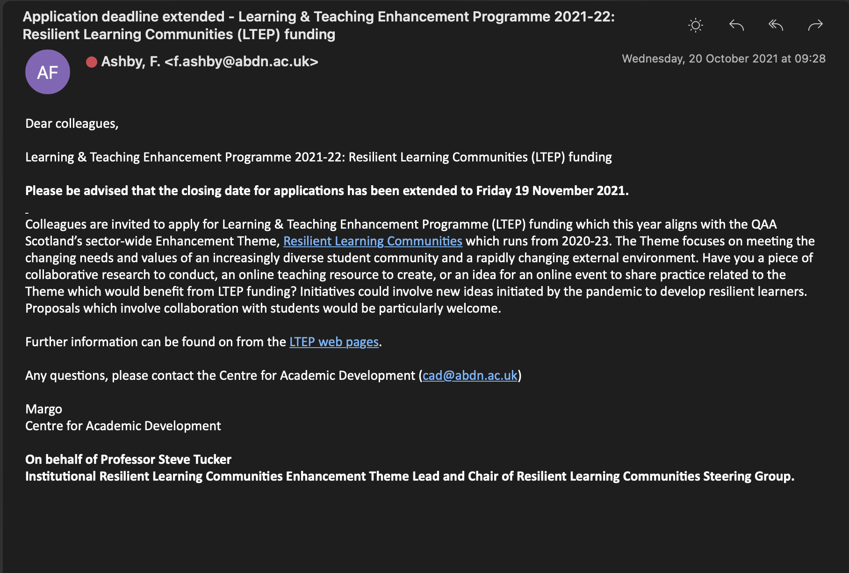
What next?
1. Detailed data analysis...
2. Follow on primary study…

Slide 24
Ideas for local innovation…
e.g. PU5923
Assessment name | Type | Learning outcomes | Due UoA Week (teaching week) | % grade
Roles and responsibilities placement agreement | Reflective assessment | 1 | 42 | 10
Workplace profile | Pre-recorded video presentation | 3 | 43 | 20
Professional development objective setting, appraisal and skills matrices | Case study report | 2, 5 | 42 51 | 0 30
Workplace output(s) | Practical report | 4 | 51 | 40
→ Contract? (vs. Agreement)
Digital Storytelling? (vs. Profile/Workplace output(s))
LinkedIn profile or CV? (vs. Professional development)
EMPLOYERS?

Slide 25

Questions and suggestions?

Slide 26
References
Brodie, Pandy, and Kate Irving. "Assessment in work‐based learning: investigating a pedagogical approach to enhance student learning." Assessment & Evaluation in Higher Education 32.1 (2007): 11-19.
Carlos, Roweena. Developing best practices to ensure that students gain context-based skills and knowledge in work-based learning opportunities. Diss. Northeastern University Boston, 2021. [ONLINE]: https://repository.library.northeastern.edu/files/neu:bz60qs26d/fulltext.pdf (last accessed 17 May 2021).
Pokorny, Helen, and Digby Warren, eds. Enhancing teaching practice in higher education. Sage, 2021.
Woolf, Harvey and Mantz Yorke. Guidance for the assessment of work-based learning in Foundation degrees. [ONLINE] https://www.heacademy.ac.uk/system/files/fdf_Guidance_for_assessment_of_workbased_learning.pdf (last accessed 17 May 2021).

