Slide 1
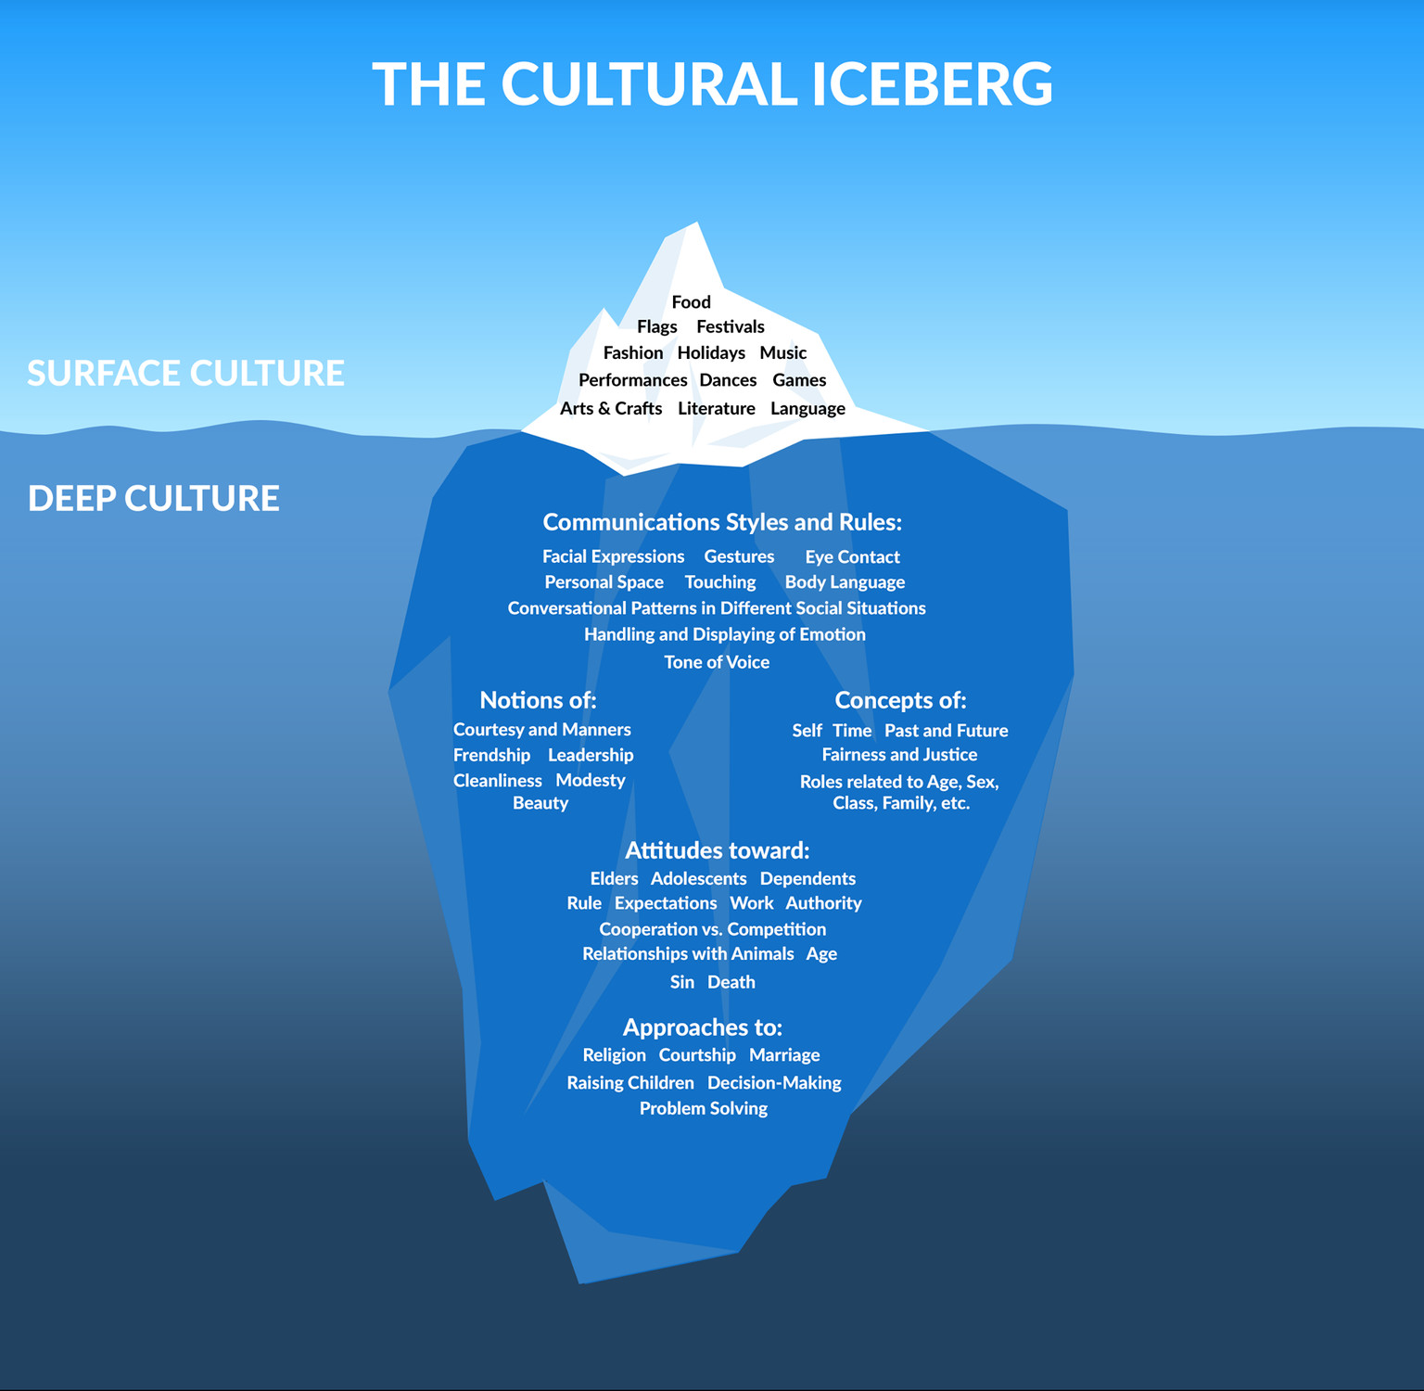
Setting Expectations and Acknowledging Diversity
Edward Hall (1976) The Cultural Iceberg
What are your students’ expectations in terms of timing / addressing teaching staff / students?
How do your students expect to communicate with you?
What hierarchical systems are your students familiar with?
How do your students accept feedback?
https://www.linkedin.com/pulse/cultural-iceberg-lisa-mills-phd

Slide 2
Setting the tone:
Introductions – and naming patterns
Teaching patterns – explain how your class will work
Class etiquette – i.e. question and answer; discussion-based;
Communication protocol – what software and how and when to use it
Language issues – acknowledge the additional effort in working in a 2nd language
Group work

