Slide 1

Early adopters versus the majority in technology-enhanced learning and teaching (TELT)
Dr Vicki Dale, Senior Academic and Digital Development Adviser, Academic and Digital Development Unit

Slide 2
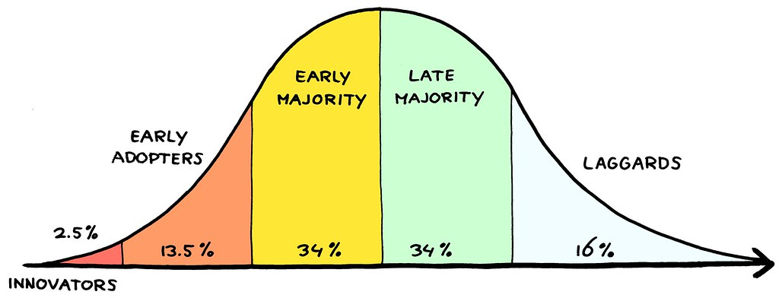
Background to the study
ADD contact for the College of Science and Engineering (CoSE)
Long-time advocate for Technology Enhanced Learning and Teaching (TELT)
How could I make the best use of my role, using my MEd dissertation, to support the college to most effectively use TELT?
Roger’s (2003) ‘diffusion of innovations’ curve as a framework
Used to working with ‘early adopters’; how can we engage the majority?
This Photo by Unknown Author is licensed under CC BY

Slide 3
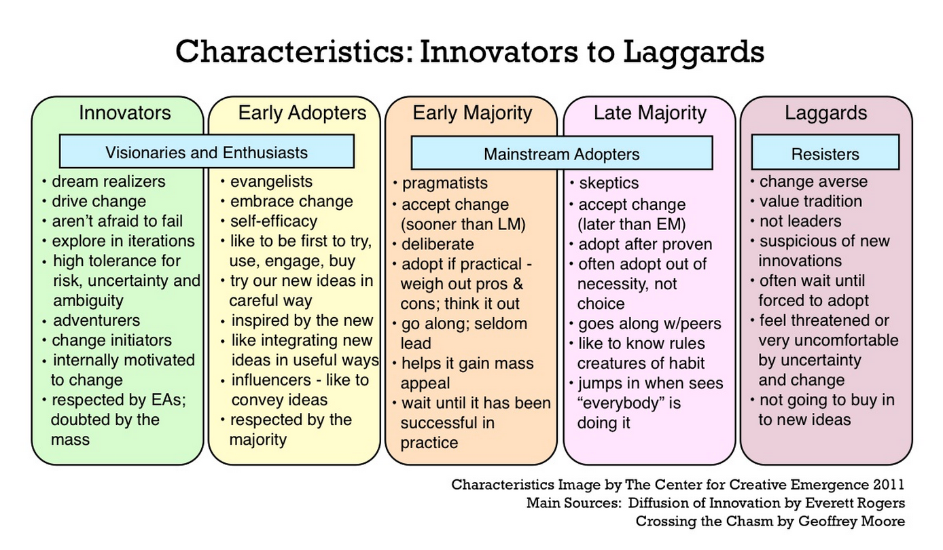
(More information about the five types)
This Photo by Unknown Author is licensed under CC BY

Slide 4
Research questions
1. How do teachers in higher education construe the concept of teaching innovation?
2. What intrinsic characteristics are associated with innovator-adopters versus the majority?
3. What extrinsic factors influence teachers’ engagement in teaching innovation and TELT?
4. What methods of academic development may be used to support all teachers in higher education?

Slide 5
Study design
Interpretivist epistemology and constructivist ontology (Cousin, 2009)
Sequential, explanatory mixed methods (Jones, Torres & Arminio, 2006)
No incentives
Study design approved by CoSE ethics committee

Slide 6
Literature: characteristics of teaching innovation
High self-efficacy incl. tech use (Ertmer and Ottenbreit-Leftwich, 2010; Thurlings et al., 2015; Hsu, 2016; Klaeijsen et al., 2017)
Risk-taking over conservativism (McGeown, 1980; Lunde and Wilhite, 1996; Wilson and Stacey (2004, citing Geoghan (1995))
Student-centred pedagogical beliefs (Thurlings et al, 2015; Prestridge, 2017)
Confidence in using technology (Jacobsen, 2000)
Associated with teaching awards (Lunde & Wilhite, 1996)
Can be impeded by barriers (Al-Senaidi et al., 2009; Fresen, 2011; Brown, 2016); early adopters persist in face of adversity (Lunde & Wilhite, 1996)

Slide 7
Research methods
Online survey
Teacher efficacy (Emmer and Hickman, 1991)
Risk-taking vs. conservativism (Bobic, Davis, & Cunningham, 1999)
Use of virtual learning environment (VLE) (González, 2012)
Digital practitionership (Bennett, 2014)
CPD methods (van Eekelen et al., 2005; and authors’ own experiences)
Contextual enablers and barriers (Al-Senaidi et al., 2009; Brown, 2016;
Fresen, 2011; Hsu, 2016; Mumtaz, 2000).
70 responses (18%)
Frequency data, Kruskal-Wallis ANOVA, chi-square (SPSS)

Slide 8
Research methods
Semi-structured focus groups
All invited to explore:
  Understanding of the term ‘teaching innovation’
  Enablers and barriers to TELT teaching innovation
  Most useful methods of CPD
  How the institution could better support staff to innovate
Early adopters (n=4)
Early majority (n=5)
General inductive approach to thematic analysis (Thomas, 2003)

Slide 9
Results: Survey responses
LTS = Learning, Teaching and Scholarship; R&T = Research & Teaching

Slide 10
Results: Definitions of teaching innovation
Most responses concerned with using new technologies or tools (n=19), enhancing student learning (n=17) or new teaching methods/approaches/techniques (n=16).
“…anything which enhances the student learning. Even if it’s a small … increase in their interest, if you can use technology to do that, I mean, that would be…to me, that would be an innovation.” (EA3)
“As head of first year in [my subject] … I'm interested from that viewpoint, you know, how we can use technology to provide better support to students.” (EM2)

Slide 11
Self-efficacy
SD = Strongly disagree
D = Disagree
N = Neither
A = Agree
SA = Strongly agree

Slide 12
Risk-taking vs. conservativism

Slide 13
'Fear of failure' with large student numbers
Unlike innovators, early adopters and early majority reluctant to take risks with technology with large student numbers
“[I’m] not really at the bleeding edge of technology, more the kind of cutting edge … There’s a lot of blood, sweat and tears at that level too, to implement it, especially with large numbers. ‘Cause you’re at the stage where it has to work, otherwise you are in an awful lot of trouble with 250 students where you messed up.” (EA2)
“I'm quite conservative before I let this loose on 600 students. So, I would like to be convinced that there is an actual benefit … robust and reliable, and also sustainable.” (EM2)

Slide 14
Use of e-learning systems (after Gonzalez, 2012)

Slide 15
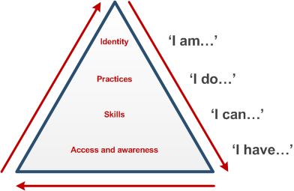
Digital practitionership
Bennett (2014) derived a digital practitionership framework from Beetham and Sharpe’s (2010) digital literacies model
https://www.jisc.ac.uk/guides/developing-digital-literacies

Slide 16
Findings: Digital practitionership (access)
SD = Strongly disagree
D = Disagree
N = Neither
A = Agree
SA = Strongly agree

Slide 17
Findings: Digital practitionership (skills)
SD = Strongly disagree
D = Disagree
N = Neither
A = Agree
SA = Strongly agree

Slide 18
Findings: Digital practitionership (practices)
SD = Strongly disagree
D = Disagree
N = Neither
A = Agree
SA = Strongly agree

Slide 19
Findings: Digital practitionership (identity)
SD = Strongly disagree
D = Disagree
N = Neither
A = Agree
SA = Strongly agree

Slide 20
Engagement in developmental TELT opportunities

Slide 21
Usefulness of CPD methods (self-directed)

Slide 22
Usefulness of CPD methods (CoPs and events)

Slide 23
Usefulness of CPD methods (formal learning)

Slide 24
Usefulness of CPD methods
Early adopters can see potential across disciplines
Early majority prefer to learn from their own or cognate disciplines
“… you’ be surprised that a First Year Course Coordinator in Physics has as much in common with a First Year Course Coordinator in Theatre Studies. But it’s exactly the same problems with very different kind of bent and direction. The problems we had, everybody could identify with, and so there was that kind of common thread.” (EA2)
“I quite like some of the [central] CPD events that […] run at lunchtime. I've been to some of them … especially if it's something at your own college it would be more relevant to you and you're going to learn some things that they're doing …” (EM3)

Slide 25
Role of serendipity for development of early adopters
“…it’s very informal, but the colleagues that I sort of associate with have mutual interests … it’s kind of informal and just kind of like bumping into people and something comes up and not necessarily when you’re expecting it. So I find a lot of my ideas and so on come from just happenstance.” (EA1)

Slide 26
Contextual factors (enablers and barriers)
SB = Significant barrier
B = Barrier
N = Neither
E = Enabler
SE = Significant enabler

Slide 27
Contextual factors (enablers and barriers)
SB = Significant barrier
B = Barrier
N = Neither
E = Enabler
SE = Significant enabler

Slide 28
Summary of findings
No differences in terms of self-efficacy and risk-taking (potentially due to small sample size and selection of items from inventories)
I/EA most likely to use VLEs in more student-centred ways for collaboration
(and potentially knowledge-building)
I/EA more confident in higher levels of digital practitionership (learning to use software, digital practices and attributes
I/EA more likely to apply for and be successful in teaching awards
I/EA engage in a wider variety of CPD, however informal communities important for all participants
I/EA view management support as more of an enabler than the other two groups
I/EA and EM view communities of practice as more of an enabler than LM

Slide 29
Discussion
Innovators/early adopters have a critical role to play in agility and resilience of institution; recently very important in context of pivot to online (Singer et al, in review)
However, fear of failure in early adopters and early majority reflective of ‘emotional work’ of TELT (Bennett, 2014)
Increased remote & blended learning post-pandemic means all groups need supported:
  Informal learning communities hosted by academic developers essential (Vogel, 2010)
  Create opportunities for serendipitous learning from conversations (Haigh, 2005)
  Early adopters can transfer learning from other disciplines while early majority prefer to learn from their own or cognate disciplines (Wilson and Stacey, 2004).
In terms of contextual factors, need a supportive organisational climate (Adekola et al., 2017)

Slide 30



Acknowledgements: Thanks to all study participants and my supervisors: Dr Michael McEwan and Dr Jason Bohan
Forthcoming:
Dale, V.H.M., McEwan, M. and Bohan, J. (2021) Early adopters versus the majority: Characteristics and implications for academic development and institutional change. Journal of Perspectives in Applied Academic Practice.
#UofGWorldChangers
@UofGlasgow

Slide 31

Thank you for listening.
vicki.dale@glasgow.ac.uk
@vhmdale
This Photo by Unknown Author is licensed under CC BY-SA

Slide 32
References
Adekola, J., Dale, V. H. M., & Gardiner, K. (2017). Development of an institutional framework to guide transitions into enhanced blended learning in higher education. Research in Learning Technology, 25, 1-16. doi:https://doi.org/10.25304/rlt.v25.1973
Al-Senaidi, S., Lin, L., & Poirot, J. (2009). Barriers to adopting technology for teaching and learning in Oman. Computers & Education, 53(3), 575-590. doi:https://doi.org/10.1016/j.compedu.2009.03.015
Bennett, L. (2014). Learning from the early adopters: developing the digital practitioner. Research in Learning Technology, 22(1), 21453. Retrieved from https://journal.alt.ac.uk/index.php/rlt/article/download/1450/pdf_1
Bobic, M., Davis, E., & Cunningham, R. (1999). The Kirton adaptation-innovation inventory: validity issues, practical questions. Review of Public Personnel Administration, 19(2), 18-31. doi:https://doi.org/10.1177/0734371X9901900204
Brown, M. G. (2016). Blended instructional practice: A review of the empirical literature on instructors' adoption and use of online tools in face-to-face teaching. The Internet and Higher Education, 31, 1-10. doi:https://doi.org/10.1016/j.iheduc.2016.05.001
Cousin, G. (2009). Chapter 1. Framing higher education research. In Researching learning in higher education. An introduction to contemporary methods and approaches. (pp. 1-15). New York & Abingdon: Routledge.
Emmer, E. T., & Hickman, J. (1991). Teacher efficacy in classroom management and discipline. Educational and psychological measurement, 51(3), 755-765. doi:https://doi.org/10.1177/0013164491513027
Ertmer, P. A., & Ottenbreit-Leftwich, A. T. (2010). Teacher technology change: How knowledge, confidence, beliefs, and culture intersect. Journal of research on Technology in Education, 42(3), 255-284. doi:https://doi.org/10.1080/15391523.2010.10782551

Slide 33
References
Fresen, J. W. (2011). Factors influencing lecturer uptake of e-learning. Teaching English with Technology, 11(1), 81-97. , J. W. (2011). Factors influencing lecturer uptake of e-learning. Teaching English with Technology, 11(1), 81-97. , J. W. (2011). Factors influencing lecturer uptake of e-learning. Teaching English with Technology, 11(1), 81-97.
González, C. (2012). The relationship between approaches to teaching, approaches to e-teaching and perceptions of
Haigh, N. (2005). Everyday conversation as a context for professional learning and development. International Journal for Academic Development, 10(1), 3-16. doi:10.1080/13601440500099969the teaching situation in relation to e-learning among higher education teachers. Instructional Science, 40(6), 975-998. doi:10.1007/s11251-011-9198-x
Haigh, N. (2005). Everyday conversation as a context for professional learning and development. International Journal for Academic Development, 10(1), 3-16. doi:10.1080/13601440500099969
Hsu, P.-S. (2016). Examining current beliefs, practices and barriers about technology integration: a case study. TechTrends: Linking Research & Practice to Improve Learning, 60(1), 30-40. doi:10.1007/s11528-015-0014-3
Jacobsen, M. (2000). Excellent teaching and early adopters of instructional technology. Paper presented at the ED-MEDIA 2000 12th World Conference on Educational Multimedia, Hypermedia & Telecommunications, June 26-July 1, 2000, Montreal, Quebec, Canada.
Jones, S. R., Torres, V., & Arminio, J. (2006). Choices and consequences of mixing methods in qualitative research. In Negotiating the complexities of qualitative research in higher education: Fundamental elements and issues (pp. 135-151). New York and Abingdon: Routledge.
Klaeijsen, A., Vermeulen, M., & Martens, R. (2017). Teachers’ innovative behaviour: The importance of basic psychological need satisfaction, intrinsic motivation, and occupational self-efficacy. Scandinavian Journal of Educational Research, 1-14. doi:10.1080/00313831.2017.1306803

Slide 34
References
Lunde, J. P., & Wilhite, M. S. (1996). Innovative teaching and teaching improvement. In L. Richlin (Ed.), To Improve the Academy (pp. 155-167). Stillwater, OK.
McGeown, V. (1980). Dimensions of Teacher Innovativeness. British Educational Research Journal, 6(2), 147-163. doi:10.1080/0141192800060204
Mumtaz, S. (2000). Factors affecting teachers' use of information and communications technology: a review of the literature. Journal of Information Technology for Teacher Education, 9(3), 319-342. doi:10.1080/14759390000200096
Prestridge, S. (2017). Examining the shaping of teachers’ pedagogical orientation for the use of technology. Technology, Pedagogy and Education, 1-15. doi:10.1080/1475939X.2016.1258369
Rogers, E. M. (2003). Diffusion of innovations (5th ed. ed.). New York, N.Y.: Simon & Schuster.
Thomas, D. R. (2006). A general inductive approach for analyzing qualitative evaluation data. American Journal of Evaluation, 27(2), 237-246. doi:10.1177/1098214005283748
Thurlings, M., Evers, A. T., & Vermeulen, M. (2015). Toward a Model of Explaining Teachers’ Innovative Behavior:A Literature Review. Review of Educational Research, 85(3), 430-471. doi:10.3102/0034654314557949
van Eekelen, I. M., Boshuizen, H. P. A., & Vermunt, J. D. (2005). Self-Regulation in Higher Education Teacher Learning. Higher education, 50(3), 447-471. Retrieved from http://www.jstor.org/stable/25068106
Vogel, M. (2010). Engaging academics in professional development for technology-enhanced learning. Retrieved from https://www.heacademy.ac.uk/resource/engaging-academics-professional-development-technology-enhanced-learning
Wilson, G., & Stacey, E. (2004). Online interaction impacts on learning: Teaching the teachers to teach online. Australasian Journal of Educational Technology, 20(1). doi:https://doi.org/10.14742/ajet.1366

