Slide 1
Strategies to improve intercultural communication
Dr Cheryl Dowie
24th August 2021

Slide 2
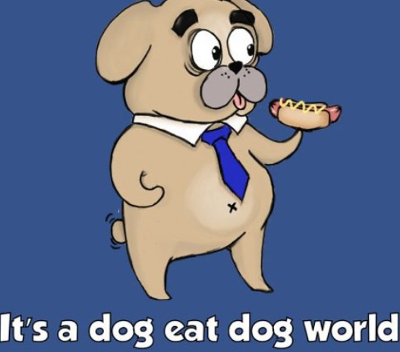
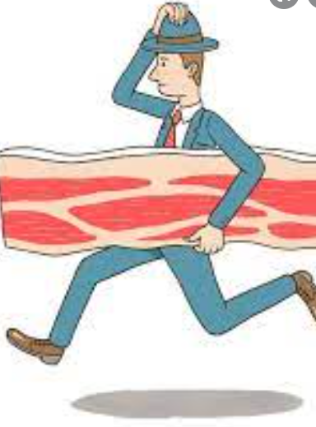
Do we see the world in our lens?
1) Is ethnocentricity different from stereotype and bias?
2) Do our ethnocentric views affect intercultural communication in the workplace?
Slides created by Dr C. Dowie

Slide 3
How do we mitigate our ethnocentric views?
Be self-aware
- Be willing to learn about people and cultures that are different to your own.
Discard old ways and embrace new ways
- A practical approach of discarding views that are outdated and no longer fit within today’s globalised world.
Take some risks
- Immerse yourself in uncomfortable situations. Put theory into practice.
Slides created by Dr C. Dowie

