Slide 1
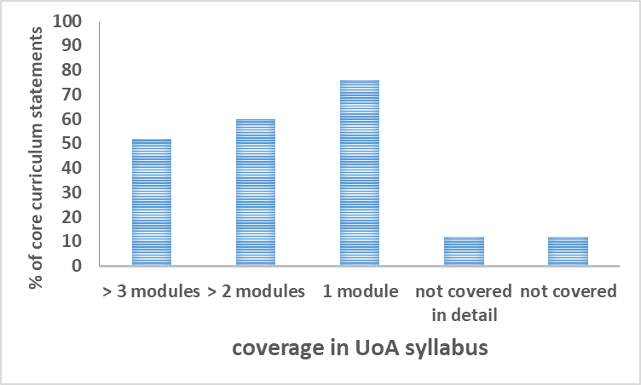
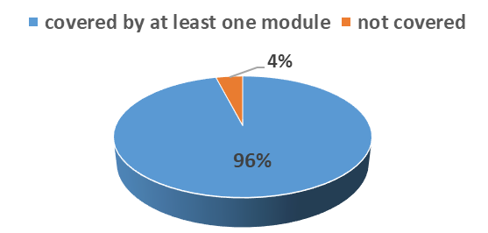
Benchmarks for quality assurance and course enhancement
SJ Tucker
School of Medicine, Medical Sciences & Nutrition, University of Aberdeen
Background Context
Results
The British Pharmacological Society published a core curriculum for undergraduate pharmacology in 2016 (extract below)
UoA programme compares well:
Over half of the statements are delivered across 2 or more modules
Qualitative checks confirmed that this represented progression of material, not repetition
Enhancement of existing programme:
A new module was designed and implemented in 2018 to address those areas with little or no coverage
Integrated well into existing programme
Students very positive about impact:
This provided an ideal benchmark for the current University of Aberdeen pharmacology syllabus
Such reflective practice is fundamental for quality assurance of programmes and offers the opportunity for quality enhancement
Aim
Quality Assurance
To align the Aberdeen pharmacology syllabus with the 50 core curriculum statements highlighting modules where these are delivered
Quality Enhancement
To identify areas for development from the alignment matrix and implement course changes to ensure we are effectively delivering across the core curriculum
Re-evaluation since 2018 enhancements:
Alignment matrix
Discussion
Core curriculum statements
Which modules?
Subject benchmarks provide a valuable reflective tool to quality assure programme content
This project demonstrates use of the BPS core curriculum as a benchmark to assess current content, and make changes to maintain currency and relevance
Clearly, this is valuable from a quality assurance and quality enhancement perspective
Covered at UoA?

