Slide 1
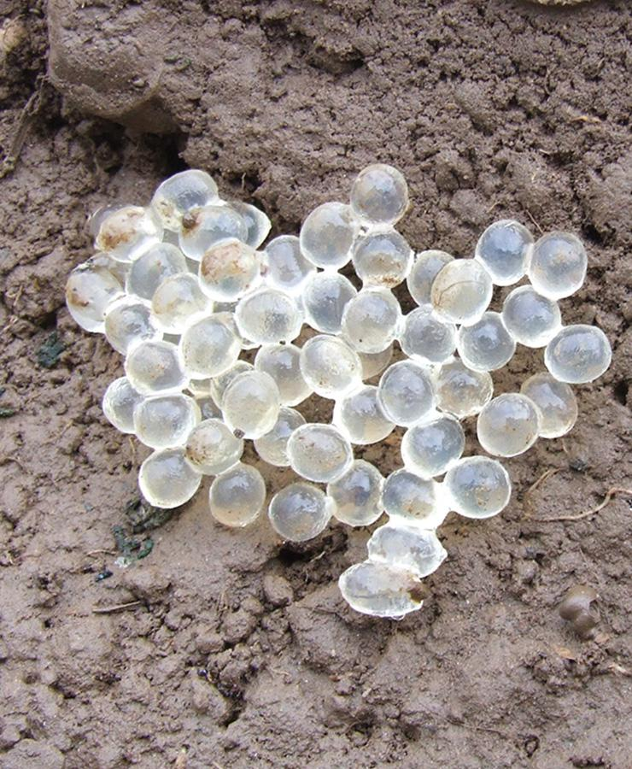
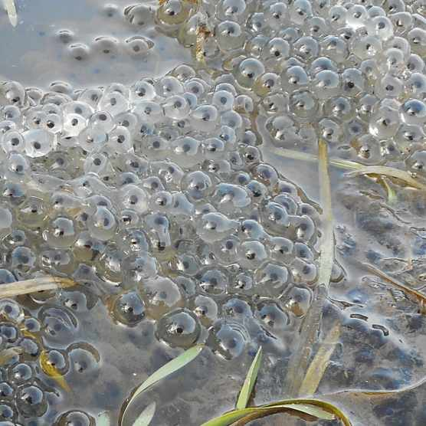
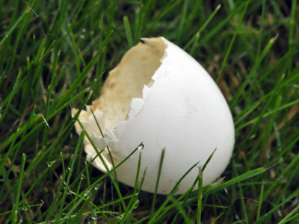
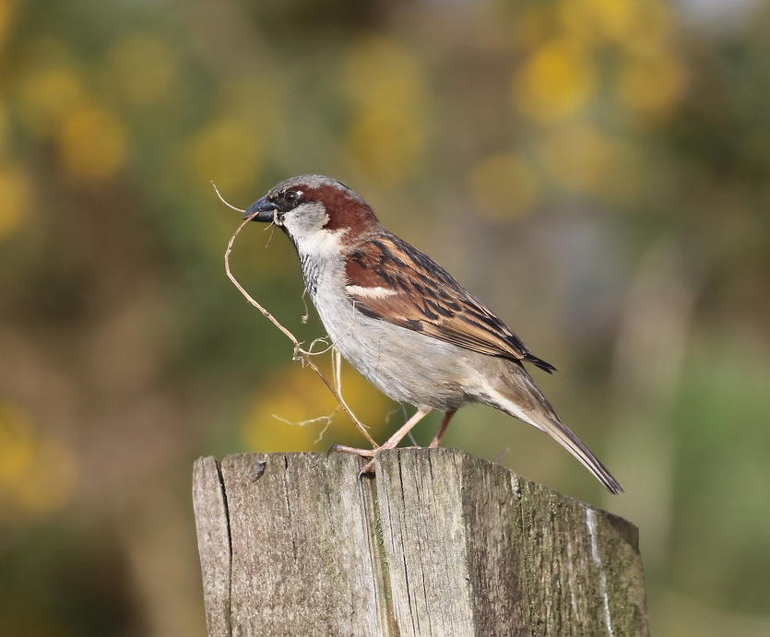
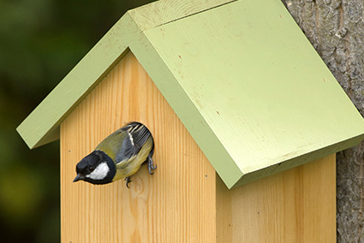
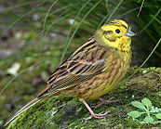
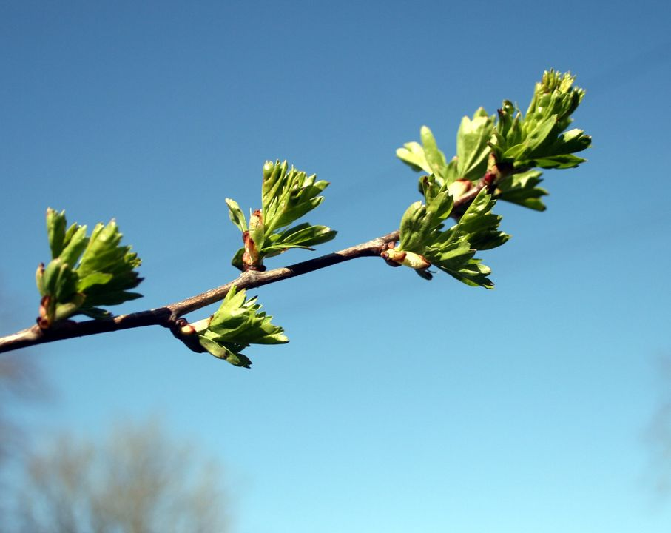
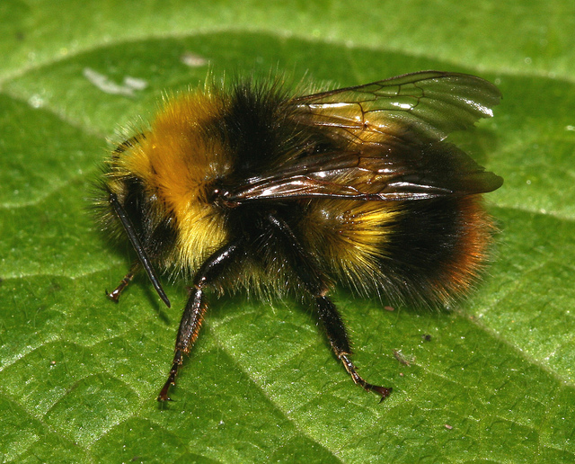
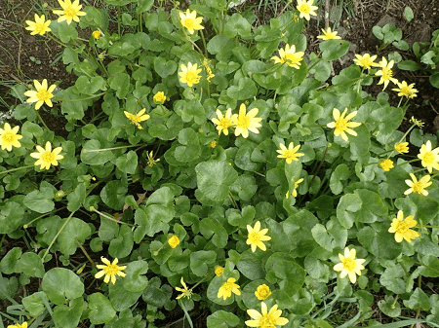
An Easter Egg hunt with a difference.
What can you spot in your green space?
Eggs are associated with Easter because of the promise of new life they contain. We all love hunting for chocolate eggs, but why not also try our alternative Easter Egg hunt to look for natures signs of new life that are all around us?
Eggs
It’s still early for some birds to be nesting, but wood pigeons have been recorded nesting in every month of the year. Look out for their pale eggs shells in parks and gardens.
Slug and snail eggs can be found all year round. Try looking under old bricks or logs or inside flowerpots.
Frogspawn is one of the most eagerly anticipated signs of spring. Can you see any in your local pond?
Nesting
Lots of birds are nest building. Can you spot any birds carrying nesting material?
Do you have any nest boxes near you? Keep an eye on them to see who might make them their home this year.
Dressed to impress! Lots of birds, like this male Yellowhammer have their most colourful plumage at this time of year to attract a mate.
New Season
Leaves bursting from buds, like this hawthorn.
Early bumblebees are out and about.
Keep an eye out for the first spring wild flowers.

