Slide 1

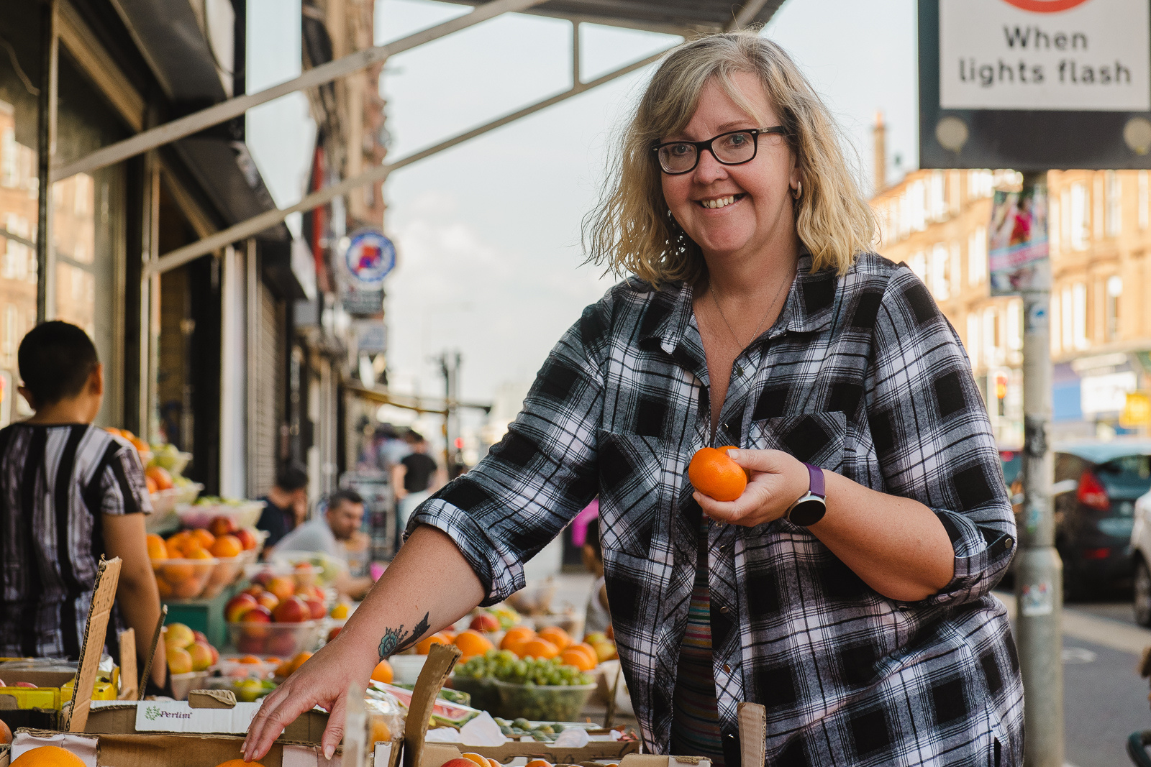





Challenge Poverty Week
Patient and Public Involvement (PPI) workshop
4th of October 2022
The Rowett Institute, University of Aberdeen
Organised with the Aberdeenshire Council

Slide 2

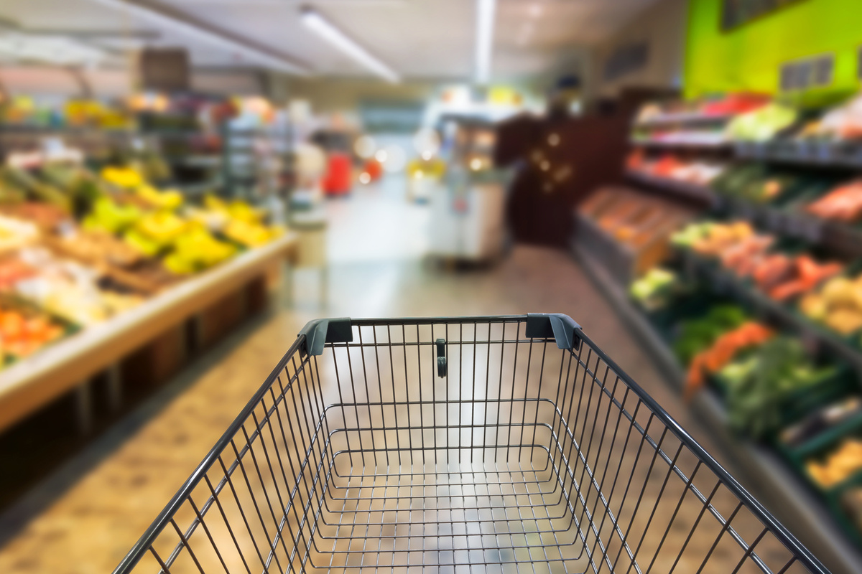
This is a characterisation and representation of the discussion
on the experience of shopping in the retail sector
What is PPI?
In research, Patient and Public Involvement (PPI) means that members of the public work alongside the research team and are actively involved in contributing to the research process as advisers and possibly as co-researchers (source: NIHR)
What is food insecurity?
The condition of not having access to sufficient food, or food of an adequate quality, to meet one's basic needs (Oxford Dictionary Definition).

Slide 3

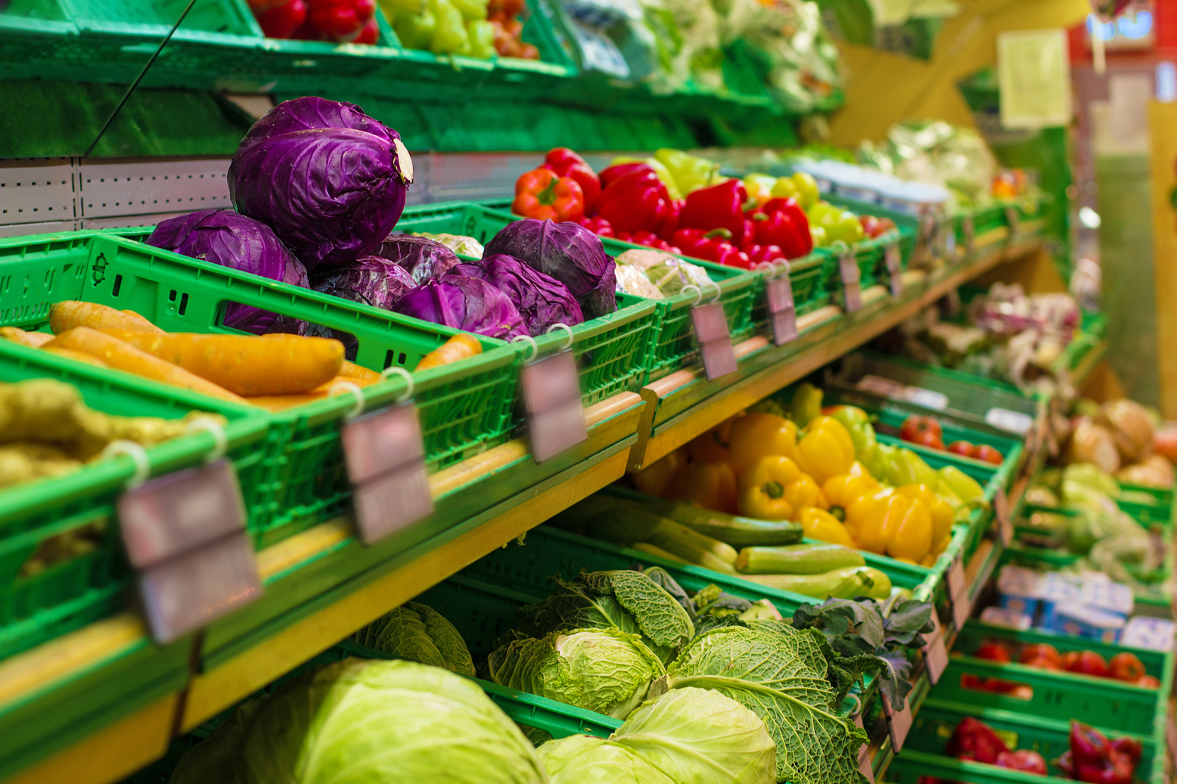
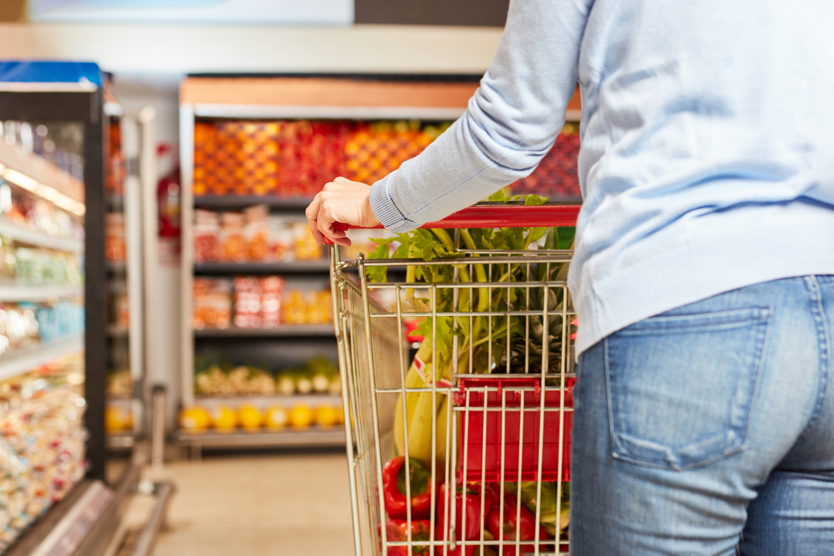

Improving sustainable and healthier food choices in the retail food environment
Food Insecurity
in people living with Obesity
The overall aim of the project is to provide actionable evidence for policy on retail strategies to address dietary inequalities in people living with obesity and food insecurity, to support sustainable and healthier food choices in the UK food system.
Funding
Biotechnology and Biological Sciences Research Council (BBSRC) Strategic Priorities Fund (SPF), part of UK Research and Innovation (UKRI).

Slide 4
Food and health inequalities
Experience in Aberdeenshire
Focus group run by: Prof Alex Johnstone and Prof Flora Douglas
Number of attendees: 31
Discussion themes
What are your priorities for food shopping for health?
1
Has this changed recently?
2

Slide 5

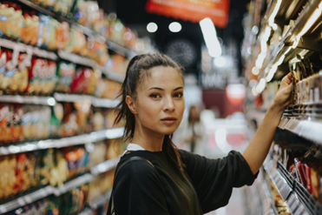

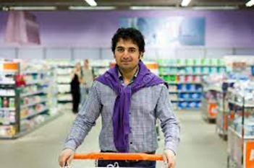

The lived experience of retail shopping with food poverty​
Mandy
Shirley
Robert
Make ends meet shopper
“It was hard to admit that I needed help to feed the family”​
“I use the local food bank and larder to get food. I have noticed that the quality and quantity of food there has decreased recently. It has helped to get help with budgeting for food shopping and to use shopping list to plan what to cook”
The secret shopper
“I have a car, a house and live in a nice area, but I was made redundant during the COVID pandemic. ”
“I feel ashamed that I need to use the local food larder as I don’t have enough money to buy the weekly shopping. I live in an area that is perceived to be nice, but I am in trap of poverty”​
The reduced counter shopper
“I shop at 7-8pm at a local supermarket which is the time that the food is reduced”
“It’s called ‘feeding time at the zoo’ locally, when all the food is reduced. I wait for meat to be reduced in price, then do the rest of my shopping. I don’t have time to think about all this eco- friendly nonsense”

Slide 6
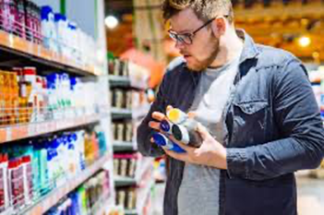


The lived experience of retail shopping with food poverty​
Sam
Olivia
Fred
The scoop shopper
“I go shopping with a list, but it is too expensive to buy all my food at a supermarket”
“I use a local ‘scoop shop’, to buy dried foods by weight, such as pasta and lentils - it is cheaper to buy smaller amounts, I only get what I need"
The rural shopper
“There isn’t many shops near me, I live in a remote area. Its not heat or eat, I can’t afford either"
”Prices of food are higher at the local corner shop. I’d like to get a veg box, but I don’t know what to do with all the produce and it ends up in the bin”
The pensioner shopper
“I don’t have a fancy computer to do online shopping”
“I can’t carry heavy shopping bags from the supermarket, so I prefer to do a single shop each day. Its cheaper for me to eat cold food, as I don’t have to pay for cooking”
*Names have been changed
to protect anonymity.

Slide 7
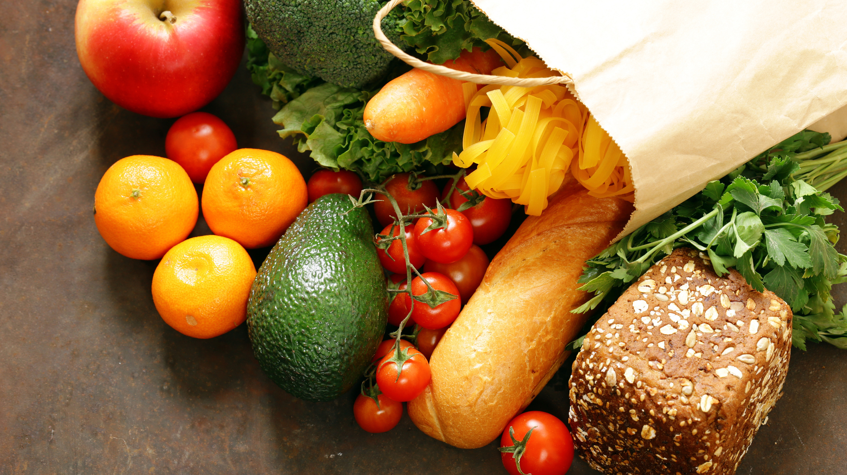
Thank you
The research team would like to thank the workshop attendees who shared their time and experience
with the project team as well as provided a valuable insight into the lived experience
of food insecurity and living with obesity.
Other themes relating to the UK food system were discussed and these are worth noting for future sessions. Supporting vulnerable shoppers or those with disabilities, exploring the needs of ethnic minority groups, and the role of community growing to support food access in the local environment.
Contact
The FIO Food Project
Website
Twitter: FIOFood
Professor Alex Johnstone
alex.johnstone@abdn.ac.uk
University of Aberdeen
Professor Flora Douglas
f.douglas3@rgu.ac.uk
Robert Gordon University

