Slide 1
Welcome to the Rowett Institute Health and Safety
Lead adviser - Dana Wilson dana.wilson@abdn.ac.uk
Deputy - Susan Hay s.hay@abdn.ac.uk
18 May 2021

Slide 2
Health and Safety Arrangements/Responsibilities
The Rowett Institute
dana.wilson@abdn.ac.uk
Notes:
All responsible for one anothers H&S

Slide 3
Key Safety Contacts
Lab Coordinators and local safety advisers
who can give general advice on safety in work area
Supervisors
who have more specific knowledge relating to your project
Other Advisers that you may require to see depending on your project
Biological Safety Adviser – Karen Scott
Radiation Protection Adviser – Dana Wilson
Genetic Manipulation Adviser - Bill Rees
The Rowett Institute
dana.wilson@abdn.ac.uk
Notes:
Important to meet other advisers before work starts

Slide 4
What to expect
What we provide for you
A safe working environment
Give you training to ensure that you are able to work competently and safely
Personal Protection Equipment (PPE)
What we expect from you
Follow local procedures
Work safely and show consideration to your co-workers
Ask advice if you are unsure of any procedure you have been asked to carry out
Discuss with your supervisor any changes to techniques you want to carry out and make sure that you risk assess the procedure before carrying out any work
The Rowett Institute
dana.wilson@abdn.ac.uk
Notes:
Any new technique should be written up and risk assessed prior to commencement of the work. The risk assessment process involves recording the significant risks that are not covered by standard laboratory precautions. Risk assessment should be recorded on the method, standard operating procedure or in a lab book if method development is occurring.

Slide 5
Biological hazards
Working with Human samples
Speak with biological safety adviser before any work starts
Risks from unscreened blood samples/fecal samples
Vaccinations are advised but are no substitute for working safely and competently
Follow code of practice for working with human samples
Use a microbiological safety cabinet if aerosols are likely to be formed
Get training
The Rowett Institute
dana.wilson@abdn.ac.uk

Slide 6
Working in a Laboratory
Basic Rules
Wear Howie lab coat and eye protection plus any additional PPE required for the task you are performing
No eating, drinking, chewing of pens, taking medicines, applying of cosmetics, touching of the mouth or face
Do not move around the building with gloves on both hands
Label all solutions clearly using tape or labels
Use the correct disposal route for waste
If in a doubt ask an experienced lab member for advice
Always wash your hands when leaving the laboratory
The Rowett Institute
dana.wilson@abdn.ac.uk

Slide 7
Chemical Contamination/Spills
Contamination of the body - flood the area with water for a minimum 10min - Emergency Showers
Contamination of the eye - irrigate with lots of water with the water running away from the good eye – Eye wash
Get first aid help as soon as possible
Find out where spill response kits are kept
Absorb and contain any spilt liquids
Collect all hazardous waste in a suitable sealed container for disposal
Be aware a Breathing Apparatus Team available to deal with major spillages
The Rowett Institute
dana.wilson@abdn.ac.uk
Notes:
Should be familiar with where safety showers are

Slide 8
First aid
Emergency situation
Dial 8686
Receptionist will respond immediately
You will be asked for your location and the nature of the injury. Location can be found on the card by every telephone
A first Aider will be sent to your location
Non Emergency situation
Dial 8701
Receptionist will answer the call
Ask for first aid assistance
You will be asked if you are able to go to the first aid room (2.043)
A first aider will be contacted to attend to you
Safe zone App
Available while on campus gives direct link to first aid help and
university security
The Rowett Institute
dana.wilson@abdn.ac.uk
Notes:
Cards by phones

Slide 9
Accidents/Near-misses
All accidents and near-misses should be reported using the online University reporting system
[Near-misses are where no injury has actually occurred but the incident/action could have resulted in an injury/ contamination or damage to equipment]
The aim of the reporting is to
Prevent future accidents
Helps to maintain a safe working environment
We should all be able to go home from work/study without having injured or damaged our health or wellbeing
The Rowett Institute
dana.wilson@abdn.ac.uk
Notes:
Important to record /learn from accidents and prevent accidents by acting on nearmisses

Slide 10
Fire Evacuation
On hearing a fire alarm you must leave the building immediately using the nearest fire exit and go to the Assembly point
Please note the main atrium stairs are NOT a fire evacuation route. Please take a moment to ensure you know your fire exit routes
If it safe to do so turn off electrical equipment, gas supplies and close doors behind you as you leave
If you discover a fire - raise the alarm by activating the break glass point
Do not enter the building if the alarm is sounding
Do not use the lift
(The fire alarm is tested every Wednesday at 9am - constant sound)
The Rowett Institute

Slide 11
Gas Alarm
When a detector is activated the beacon will flash and an intermittent alarm will sound. Leave the room immediately.
If it safe to do so turn off electrical equipment, gas supplies and close doors behind you as you leave
The gas alarm response team will be automatically contacted and will deal with the alarm
Do not enter any lab where an alarm is sounding or a “do not enter sign” is displayed on the door
You should return to your write up area or another laboratory until the event is dealt with.
NB These alarms can be heard in the write up areas if they are activated in the multiperson labs on levels 4 & 5 but do not require evacuation of the building. Alarm sounds- constant = Fire
- intermittent = Gas
The Rowett Institute

Slide 12
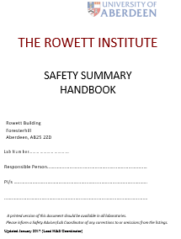
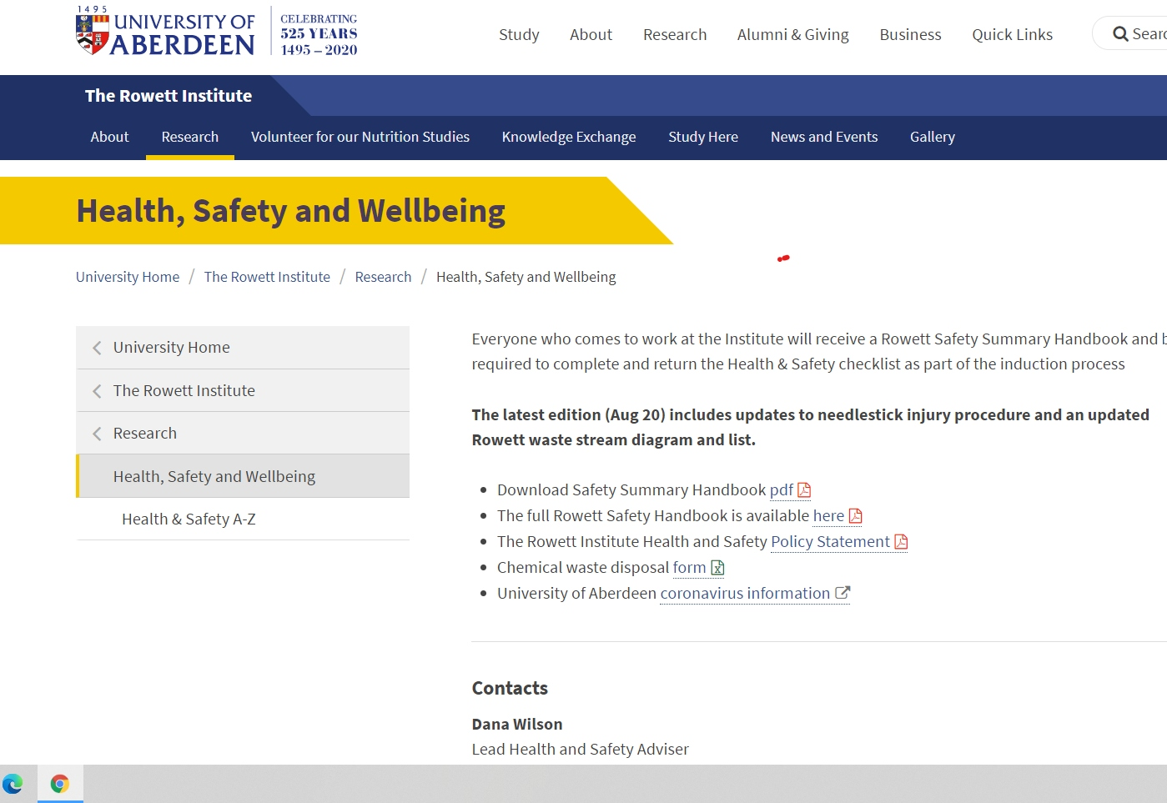
Information on Safety
Local Safety information should be available
Here we have it available online
Rowett Institute Safety Summary
All new starts will be issued with a copy

Slide 13
Wishing you a successful, enjoyable and safe time working in the Rowett Institute.
Contact details
Dana Wilson, Level 4, 4.037, dana.wilson@abdn.ac.uk
Susan Hay, Level 5, 5.059, s.hay@abdn.ac.uk
The Rowett Institute
dana.wilson@abdn.ac.uk

