Slide 1
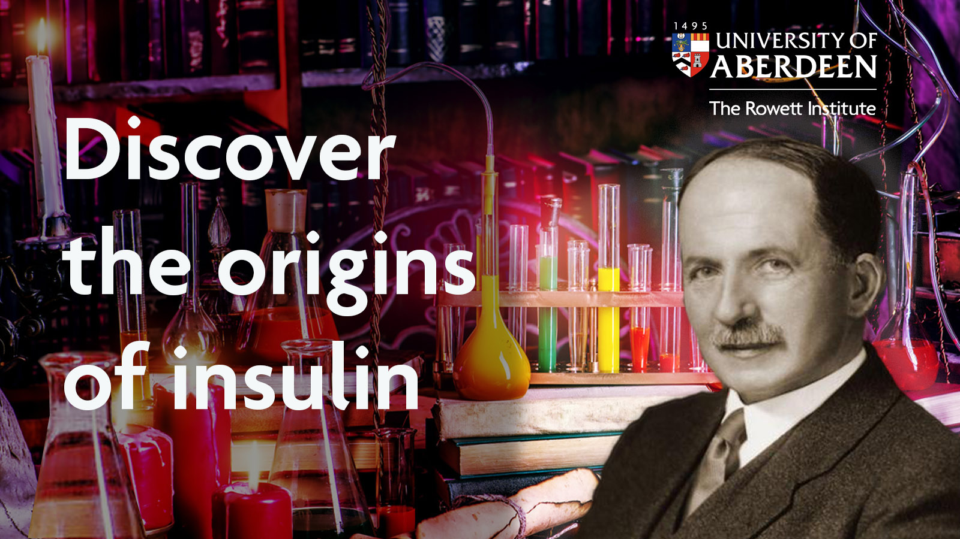

Slide 2


WELCOME
Join in the discovery
– let’s make history come alive!
www.abdn.ac.uk/rowett

Slide 3
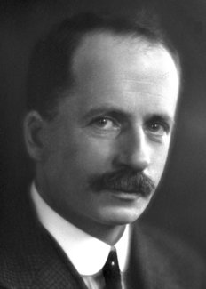
Discover the origins of insulin
Who was John Macleod?
To celebrate 100 years since the discovery of insulin, Aberdeen’s Rowett Institute invite you to explore the history of John Macleod.
www.abdn.ac.uk/rowett

Slide 4

Discover the origins of insulin
John Macleod was born in Scotland in 1876 and was jointly awarded a Nobel Prize for Physiology or Medicine in 1923 for the discovery of insulin.
www.abdn.ac.uk/rowett

Slide 5
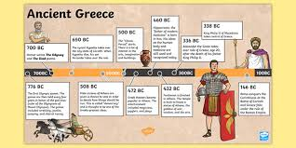
Explorathon’21 TechFest Schools Event: Timeline
Discover the origins of insulin
Can you create a timeline of the discovery of Insulin?
This important medical discovery has saved millions of lives!
You can use a big piece of paper or perhaps an ipad or device to design it
What is a Timeline? Look at the one on Ancient Greece for ideas!
100 years of Insulin A useful site for your research
www.abdn.ac.uk/rowett

Slide 6
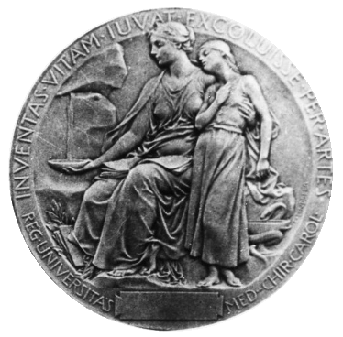
Discover the origins of insulin
Can you design your own medal?
Design your own Nobel Prize medal for Macleod who jointly received the 1923 Nobel Prize in Physiology or Medicine for the discovery of insulin. You will need paper and a pencil for this task.
Reverse side of the Nobel Prize medal for physiology or medicine
www.abdn.ac.uk/rowett

Slide 7
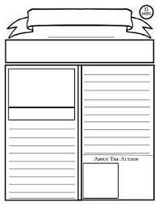
Discover the origins of insulin
Can you write a news article?
Being awarded a Nobel Prize is an amazing achievement!
Can you design the front cover of a newspaper to celebrate this?
Task: News Article
You need to plan your article carefully. Have a look at this link by the Press and Journal.
www.abdn.ac.uk/rowett

Slide 8



Explorathon’21 TechFest Schools Event: Twitter
Write your own ‘Tweet’ !
How would John Macleod respond in the 20th Century learning of his Nobel Prize achievement ?
Perhaps your teacher might like to share your best class tweet?
(You can use up to 280 characters, so it has to be short and eye catching!)
*Remember to tag @Rowett_abdn and @Dr_A_Johnstone
for your tweet!
Discover the origins of insulin
Write your own ‘Tweet’ !
How would John Macleod respond in the 20th Century learning of his Nobel Prize achievement ?
Perhaps your teacher might like to share your best class tweet? (You can use up to 280 characters, so it has to be short and eye-catching!)
Remember to tag @Rowett in your tweet!
www.abdn.ac.uk/rowett

Slide 9
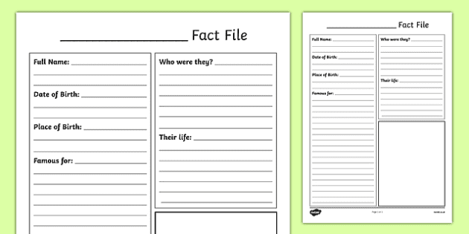
Explorathon’21 TechFest Schools Event: Interview John Macleod
Discover the origins of insulin
Can you research and find the main facts about John Macleod?
Where was he born?
Where did he study?
When did he return to Aberdeen?
What did he work as in Aberdeen?
When was he awarded the Nobel Prize?
John Macleod Biography
Use this link to research main events about his life and you can present it on paper or using your technology!

Slide 10
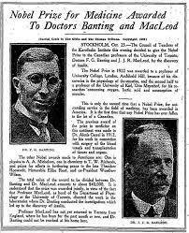
Discover the origins of insulin
What 3 questions would you ask John Macleod on the discovery of insulin in 1921?
Write or work with your peers to record what you think answers might have been or write them down!
Remember to use open questions and ask about his fantastic achievement of discovering insulin and his Nobel Prize.
Good ways to start your questions
How did you feel ?
When did you realise?
What was it like?
*Remember to do your research of John Macleod to
give accurate responses! *
www.abdn.ac.uk/rowett

Slide 11
Discover the origins of insulin
Now you have learned about John Macleod’s life and his contribution to Science, can you create a poster to tell your peers in school what you have learned?
A poster has to be eye catching, colourful, have clear text sharing the main points.
What stands out to you as being his main achievements?
Your poster ideas
www.abdn.ac.uk/rowett

Slide 12
Discover the origins of insulin
We gratefully acknowledge this preparation of this workshop as a team effort from :-
Jamie Drummond
Lynsey Cromar
Lisa Cromar
Annika Bucky
Dr Heidi Gardener
Margaret Johnstone
Pam Cummings
Pat Bain
Dr Julia Mitchell
Dr Russ Betney
TechFest Team
EXPLORATHON’21 Team
www.abdn.ac.uk/rowett

