Slide 1
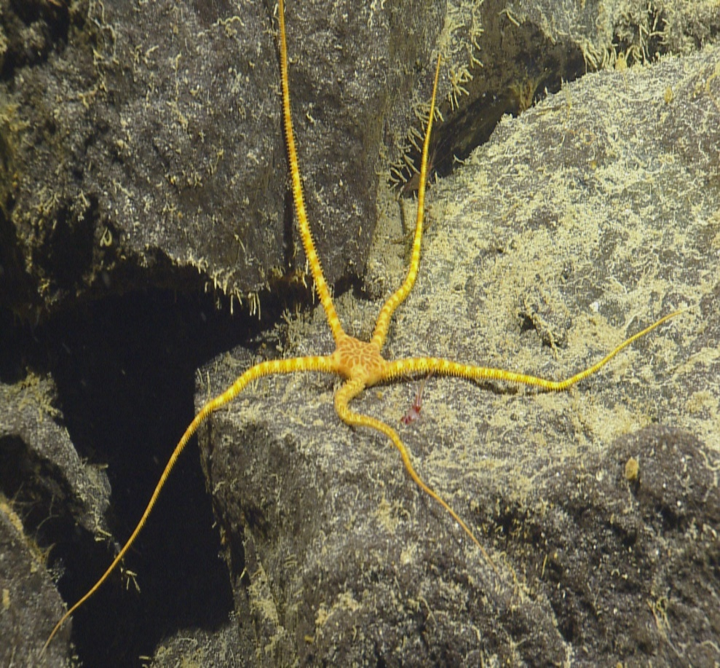


Marine Genetic Resources and Benefit sharing
Dr. Judith Gobin
Faculty of Science and Technology, Dept. of Life Sciences, University of the West Indies

Slide 2
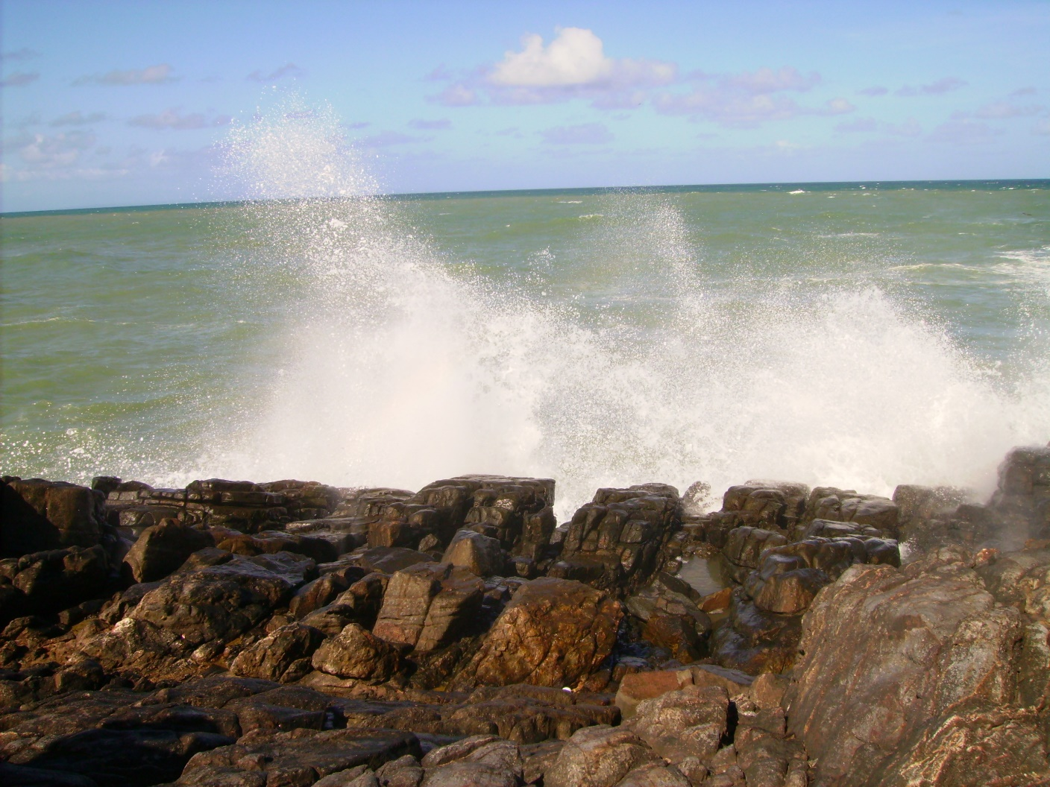
POTENTIAL BENEFITS of MGRs
Pharmaceuticals (drugs, cosmetic products)
Biomaterials – bioplastics, biopaints, anti-fouling,
Industrial bio-processes - enzymes, solutions,
Novel species aquaculture (microalgae),
Biorefineries and CO2 capture - microalgae;
Agricultural pest control and fertilizers (bioactive materials)

Slide 3
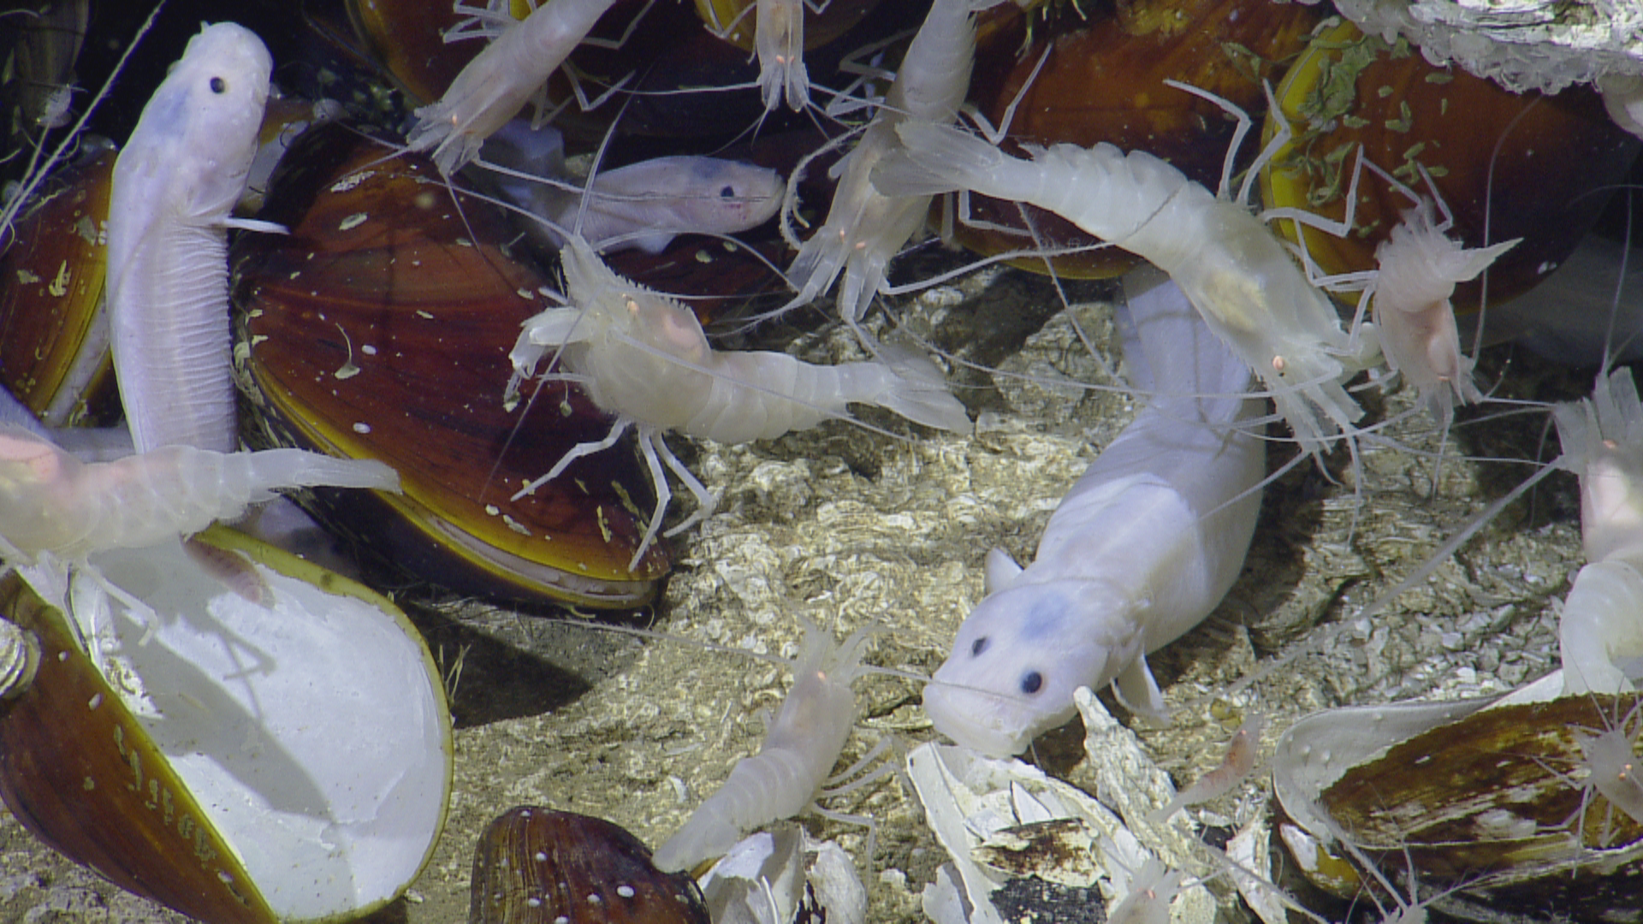
Benefits
Global access to material
Global access to metadata (includes biological data)
Sharing of sequence data, Biochemical data
Scientific publications and authorship
Potential monetary benefit-sharing

Slide 4
Benefits- with challenges
Small universities, museums and institutions- particularly vulnerable to accessing/using the data
Data storage- IT infrastructure will need to be significantly improved; big data storage and analysis requiring new approaches to information architecture
Data analysis – computationally demanding significant advances in data analyses approaches needed
Commercialization (monetary benefits) of marine biotechnology products- takes a long time

Slide 5
Benefit sharing is cross-cutting
Development of research clusters - assists in achieving internal & external integration (industry, government research institutes & universities etc.)
Promote & expand training & career opportunities for scientific research, policy & industry
Research training & the transfer or exchange of knowledge or marine technology
Capacity Building- Financing/Funding eg. scholarships, training workshops, exchange research visits
Includes both scientific & technical eg.IT
Educational & institutional capacity-building to more specific training (MGRs specific)

Slide 6
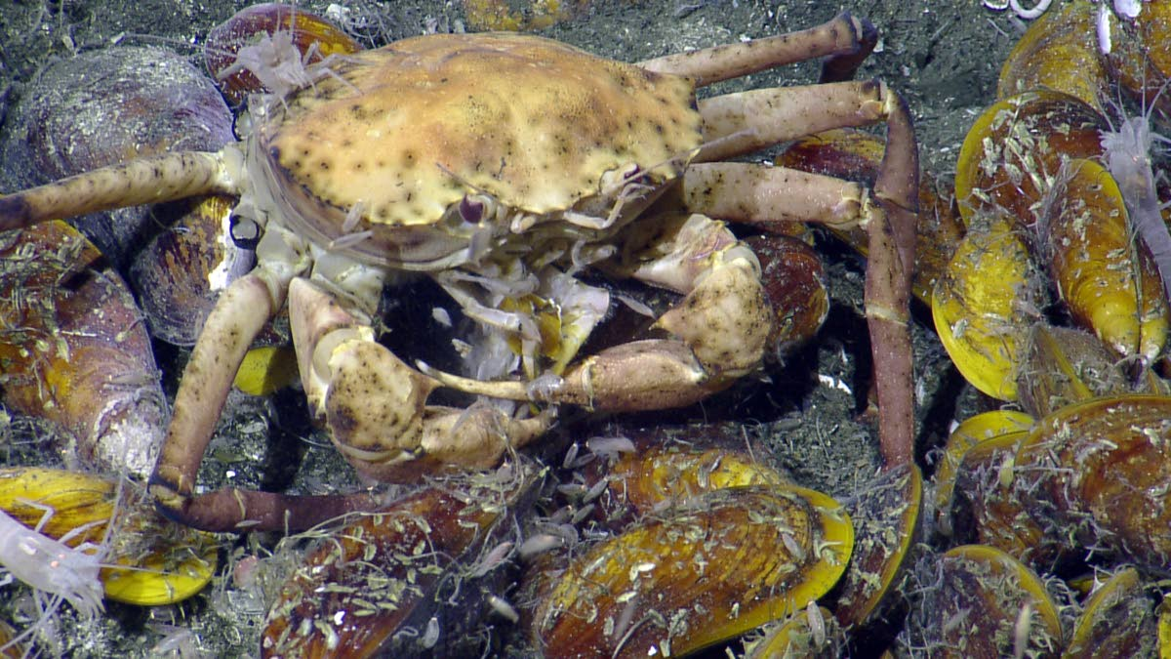
SIDs – special considerations
Unknown biodiversity (Deep sea & ABNJ)
Increase research opportunities
Increase numbers of trained marine scientists (including MGR /Biotechnology experts)
Big data storage and analysis

Slide 7
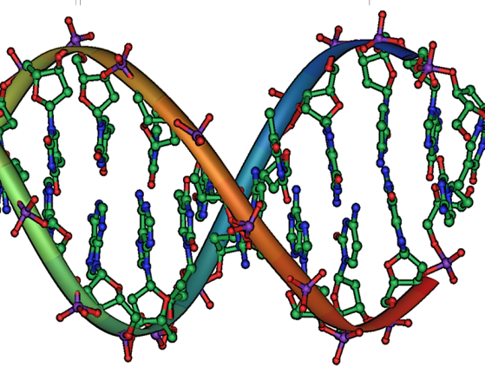
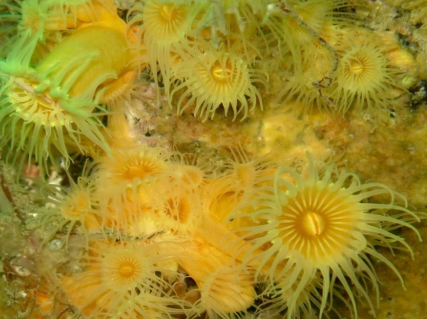
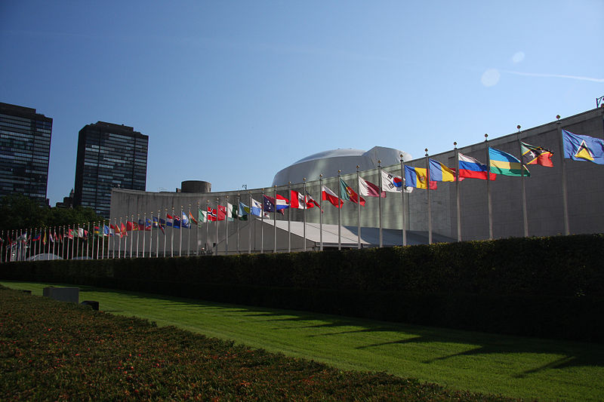
DOSI Deep-Sea Genetic Resources Working Group
GOAL
  Explore and identify options to conserve and sustainably use deep-sea marine genetic resources (MGR)
  Including access and benefit sharing of marine genetic resources in areas beyond national jurisdiction (ABNJ)
Support deep-sea marine scientific research in ABNJ
Enhance international cooperation in marine scientific research in ABNJ
Facilitate open-access sharing of deep-sea biological data, samples and knowledge.
Avoid excessive bureaucratic burdens that could hamper marine scientific research.
Improve marine scientific research capacity building of SIDs
Build on best-practice in deep-sea scientific research for accessing MGR in ABNJ
Support mechanisms that facilitate the sharing of expertise and methodologies, international cooperation for access to research vessels, equipment and other resources as well as costs of undertaking research and support capacity development through increased opportunities to participate in research cruises.
Image credits: Michael Ströck via Wikimedia Commons (top); H Harden-Davies, 2016 (middle); Shealah Craighead, 2006, via Wikimedia Commons (bottom)
Notes:
CONTEXT:
MGR one of the key issues for the development of a new agreement for the conservation and sustainable use of marine biodiversity in ABNJ (65% ocean surface) under the UN Convention on the Law of the Sea.
First Preparatory Committee meeting to take place in March 2016.
KEY ISSUES:
Many potential uses of genetic resources
Gaps in international legal framework
Need to support biodiversity conservation, share non-monetary & monetary benefits, and facilitate scientific research
Questions relating to access and sharing of to samples, data, information, capacity building, and international cooperation
Scientific community key actor
DOSI working group:
Leadership: Kristina Gjerde, Harriet Harden-Davies, Elva Escobar
Members: 70

Slide 8
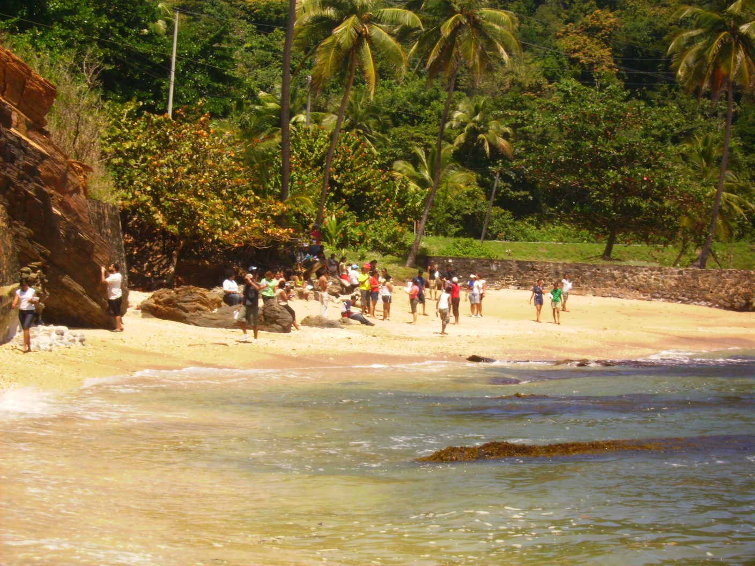
Thank you

