Slide 1
Pre-Assessment and Pain
Synchronous Online Session
Dr Iona Campbell Teaching Fellow

Slide 2
Introductions
Dr Laurin Allen Consultant
Dr Veena Chapgoan Specialty trainee
Dr Sophie Pitts Core Trainee
Dr Iona Campbell Post Core Trainee/ Teaching Fellow

Slide 3
Plan
1 hour pre-assessment
1 hour pain tutorial
Ground Rules, respect, collaboration…ask questions!
Moderated chat

Slide 4
Pre-Assessment Learning Outcomes
To understand the types of surgery and pre-operative investigations
To understand the ASA scoring system and implications for pre-operative assessment
To understand the reasons for optimising existing health conditions prior to surgery

Slide 5
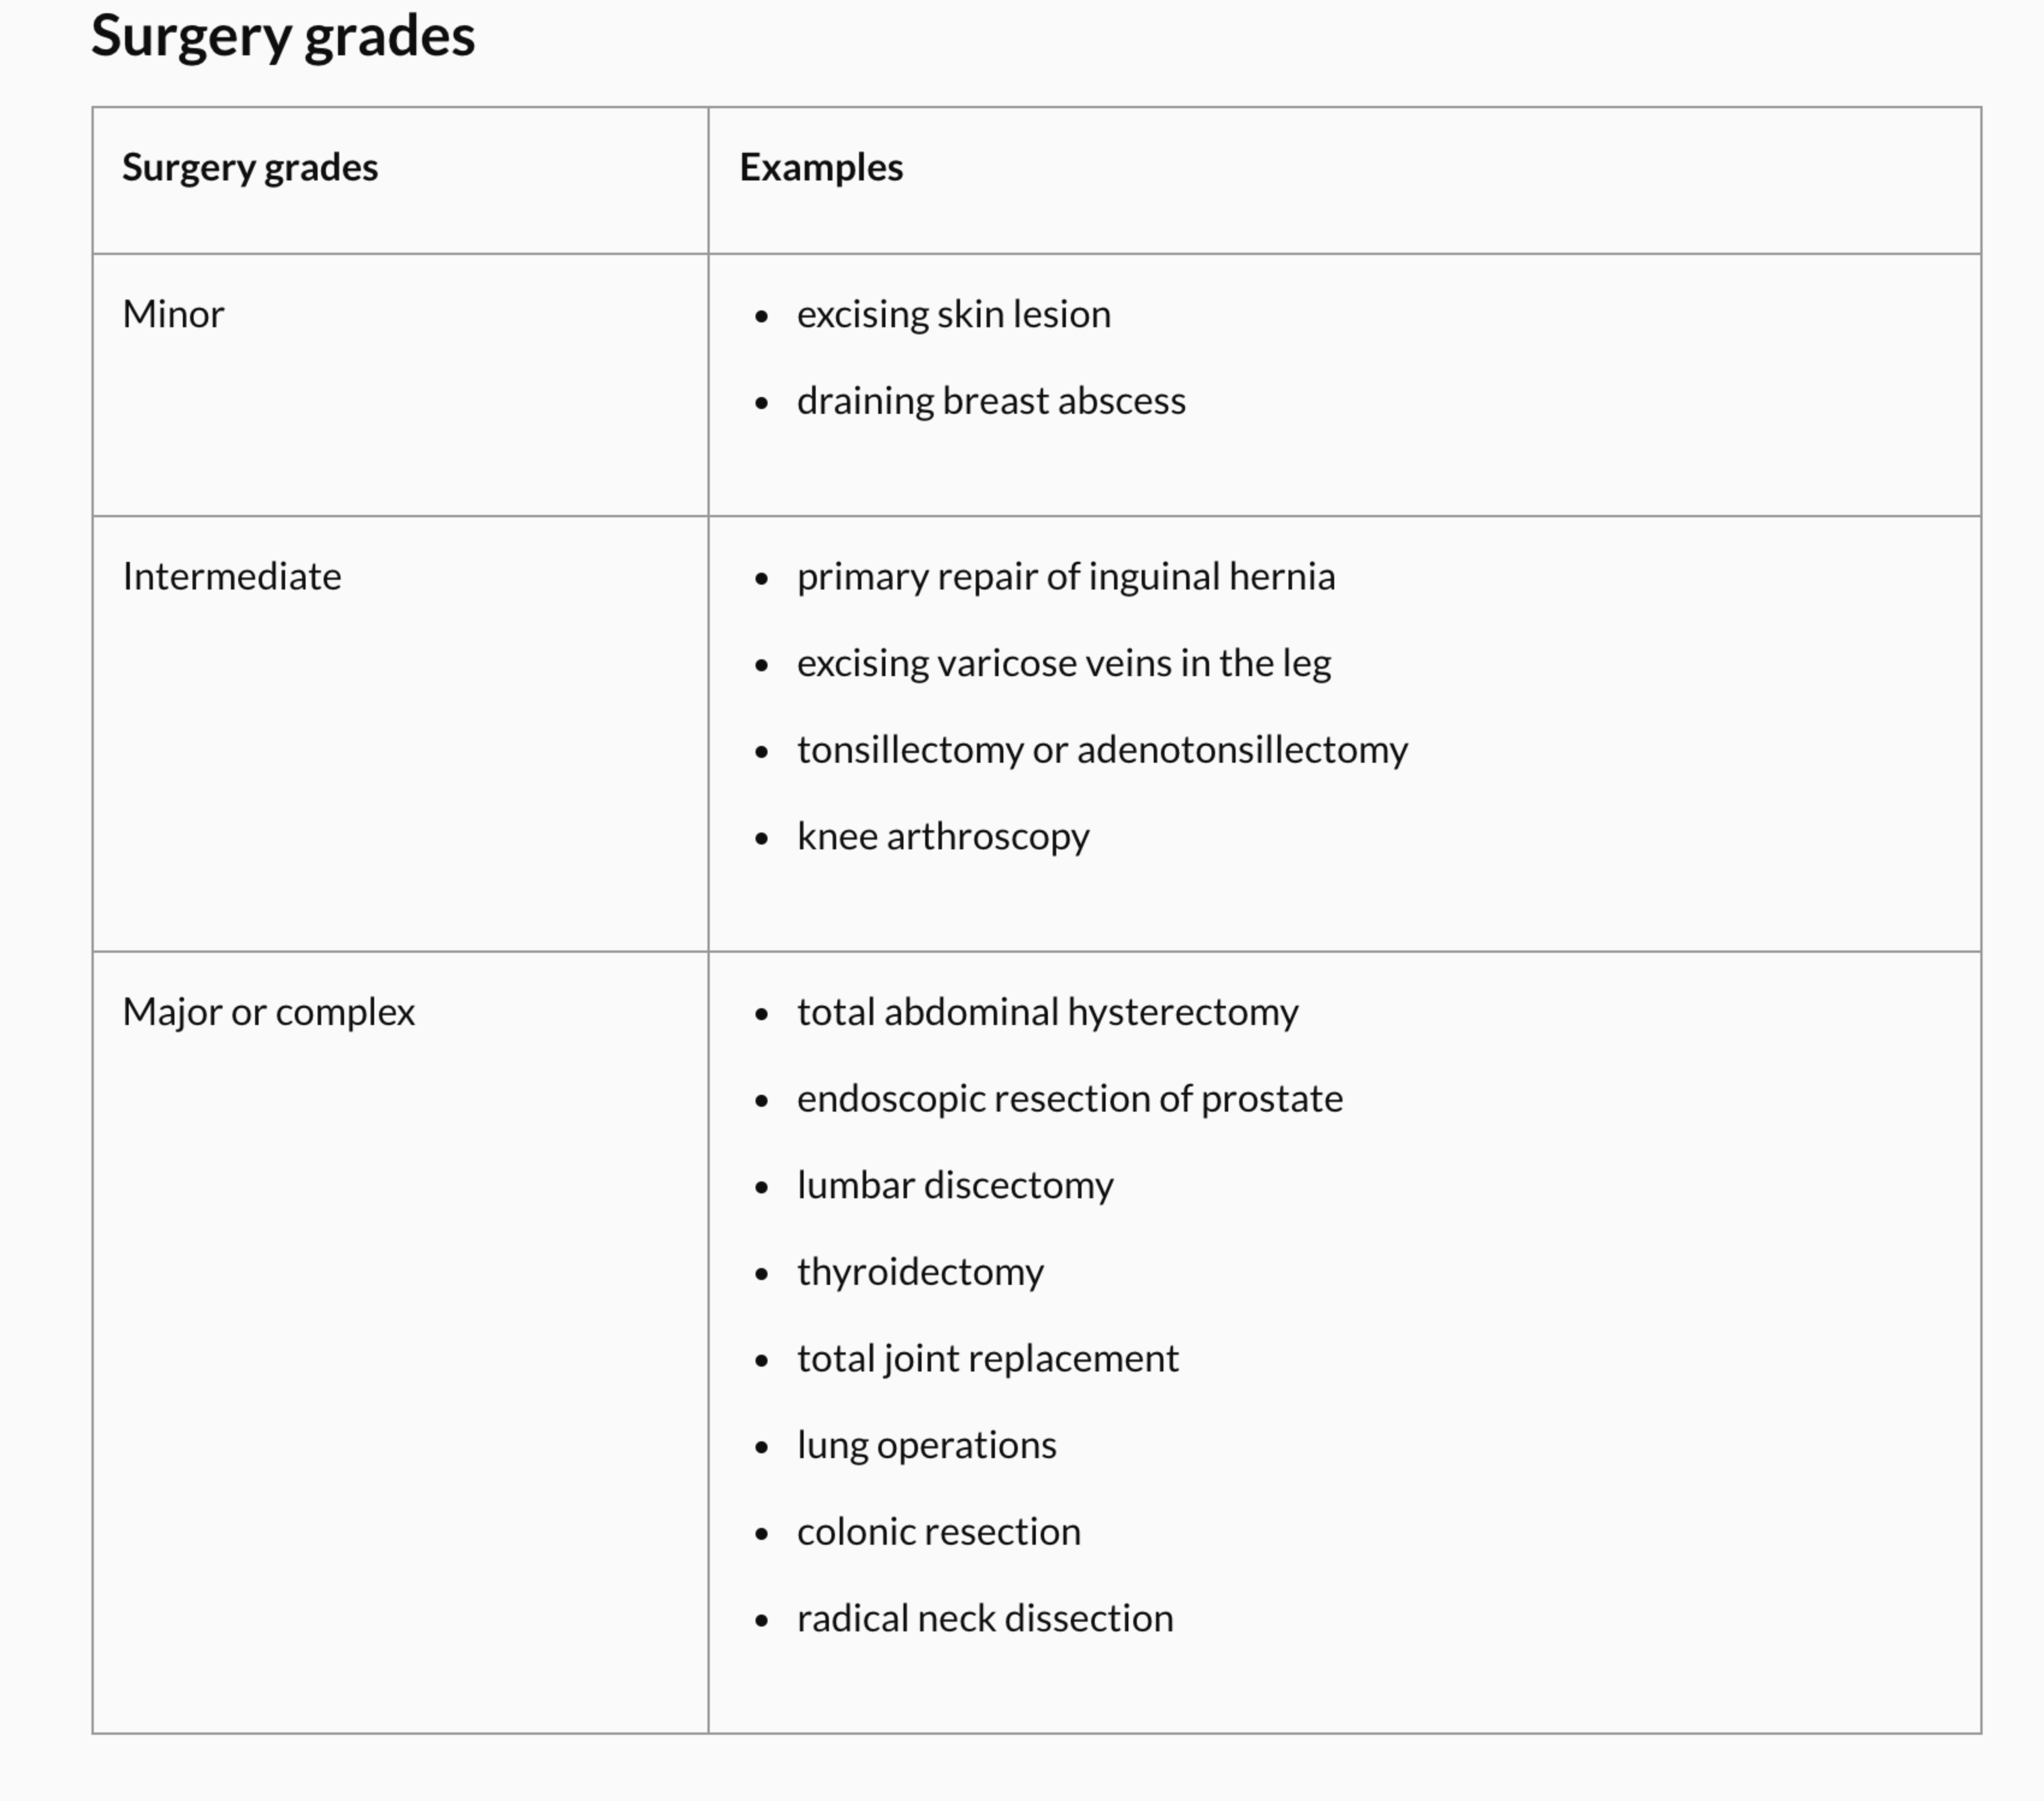
Type of Surgery?
Notes:
Get the students to think about the implications of type of surgery and investigations for minor/intermediate/major or complex surgeries.
Surgery can be routine but major and rare but minor.

Slide 6
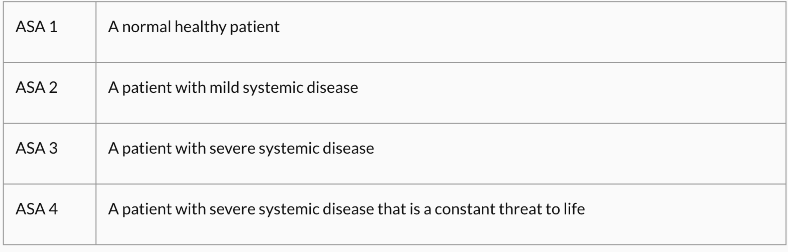
ASA Score

Slide 7
Breakout Groups
Assign a spokesperson and put their name in the group chat
Work through the questions
Discuss as a group
Moderates will drop in

Slide 8
Questions to Consider
What is the type of surgery?
What is this patient’s current ASA score?
Is this patient currently fit for surgery?
What needs to happen next for the patient?
Why do we need to pre-assess carefully? What complications could happen in this patient?

Slide 9
PLEASE INSERT ‘POAC’ DOCUMENT HERE

Slide 10

BREAK TIME

Slide 11

Post Operative Pain Relief

Slide 12
Pain Learning Outcomes
To be aware of analgesia options in joint replacement surgery
To consider analgesia options in a patient already taking analgesia pre-operatively.

Slide 13
Patient Journey
Bill has now had his surgery and you’re the FY on in Woodend Hospital. The nursing staff have asked you to review him as he is complaining of pain.
You have a copy of his Kardex (MyMBCHB file)

Slide 14
Opiate Conversions
Pre-Operative 30mg QDS codeine – 120mg/day
= 12 mg oral morphine
= 4mg IV morphine

Slide 15
Questions to Consider
What questions will you ask for post-operative pain review?
What pain relief could be prescribed?
What are non-pharmacological treatment options?
How do you explain your plan to the patient?
What pain relief should Bill have to go home?

Slide 16
PLEASE INSERT ‘KARDEX’ FILE HERE

Slide 17

Single Best Answer Questions

Slide 18
June, a 60-year-old lady is being listed for a wide local excision of breast cancer diagnosed at routine mammography. She has a background of type 2 diabetes, which is diet controlled. Here HbA1c is 65. She is allergic to codeine which causes nausea and vomiting.
What is the correct combination of ASA score and type of surgery?
ASA 1, Minor surgery
ASA 1, Moderate Surgery
ASA 2, minor surgery
ASA 1, Major surgery
ASA 2, moderate surgery

Slide 19
June, a 60-year-old lady is being listed for a wide local excision of breast cancer diagnosed at routine mammography. She has a background of type 2 diabetes, which is diet controlled. Here HbA1c is 65. She is allergic to codeine which causes nausea and vomiting.
What is the correct combination of ASA score and type of surgery?
ASA 1, Minor surgery
ASA 1, Moderate Surgery
ASA 2, minor surgery
ASA 1, Major surgery
ASA 2, moderate surgery

Slide 20
You are working on the general surgery ward, Mrs Pavel has undergone bowel resection due to obstruction yesterday. She has an NG tube in situ due to ongoing vomiting. She is complaining of severe pain across her abdomen. What is the most appropriate pain relief strategy?
Oral/NG 1 gram paracetamol and oral morphine 10 mg
IV 1 gram paracetamol and oral morphine 10mg
IV 1 gram paracetamol and IV morphine titrated to effect
Oral/NG 1 gram paracetamol and IV morphine titrated to effect
IV 1 gram paracetamol and 5mg IV morphine bolus

Slide 21
You are working on the general surgery ward, Mrs Pavel has undergone bowel resection due to obstruction yesterday. She has an NG tube in situ due to ongoing vomiting. She is complaining of severe pain across her abdomen. What is the most appropriate pain relief strategy?
Oral/NG 1 gram paracetamol and oral morphine 10 mg
IV 1 gram paracetamol and oral morphine 10mg
IV 1 gram paracetamol and IV morphine titrated to effect
Oral/NG 1 gram paracetamol and IV morphine titrated to effect
IV 1 gram paracetamol and 5mg IV morphine bolus

Slide 22
Mr Singh has undergone fixation of his broken ankle which he sustained playing football. He didn’t take any pain killers prior to his injury. He is taking regular paracetamol and dihydrocodeine last required breakthrough pain relief yesterday. He is ready to be discharged home after passing a physiotherapy assessment. What is the best analgesia plan for this patient?
Paracetamol and dihydrocodeine regularly with breakthrough dihydrocodeine
Ibuprofen alone
Paracetamol and ibuprofen regularly
Paracetamol and regular oral morphine solution
Paracetamol and regular long-acting morphine with breakthrough oral morphine solution

Slide 23
Mr Singh has undergone fixation of his broken ankle which he sustained playing football. He didn’t take any pain killers prior to his injury. He is taking regular paracetamol and dihydrocodeine last required breakthrough pain relief yesterday. He is ready to be discharged home after passing a physiotherapy assessment. What is the best analgesia plan for this patient?
Paracetamol and dihydrocodeine/ibuprofen regularly with breakthrough dihydrocodeine
Ibuprofen with paracetamol breakthrough
Paracetamol and ibuprofen regularly
Paracetamol and regular oral morphine solution
Paracetamol and regular long-acting morphine with breakthrough oral morphine solution

Slide 24
Resources Used
https://southwest.devonformularyguidance.nhs.uk/documents/Formulary-documents/Pallative-Care/Guide_to_equivalent_doses_for_opioid_drugs_Dec-2014.pdf
Pain service guidance https://rcoa.ac.uk/gpas/chapter-11
https://www.bjanaesthesia.org.uk/article/S0007-0912(19)30435-0/pdf

Slide 25
Resources
NICE Pre-Operative Assessment Guidelines https://www.nice.org.uk/guidance/ng45
Association of Anaesthetists Guidelines https://rcoa.ac.uk/sites/default/files/documents/2019-09/Guideline_preoperative_assessment_patient_preparation_anaesthetist_2010_final.pdf
Management of BP : https://anaesthetists.org/Home/Resources-publications/Guidelines/Measurement-of-adult-blood-pressure-and-management-of-hypertension-before-elective-surgery
Diabetes Guidelines https://www.diabetes.org.uk/resources-s3/2017-09/Surgical%20guideline%202015%20-%20summary%20FINAL%20amended%20Mar%202016.pdf

