Slide 1



NoS Trauma Network Event 2019

Slide 2
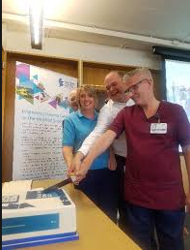
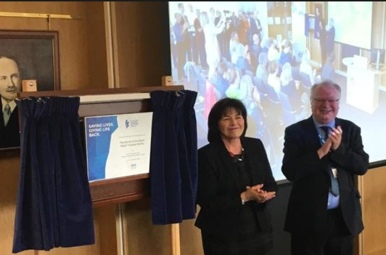
NoS Trauma Network ‘Go Live’
1st October 2018

