Slide 1



EMRS North
Alastair Ross
Clinical Lead
ScotSTAR Emergency Medical Retrieval Service (North)

Slide 2
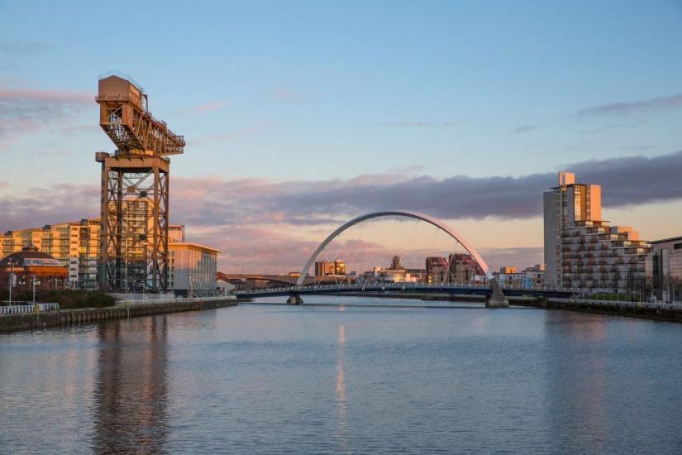
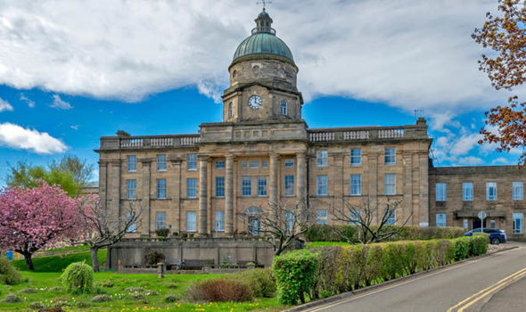
Introduction

Slide 3
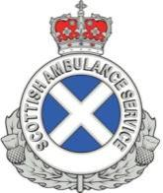

The Organisation
Neonates
Scottish Neonatal Transport Service
Paediatrics
SNPRS
“Adults”
EMRS
Glasgow
Edinburgh
Glasgow
West
Glasgow
North
Aberdeen
Aberdeen

Slide 4
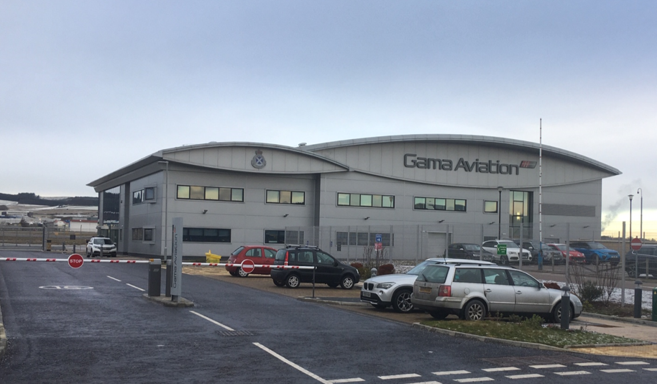
ScotSTAR North
EMRS North
Neonates

Slide 5
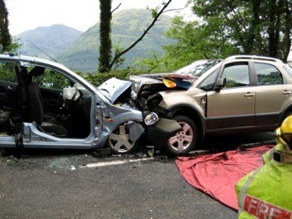
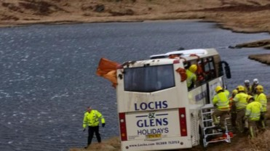
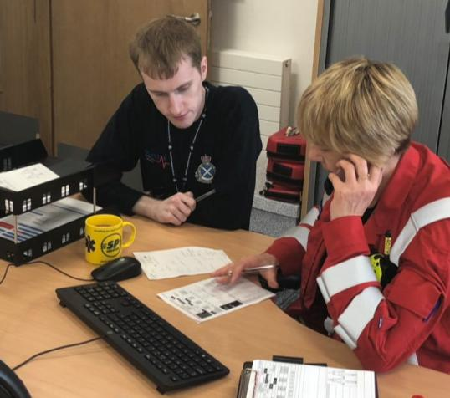
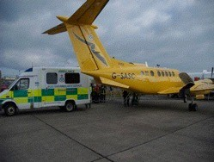
EMRSN Roles
Primary
Secondary
Advice
Major Incident Response

Slide 6
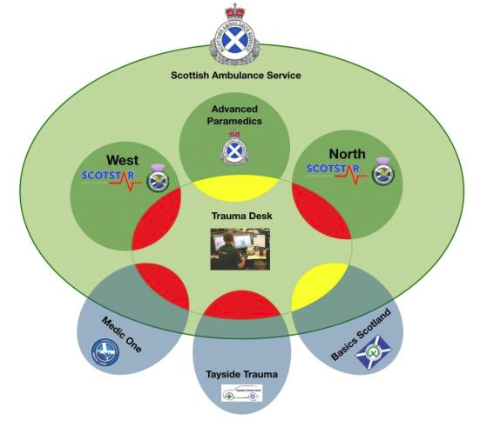
Pre-hospital trauma care

Slide 7

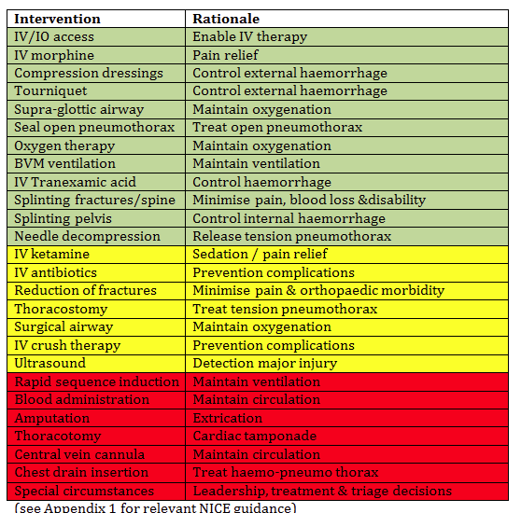
Pre-hospital trauma care
Pre-hospital anaesthesia
Blood
Amputation
Thoracotomy
Central vein cannulation
Chest drain insertion
Leadership, treatment & triage

Slide 8
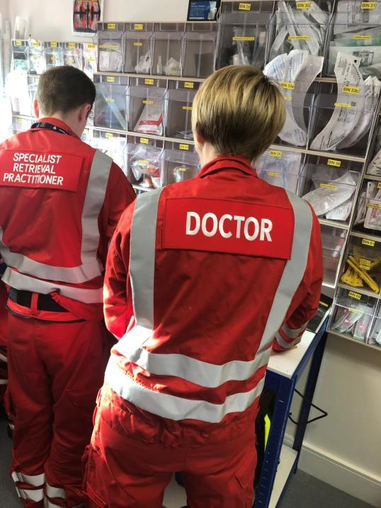
Who are EMRSN?

Slide 9
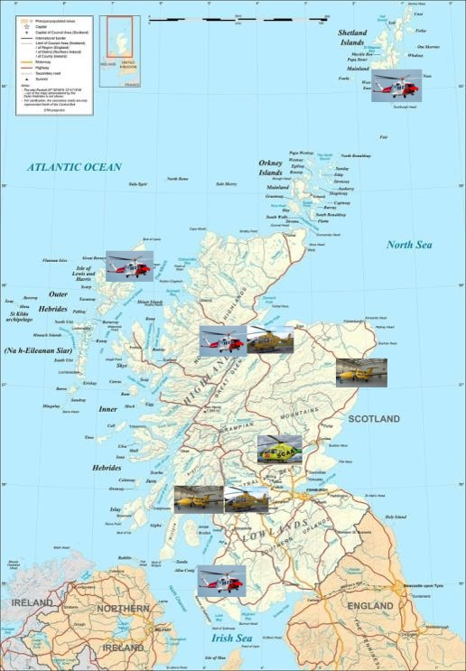
Air Ambulance Service
Geography & Activity
Air Ambulance (SAS)
Fixed wing aircraft:
Aberdeen
Glasgow
Rotary Assets:
Glasgow
Inverness
Charity Helicopters
Perth
(Aberdeen)
Coastguard Assets
Stornoway
Shetland
Inverness
Prestwick
Notes:
Occupy 32% that of UK – 80,000 sq KM
5m people
Most mountainous part of UK
9900km of coastline
750 islands
Limited transport infrastructure
Guess activity – just under 4000 missions (ScotSTAR accounts for around 15% of air movements) – not all by air

Slide 10
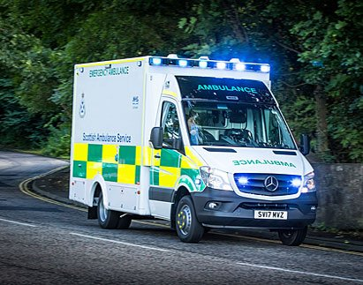
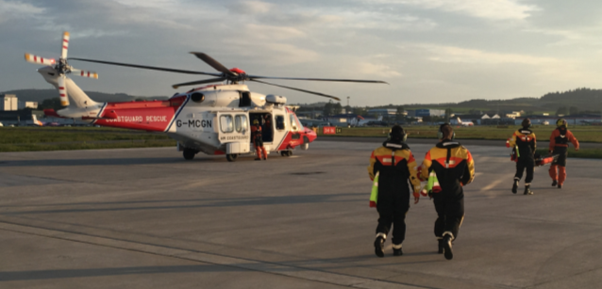

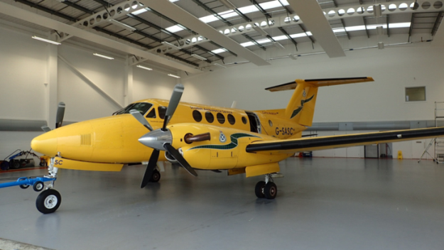
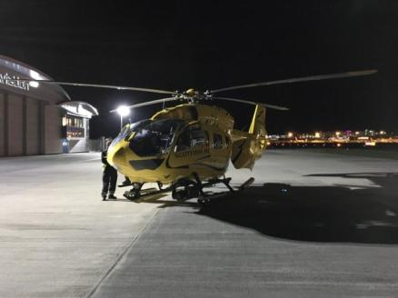
Travel

Slide 11
How did we get here?

Slide 12
EMRS history
Pre-2004
Ad hoc retrievals from SGH
Oct 2004
Voluntary service in Argyll
June 2007
SGDH propose funded pilot
June 2008
18 month West coast pilot starts
Nov 2010
All Scotland service starts
Oct 2015
ScotSTAR, Glasgow airport

Slide 13
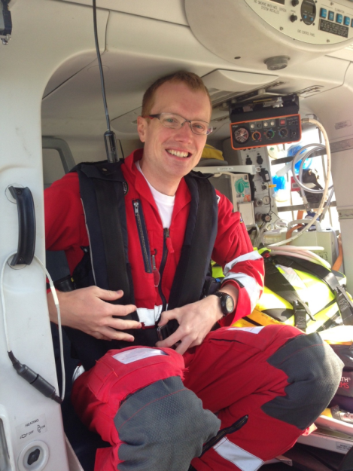
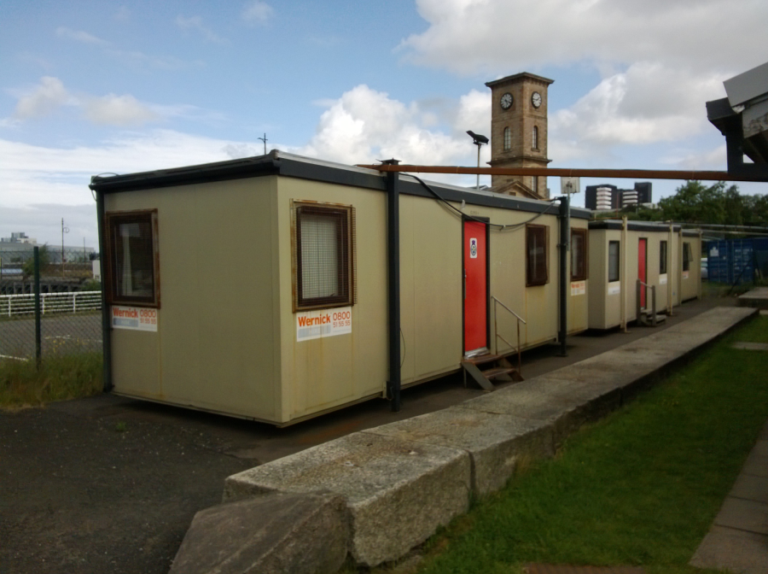
Glasgow 2013

Slide 14
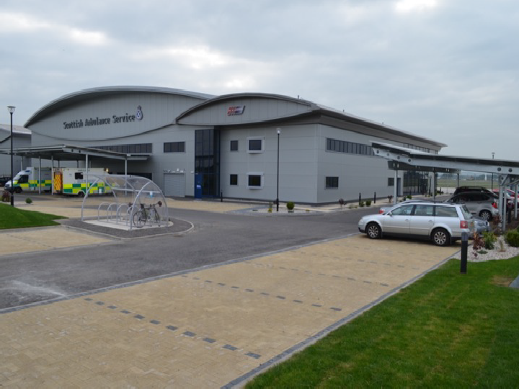
Glasgow

Slide 15
Timeline
£1.1 Million funding via Trauma Network from April 19
August 2018 - Aberdeen confirmed as location
Nov 18 Project manager Appointed- Steve Munro
December 18- Consultants Interviewed

Slide 16
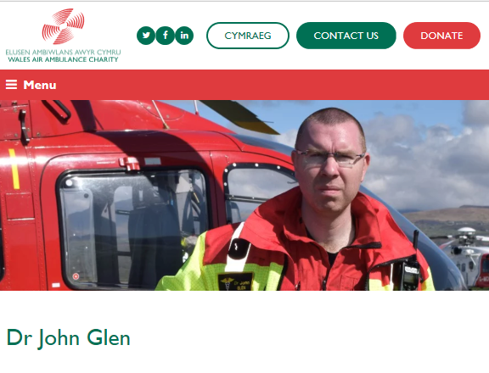

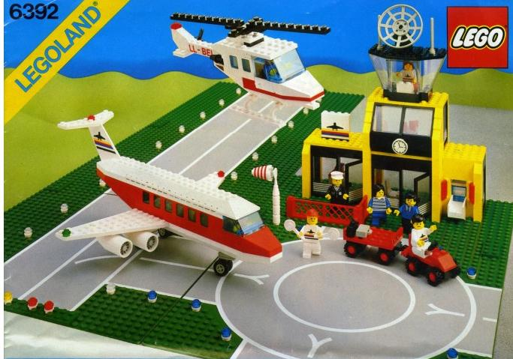
What now?

Slide 17


Slide 18
Priorities
People
Procedures
Equipment / consumables
  At least 400 products
Training

Slide 19
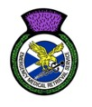

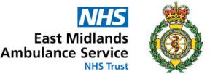







Collaborative

Slide 20
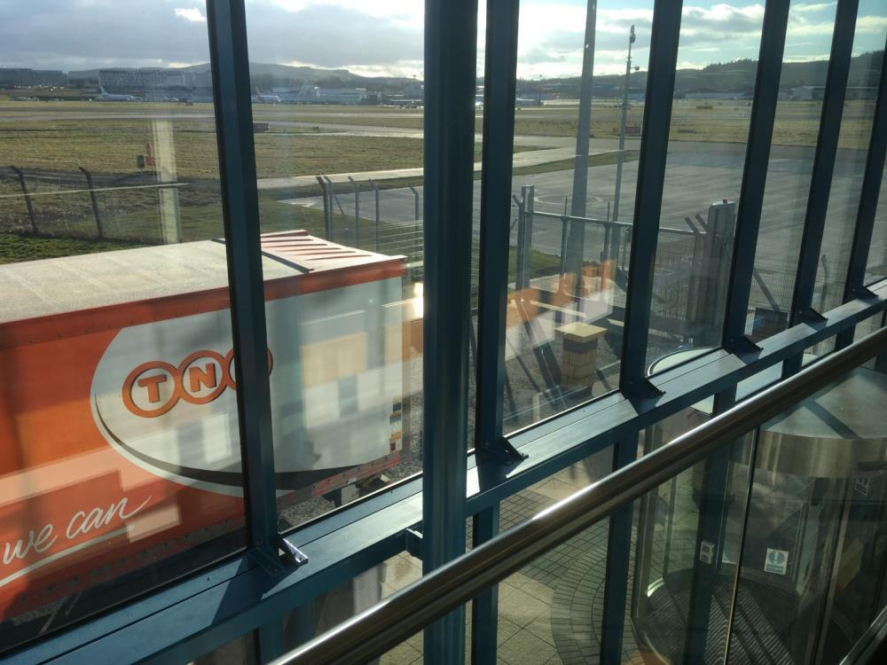
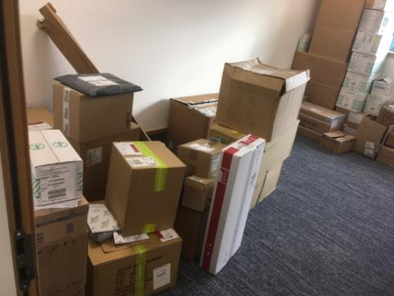
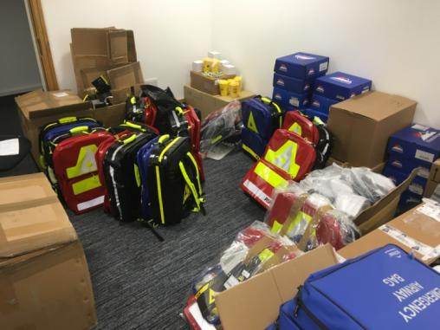
5th March

Slide 21
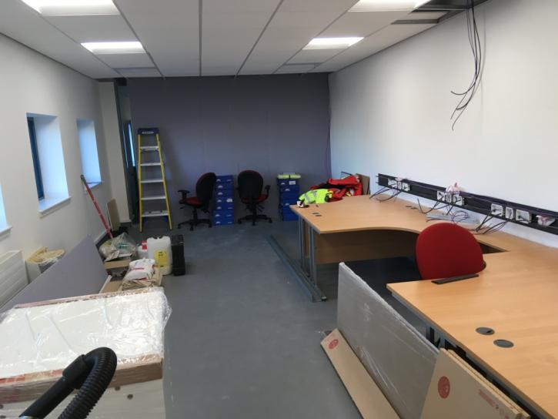
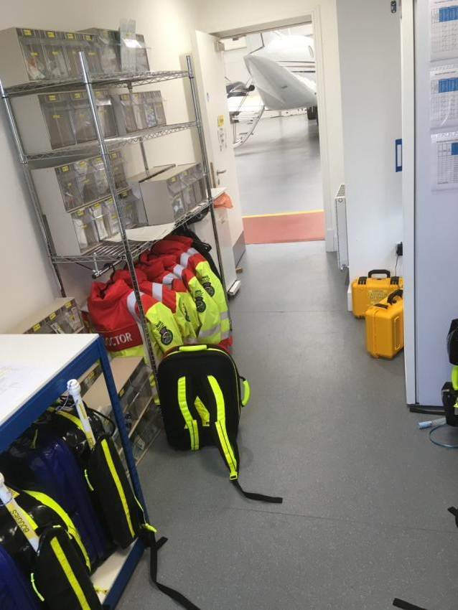
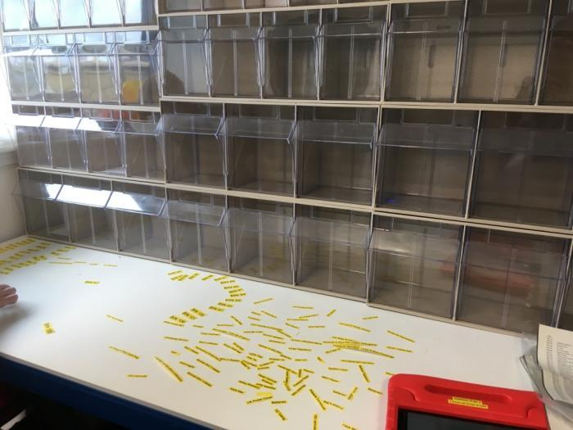
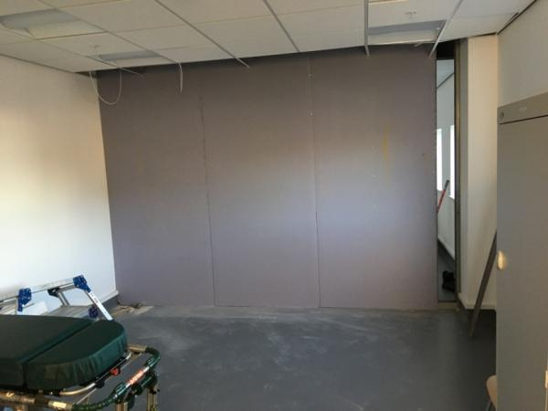
Infrastructure

Slide 22
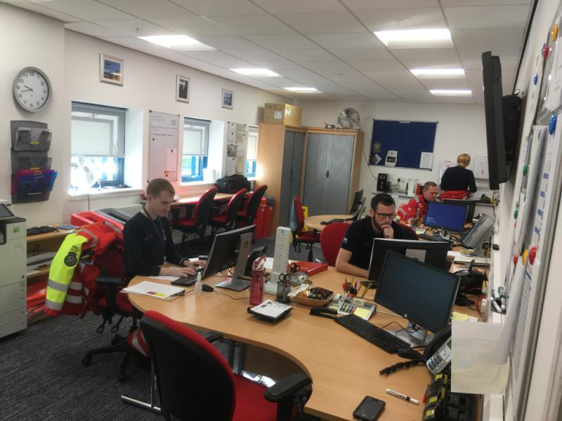
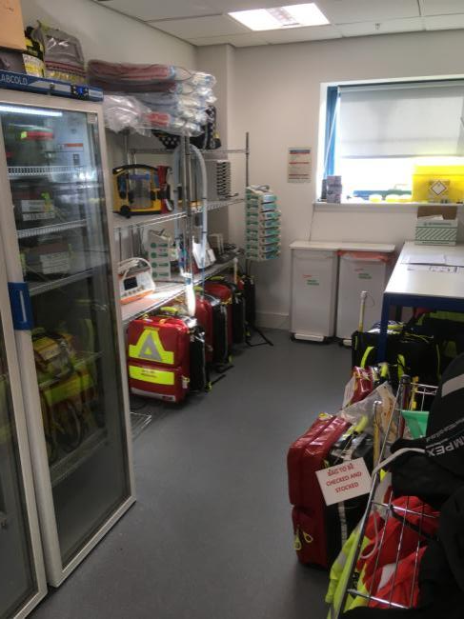
Now

Slide 23
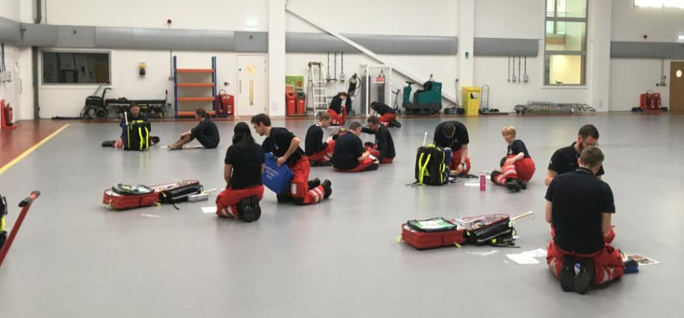
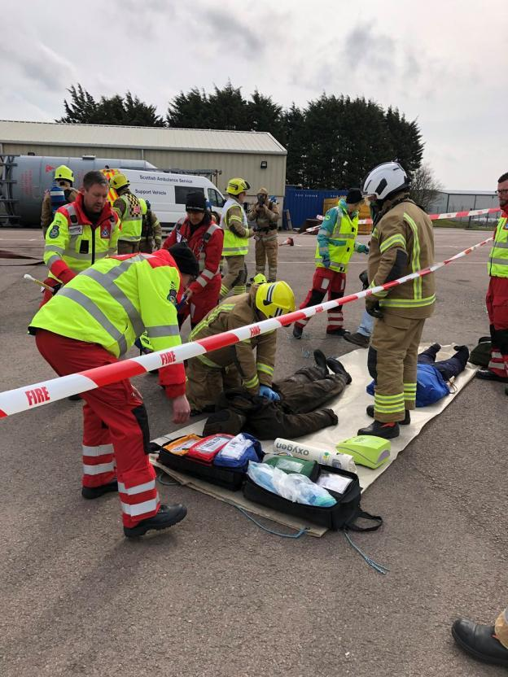
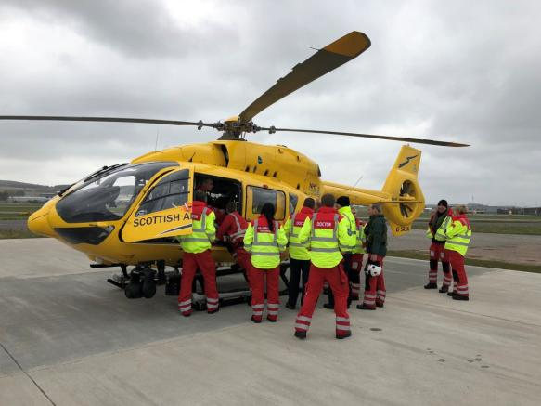
Training

Slide 24
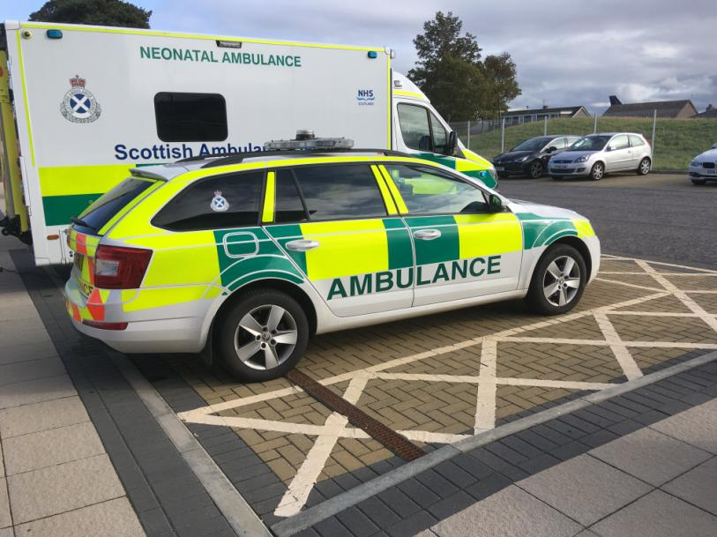
Go-live 23rd April

Slide 25
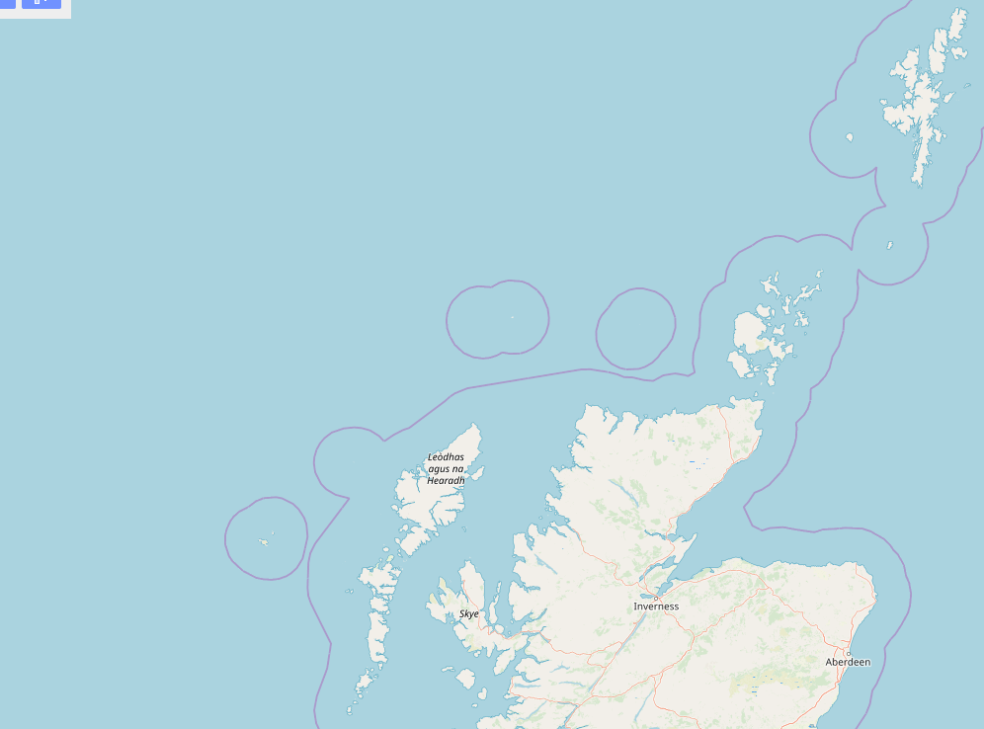



MTC
TU
LEH
GP Hospital

Slide 26
5 months Activity
60 Primary Missions (13 stood down 22%)
40 Advice Calls
76 Secondary Missions
Referring Site | North | West
Elgin | 30
Wick | 14 | 3
Orkney | 12
Raigmore | 10 | 2
Shetland | 8
Ninewells | 1

Slide 27
Case Example
  Saturday Night
  Fall from height – Chest / Abdo / Pelvis injury
  Call via trauma transfer line- SSD / Referrer / EMRSN / MTC SPOC
  EMRSN Deploy by fixed wing
  Second patient from same site- team work with local clinicians to stabilise second patient and prioritise for transfer
  Further discussion with SPOC
  EMRS West activated
  Both patients transferred

Slide 28


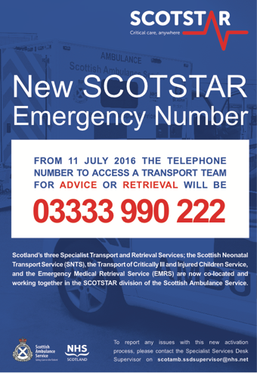



For North Major Trauma Patients-
03333 990 249

Slide 29
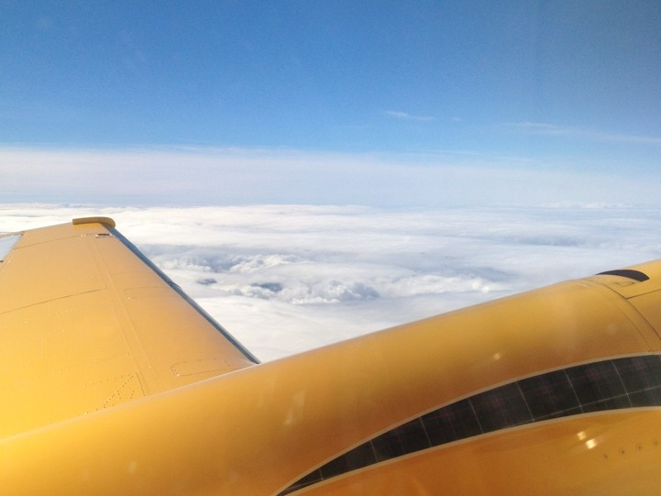
Upcoming
Clinical Governance Meeting 20th December 1330 VC Links
Liaison visits

Slide 30
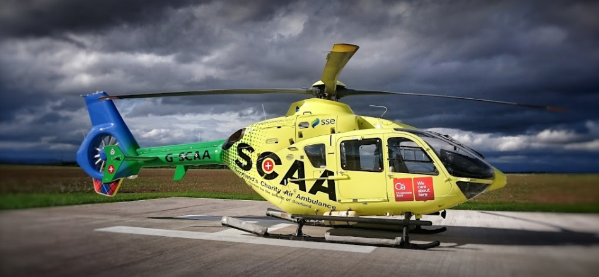
Next steps

Slide 31
Summary
New red primary response in North of Scotland
Increased national secondary transfer capacity
National major incident response
North / West cross cover provides enhanced resilience
Enhanced service for patients across all of Scotland

Slide 32
Questions?

Slide 33
