Slide 1
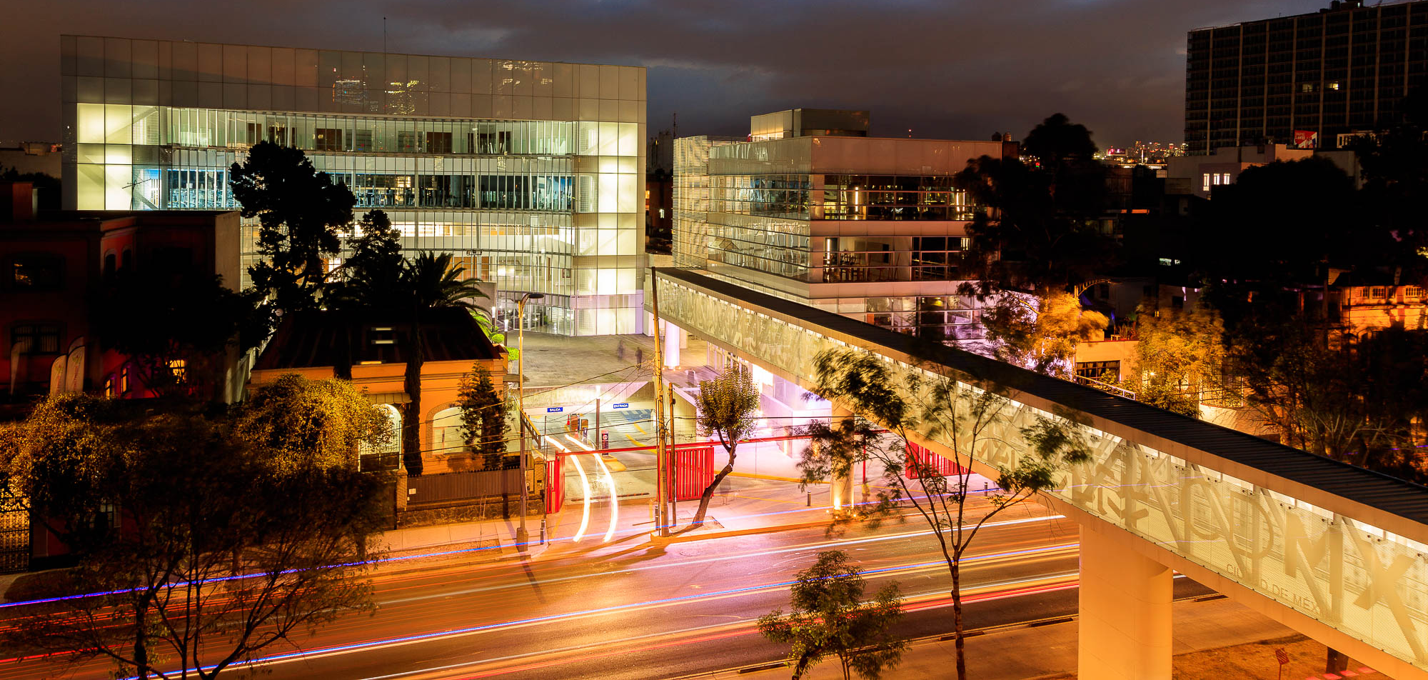
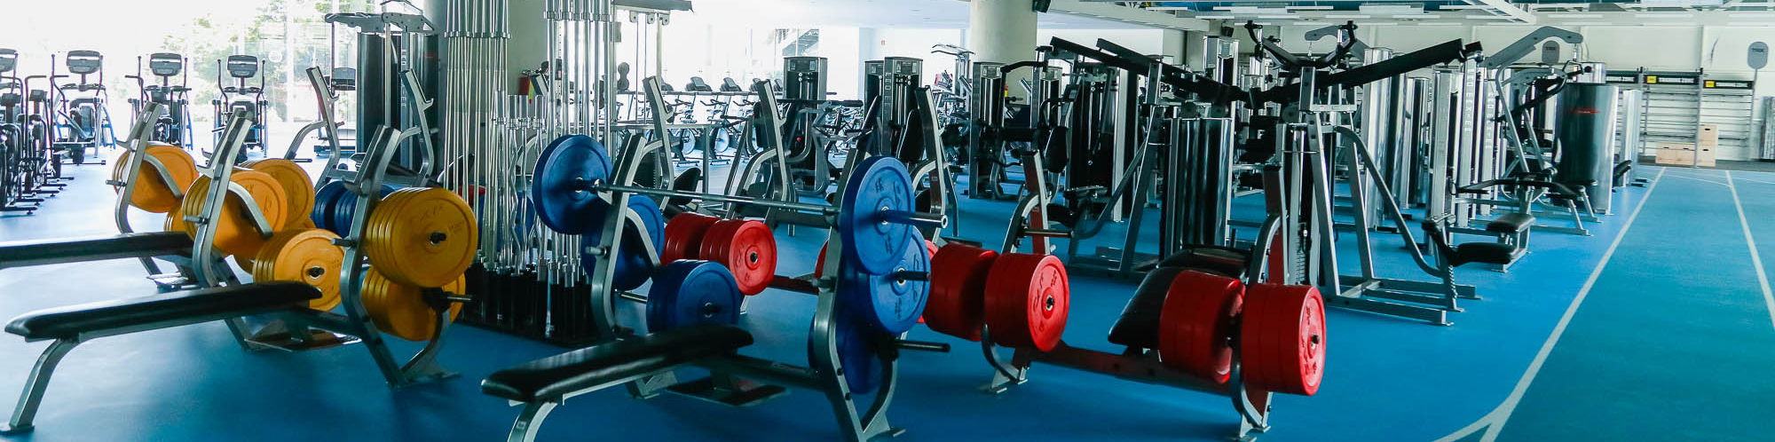

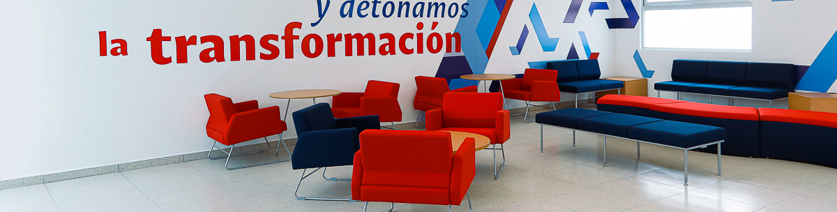
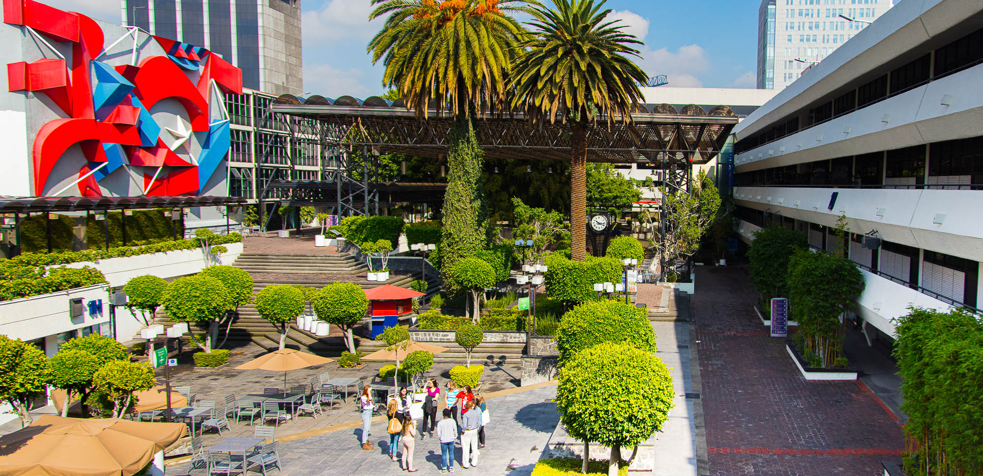
STUDENT EXCHANGE PROGRAM
FACT SHEET
ACADEMIC YEAR
2025-2026

Slide 2
Institution | Address | Contact
Universidad La Salle | Av. Benjamin Franklin 45, Col. Condesa 06140, Ciudad de México, México | Head of International Relations Office Mrs. María del Rosario Escalada rosario.escalada@Lasalle.mx | Contact for exchange students Ms. Liliana Alcántara Academic Exchange Coordinator liliana.alcantara@Lasalle.mx
 |  | Telephone | +52 (55) 5278 9500 ext. 3303
 |  | Website | Universidad La Salle
Areas and levels of study | Undergraduate Programs 30 programs in 7 faculties are open for mobility students Business Humanities and Social Sciences Law Chemistry Engineering Architecture, Design and Communication Santa Teresa Campus: Nursing, Physiotherapy, Sports Science, and Dentistry. | Graduate Programs Especialidades at the Business School are open to students who have authorization from their home university and have completed an undergraduate degree. Courses have some restrictions. Graduate programs in other faculties may be available upon request. The MIEX Program, available only in the fall, will only accept students with advanced level of English. TOEFL IBT score above 92. Letters from home university are not accepted.
Course Information | Course availability Subject Database Course descriptions may be found https://lasalle.mx/oferta-educativa List of courses requested must be included in application: https://academia.lasalle.mx/wp-content/uploads/2024/07/Learning-Agreement-incoming-2024-final.pdf Course registration takes place during orientation week. For undergraduate programs, students must register between 4 and 9 courses from the same faculty. For graduate programs, students must register between 3 ant 5 courses. Course availability: Academic offering.
Language of instruction and language requirements | Students must have an upper-intermediate level of Spanish to enroll the mobility program and present an official B2 certificate (DELE or SIELE). Otherwise a Spanish exam will be applied. Spanish classes have an extra cost and offer academic credit. Costs will be provided at your arrival at La Salle. For the MIEX program, a TOEFL iBT score of 92 is required.

Slide 3
Exchange Student Information
Application form and documents required | Through http://bit.ly/LaSalleInternacional the home university must do the registration online, attach the list of requested courses , and supporting documents in a single-color PDF: Application form: Download. Official transcripts Learning Agreement. Course availability Subject Database Social Media Profile (screenshot of your user) Official Spanish certificate (SIELE or DELE) Passport (ID image) Photo in JPEG format (No glasses, white background, no photoshop)
Health insurance requirements | Students must have an international health insurance plan with coverage in Mexico during all their stay. It must include repatriation of remains. Proof of coverage must be provided before arrival.
Accommodation | Universidad La Salle does not provide on-campus accommodation, but exchange students can request housing assistance or apply for Home-stays. Monthly costs range from $7,000 to $10,000 MX (subject to change), and the application deadline is 30 days before arrival. Students may do their own housing arrangements. Living in the Condesa-Roma area is highly recommended.
Air transportation | Universidad La Salle does not offer airport picking up service for students. Students should use an authorized taxi from the airport upon arrival. Service to the La Salle area has a cost of $30.00 USD approximately.
VISA Information | Student VISA is not required for one semester students. However, candidates must check if they are from a country that does require a Visa even if it is not for studying purposes. https://www.inm.gob.mx/gobmx/word/index.php/paises-requieren-visa-para-mexico/ If coming for two semesters, students must acquire a student VISA in their home country, and request a Non-Immigrants Form within the first 30-days of arrival in Mexico. More information here. Please consider that student visas do not enable the visa holder to work.
Cost of living (USD approx. Per month) | Housing: $350.00 to $600; food: $150.00 to $250; transportation: $10.00 to $20.00; cellphone: $10.00 to $15.00; other personal expenses: $100.00 to $150.00 (all US dollars)
Accepted Students | Information for accepted students

Slide 4
Academic Calendar *Dates may change*
 | Fall 2025 | Spring 2026
Nomination and Aplication period | March 10 – May 15 | September 15 – November 15
Arrival dates | July 27 or 28 (undergraduate) August 17 or 18 (graduate) | January 17 or 18 (undergraduate) January 4 (graduate)
Orientation Week | July 30, 31 and August 1 Mandatory for undergraduates students | January 21, 22 and 23 Madatory for undergraduate students
Beginning & end of the semester (including examination dates) | Undergraduate Programs: August 4 to November 28 Undergraduate Health Programs: July 21 to November 28 Graduate Programs: August 25 to December 5 | Undergraduate Programs: January 26 – June 5 Undergraduate Health Programs: January 26 – June 19 Graduate Programs: January 5 - April 28
Transcripts released | Digital transcripts are sent to mobility coordinator in home university, approximately five weeks after the end of the semester.

Slide 5
Tips & Recomendations
Aditional Information
Home institution must nominate students and send the supporting documents (EXCEL and PDF) through a http://bit.ly/LaSalleInternacional. Candidates must be enrolled as a full-time student home institution, have completed at least one full year of studies at home institution, have a minimum GPA of 2.5/4, be able to follow courses in Spanish. Grade system at Universidad La Salle is based on a 1 to 10 scale (6 is the minimum approbatory and 10 is excellent). Students must attend 80 % of classes to receive a final grade, Universidad La Salle does not exempt unattendance under any circumstances. Students must enroll a minimum of 4 courses and a maximum of 9 courses for undergraduate programs and for graduate programs must enroll a minimum of 3 courses and a maximum of 5. Students must have an advanced level of Spanish to enroll in the mobility program. Spanish courses are mandatory for students not meeting the B2 level; fees per course apply. Tuition fees are waived to mobility students. Students must pay a mobility fee of $2500.00 MX upon arrival. If staying for the academic year, the fee for the second semester is $1500.00 MX. Upon arrival, students must provide a copy of migratory form (FMM), VISA (if required) and pay the mobility fee. Foreign accepted students can’t work in Mexico. Mexico has a voltage between 110-220 and a frequency between 50-60.
Get familiar with the public transport system of Mexico City, you will need the “Tarjeta de movilidad Integrada” which gives you access to the Metro, Metrobus and EcoBici. Safety can be a concern, so it’s essential to stay aware of your surroundings. If you're unsure about a specific area, ask locals where it's safe to go, especially at night. Keep an eye on your belongings, particularly in crowded places like markets. Many places offer student discounts, and some museums have free entry on specific days, so be sure to take advantage of these opportunities. The city offers a lively nightlife scene. There’s something for every taste, and many venues host themed nights or special events.

Slide 6



Social Networks
LaSalleMXCIEL

