Slide 1
Go Beyond Boundaries

Slide 2

International Opportunities
Louisa Stratton, Go Abroad Manager
Register while you wait…

Slide 3

Overview
Why go abroad?
What are my options?
What do our students say?
Funding and support
What are the next steps?
The Go Abroad fair
NB this presentation is being recorded and will be uploaded to the website, along with a copy of the slides

Slide 4
Common misconceptions
Going abroad adds time to your degree
You need to be fluent in another language
It will bring down your degree classification
These statements are all FALSE!
So let’s look at all the POSITIVES…

Slide 5

Why go abroad?
Academic reasons
Learn a language
Get a new perspective
Discover new ways of learning
Fall in love with your subject
Try something new

Slide 6

Why go abroad?
Professional reasons
Grow your network
Boost your skills
Gain intercultural competence
Learn from best practice

Slide 7

Why go abroad?
Personal reasons
Broaden your horizons
Make new friends
Get to know a new culture
Redefine yourself
Grow in confidence

Slide 8
What are my options?
Study OR Train OR Volunteer OR Research
One week to 12 months
Within programme OR additional year OR post-university
Compulsory or non-compulsory
Undergrad OR Postgrad OR PhD
Europe OR further afield
With OR without funding support

Slide 9
Study exchange
WHO?
All UG degree programmes (except Medicine and Dentistry)
WHEN? (depends on your programme)
Level 2 (full year or single semester)
Level 3 (single semester only, with some exceptions)
ELIGIBILITY
Overall C average (or higher for selected programmes) and be on track to achieve
  120 Credit points by the end of 1st year AND/OR
  240 Credit points by the end of 2nd year
have the support of your Go Abroad Tutor/s (you don't need to request this in advance - they will be contacted as part of the application process)
MORE INFO
https://www.abdn.ac.uk/study/undergraduate/for-study-exchange-3211.php

Slide 10
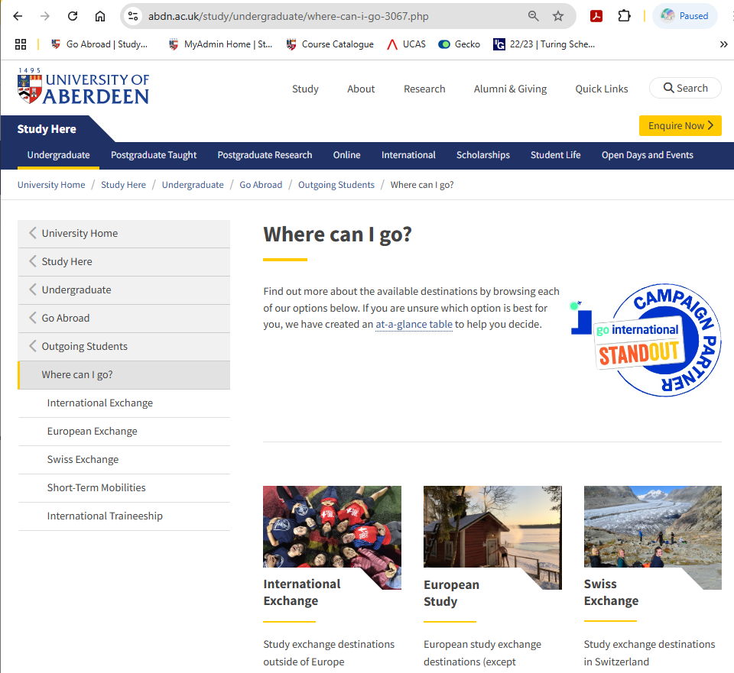
Study exchange
Website
HOW TO SEARCH

Slide 11
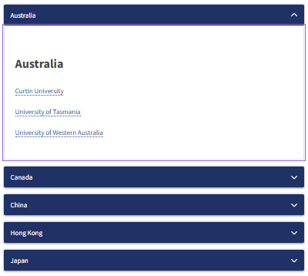
Study exchange
International
HOW TO SEARCH

Slide 12
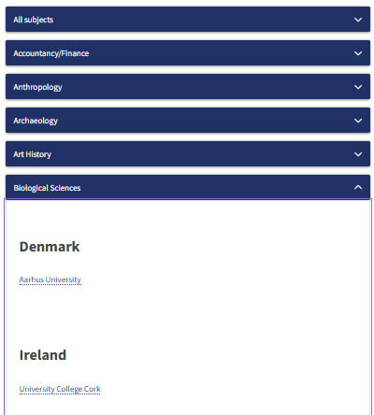

Study exchange
European
HOW TO SEARCH
NB Swiss institutions are on a separate page

Slide 13
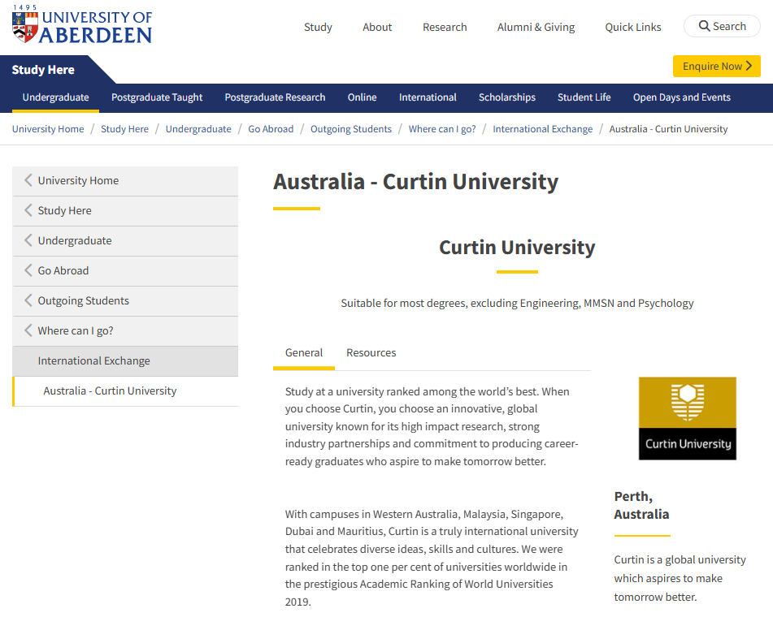
Study exchange
Partner info
HOW TO SEARCH

Slide 14
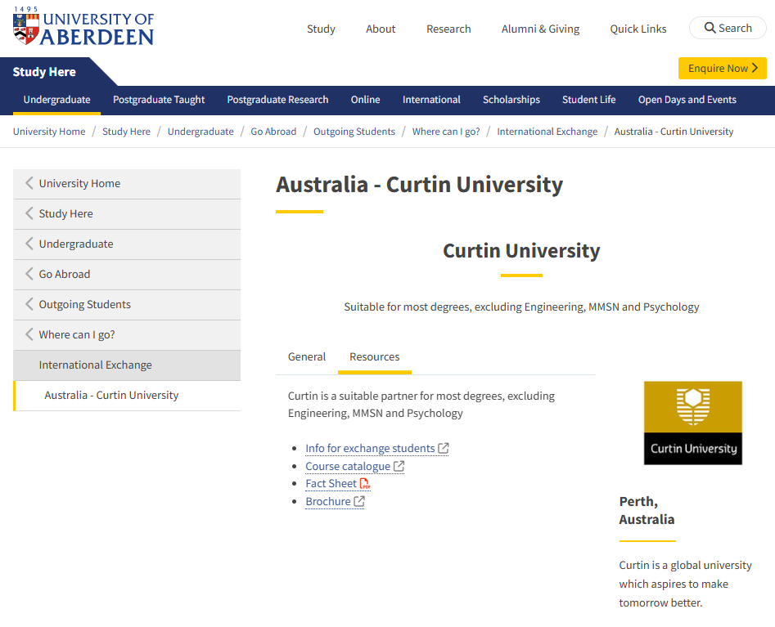
Study exchange
Partner links
HOW TO SEARCH

Slide 15
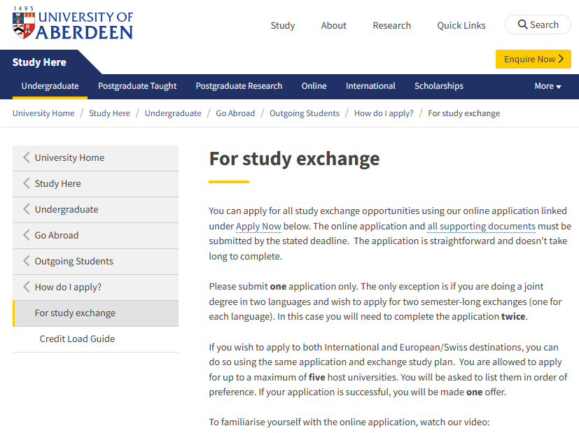
HOW TO APPLY
Study exchange
List of restrictions by degree
List of destinations by degree
Detailed eligibility criteria
Credit load guide
Application documents

Slide 16
Study exchange
Inter-campus transfer
WHO?
Selected programmes (see next slide)
WHEN?
UG: Level 2, Term 1; PG: Term 3
ELIGIBILITY
Overall C average (or higher for selected programmes) and be on track to achieve
  120 Credit points by the end of 1st year AND/OR
  240 Credit points by the end of 2nd year
have the support of your Go Abroad Tutor/s (you don't need to request this in advance - they will be contacted as part of the application process)
MORE INFO
Webpage coming soon
NB Spend a semester at our Qatar campus

Slide 17
Study exchange
Inter-campus transfer - degrees
Suitable for the following degrees
MA Accountancy
MA Accountancy & Business Management
MA Accountancy & Finance
MA Business Management
MA Business Management & Finance
MA Business Management & International Relations
MA Finance
MA Finance & International Relations
MA Politics & International Relations
MBA and selected MSc programmes
NB Spend a semester at our Qatar campus

Slide 18
Traineeship
WHO? and WHEN?
Languages – depends on programme (mostly Level 3)
MSci with Industrial Placement – Full Year Level 4
MChem/Engineering degree project – Term 2 Final Year
Medical Elective – 8-week block Level 5
ELIGIBILITY
On track with your degree programme
have the support of your Go Abroad Tutor/s (you don't need to request this in advance - they will be contacted as part of the application process)
MORE INFO
https://www.abdn.ac.uk/study/undergraduate/for-traineeship-3212.php

Slide 19
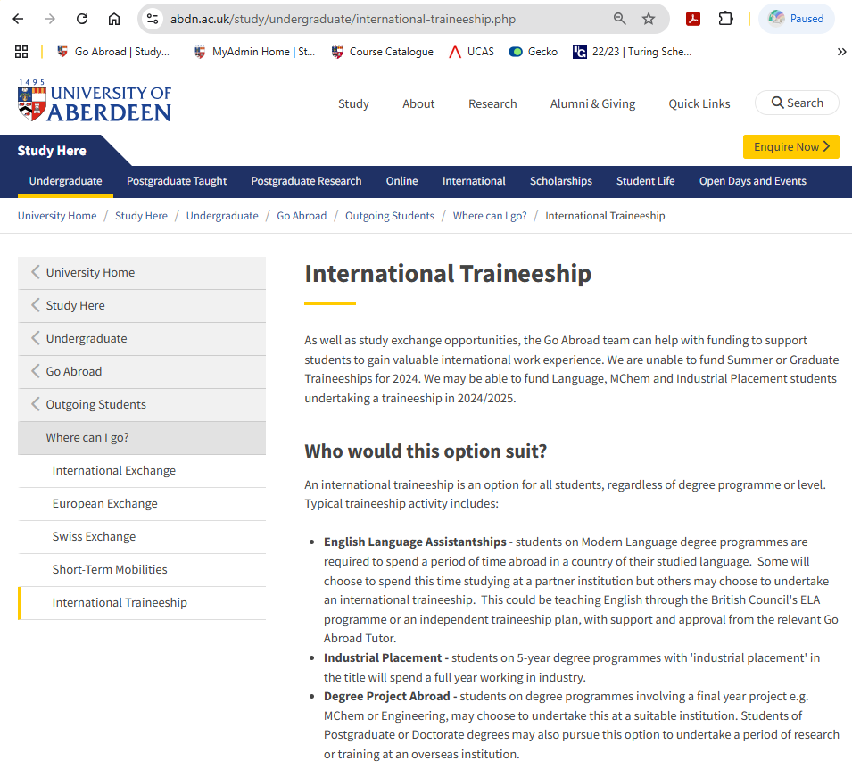
Traineeship
Website
HOW TO SEARCH

Slide 20
Short-term activities
Summer Schools
WHO?
All degree programmes
WHEN?
Summer period, duration varies (1-8 weeks)
ELIGIBILITY
Current student status (usually)
MORE INFO
https://www.abdn.ac.uk/study/undergraduate/summer-schools-3280.php

Slide 21
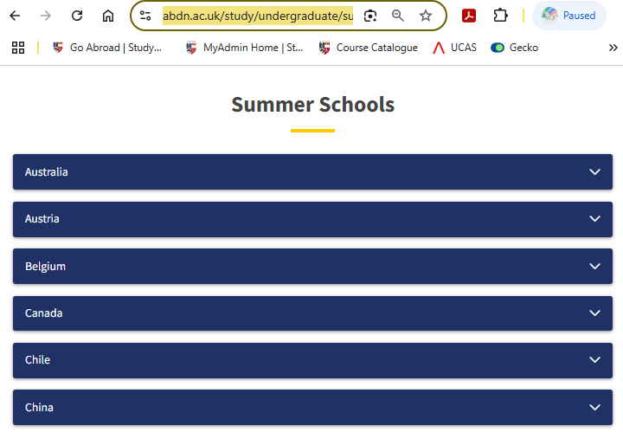
Short-term activities
Website
HOW TO SEARCH
NB Information for summer 2026 will be updated soon

Slide 22
Short-term activities
Mitacs Research Internship
WHO? and WHEN?
All degree programmes that can incorporate a 12-week internship the summer before their final year
ELIGIBILITY
Minimum weighted average of 65%
(60% for widening access backgrounds)
MORE INFO
https://www.abdn.ac.uk/study/undergraduate/mitacs-uuki-globalink-internship-7278.php
NB Applications open in summer for the following year

Slide 23

Student Profiles - Calum
Compulsory mobility – Languages
Calum Mackinnon
MA ML Translation & Interpreting Studies
Level 3 study exchange
University of Granada, Spain and ULB, Belgium
“Never lose sight of the skills you're gaining and friends you're making whilst abroad - both are invaluable and will reward you long after your exchange has ended.”

Slide 24

Student Profile - Laura
Compulsory mobility – Languages
Laura Heeb
MA English - Spanish & Latin American Studies
Level 3 traineeship
English teaching in Mallorca
“The friendships I forged during my stay are some of the most cherished in my life, and the memories remain deeply ingrained in my heart. Immersing myself in a different culture opened my eyes to new possibilities, allowing me to evolve and discover my true self.”

Slide 25
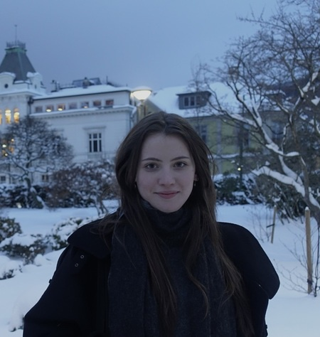
Student Profile - Katie
Compulsory mobility – 5-year LLB
Katie Aspinall
LLB Law with European Legal Studies
Level 3 study exchange
University of Bergen, Norway
“I found that being able to frame the way I thought about my time abroad before I went really helped me navigate the experience once I was there and get what I wanted out if it. For me, this was simply to push myself out of my comfort zone!”

Slide 26
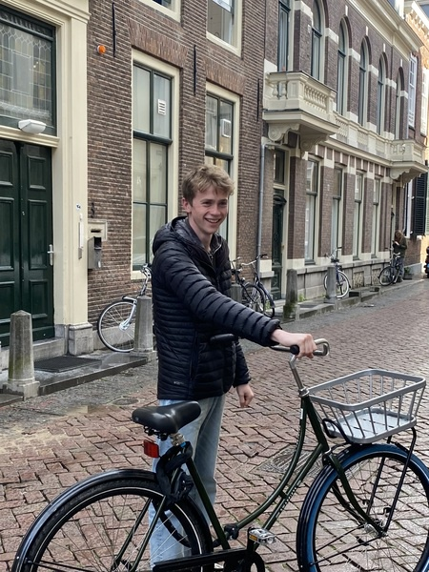
Student Profile - Will
Non-compulsory mobility – MA
Will Milsom
MA History
Level 3 study exchange
Utrecht University, Netherlands
“Living and studying abroad was an amazing, transformative part of my university experience. Immersed in new cultures, I met people from diverse backgrounds who expanded my world view in ways that I could never have imagined. ”

Slide 27
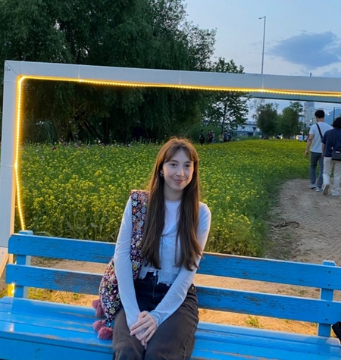
Student Profile - Katie
Non-compulsory mobility – MA
Katie Brodie
MA Politics & International Relations
Level 2 study exchange
Yonsei University, South Korea
“Be open-minded! Try things you might never have considered before, meet lots of new friends and be prepared to step outside of your comfort zone. After all, adventure and travel are some of the best ways to learn. ”

Slide 28

Student Profile - Becca
Non-compulsory mobility – BSc
Becca Elias
BSc Physiology
Level 2 study exchange
University of British Columbia, Canada
“My top tip is to try things you’d never think you would back at home: whether that’s a sport, travelling to a new location or different foods. And plan ahead: get a bucket list of things you’d like to try out or visit beforehand as you’ll be home before you know it!”

Slide 29
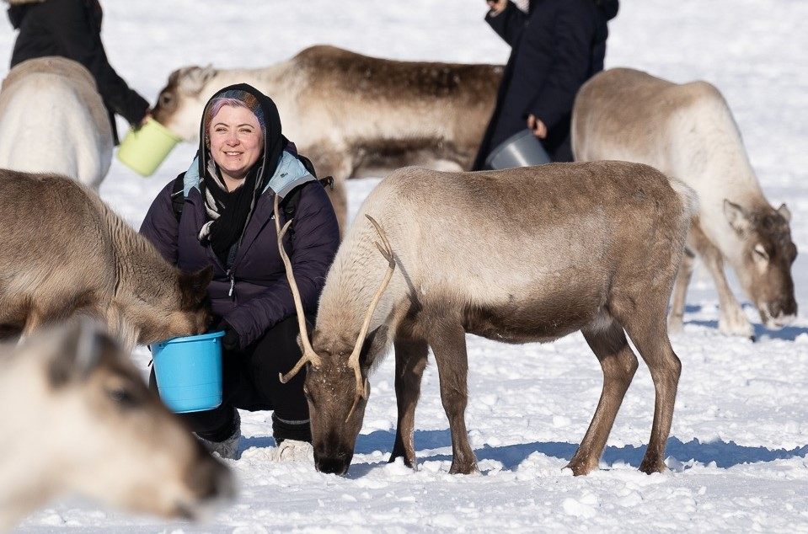
Student Profile - Mazz
Non-compulsory mobility – BSc
Mazz Cummings
BSc Ecology
Level 2 study exchange
University of Tromso, Norway
“I was worried about being away from my husband for 6 months, but having done a year abroad himself 10 years ago, he didn't want me to miss out on the opportunity, and ultimately, neither did I!”

Slide 30
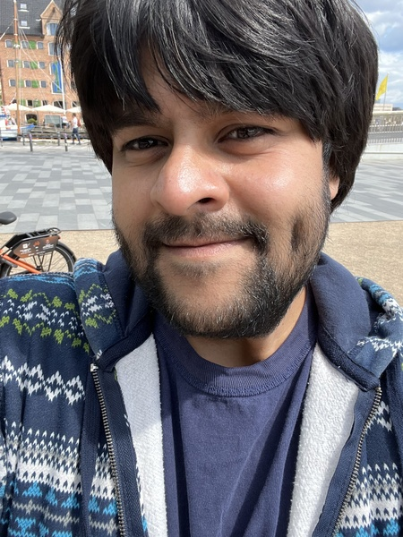
Student Profile - Varun
Short-term activities
Varun Sahani
MA Business Management & Finance
Summer School
Copenhagen Business School
“I went abroad because I wanted to develop my academic, professional, and personal skills. It was a great opportunity to step outside my comfort zone and appreciate different cultures while working on career progression.”

Slide 31
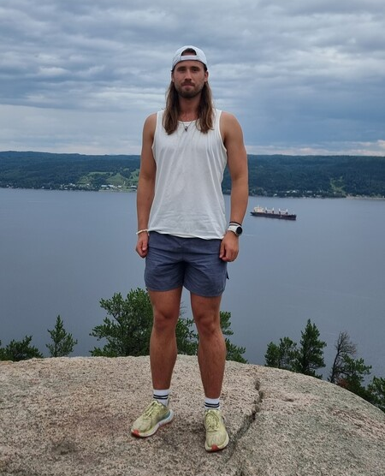
Student Profile - Matt
Short-term activities
Matt Wrobel
BEng Civil Engineering
Research Internship
University of Montreal, Canada
“The environment we are adjusted to puts us in the comfortable zone but in order to develop on an emotional, personal and educational level, it is important to put yourself into the unknown.”

Slide 32
Funding
Tuition fees
Tuition fees for those spending one or two semesters abroad are usually paid to the University of Aberdeen as normal, though the exact method of payment will depend on your fee status. No tuition fees would be due to your host university for those on study exchange.
Exact tuition fee arrangements will depend on when students commenced their degree.
MORE INFO
https://www.abdn.ac.uk/study/undergraduate/how-much-will-it-cost-3069.php#panel3259

Slide 33
Funding
Turing Scheme
Global destinations
Minimum duration two weeks; maximum duration 12 months (funding year runs September to August)
However, funding for 2026/27 is likely to be limited, with the following groups being prioritised:
  Compulsory mobility (Languages/5-year LLB)
  Widening access students
  Disabled students and students with chronic health conditions

Slide 34
Funding
Turing Scheme – Additional Funding
Please note that the Scheme provides additional funding for the following groups:
  Widening access students
  Disabled students and students with chronic health conditions

Slide 35
Funding
Other funding options
Study Exchange (Switzerland)
SEMP Grant available for incoming students (payable by host institution)
Study Exchange (Denmark, Finland and Norway)
North2North Grant available for incoming students (payable by host institution)
Select institutions in Denmark, Finland and Norway only
NB Early application period
Study Exchange (France, Germany and Spain)
Stevenson Exchange Scholarship
Competitive award (Scotland)

Slide 36
Funding
Other funding options continued
Study Exchange (Drexel University, USA)
McNeil Scholarship
Competitive award (Aberdeen only)
Study Exchange (North America)
BUTEX Scholarship
Competitive award (all BUTEX member universities)
MORE INFO
https://www.abdn.ac.uk/study/undergraduate/how-much-will-it-cost-3069.php#panel3257

Slide 37
Support
The Go Abroad Team looks to support all students to have an international experience, recognising that particular groups of students may require additional assistance or specific advice relevant to their circumstances or background. Collectively, the Go Abroad team has more than 25 years’ experience within the field of international education, and have supported thousands of students across a wide range of backgrounds and circumstances to find an international experience that is right for them.

Slide 38
What are the next steps?
November - February
November/December 2025
Research your options via Go Abroad website
Subject info sessions (dates vary)
Application info session (03 December 2025)
Summer school funding application (until 05 December 2025)
North2North application (03-17 December 2025)
January 2026
Study exchange application open (07-30 January 2026)
February 2026
Summer school applications (deadlines vary)

Slide 39
What are the next steps?
March - June
March
Next steps info session (March 2026 – date TBC)
April
Pre-departure info session (April 2026 – date TBC)
May/June
Turing funding application (dates TBC)
Ongoing
Go Abroad drop-in desk in Infohub
Email Go Abroad Ambassadors/Champions
Bookable one-to-one appointments
Feedback reports on MyAberdeen (request access)
https://www.abdn.ac.uk/study/undergraduate/engage-with-us-3070.php

Slide 40
Go Abroad Fair
If you pre-registered before today, you should have received your personalised QR code which will be scanned on entry to Elphinstone Hall.
Students who have pre-registered should access the hall through the main set of double doors. An accessible route to the hall is available from the corner of the building, just to the left of the main door.

Slide 41
Go Abroad Fair -
Register now
Anyone who did not already pre-register, can register now using this QR code. You will not get your own personalised QR code, but should instead see a confirmation screen once you have submitted the form.
Please show the confirmation screen (or a screenshot of the confirmation screen) to access the hall, and use the entrance to the right of the main door.

Slide 42
Go Abroad Fair –
What happens
ELPHINSTONE HALL – 13:00-15:00
Country stands staffed by returned UoA students and incoming exchange students
Info stands staffed by Go Abroad team and Go Abroad Tutors
Careers
Language Centre
ESN Aberdeen
And more…

Slide 43
Ready to start breaking boundaries

