Slide 1


Slide 2


Why choose us?
Ensures that living away from home for the first time is a welcoming and exciting experience
We provide all the support you need
You will be part of a vibrant community with the opportunity to make life-long friends
We are an international campus with students from all over the world
Guaranteed accommodation for all first-time students
40-week lease lengths and flexible payment plans
Dedicated accommodation for Postgraduates and mature students on the Old Aberdeen campus and at Hillhead

Slide 3
Student Accommodation
All accommodation benefits from access to 24/7 assistance from the Accommodation Management Team and Student Resident Assistants
Students are housed along with other first years
The rents are all inclusive – no surprise heating or electricity bills
Unlimited and free Wi-Fi
Basic personal contents insurance included

Slide 4
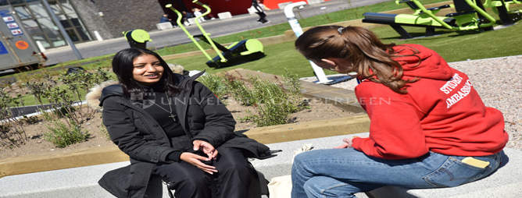
Hillhead Student Village
Hillhead Student Village is by far the most popular location for undergraduate students, a 15-minute walk or a 5-minute bus ride to King's campus
2000 + students are housed across different properties on the site
Full Laundry facilities are on site
Free car parking areas and bike storage available
Headspace building with social and activity spaces
Outdoor social space
24/7 reception
And more…..

Slide 5
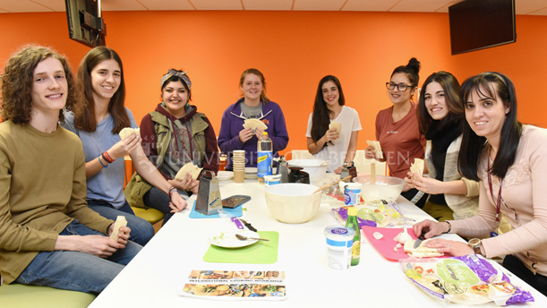
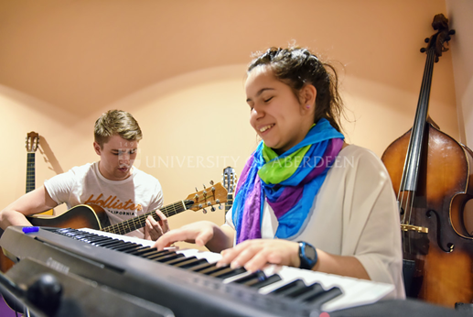


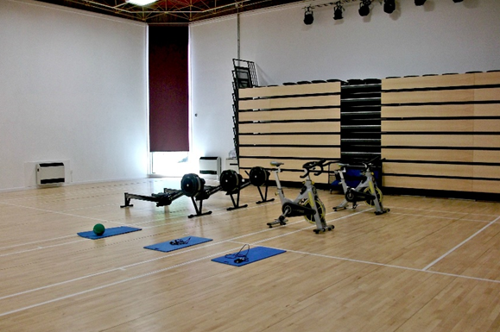
Hillhead Student Village

Slide 6
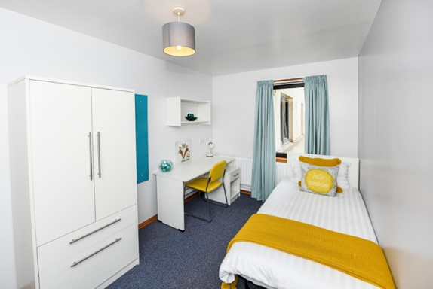
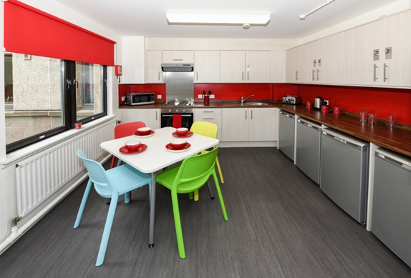
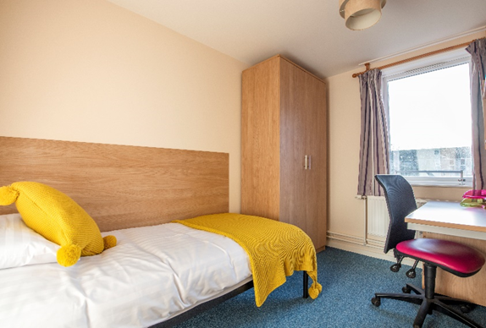
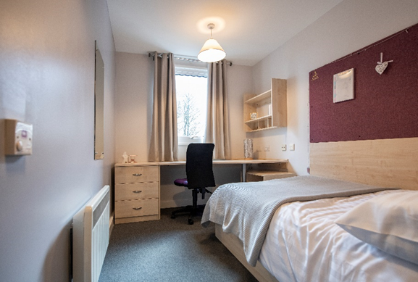
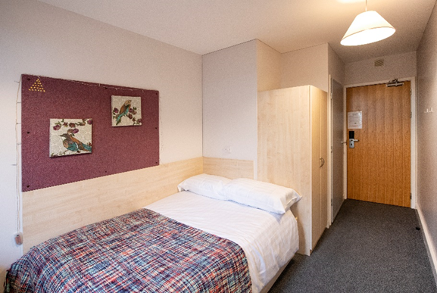
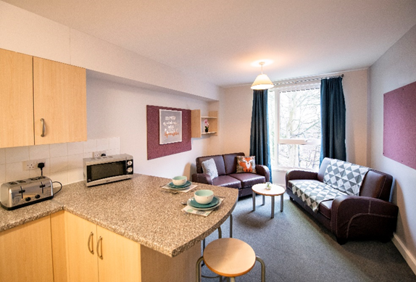
Hillhead Student Village
Single study bedrooms with shared bathroom and kitchen facilities
En-suite rooms with ¾ sized beds and shared kitchen facilities

Slide 7

Support Services
A team of dedicated Student Resident Assistants (SRAs) working throughout the evening/night
Students can go to them with any worries that they may have including home sickness, exam worries and relationship problems and more..
Students are provided with confidential advice and are signposted in the direction of any relevant professional services
Always somebody there for you

Slide 8
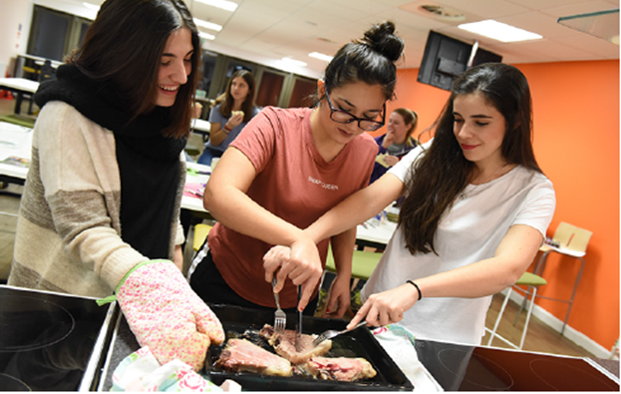

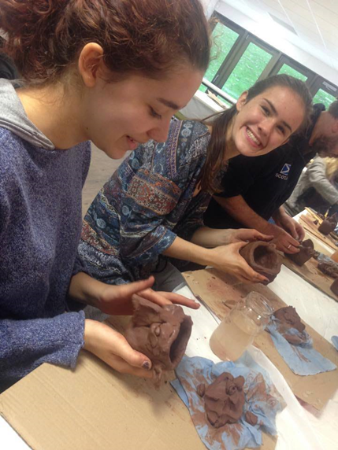

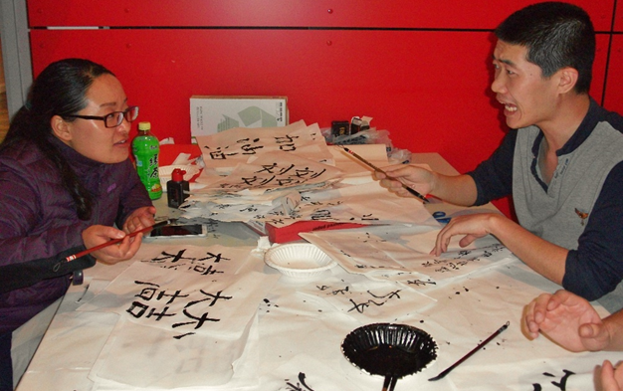
Social Activities at Hillhead
Cooking Classes
Cultural Events
Art Workshops
Pet Therapy
Language Cafe

Slide 9
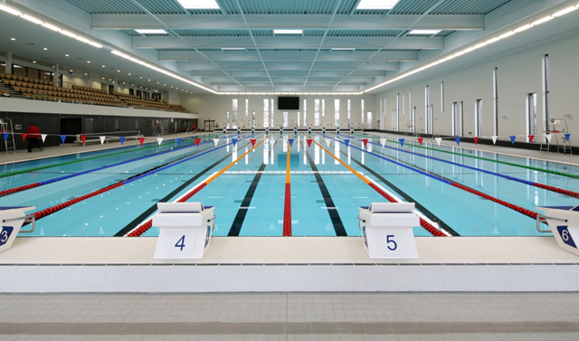


Aberdeen Sports Village Membership
We are giving a 75% discount on Aberdeen Sports Village membership to all our students who accept an offer to stay in University accommodation for the 2026/2027 Academic year
*subject to terms and conditions which can be viewed on our website

Slide 10

Security
The university encourages all our students to download and utilise the SafeZone App.
Students can access assistance when required by the touch of a button
Nearest first aider will be alerted and attend area where injured party is located.

Slide 11
Prices at Hillhead
Name of Accommodation | Type of Accommodation | Lease Dates | Rent per Week
Hillhead Houses Adam Smith & Fyfe houses | Single-study self-catering bedrooms with access to shared kitchen and bathrooms | 40 weeks | £111 standard room
Hillhead Traditional Flats – Hector B, Grant Ct, Keith House | Self-catering flats with single-study bedrooms (5 person flat) | 40 weeks | £145 standard room (1 toilet per flat) £151 standard room (2 toilets per flat)
North Court | Self-catering flats with single-study bedrooms (3 or 4 person flat) | 40 weeks | £151 standard room
New Carnegie Court | Self-catering flats with single-study en-suite bedrooms | 40 weeks | £191 En-suite room

Slide 12
How and When to Apply
Apply online at www.abdn.ac.uk/accommodation
Unconditional offer holders can apply once they have firmly accepted their offer to study at the University
Conditional offer holders, who have firmly accepted their offer to study at the University, can ‘note an interest’ through the application portal

Slide 13


