Slide 1
University of Aberdeen Superannuation
& Life Assurance Scheme
Update for AGM
June 2026

Slide 2
Contents
Market background Current asset allocation and UASLAS implications Actuarial Valuation Project | 3
 | 5
 | 8

Slide 3
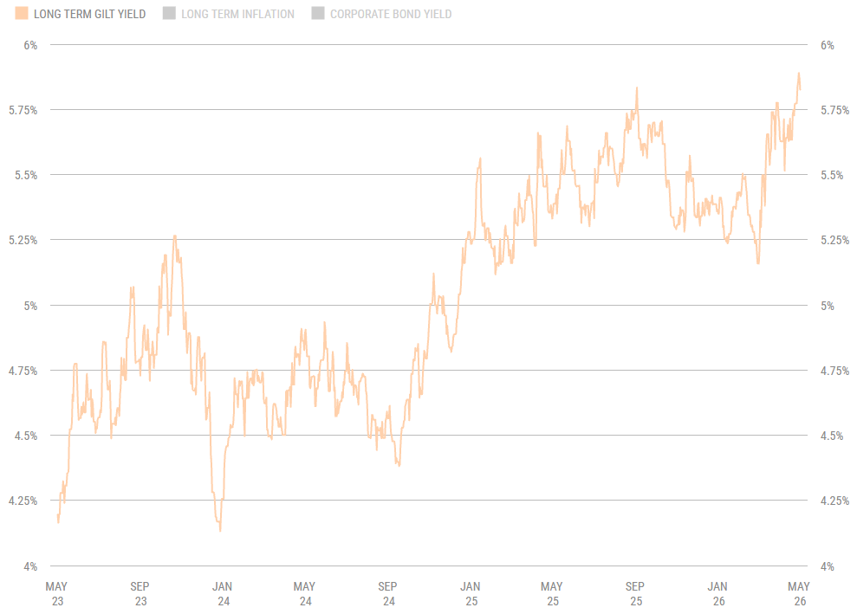
Continuing volatility of gilt markets
Source: XPS Radar.
3
Notes:
Gilt yields have been on an upward trajectory in recent years – the result of persistent inflationary pressures, a higher interest rate environment, political instability and a weakening economy.
This has a direct impact on the value of the Scheme’s underlying Gilt holdings as well as the value of the Scheme’s liabilities.

Slide 4
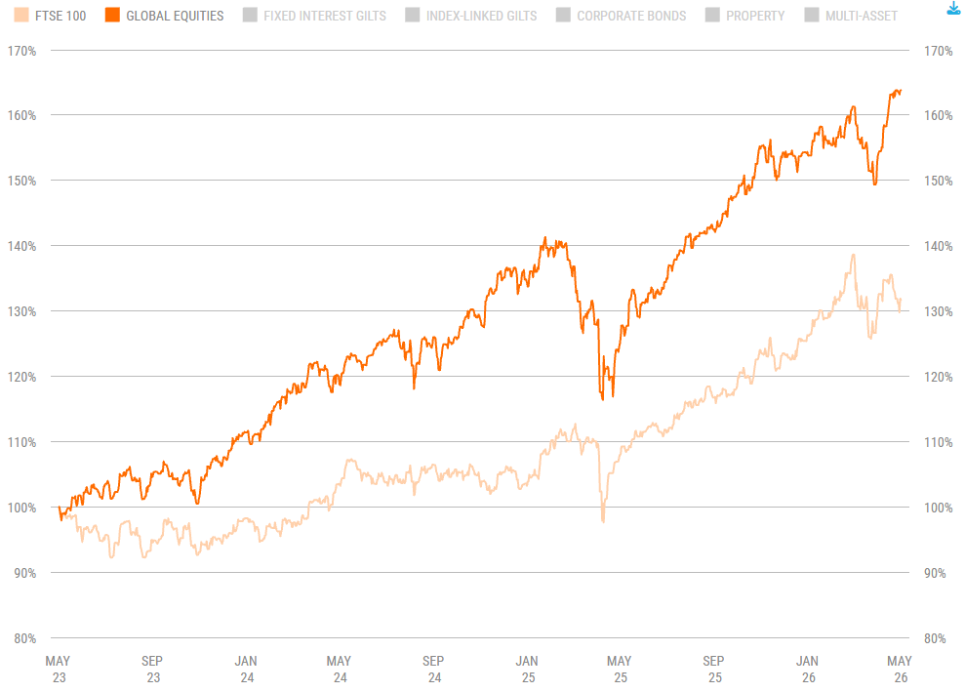
Strong period for growth markets
Source: XPS Radar.
4
Notes:
Global equities have enjoyed a particularly strong few years overcoming several obstacles. Early rallies were concentrated in the US, however participation has broadened over the last year, with the UK and emerging markets also performing well.
The Scheme’s two multi-asset funds both hold material allocations to equities and have delivered strong returns as they ‘ride the wave’ in equity markets.

Slide 5
No investment strategy changes
Matching Assets
30%
Growth Assets
70%
No notable changes to the Scheme’s investment strategy since the last AGM

Slide 6
Performance since 2025 AGM
Growth assets performance for the year to 31 March 2026
Fund name | 1 Year
 | Fund | Comparator
L&G Secure Income Assets Fund | 6.2% | 6.0%
L&G Sterling Liquidity Fund | 4.3% | 4.1%
L&G Diversified Fund | 12.0% | 19.1%
L&G Dynamic Diversified Fund | 11.5% | 8.5%
Ninety-One Global Total Return Credit Fund | 4.6% | 8.0%
Notes:
Markets have been particularly volatile over the last year. Despite this, the Scheme’s growth assets have had a strong year.
Rising gilt yields over the last year means that the value of the gilt assets (and liabilities) have fallen. The Scheme invests in gilts to hedge the risk of the assets and the liabilities being ‘mismatched’ – so while these assets have fallen in value, they are performing as intended by matching the movement in the value of the scheme’s liabilities.
The increase in the Scheme’s deficit is a result of changes on the liability side such as (i) a change to the actuarial basis, (ii) member movements and (iii) new benefits being accrued.

Slide 7

Member query
1 member query was received during the year:
  “Due to the Bull market in USA and the effect of middle east conflict, major asset management groups such as Black stone, Blue Owl, KKR Ares, Black Stone and particularly Black Rock are in Crisis Mode. With Black Rock only allowing 5% redemption per quarter. HP Private Credit funds are in free fall. How if any does this impact on our Pension funds?”.
Our response:
  Your pension fund has very limited exposure to private credit, around 0.9% of total assets. Recent issues in the press mainly relate to retail-focused funds managing investor withdrawals rather than broader concerns for diversified pension scheme investments. In fact, the growth assets invested in your scheme continue to perform very well.
  XPS produced a paper to reassure investors amid regular headlines on private credit ‘stress events’.

Slide 8
UASLAS valuation at 31 July 2025
1
Training
Valuation documentation
and submission
9
Monitor
& review
2
Agree and document long-term strategy
15 Months
Statement of Strategy
8b
3
Covenant assessment
Fast Track certification (OPTIONAL)
8a
4
Demographic analysis
7
5
Low dependency investment allocation and journey plan
Agreement with the employer
6
Technical Provisions and Recovery Plan

Slide 9
Any questions?

Slide 10
Thank you
Sian Pringle FIA Partner - Investment 0131 370 2614 sian.pringle@xpsgroup.com
Disclaimer
This document is addressed to, the Trustees of the University of Aberdeen Superannuation and Life Assurance Scheme and it is for their exclusive use. This document should not be distributed to any third parties and is not intended to, and must not, be relied upon by them. Unauthorised copying of this document is prohibited. This document is intended for information only. It does not constitute any form of investment advice or recommendation to utilise any particular investment strategies, and should not be relied upon as such. The information expressed is provided in good faith and has been prepared using sources considered to be reasonable and appropriate. While information from third parties is believed to be reliable, no representations, guarantees or warranties are made as to the accuracy of information presented, and no responsibility or liability can be accepted for any error, omission or inaccuracy in respect of this. This document may also include our views and expectations, which cannot be taken as fact.
Please note that all material produced by XPS Investment Limited is directed at, and intended for the consideration of, professional clients within the meaning of the Financial Services and Markets Act 2000 (“FSMA”). Retail or other clients must not place any reliance upon the contents. The value of investments and the income from them can go down as well as up as a result of the market and currency fluctuations and investors may not get back the amount invested. Past performance is not necessarily a guide to future returns.
The value of investments and the income from them can go down as well as up as a result of market and currency fluctuations and investors may not get back the amount invested. Past performance is not necessarily a guide to future returns.
XPS Pensions Consulting Limited, Registered No. 2459442. XPS Investment Limited, Registered No. 6242672. XPS Pensions Limited, Registered No. 3842603. XPS Administration Limited, Registered No. 9428346. XPS Pensions (RL) Limited, Registered No. 5817049. XPS Pensions (Trigon) Limited, Registered No. 12085392. Penfida Limited Registered No. 8020393. Polaris Actuaries and Consultants Ltd, Registered No. 09640309. All registered at: Phoenix House, 1 Station Hill, Reading, RG1 1NB.
XPS Investment Limited is authorised and regulated by the Financial Conduct Authority for investment and general insurance business (FCA Register No. 528774).

