Slide 1

Your Digital Footprint
A guide to building your online presence

Slide 2



Introduction
In today’s digital age, it has become more and more essential for academics to extend their career into the digital world.
The aim of this resource is to guide researchers through the process of developing their digital footprint and effectively presenting themselves and their research online.
An effective use of digital tools is very advantageous when it comes to academic networking, reputation-building, and dissemination of knowledge.

Slide 3
Contents
I. Why build an online presence?
  Networking
  Engagement
  Discovery
  Dissemination
II. Steps to developing your digital footprint.
  Step 1: Create an online presence
  Step 2: Promote our work on social
  Step 3: Track your progress
III. Summary and Resources.

Slide 4
I. Why build an online presence?
The benefits of effectively presenting yourself and your research online.

Slide 5




Why build an online presence?
Networking
Engagement
Discovery
Dissemination

Slide 6

Networking
Networking
Engagement
Social media and academic platforms allow you to reach out to and communicate with academics in your field.
Discovery
Dissemination

Slide 7
Networking
Networking
Engagement
Through digital platforms you can:
Take part in conversations relating to your field of study.
Build communities that connect researchers from across the world.
Networking with academic peers can be insightful to your own research, and pave the way for potential future collaborations.
Discovery
Dissemination

Slide 8

Engagement
Networking
Engagement
Using social media can help you identify and get in touch with stakeholders outside academia. Similarly, your presence on social media can allow stakeholders to identify and contact you for your expertise.
This can include: businesses, policy makers, practitioners, charity organisations, members of the public, etc.
Discovery
Dissemination

Slide 9
Engagement
Networking
You can involve external stakeholders in your research:
By collecting data using digital methods (i.e. online surveys, videos, audio recordings, sharing on social media, etc).
By sharing your research findings in digital formats, and presenting them in an easy-to-understand manner. This will make your work accessible to people outside academia.
Effective engagement makes your research more relevant to external stakeholders, and maximises its impact.
Engagement
Discovery
Dissemination

Slide 10

Discovery
Networking
Engagement
Discovery
Discover what is happening in your academic field through different online platforms.
Dissemination

Slide 11
Discovery
Networking
Engagement
Following organisations, funding bodies and other academics on social media gives you the opportunity to:
Keep up to date with the latest news and research developments.
Find other researchers in the same field as you.
Be aware of funding opportunities in your field.
Discovery
Dissemination

Slide 12

Dissemination
Networking
Engagement
Discovery
Publicise and enhance the awareness of your work, by making it more visible and accessible.
Dissemination

Slide 13
Dissemination
Networking
Engagement
Keep your followers up-to-date by releasing regular updates on the advancements of your research projects. You can do so by:
Posting about it on academic platforms.
Using a range of digital media (i.e. text, images, video, infographics, presentations, blogs, etc).
An effective dissemination and widespread awareness of your work increases your chances of collaborations, funding, and creates a lasting impact.
Discovery
Dissemination

Slide 14
II. Developing your digital footprint
A guide to optimizing your use of digital tools.

Slide 15
What are the steps to developing your digital footprint?
Step 1
Create an online presence.
Step 3
Track your progress.
Step 2
Promote your work on social media.

Slide 16

Step 1: Create an online presence
Online presence
Social media
What digital platforms can you use to optimise your online presence?
Track your progress

Slide 17

Step 1: Create an online presence
Set up an ORCID ID
Online presence
Set up an ORCID identifier to distinguish yourself and your research online.
Social media
Track your progress

Slide 18
Step 1: Create an online presence
Set up an ORCID ID
Online presence
Why use an ORCID?
It ensures that all your research outputs and activities are attributed to you.
Your ORCID ID and records stay with you throughout your career, even when you change institution, or even your name.
ORCID is becoming an international standard and is recognised by many institutions, research funders and publishers.
ORCID can help synchronise all your information from one system to another, which reduces time and effort with form-filling.
Social media
Track your progress

Slide 19
Step 1: Create an online presence
Set up an ORCID ID
Online presence
1. Follow the link:
https://orcid.org/register
2. Register for free for a unique ORCID identifier.
3. Add your professional information to your ORCID record.
4. Include your ORCID identifier when you submit publications, apply for grants, and in any research workflow.
Social media
Track your progress

Slide 20
Step 1: Create an online presence
Set up an ORCID ID
Online presence
Social media
For more information on ORCID, check out the University’s guide.
Track your progress

Slide 21



Step 1: Create an online presence
Set up professional accounts on digital platforms
Online presence
Twitter: Follow discussions on issues related to your research. Twitter also helps you find and engage with peers from different universities and countries.
Social media
Track your progress
LinkedIn: Show your work history, expertise and accomplishments, and build a professional network by establishing connections both within and beyond academia. You can also seek out professional opportunities, and update your network on your research projects.
Blogging: Post regular updates about your work. Having a blog is also a good way to personalise your image online and promote your brand.

Slide 22


Step 1: Create an online presence
Set up professional accounts on digital platforms
Online presence
Social media
Acedemia.edu: Learn about research projects in your field of interest, read papers written by fellow researchers, share your work and expand your academic network.
Track your progress
ResearchGate: Find and share research papers, ask and answer questions about different research projects, and find collaborations. This digital platform is targeted towards scientists.

Slide 23
Step 1: Create an online presence
Set up a PURE account
Online presence
PURE is the University’s research management system, where you can document your research outputs
(i.e. publications, projects, awards, datasets, press clippings, posters, and more).
Uploading your research outputs to PURE increases the visibility of your research.
You can access the University of Aberdeen’s PURE portal here.
Social media
Track your progress
’How to’ videos and training resources can be found here.

Slide 24
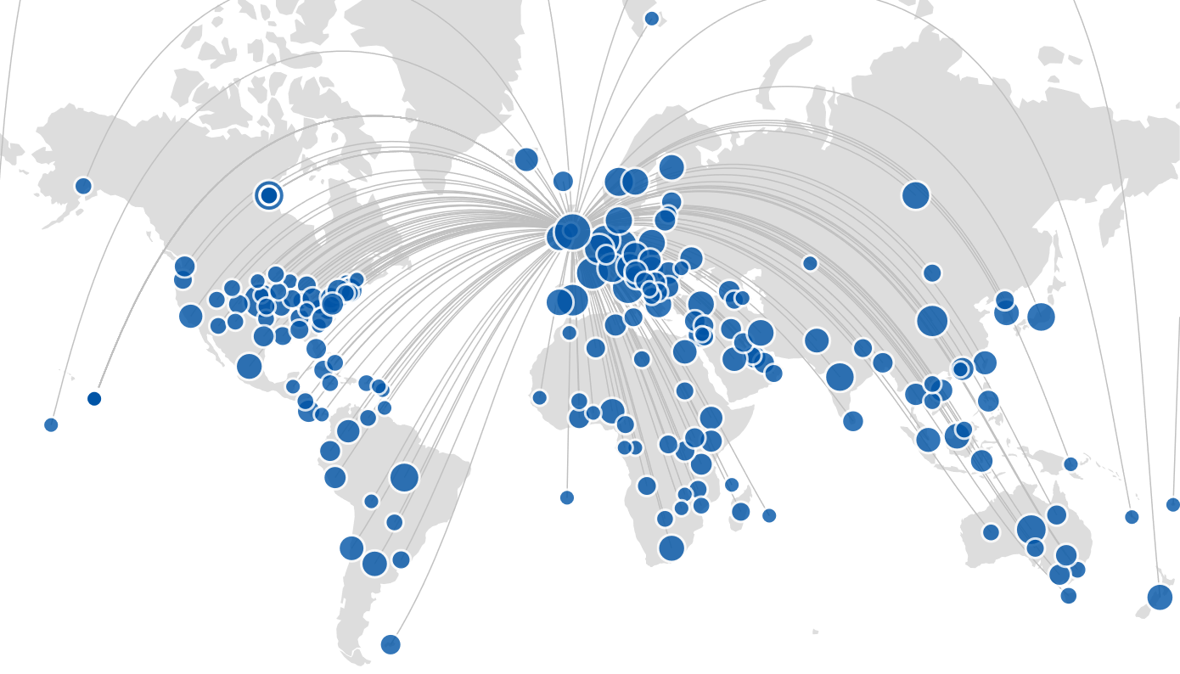
Step 1: Create an online presence
Set up a PURE account
Online presence
The University of Aberdeen Research Portal:
Lists all public outputs as entered in PURE.
Links to the Aberdeen University Research Archive where all open access publications are available to read.
Social media
Track your progress
This map shows the University’s collaborations between 2015 and 2020.
You can find it on the University’s PURE portal here.

Slide 25
Step 1: Create an online presence
Now what?
Online presence
Social media
Now that you have established your professional online presence, you can use different digital platforms to promote your work, and keep your network updated on your research findings and project advancements.
Track your progress

Slide 26

Step 2: Promote your work on social media
Type your name into google: what is the first thing that appears?
Online presence
Social media
Your online presence can be a first impression for potential employers, funders, or collaborators.
Your social media profiles are a track record of your accomplishments.
Promoting your work on social media increases its discoverability, as well as the number of people following it.
Track your progress

Slide 27
Step 2: Promote your work on social media
Online presence
A way to promote your work is to post about it regularly on your different professional accounts.
It is also important to keep your professional information up to date, so that your digital presence properly reflects you and your work.
Social media
Track your progress
The next slide contains the main DOs and DON’Ts of social media, which you can use to ensure the most effective use of digital tools.

Slide 28
Step 2: Promote your work on social media
Social media Dos and Don’ts
Do
Don’t
Online presence
Present yourself and your work in a clear, concise manner. You only need a few words to catch the reader’s attention.
Use visual material
(i.e. pictures, stock photos, videos, etc).
Keep your public accounts professional, and make your personal accounts private.
Keep your accounts up-to-date and post regularly.
Stay respectful and polite when engaging in online discussions.
Write a lengthy and complicated description of yourself and your work: you might lose the reader’s interest.
Forget to update your information. Out of date content will not properly reflect you or your work.
Post overly personal content on your public professional accounts.
Get into heated arguments, and post something you might regret.
Forget that the way you present your content is just as important as the content itself.
Social media
Track your progress

Slide 29
Step 2: Promote your work on social media
The Conversation
Online presence
The Conversation is a news website founded in part by the University of Aberdeen. The news articles that are published are the result of a collaboration between academic researchers and the journal’s team of professional editors.
This kind of medium delivers research and information directly to the public.
This format is easily digestible and is often picked up by the media. For example, authors in The Conversation are regularly approached to speak for the BBC or Parliament.
Social media
Track your progress

Slide 30

Step 2: Promote your work on social media
The Conversation
Online presence
Social media
Track your progress
You can sign up to become an author for The Conversation here.
External websites
You can also share your work on open access websites such as Academia.edu or ResearchGate. However, using external websites could restrict your capacity to publish in the future.
See the next slide for more information.

Slide 31

Step 2: Promote your work on social media
Use external websites with caution
Online presence
If you’re already published, you may only be able to share your work where you retain copyright. Make sure you don’t publish outside copyright by contacting the Research Information Officer.
Also, if you have already shared your research on open access websites, you might not be able to publish it in a journal in the future. It is advisable to contact the Research Information Officer before sharing your research online.
Social media
Track your progress

Slide 32

Step 3: Track your progress
Online presence
  How many people have read, used and cited my paper?
  Where has my work been cited?
  How effective are the digital platforms I have used to disseminate my research?
Social media
Track your progress
The online tools presented in this section help you answer these questions, by tracking the progress and dissemination of your work online.

Slide 33
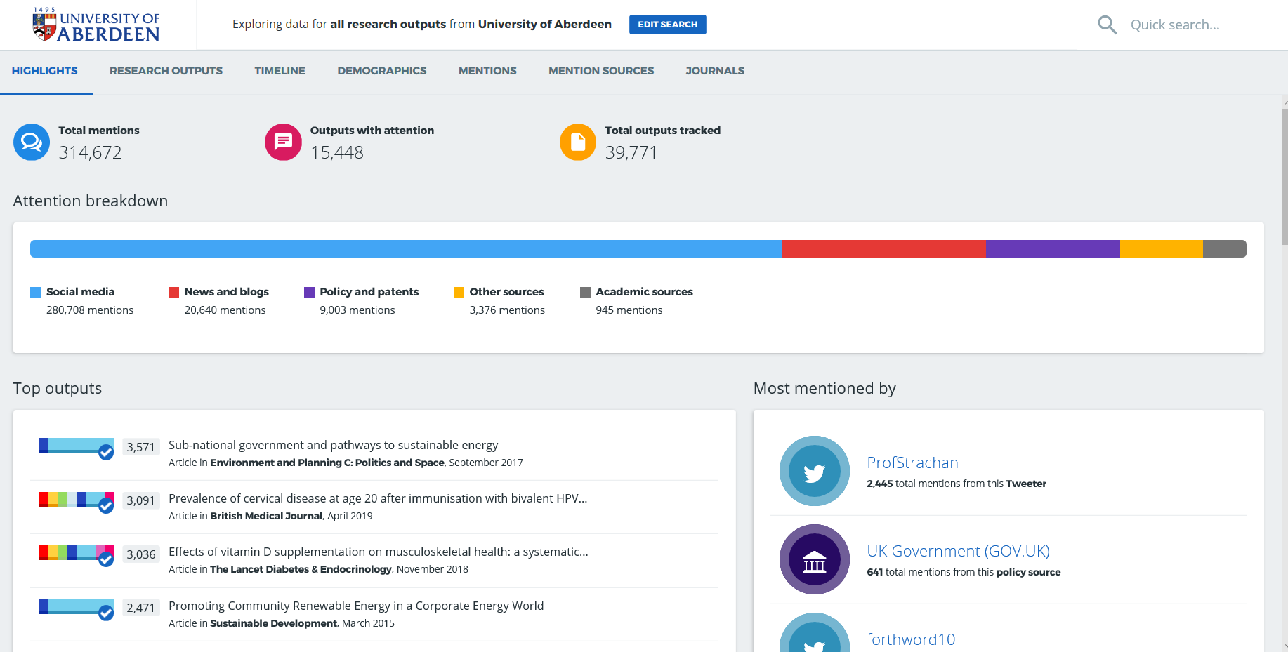
Step 3: Track your progress
Altmetric
Online presence
Altmetric is a third party website that helps researchers discover the reach and impact of their research.
Social media
Track your progress
You can login to the University of Aberdeen’s Altmetric portal here.
The screenshot was taken on February 3rd 2020.

Slide 34
Step 3: Track your progress
Altmetric
Online presence
When your paper is published, it is assigned a unique digital object identifier (DOI).
Altmetric uses the DOI to track where and how many times your publication has been used in news outlets, policy documents, social media, blogs, peer review websites, etc.
Social media
Track your progress
Remember to provide your paper’s DOI whenever you share or post about your work to ensure Altmetric can properly track its progress.

Slide 35
Step 3: Track your progress
Altmetric
Online presence
The University of Aberdeen is subscribed to Altmetric to allow our researchers to:
Discover the online attention their research has received.
Evidence potential research impact.
Provide additional evidence when applying for funding.
Social media
Track your progress

Slide 36
Step 3: Track your progress
Altmetric
Online presence
Social media
Check out the University’s guide to Altmetric.
Here is more information from
the Altmetric website.
Track your progress

Slide 37
Step 3: Track your progress
Publons
Online presence
Social media
Use Publons to track your publications, citation metrics, peer reviews, and journal editing work.
Track your progress
You can set up a Publons account here.

Slide 38
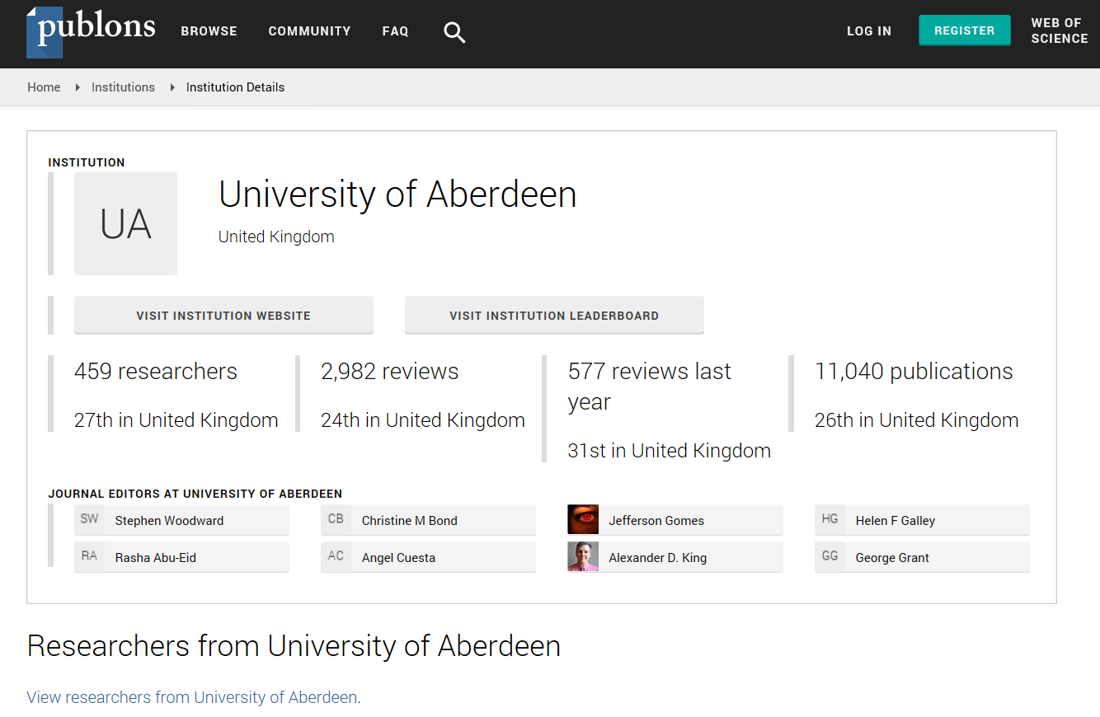
Step 3: Track your progress
Publons
Online presence
Social media
You can find the University of Aberdeen’s Publons profile here.
The screenshot was taken in January 2020.
Track your progress

Slide 39
Step 3: Track your progress
Konfer
Online presence
Konfer connects researchers, services and institutions in the UK. It is a good way to follow academic news and the research being led in different institutions.
Social media
Track your progress
You can get started on Konfer here.

Slide 40
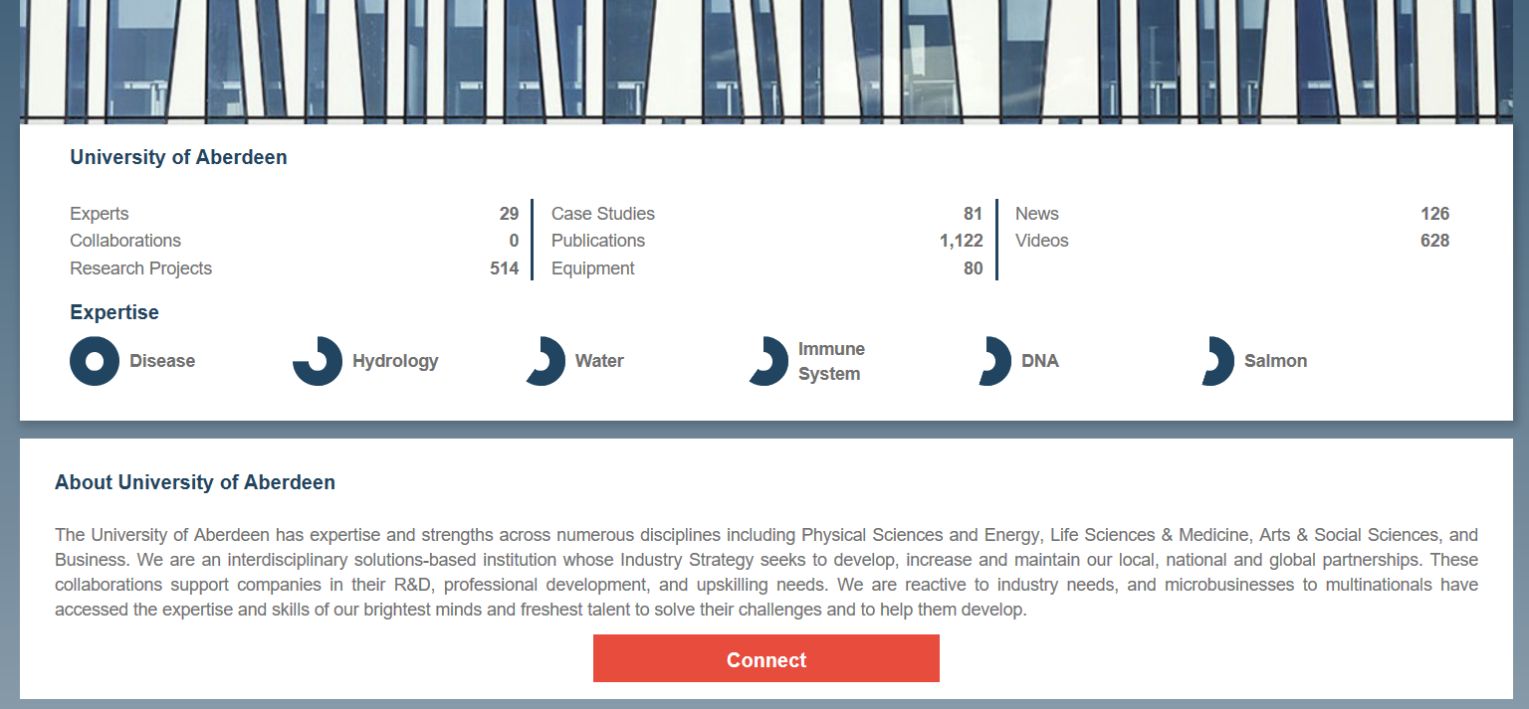
Step 3: Track your progress
Konfer
Online presence
Social media
You can find the University of Aberdeen’s Konfer profile here.
The screenshot was taken in January 2020.
Track your progress

Slide 41
Step 3: Track your progress
Online presence
Social media
With these tools, you can find out where and by whom your work is shared and cited.
This information can help you design and adjust your promotion strategy, and optimise your professional use of social media.
Track your progress

Slide 42
III. Summary and resources

Slide 43
Summary
Your digital footprint is an important part of your career as a researcher.
An effective use of digital tools allows you to network with fellow academics, engage with external stakeholders, discover the latest developments in your field and funding opportunities, and disseminate your research findings.
Steps you can take to develop your digital footprint include:
Setting up an ORCID ID, creating a professional account on different digital platforms, using online tools to share your research (i.e. PURE), promoting your work with social media (i.e. The Conversation), and tracking the progress of the dissemination of your research.
An effective digital presence will help you build a reputation among your peers, enhance the awareness of your work, make it more relevant to people following it, and finally maximise its impact.

Slide 44
Resources
JICS (Joint Information Systems Committee), ‘What is digital capability?’. https://digitalcapability.jisc.ac.uk/what-is-digital-capability/
Terra M., ‘What happens when you tweet an Open Access Paper’. http://melissaterras.blogspot.com/2011/11/what-happens-when-you-tweet-open-access.html
University of Cambridge, ‘Sharing Research effectively’. https://osc.cam.ac.uk/sharing-research-effectively
The University of Manchester Library, ‘7 Steps to maximise the profile of your next paper’. https://www.escholar.manchester.ac.uk/learning-objects/mre/7-steps/story_html5.html
Van Noorden R., ‘Online Collaboration: Scientists and the social network’, Published by Nature. https://www.nature.com/news/online-collaboration-scientists-and-the-social-network-1.15711

