Slide 1

Growing Successful Entrepreneurs

Slide 2

The Enterprise Fellowship scheme provides support to researchers and innovators who have promising science or technology-based business ideas.

Slide 3

Eligible technology areas . . .
Aerospace, defence and marine
Chemical sciences
Construction
Creative industries
Energy
Financial services
Food and drink
Forest and timber technologies
Life sciences
Manufacturing
Textiles
Tourism
Enabling technologies & convergent areas

Slide 4
The programme . . .
✓Buys you time: A 12 month salary will allow you to focus
on commercialising your research
✓ Provides business training
✓ Links you up with mentors
✓ Gives you access to entrepreneurial networks
✓ Supports you with up to £10K development funding

Slide 5




Funders
Scottish Enterprise welcomes applications from individuals based in Scotland who have a technology or science-based business idea.
New to the programme, QuantIC are supporting Fellowships for researchers working in the area of quantum technology.
BBSRC welcomes applications from individuals who have been connected to research previously funded by BBSRC. STFC welcomes applications from individuals who have been connected to research previously funded by STFC, PPARC, CERN and the EPSRC Nuclear Physics programme.
For BBSRC and STFC funding, applicants do not have to be the lead on a previous funded project but must have played some part in the research team.

Slide 6


Business training
Business training is provided by the Entrepreneur Business School.
It includes a 4-day Entrepreneur boot-camp , followed by 10 workshops spread throughout the year.
These sessions are based in different locations, determined by the geography of the cohort.

Slide 7
Strong record of success
For the 20 years that the RSE Enterprise Fellowship scheme has been running, it has supported over 200 fellowships.
In a recent survey:
92.5% of participants said the scheme gave them the confidence and skills to spin-out or start up their company
75% of those who set up businesses are either still trading or have sold their company
Over £63.24M follow-on investment was secured by survey respondents (50%)

Slide 8
Strong record of success
What do former Enterprise Fellows say about the programme?
Lets hear about their experiences . . .

Slide 9


University of Aberdeen entrepreneur . . .
James McIlroy, Enterprise Fellow 2017
Founder of EnteroBiotix Ltd
James McIlroy is the CEO of EnteroBiotix; a company he founded during his Scottish Enterprise funded RSE Enterprise Fellowship.
EnteroBiotix is an award winning biotechnology company that was established to support doctors treat a wide range of diseases by tapping into the power of the bacterial populations flourishing inside the human gut.
During his Fellowship, whist working out of the University of Aberdeen, James has been busy building his team, launching a new website and pitching to investors. In July last year he won £40K in the Scottish EDGE Awards and he was the Converge Challenge Social Enterprise Winner in 2015.

Slide 10
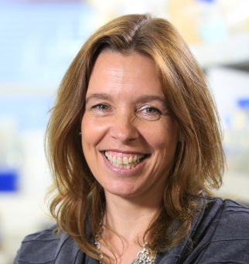

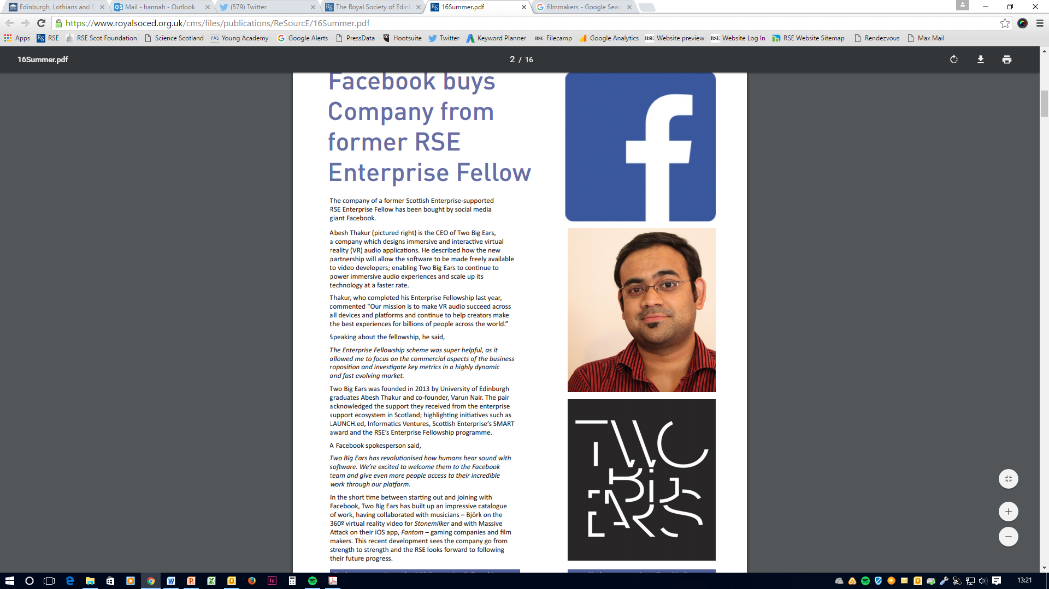
Recent successes of former Enterprise Fellows
Elasmogen, a next generation therapeutic biologics company which recently spun out of Aberdeen University, won the ‘Perfect Pitch’ biotechnology award at the BioTrinity 2016 conference in April last year.
Two Big Ears, a company that designs immersive and interactive virtual reality audio applications was acquired by social media giant Facebook in May 2016. Before the acquisition, the company had been working with filmmakers and musicians such as Massive Attack and Björk.

Slide 11
Selection committee
The selection committee looks for:
Effectiveness of technology - what is it and does it work?
Market potential - what problem is the individual providing a solution for?
Commercialisation - how will the individual commercialise the technology and what business model will they use?
Success in business - does the individual have the drive and ambition to succeed?

Slide 12
If you are interested…
Next closing date: 1 November 2017 then April 2018
For further information, please contact:
Anne Fraser, Awards Manager
The Royal Society of Edinburgh
22 - 26 George Street
Edinburgh , EH2 2PQ
Tel: 0131 240 5013
Email: afraser@theRSE.org.uk
www.rse.org.uk/awards/enterprise-fellowships

