Slide 1

Peer Assisted Learning: What do students and PAL Leaders get out of it?
Dr Mirjam Brady van den Bos
Dr Clare Kirtley
School of Psychology, University of Aberdeen
Notes:
Welcome to today’s session, my name is Clare, and I’m a Teaching Fellow in the School of Psychology. One of my roles is the PAL Co-Ordinator and organizer of this service in the school. There’s quite a bit of previous research on the role and effect of PAL in education, and myself and Mirjam were interested in exploring how this is shown in our own PAL service.

Slide 2
PAL: What is it?
Peer Assisted Learning
Students receive assistance and support from non-professional lecturers
I.e. other students
Topper & Ehly (2001) outline different approaches:
Peer tutoring, mentoring, counselling, assessment
Peer tutoring (some students take the role of tutor to help others) is the most common
Notes:
What is PAL: Peer Assisted Learning- Topping and Ehly (2001): students are assisted in their learning, in an active and interactive manner, by other learners i.e. those who aren’t professional tutors/lecturers
A system where helpers/leaders are assisting other students to learn, in a way that is complementary to the usual teaching students receive
Help and support from people who are at a similar level of understanding, a collaborative approach
Different types, but the most common is PAL tutoring,where some students take the role of tutor, and others as tutees, with much of the focus on curriculum content (mentoring is more one to one,
the key idea being that students come to other students for support around academic areas: this can be for coursework/revision and more specific assessments, but also more general academic skills, such as finding experience, what the thesis selection process will be like, worries about how the next year of study might work
Learning not just from lecturers, but from their peers: those who have been in a similar circumstance previously, and are perhaps therefore seen as more approachable and able to explain things on an understandable level (and a certain amount from each other as well)
PAL Is social and collaborative

Slide 3
The pros of PAL: Students
PAL sessions can potentially benefit both student attendees and student leaders
Higher grades in students who attend PAL
Ashwin, 2003; Cheng & Walters, 2009; Glynn et al, 2006
Broader benefits
Reduction of stress (Glynn et al, 2006)
Deeper approach to learning (Ladyshewsky and Gardner, 2008)
Smoother transition into university (Dawson et al, 2014; Byl et al, 2015)
Better social/academic integration, which benefits ongoing development of learning skills (Tinto & Pusser, 2006)
Notes:
The advantages for students attending PAL:
Evidence for raised grades in first yr students attending PAL sessions: Ahswin, 2003, Coe et al, 1999, Loviscek and Cloutier, 2001, Cheng and Walters, 2009, Ediger, 2007, Glynn et al, 2006: although this kind of comparison will suffer a bit from the self selecting nature of voluntary PAL sessions
However, beyond more quantitative comparisons of grades between groups, there is also evidence that PAL attendance has further, longer lasting benefits for students
Glynn et al, 2006: a reduction of stress about the course, and greater satisfaction in the course
Increased student retention, Congos & schoeps, 1993, deeper approach to learning Ladyshewsky and Gardner, 2008, an enhancement of transition into university and increased satisfaction with courses, Dawson et al, 2014, Keenan, 2014, Byl et al, 2015
More broadly still: Tinto and Pusser, 2006: helps with social and academic integration into the new environment of university, which has been subsequently found to affect intellectual development, enganced learning and success. Seen as a key foundation for future years, so most important for first year students
Prev work: Loviscek amd Cloutier, 2001, Byl et al, 2015- benefits of PAL to students
Donelan, 1999- benefits to the students who act as leaders
Quantitative approach: the obvious comparison of grades in those who attend vs those who don’t- studies do show a difference, but some of this might well be coming from the fact that keen students are more likely to attend PAL as part of their motivation to do better
Focus on first years

Slide 4
The pros of PAL: Leaders
Evidence PAL Leaders experience their own benefits
Development of teamwork and communication skills
Conelan, 1999; Ashwin, 2003
Changing views of learning, as a more social process
Ashwin, 2003
Re-learning through reviewing work
Capstick, 2004
More positive attitudes towards future social responsibilities
Hodgson et al, 2014
Notes:
The benefits to the students who act as tutors (PAL Leaders in School of Psychology)
Development of teamwork and communication skills (Conelan, 1999, Saunders and Gibbon, 1998, Ashwin 2003: a more social view of learning develops
An enhancement of sklls and more positive attitudes towards future social responsibilities (Hodgson et al, 2014)
Capstick, 2004: relearning thru reviewing prior work, personal development, and getting to know other students

Slide 5
The cons of PAL?
Potential pit-falls of PAL sessions:
Students’ marks increase due to learning specific approaches to assignments, rather than how they approach learning (Ashwin, 2004)
Students may be put off from attending if they perceive the PAL Leaders as having low expertise (Capstick, 2004)
Notes:
Previous work has also highlighted that there may be issues with PAL sessions, that should be considered when designing the process
Ashwin 2003: attending PAL- a reduction in learning: students marks go up, but because they’re using the insight from leaders to work out how to get through this particular assignment, rather han a general improvement in how learning is approached
Students perceptions of PAL can affect whether they attend- why be taught by ppl of their own level when there are lecturers right there? Perceived expertise of leaders questioned, Capstick 2004

Slide 6
Theories of PAL
Several broader education theories indicate why PAL might have an impact
Increased academic/social integration (Tinto, 1992)
Modelling of successful learning strategies from leaders (Vygotsky, 1968)
Reduced social distance in the relationship between tutor and tutee (Lave & Wenger, 1995)
Notes:
Tinto and Pusser, 2006: the importance of social and academic integration- learning about the attitudes and approaches of their peers/lectueres and coming to share them, and understanding the rules and requirements of, e.g. being a psychology student
Collaborative learning/Social constructivism: learning as a process, with others- the collaborative approach, helping students develop skills as self regulated learners, able to monitor and evaluate their progress
Vygotsky (1978)- learning thru social interaction: and this assistance is a more socially equal one, and one that is more interactive than a teacher-student interaction can sometimes be, or that could occur with a student learning on their own. Aspects of the zone of proximal development: the PAL Leaders can model how they themselves have used particular learning strategies, giving the newer students guidance on how they themselves might approach this
Lave & Wenger (1995): Social distances in relationship between tutor and tutee, reduced distance cf student and lecturer

Slide 7
PAL in the School of Psychology
PAL runs for each year of UG study and Psychology conversion course
Leaders are students in the year(s) above
MSc: 4th year students
L4 PAL: PG students
3-4 Leaders per year group
One PAL Team Leader, elected by other leaders
PAL Co-Ordinator: member of staff who facilitates admin aspects
Notes:
PAL in Psychology
Years 1-3: leaders in years above, either directly above, but also 4th /3rd yr leaders in 1st/2nd year sessions
MSc: 4th years, as they have done the theory and methods aspects of the MSc course before
L4 PAL: new this year, leaders are PG students who did their UG at Aberdeen, focus is on the thesis
PAL Team Leader: Organises other leaders, communicates between leaders and co-Ordinator, helps with leader selection and gets info
PAL Co-Ordinator books rooms, communicates with staff, provides training

Slide 8
PAL in the School of Psychology
Focus: Curriculum/Pastoral
Content: Lecturer determined/Student determined
Occurs: Consistently/Ad hoc
Open to: All students/Students who are struggling
Attendance: Voluntary/Compulsory
PAL Leaders: Paid/Volunteers
Staff involvement: Minimal/High
Notes:
Topping (2005) lays out particular characteristics that can vary amongst different PAL approaches: This is where we fall on these options

Slide 9
The current study
Previous work has shown the benefits PAL can have for students and leaders
Do we see similar outcomes here?
Most PAL schemes are aimed at first year students
Do students (both attendees and leaders) in different years get similar benefits from PAL?
Notes:
Study Questions/Goal:
Our broader question: What does PAL mean to students at different levels?
More specifically, since many other PAL schemes are 1st yr focused only:
Are the different years of PAL important for students and tutors in the same way at each level?
With the future question: How can we design PAL at each year to get the best out of it for the students?

Slide 10
Methods
Nov-Dec 2021: Quantitative questionnaires
Students attending PAL
Current PAL Leaders
Participants asked to rate their agreement with several statements on how they feel PAL has contributed to aspects of learning
Thinking about the PAL sessions you have attended/led, how much do you agree that they contributed to the following points?
Increased understanding of basic concepts in Psychology
Better understanding what the lecturers expect from you in assignments?
How you settled into university?
Students increased understanding of concepts in Psychology?
Your own increased understanding of concepts in Psychology?
STUDENTS
LEADERS
Notes:
Questionnaires asked students to rate their agreement with several statements in terms of how PAL contributed to various areas
For PAL Leaders, for several items they were asked to consider how much they believed these aspects had contributed to both their own and the students experiences
Categories: academic influence (understanding of concepts, scores on tests), university life (settling into uni, understanding how the course works) as a Psychology student (confidence in abilities)
They were also asked to briefly give answers as to why they chose to attend PAL sessions, or became PAL Leaders

Slide 11
Methods
Spring 2022: Qualitative focus groups
Students attending PAL
Current PAL Leaders
Questions expand on initial survey:
Students: reasons for attending PAL; perceived effects of the sessions; expectations around PAL
Leaders: reasons for becoming a leader; preparation for sessions; view of role in sessions

Slide 12
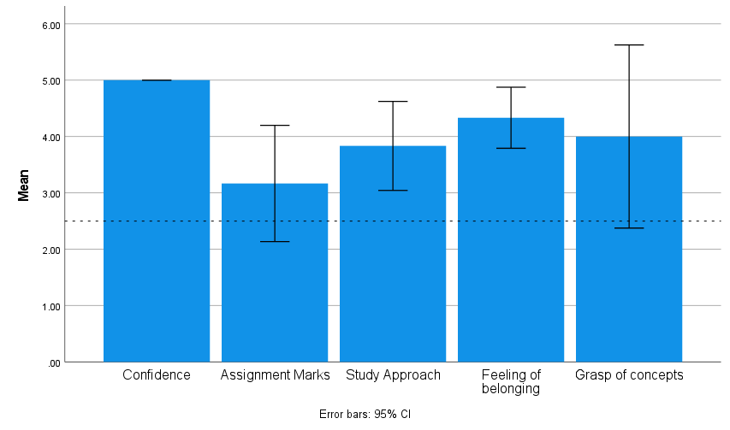
Part 1 Results: Leaders
6 participants
M_{age} = 21.5; 2 males
3rd and 4th year students
Leaders for L2 and L3
On their own experiences, Leaders felt PAL had helped with
Their confidence
Their study approach
Their feelings of belonging to the School of Psychology
Notes:
Leaders were asked to rate their agreement on statements related to both their own experiences, and their judgements of the students
Analysis: one sample t-tests comparing the average rating to the mid-point of the 5-point scale
Thinking on their own experiences: influence on the marks they received, understanding of context, sense of anxiety about their performance; their own sense of belonging and their own study
Significant difference emerges: Average rating of their own confidence: 5’s across the board Their own belonging: sig higher than midpoint
The way they choose to study: sig higher than midpoint

Slide 13
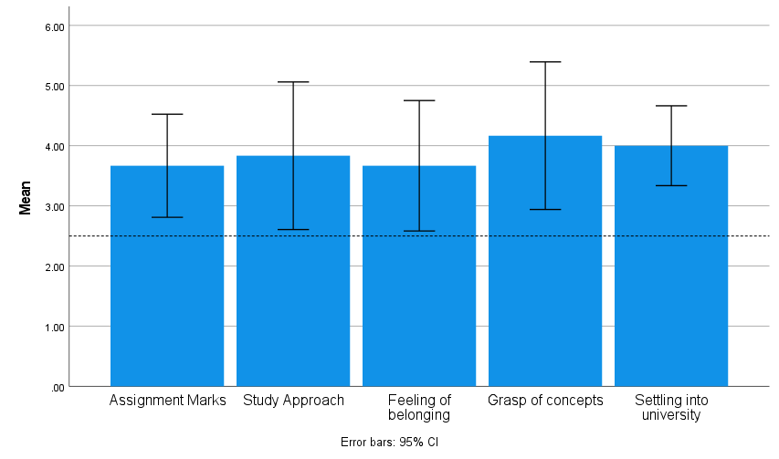
Part 1 Results: Leaders
On their judgement of how PAL affected students who attended
Leaders felt that PAL helped students with all these points:
Assignment marks
Approach to study
Feeling of belonging
Grasp of concepts
Settling into university
Notes:
On their opinions of the influence of PAL on the students who attended- everything was significant
(To be fair, do leaders have a vested interest in saying that these things are helped by their actions?)

Slide 14
Results- Leaders: Reasons to become a leader
Commonalities among the responses to ‘why did you want to become a PAL leader?’
Positive previous experience of leaders
“I was always interested in PAL. even though I didn't go to many of the PAL sessions offered to me, the ones I went to were always very helpful”
“I became a PAL leader because when I was in third year the leaders were so helpful and genuinely think I would have failed all the assignments if I didn't go to PAL”
Experience for future career plans
“I want to go into education after my degree as I enjoy working with students, so I thought PAL would be a natural extension of this”
“I wanted to do some voluntary work for work experience”
Notes:
A very rough summary of the responses: but there were commonalities amongst the responses provided
Good previous experiences of PAL when they were attending as students
Experience for CV/career plans
Fulfilling for self/way to keep busy

Slide 15
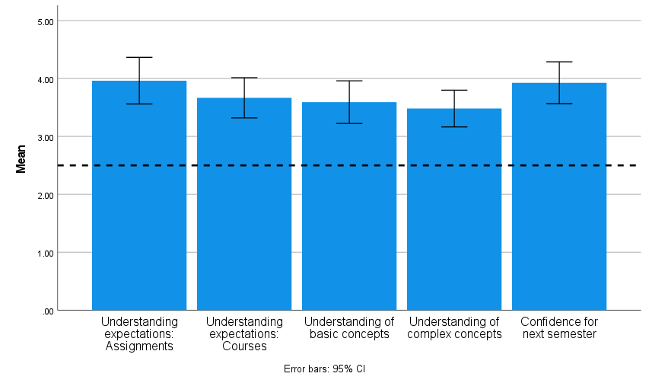
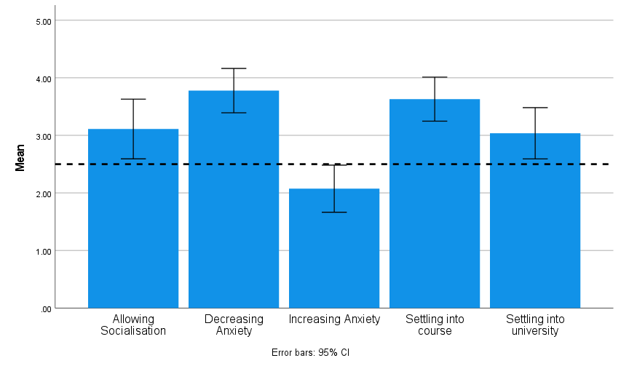
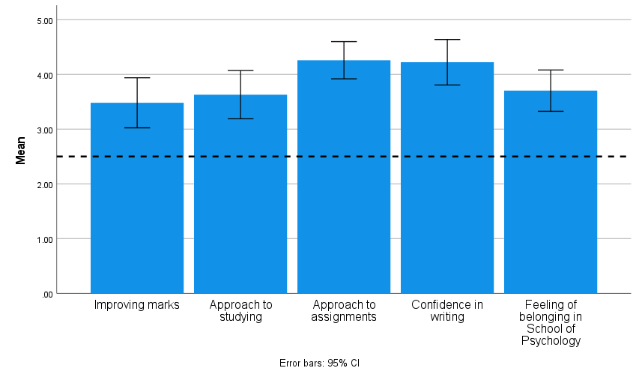
Part 1 Results: Students
27 Students
M_{age}= 23.19, 4 males
6 1st years, 8 2nd years, 5 3rd years, 3 4th years, 5 ND
Notes:
27 Students responded, M age: 23.19; 4 males, most had attended in previous years, 5 were first years, 7 had attended first time this year
6 first yrs, 8 2nd years, 5 3rd years, 3 4th years, 5 who didn’t say
1-way ANOVA run across the years to compare responses
One way t tests to compare to the midpoint (socialization only marginal, as is settling into uni; ns for pal increasing anxiety)
Otherwise it does seem that students do feel that this process is having some effect on their learning.

Slide 16
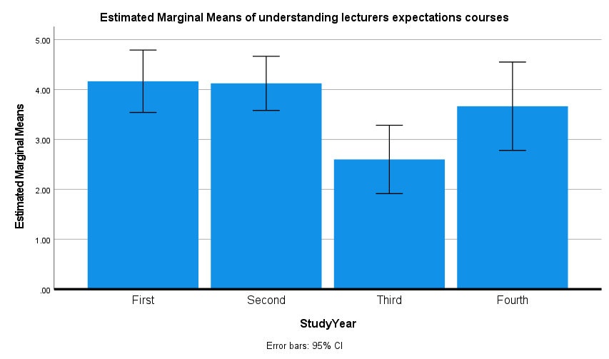
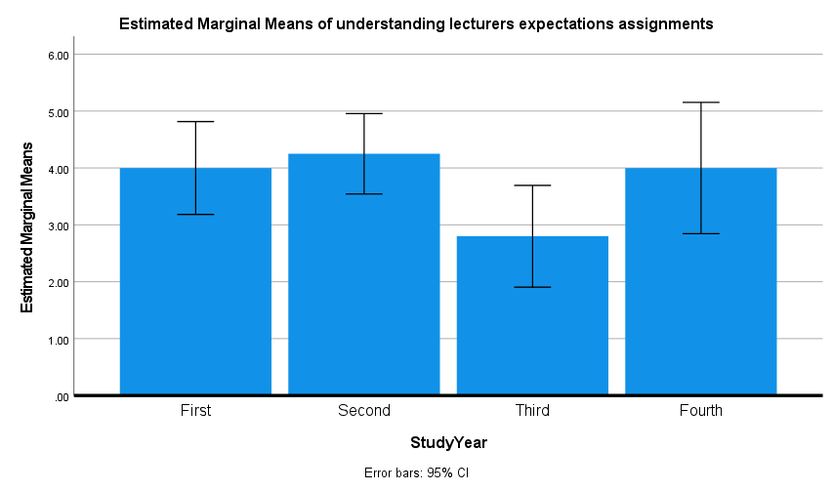
Part 1 Results: Students
Consistent pattern across all questions, some of which are significant
Third year students show less agreement that PAL contributes to these aspects, compared to first and second years
‘PAL helps me understand what my lecturers expect from me for assignments’
‘PAL helps me understand what my lecturers expect from me across the course’
Notes:
Does this differ across the years of study? Only for some of them, but there is a typical pattern even in the ones that don’t reach significance (for here, removed those Ps where there was no indication of their level of study)
Understanding what lectuers require, in specific assignments and across the course

Slide 17
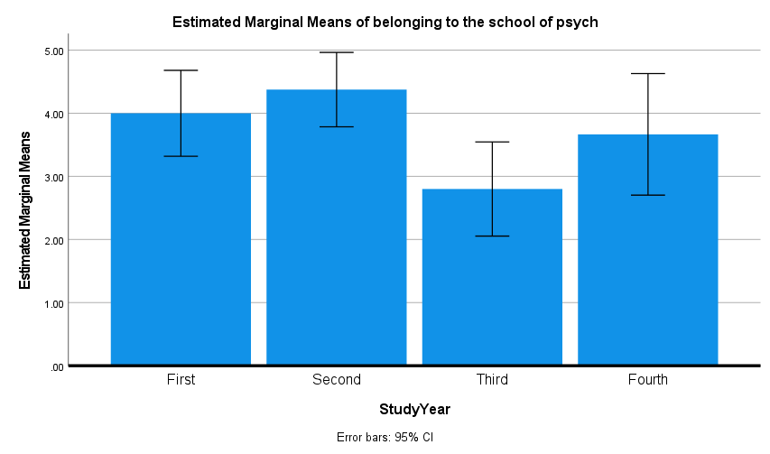
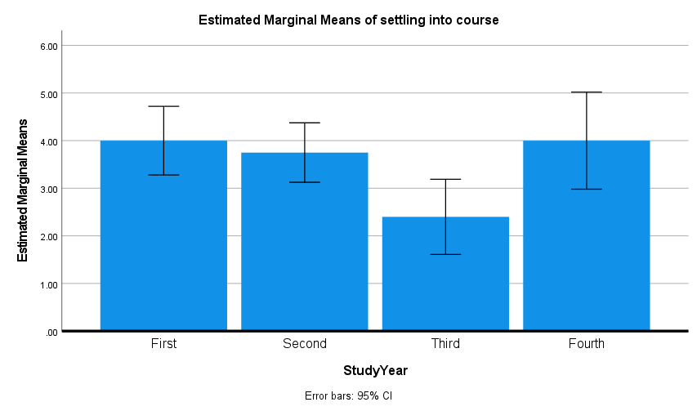
Part 1 Results: Students
Consistent pattern across all questions, some of which are significant
Third year students show less agreement that PAL contributes to these aspects, compared to first and second years
‘PAL increased my feeling of belonging to the School of Psychology’
‘PAL contributed to how I settled into my course’
Notes:
Does this differ across the years of study? Only for some of them, but there is a typical pattern even in the ones that don’t reach significance
And feelings of belonging and settling into the course

Slide 18
PAL research – qualitative data
Interviews with students attending PAL (watch this space)
Interviews with PAL leaders (3)
Interviewed through Teams by Dr Aaron Thom
Data analysis:
Contextualist Thematic Analysis (Braun & Clarke, 2006)
Descriptive
Also latent and interpretative

Slide 19
Questions we asked them:
Could you tell me why you initially signed up to be a PAL leader?

Slide 20
Questions we asked them:
Could you tell me why you initially signed up to be a PAL leader?
Could you describe to me how you typically prepare for a session? And once you’re in the session, how do you go about it?

Slide 21
Questions we asked them:
Could you tell me why you initially signed up to be a PAL leader?
Could you describe to me how you typically prepare for a session? And once you’re in the session, how do you go about it?
Now when you’re tutoring, when you’re in the session, how do you know what to do?

Slide 22
Questions we asked them:
Could you tell me why you initially signed up to be a PAL leader?
Could you describe to me how you typically prepare for a session? And once you’re in the session, how do you go about it?
Now when you’re tutoring, when you’re in the session, how do you know what to do?
This may be a bit of a hard question, so don’t worry if you can’t answer it straight away, but what do you think learning is? What happens to a person when they learn?
And along the same lines, what do you think teaching is?

Slide 23
Questions we asked them:
Could you tell me why you initially signed up to be a PAL leader?
Could you describe to me how you typically prepare for a session? And once you’re in the session, how do you go about it?
Now when you’re tutoring, when you’re in the session, how do you know what to do?
This may be a bit of a hard question, so don’t worry if you can’t answer it straight away, but what do you think learning is? What happens to a person when they learn?
And along the same lines, what do you think teaching is?
Now I’d like to ask you some specific questions about your experiences. Could you describe to me a moment during your time as PAL leader that was particularly positive? Why was it so positive?

Slide 24
Questions we asked them:
Could you tell me why you initially signed up to be a PAL leader?
Could you describe to me how you typically prepare for a session? And once you’re in the session, how do you go about it?
Now when you’re tutoring, when you’re in the session, how do you know what to do?
This may be a bit of a hard question, so don’t worry if you can’t answer it straight away, but what do you think learning is? What happens to a person when they learn?
And along the same lines, what do you think teaching is?
Now I’d like to ask you some specific questions about your experiences. Could you describe to me a moment during your time as PAL leader that was particularly positive? Why was it so positive?
And could you describe a moment that you would rather forget?

Slide 25
Questions we asked them:
Could you tell me why you initially signed up to be a PAL leader?
Could you describe to me how you typically prepare for a session? And once you’re in the session, how do you go about it?
Now when you’re tutoring, when you’re in the session, how do you know what to do?
This may be a bit of a hard question, so don’t worry if you can’t answer it straight away, but what do you think learning is? What happens to a person when they learn?
And along the same lines, what do you think teaching is?
Now I’d like to ask you some specific questions about your experiences. Could you describe to me a moment during your time as PAL leader that was particularly positive? Why was it so positive?
And could you describe a moment that you would rather forget?
We often talk about the effects of PAL on the students who attend it as tutees, but we’re also interested to see if there are any effects on the PAL leaders as well. Speaking from your experience, do you think there are any effects on you as well?

Slide 26
Questions we asked them:
Could you tell me why you initially signed up to be a PAL leader?
Could you describe to me how you typically prepare for a session? And once you’re in the session, how do you go about it?
Now when you’re tutoring, when you’re in the session, how do you know what to do?
This may be a bit of a hard question, so don’t worry if you can’t answer it straight away, but what do you think learning is? What happens to a person when they learn?
And along the same lines, what do you think teaching is?
Now I’d like to ask you some specific questions about your experiences. Could you describe to me a moment during your time as PAL leader that was particularly positive? Why was it so positive?
And could you describe a moment that you would rather forget?
We often talk about the effects of PAL on the students who attend it as tutees, but we’re also interested to see if there are any effects on the PAL leaders as well. Speaking from your experience, do you think there are any effects on you as well?
Finally, for any new student becoming a PAL leader, what advice would you give them?

Slide 27
Themes and thoughts so far
An unsurprising theme:
Being PAL leader has benefits for oneself
Affective
“I don’t know if this is like an ego thing or not but it feels nice to have helped someone figure something out”
Cognitive
“I think that kind of mentoring people on what to do academically is a very good way to actually learn better”

Slide 28
More interesting themes:
“We are not lecturers”
Notes:
Which makes me wonder… what do they think of lecturers? What can lecturers learn from PAL leaders?

Slide 29
More interesting themes:
“We are not lecturers”
PAL leaders don’t want to be called tutors
“I don’t really like to call what I do in PAL tutoring because … I really strongly believe in the peer-led power of PAL ok… I call the other people the other students that attend simply ‘other students’ ok”
“because you’re in this position where you are ‘tutoring’ let’s say for lack of a better word that it’s easy to fall into this role of being a teacher or like lecturer when actually that’s not what we’re here to do”
Notes:
Which makes me wonder… what do they think of lecturers? What can lecturers learn from PAL leaders?

Slide 30
More interesting themes:
“We are not lecturers”
PAL leaders don’t want to be called tutors
“I don’t really like to call what I do in PAL tutoring because … I really strongly believe in the peer-led power of PAL ok… I call the other people the other students that attend simply ‘other students’ ok”
“because you’re in this position where you are ‘tutoring’ let’s say for lack of a better word that it’s easy to fall into this role of being a teacher or like lecturer when actually that’s not what we’re here to do”
Student centered approach during session
“we’re always being reactive to the needs of the current students so our sessions are always built to be as flexible as possible”
Notes:
Which makes me wonder… what do they think of lecturers? What can lecturers learn from PAL leaders?

Slide 31
More interesting themes:
“We are not lecturers”
PAL leaders don’t want to be called tutors
“I don’t really like to call what I do in PAL tutoring because … I really strongly believe in the peer-led power of PAL ok… I call the other people the other students that attend simply ‘other students’ ok”
“because you’re in this position where you are ‘tutoring’ let’s say for lack of a better word that it’s easy to fall into this role of being a teacher or like lecturer when actually that’s not what we’re here to do”
Student centered approach during session
“we’re always being reactive to the needs of the current students so our sessions are always built to be as flexible as possible”
Based on PAL leaders’ own experience as students
“I’m a student just as you are I’ve been here before and this is what I think”
Notes:
Which makes me wonder… what do they think of lecturers? What can lecturers learn from PAL leaders?

Slide 32
PAL leaders have well-developed ideas of teaching and learning
“I think learning broadens an individual’s sense of being you know … and self … so I think yeah I think learning is like expanding who you are in some beneficial way”
“teaching is somehow empowering students to then do and be themselves you know what I mean rather than just teaching for learning’s sake or for knowledge’s sake it’s actually about making sure that students know what to do with their knowledge”
“learning to me is always just finishing the day saying I’ve gone forward to achieve my final goals in some respect”

Slide 33
Thoughts so far…
PAL Leaders
Benefits for confidence, belonging, and approach to working
Agreement with previous findings
But maybe NOT: ‘modelling learning strategies’
Students
Similar feeling that PAL benefits them
More pronounced for earlier years (1st/2nd)- and 4th years
Most useful at the points where a major new aspect is introduced?
Less impact on socialisation- a casualty of the restrictions?
Notes:
PAL Leaders: on the quant side, they feel that students do gain a lot from PAL- high agreement that it helps them in all areas. For their own benefits, they are more selective, but still feel that certain aspects have been improved- such as confidence, belonging and the way they work: in line with earlier work on the benefits for PAL Leaders
But maybe NOT: ‘modelling learning strategies’: it may be that for students attending PAL, they model their learning strategies on the PAL leaders, in line with Vygotsky’s ideas. However, our qualitative data so far suggest that PAL leaders do not model their tutoring strategies on how they have been taught (i.e., the behaviour of the lecturers). Instead, they lead the sessions based on their experience as a student.
Students: ½ yrs are more affected- the period where they are newest to the school so aspects like increasing belonging, understanding the course etc. are of most importance: 3rd years are already more settled? Does this mean that PAL attendance in 3rd year is low? No, actually, it’s often one of the more attended sessions, so are they getting something different out of it, or is it the same benefits, just reduced (one among several supports they have found?)
Note that 4th years show an increase- the key focus here is on the thesis project, which is new to students- so even though they are at a later stage in their uni career, the expected benefits of PAL in this specific area re-emerge
Socialising: this is something that was scored lower: PAL Has moved online in 2020-2022, and it maybe that this is affecting the feeling of togetherness and getting to know people.

Slide 34
What’s next?
Continue to interview more leaders/students on their experiences!
Further exploration of the differences between years of study
Future work:
PAL Leaders and learning to learn
Online PAL vs offline PAL?

Slide 35

Questions/Comments?

