Slide 1

Educational research for the (mostly) uninitiated
Professor Jennifer Cleland
John Simpson Chair of Medical Education Research
Former Chair, Association for the Study of Medical
Education (ASME)
Deputy Editor, Medical Education
Associate Editor, Advances in Health Sciences Research

Slide 2
Overview
Research assumptions
The research process – the necessity of paradigmatic alignment
Examples
The first steps
Use of theory
Useful strategies for setting out on your pedagogic research journey

Slide 3
Introductions

Slide 4


Slide 5
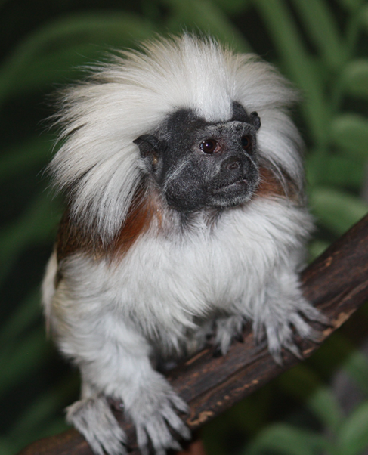


Slide 6



Slide 7




Slide 8
Introductions
Your training and disciplinary backgrounds
Your underlying beliefs about the nature of research
  About the nature of knowledge and reality
  About how one understands knowledge and reality
  About the process of acquiring knowledge and knowledge about reality
  And the researcher’s role in the process

Slide 9

Important concepts
Epistemology
Ontology

Slide 10
McMillan W. Theory in healthcare education research:
the importance of worldview. In Cleland JA & Durning SJ.
Researching Medical Education. 2015. Wiley: London.

Slide 11
Assumptions
Quantitative
Qualitative
Positivism/post-positivism
There is one objective reality
Which can be measured
A specific variable of interest can be isolated
Constructivism/ interpretativism
Reality is socially constructed
“Variables” are complex, social and intertwined (and cannot be isolated)

Slide 12
The process of a study or programme of study
Assumptions - situating your work philosophically (paradigmatically)
Study design
Methodology and Methods
Data management and initial analysis
Interpreting your data

Slide 13
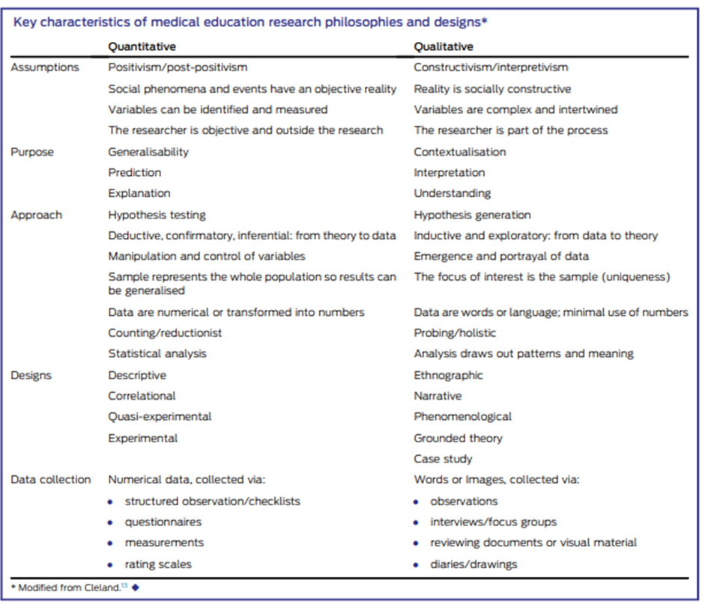

Slide 14


Slide 15
Students
Blamed others
Personal problems
Overestimated their competence
Systems
Underperformance not identified earlier in the curriculum “bumping along”
Assessment and feedback less than perfect, particularly on wards/placements
Didn’t study effectively
Didn’t seek help (as didn’t perceive any issues)

Slide 16

More questions
A small study but led to lots of research questions
  Does early performance predict later performance in the whole cohort?
  Why are we “passing” weak students?
  Do “weak” and “good” students differ in their behaviour?
  Do we support underperforming students well enough?

Slide 18
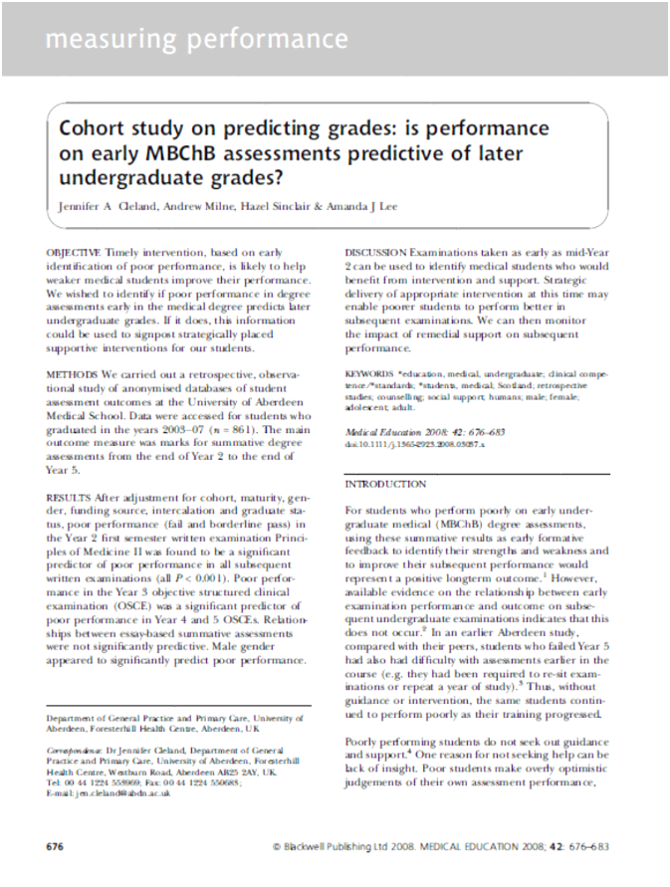
Objective, a priori and deductive…
Our theory – early identification of difficulties and timely intervention, will help weaker students improve
Our hypothesis - poor performance in early assessments predicts later poor performance
Our population - students
Our variables – exam scores
Our approach – statistical analysis

Slide 19
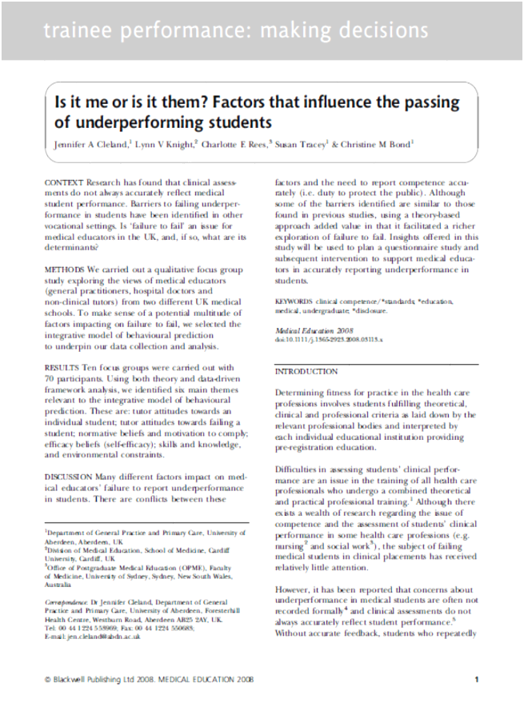
Subjective, exploratory, theory followed
Our question -why do assessors fail to report underperformance in medical students?
No “hypothesis” – open question
Purposive sampling (tutors)
Our approach – exploratory, interpretative
No variables or analysis

Slide 20

Notes:
Alignment is critical! Example of paper I reviewed saying it was from a positivist perspective yet used semi-structured interviews…

Slide 21
Language is important
Cleland JA. Exploring versus measuring: considering the fundamental differences between quantitative and qualitative research.
In Cleland JA & Durning SJ. Researching Medical Education. 2015. Wiley: London.

Slide 22
Language is important
Cleland JA. Exploring versus measuring: considering the fundamental differences between quantitative and qualitative research.
In Cleland JA & Durning SJ. Researching Medical Education. 2015. Wiley: London.

Slide 23




Inspiration!

Slide 24
The first steps
Define your research question
No gap in the literature
Gap in the literature
Conduct a literature review
Refine your research question

Slide 25
FINER Research questions
Feasible
Interesting
Novel
Ethical
Relevant
A well defined research question is key to making decisions about study design, study participants/population, data collection and analysis

Slide 26
The use of theory in pedagogic research
Pedagogic papers and research from “non-educationalists” criticised because of lacking an explicit theoretical basis, and/or methodological rigour ¹⁻³
Theory: “An organized, coherent, and systematic articulation of a set of issues that are communicated as a meaningful whole”⁴
Recent attempts to address this in my particular field ⁵
Things are definitely improving!
1. Albert M, Hodges B, Regehr G. Adv Health Sci Educ. 2007;12(1):103–15.
2. Bordage G. Med Educ. 2009;43(4):312–9.
3. Teunissen PW. Med Educ. 2010;44(6):534–5.
4. Reeves S, Albert M, Kuper A, Hodges BD. BMJ. 2008;337(7670):631–4.
5. Cleland and Durning. Researching Medical Education. Wiley 2015.

Slide 27

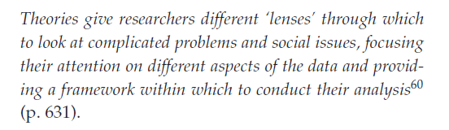

What theory?!
Adopting a theoretical position involves a process of privileging some data over other data
Notes:
What does each lens foreground and occlude? Think of levels of analysis
Macro, meso and micro. Whats the danger of each – looking at the micro means missing structural/organisational influences on behviour and social processes.
Micro – you miss social processes operating on the ground.

Slide 28


Useful strategies for setting out
Align opportunities with your “day job” and interests
Recognise your limitations and collaborate!
Network/get out there/see what others are up

Slide 29
Summary
Good educational research needs:
To be topical and of interest to your community
Have a good research question which is clearly grounded in the literature
Be clearly underpinned in terms of assumptions
Use paradigmatically aligned design, methodology, methods, analysis approaches and language to answer the question
Use theory appropriately

Slide 30
Really useful resources
How to get clear about method, methodology, epistemology and ontology, once and for all. Video recording from a workshop by Professor David James at the ESRC First Year Student Conference in Cardiff, January 2015
http://walesdtp.ac.uk/onlinematerials/how-to-get-clear-about-method-methodology-epistemology-and-ontology-once-and-for-all/
Bordage, G. (2009) Conceptual frameworks to illuminate and magnify. Medical Education, 43, 312–319.
Cleland JA. Exploring versus measuring: considering the fundamental differences between qualitative and quantitative research. In: Researching Medical Education, First Edition. Edited by Jennifer Cleland and Steven J. Durning, 2015, p. 3-14.
Creswell, J.W. (20133-14) Educational Research: Planning, Conducting, and Evaluating Quantitative and Qualitative Research, 4th edn. Pearson, Boston.
Creswell, J.W. & Plano Clark, V.L. (2010) Designing and Conducting Mixed Methods Research. Sage Publications,Thousand Oaks, CA.

Slide 31

THANK YOU AND QUESTIONS
jen.cleland@abdn.ac.uk

Slide 32
Next PIN meeting
Tuesday 25th Feb 2020
Dr Nigel Beacham
Senior Lecturer, Computing Science
"The need for effective cloud-based Integrated Development Environments in H.E.“
VC-Room A04, Postgraduate Research School, Crombie Hall, OA Campus & Foresterhill Campus, Room TBA or via Collaborate

