Slide 1

Pedagogical Inquiry Network
12 Speakers of Christmas!
15 December 2021
This Photo by Unknown Author is licensed under CC BY-NC

Slide 2

On the first day…..
A partridge in a pear tree: Heather Morgan, Lecturer (Scholarship) School of Medicine, Medical Sciences and Nutrition
2 turtle doves: Heather Branigan Teaching Fellow & Jacqui Hutchison, Teaching Fellow, School of Psychology
3 French hens: John Storm, Senior Lecturer (Scholarship), Business School
4 calling birds: Vasilis Louca, Senior Lecturer (Scholarship), School of Biological Sciences
5 gold rings: Kirsty Kiezebrink, Dean for Educational Innovation & Institute of Applied Health Sciences Education Lead
6 geese a-laying: Ceri Trevethan, Lecturer (Scholarship), School of Psychology

Slide 3
7 swans a-swimming: Joy Perkins, Educational & Employability Development Adviser, Centre for Academic Development
8 maids a-milking: Anne Tierney, Assistant Professor, Learning and Teaching Academy, Heriot-Watt University
9 ladies dancing: Kirsty Kiezebrink, Dean for Educational Innovation & Institute of Applied Health Sciences Education Lead
10 lords a-leaping: Bruce Scharlau, Senior Lecturer (Scholarship), School of Natural and Computing Sciences
11 pipers piping: Neil Lent, Lecturer (University Learning & Teaching), Institute for Academic Development, University of Edinburgh
12 drummers drumming: Mirjam Brady-Van den Bos, Lecturer (Scholarship), School of Psychology

Slide 4

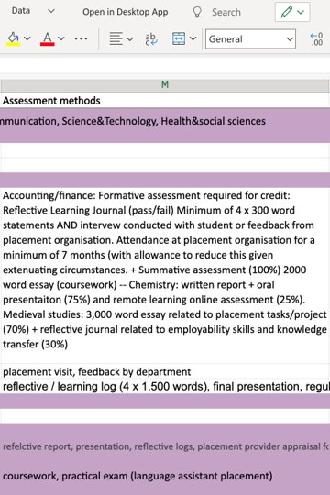

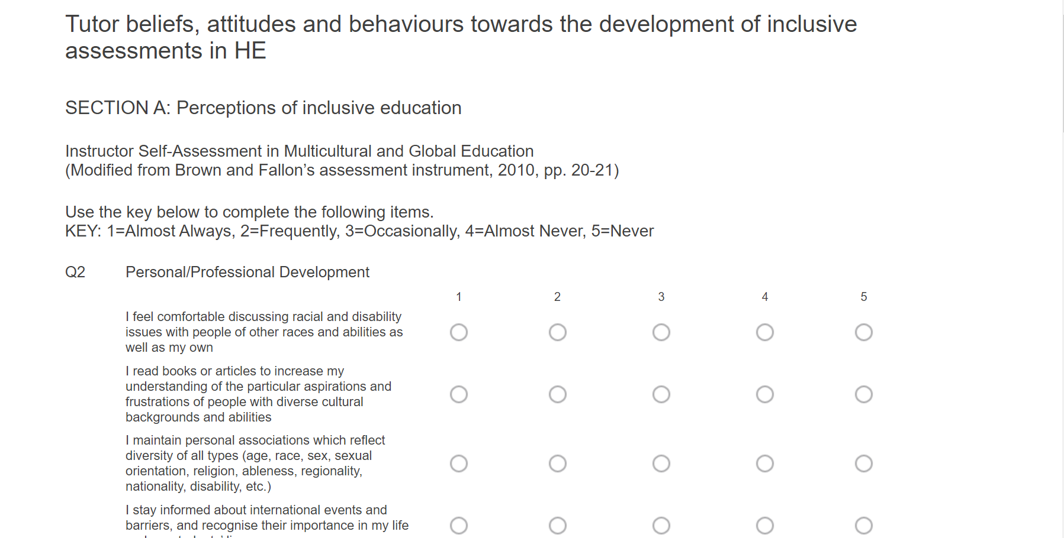
On the first day… Dr Heather May Morgan
Lecturer (Scholarship) in Applied Health Sciences

Slide 5
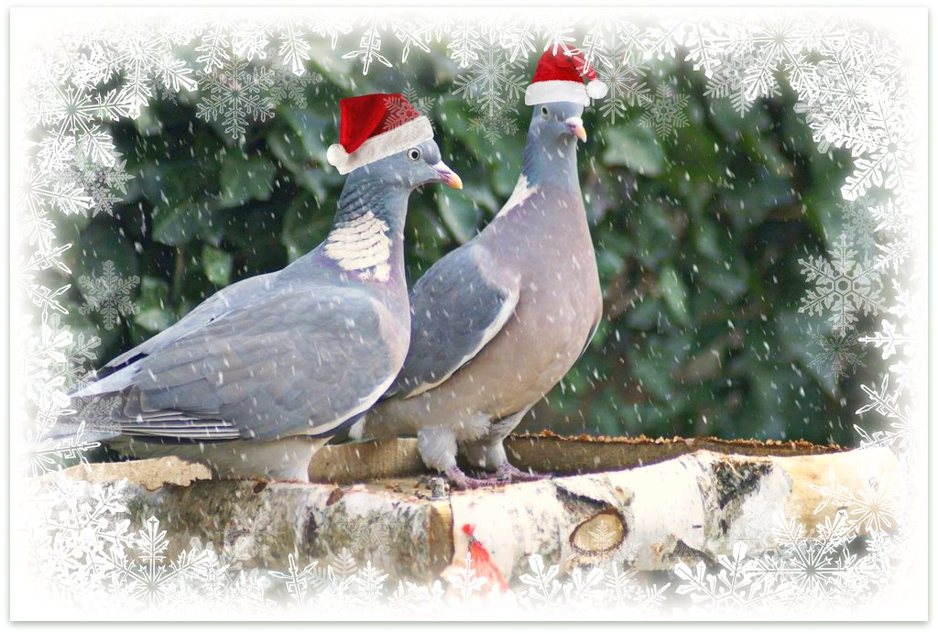
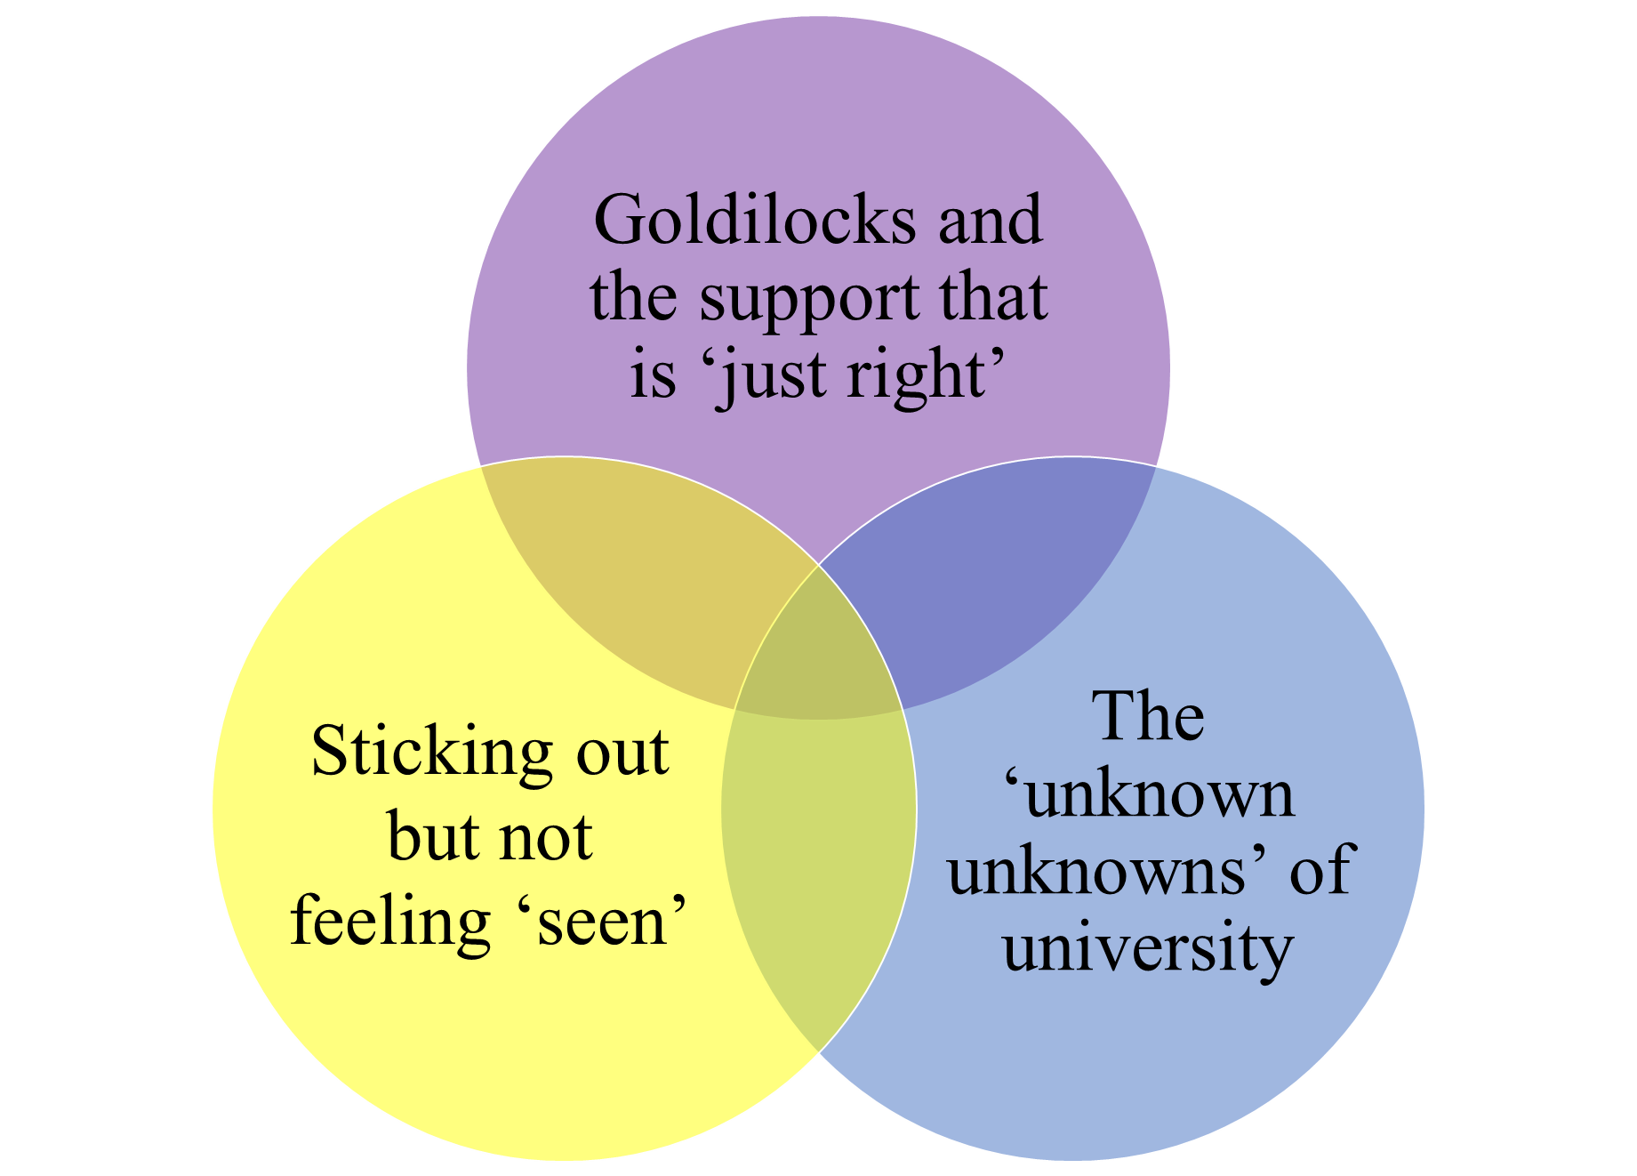
Advanced Entry Students’ Experiences of Transitioning to University
Heather Branigan & Jacqui Hutchison | Funded by LTEP
"[at college] it did kind of frustrate me getting kind of told off...or just generally talked to patronisingly, and whereas when I started university ...there was just an immediate shift in how they spoke to you"
"felt like direct entry students were thrown into the deep end"
“I thought of it as a sink or swim kind of thing” [transitioning to university]
[at college] “they were treating us a little bit like children “
“I feel like you are really dragged through the trenches at uni”
I just think it was a struggle [to settle in to university]. Yeah, like you know if you look just like any other student.”
“I didn't realise I was walking into such a big space…. like the size of the chairs, what you should be bringing in to when you're sitting in a lecture”
“I’ll find myself sitting in a lecture and they’ll say oh, you've already covered this in first year and then you're like, oh, I've not”
“the unofficial etiquette at the place [university] … like when is it OK to contact somebody, how do we address them? Is it OK to go and see them and stuff that it's just, you can't really find written down anywhere"
I was coming in and everyone was kind of looking at me like ‘who is this person? She's new, where has she been for the past two years?’
Notes:
Mollycoddled…. Babying (at college)
‘overwhelm’ – when transitioning to unviersity

Slide 6

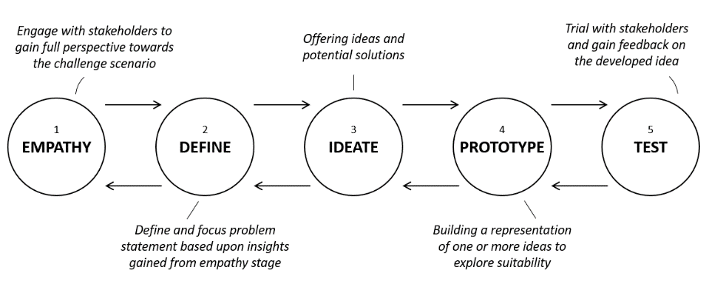
DESIGN THINKING IN IMPLEMENTATION
Introduction to Design Thinking
(Storm, 2021)
Model characteristics
The challenge
Acceptance towards ambiguity
Empathise with whom?
Overarching focus on human need
How should businesses empathise?
Challenges during implementation
Notes:
An emotional and cognitive activity that seeks to affectively comprehend the viewpoints and experiences of another person or group via concrete interactions and generate a reactive outcome.” (Köppen & Meinel, 2015; Gasparini, 2015; Davis, 2006 )

Slide 7
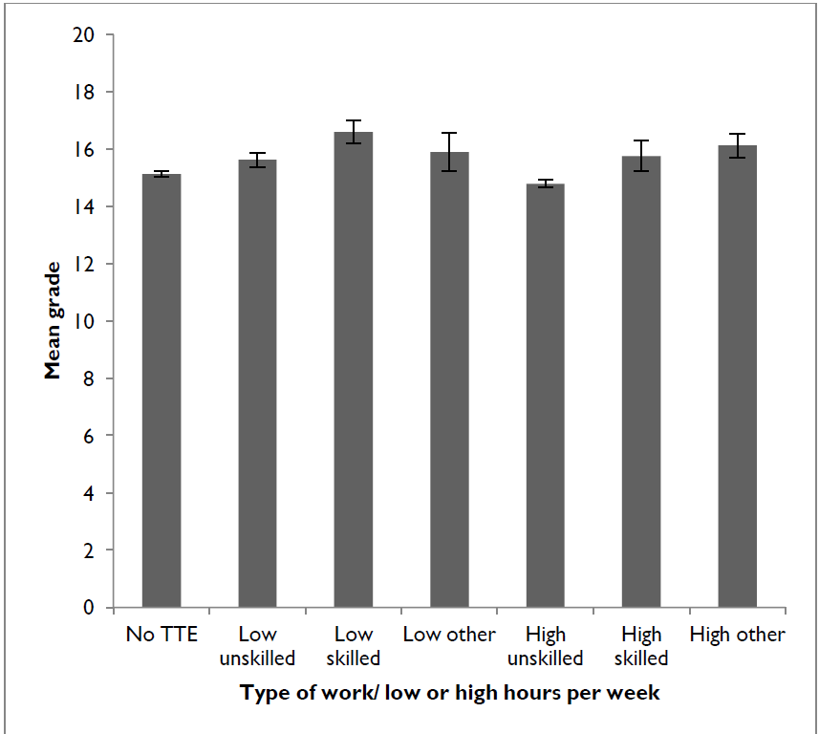
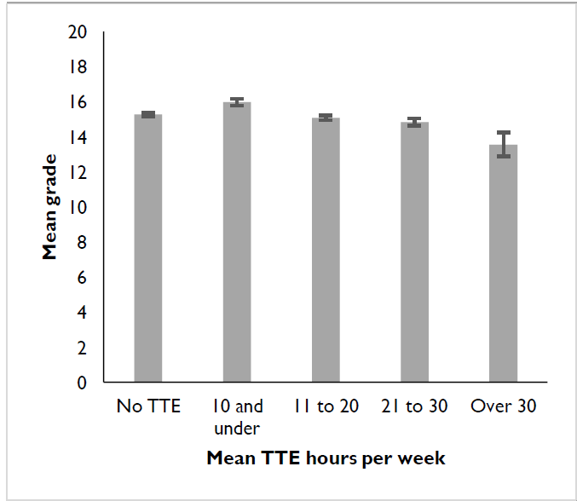

To work or not to work?
A study on the impact of term-time work on student attainment
Background: The number of UK full-time university students engaging in term-time employment (TTE) is rising – but what is the impact on student performance?
1652 respondents
68% engaged in TTE
71% worked to cover living expenses
students engaged in TTE of < 10 hours have higher (4.9%) mean grades than the baseline group.
Working ≤10 hrs/week had grades 7% higher than those not in TTE;
working >10 hrs/week in unskilled positions showed a mean 1.6% lower grade.
students may benefit from taking on 10 or fewer hours of TTE per week
How do we incorporate working in the curriculum?
CA Dennis, J Lemon, V Louca (2018) Term-time employment and student attainment in higher education. - J of Perspectives in Applied Acad Pract

Slide 8

Formative feedback – is it wanted?
PreSF 2021/22 - 126/203(62%), 2020/21 - 103/184 (56%)
Self test 2021/22 –
Staff time / need to be organised / format
Does not predict performance
Equity / On the spot / Efficiency

Slide 9


LTEP: From Surviving to Thriving - Building student resilience through course development
Dr Amy Irwin, Dr Joy Perkins, Dr Heather Branigan, Dr Ceri Trevethan Student Interns: Caitlin Tawse & Sophie Westhead
0-Credit, asynchronous, online course to enhance student resilience
Pre-recorded talks & practical exercises for experiential learning
Resilience and
mental health measures with automated feedback
Broad approach: mental health, metacognition, employability & self-management
1
Ability to positively adapt in face of adversity/challenge and access/draw on range of resources (Brewer et al., 2019)
ACADEMIC
METACOGNITION
3
Internship project 1: Scoping review of resilience literature, development of proposed course framework.
GRADUATE ATTRIBUTE
MENTAL HEALTH & WELLBEING
Development of resilience podcasts, information leaflets and course materials.
Launch of first online resilience micro-credential course.
2
June 2021
Aug. 2021
Jan. 2022
July 2022
Sep. 2022
Internship project 2: Student focus groups to assess resilience awareness and attitudes towards suggested course content.
Generation of summer school content relevant to resilience (TBC).
“Keeping going even when things get tough”
Physical & mental health
Direct Entry & L1
Plan your own journey
4
Resilience matters
Podcasts
Reduce stigma
Interactive
In person element
Certificate
?...

Slide 10

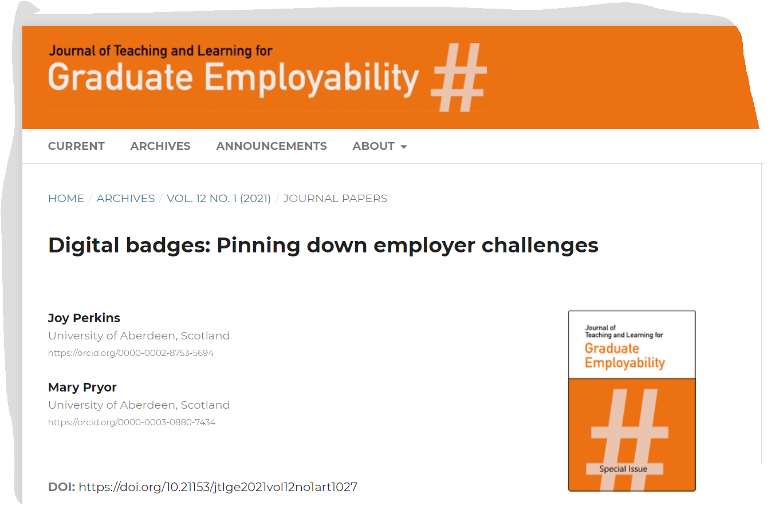
Digital badges: Pinning down employer challenges
Literature Review
Digital badges and employers: An underexplored area.
Methodology
Mixed-method survey explored the following themes organisational typology; digital badges and student competencies; digital badges, student employability and recruitment.
Research Findings
General lack of digital badge awareness by the employers surveyed in this research.
Despite lack of employer awareness, there was no widespread resistance to the concept of badges, but a strong appeal for further clarification of their value, credibility, and security.
Recommendations
Enhance partnership working with employers to help inform and identify the badge skills and competencies to meet existing and future workplace needs.
Establish a well-defined, accessible, and verifiable digital badge framework to underpin the badge awarding rationale.

Slide 11




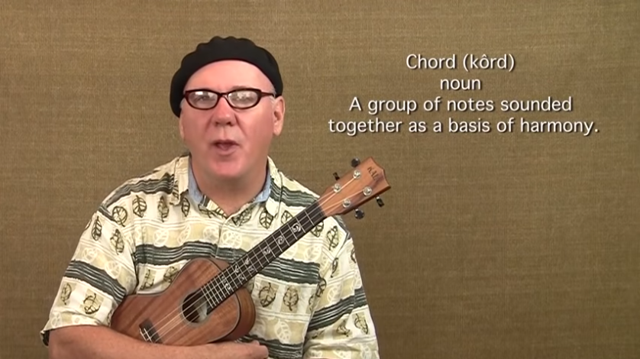


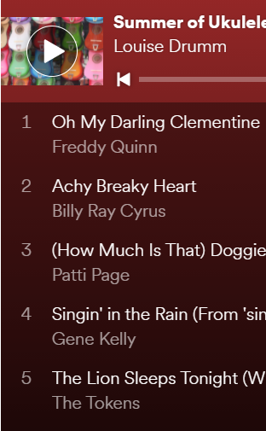
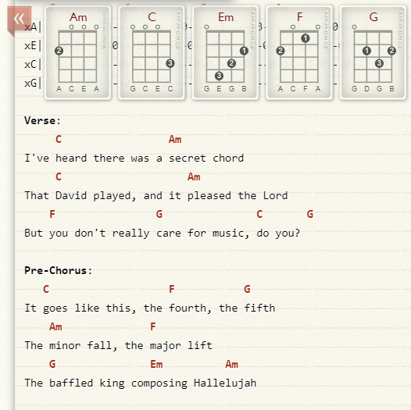



In 2020 we received funding to buy 25 ukuleles to teach academic staff about enquiry based learning (Kahn & O’Rourke, 2005) and a workshop by Laura Ritchie (Yes I Can?, 2020). Then COVID-19 happened and we had to rethink what we were going to do. We advertised for volunteers to learn to play the ukulele online, and waited…
Summer of Ukuleles:
Fostering community and having fun
Anne M. Tierney* & Louise Drumm**
a.tierney@hw.ac.uk, l.drumm@napier.ac.uk
*Heriot-Watt University, Riccarton Campus, Edinburgh, EH14 4AS
**Edinburgh Napier University, Sighthill Campus, Edinburgh, EH11 4BN
We created weekly lessons from material available on the internet, starting with getting to know the instrument, tuning, and simple chords.
We had a discussion board to swap tips and tricks, and post progress.
We got:
16 Volunteers
Ukuleles sent through the mail
No previous experience
Necessary
We achieved:
6 learning units
7 chords (plus a few others thrown in)
34 songs
2 sing-a-longs
Christmas (13 songs)
St Patrick’s Day (5 songs)
2 student practice videos
1 ukulele community of practice (Wenger, 1998)
What’s next?
You can join in. The Summer of Ukuleles is now open to everyone at
https://t.co/bdGDa2smhj?amp=1
Acknowledgements: Many thanks to the wonderful ukulele tribe at Edinburgh Napier University. Special thanks to Dr Stuart Taylor who led the sing-a-longs.
Kahn, P., & O’Rourke, K. (2005). Understanding Enquiry-based Learning (All Ireland Higher Education Report). http://www.aishe.org/readings/2005-2/chapter1.pdf
Wenger, E. (1998). Communities of Practice: Learning, Meaning and Identity. Cambridge University Press.
Yes I can? YES YOU CAN! (2020, January 9). Lauraritchie.Com. https://www.lauraritchie.com/2020/01/09/yes-i-can-yes-you-can/

Slide 12

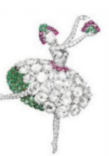

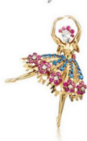






Innovative Assessment / Adaptive Assessment
What assessment do we do?
How often is the format a component of the assessment?
What is the evidence base of offering student led choice in assessment?
  Format
  Weighting
  Timing
Student and staff views on the value of formatives
Is there a cultural hierarchy of assessments?
HOW AM I GOING TO INVESTIAGTE ANY /ALL OF THESE?

Slide 13

Team collaboration has many stages
How do we stay in touch?
Let’s remove the risks
How do we talk to each other?
How do we work together?
How much work is there?
Who’s on the team
What order do we do the work?
Review our process
Why collaborate
Pull the work together
Discovery
Design
Develop
Deploy
Review
Pre-work
Doing the work
Post-work
https://leanpub.com/101teamcollaborationideas/c/PIN_ABDN
Coupon until 25 Dec

Slide 14
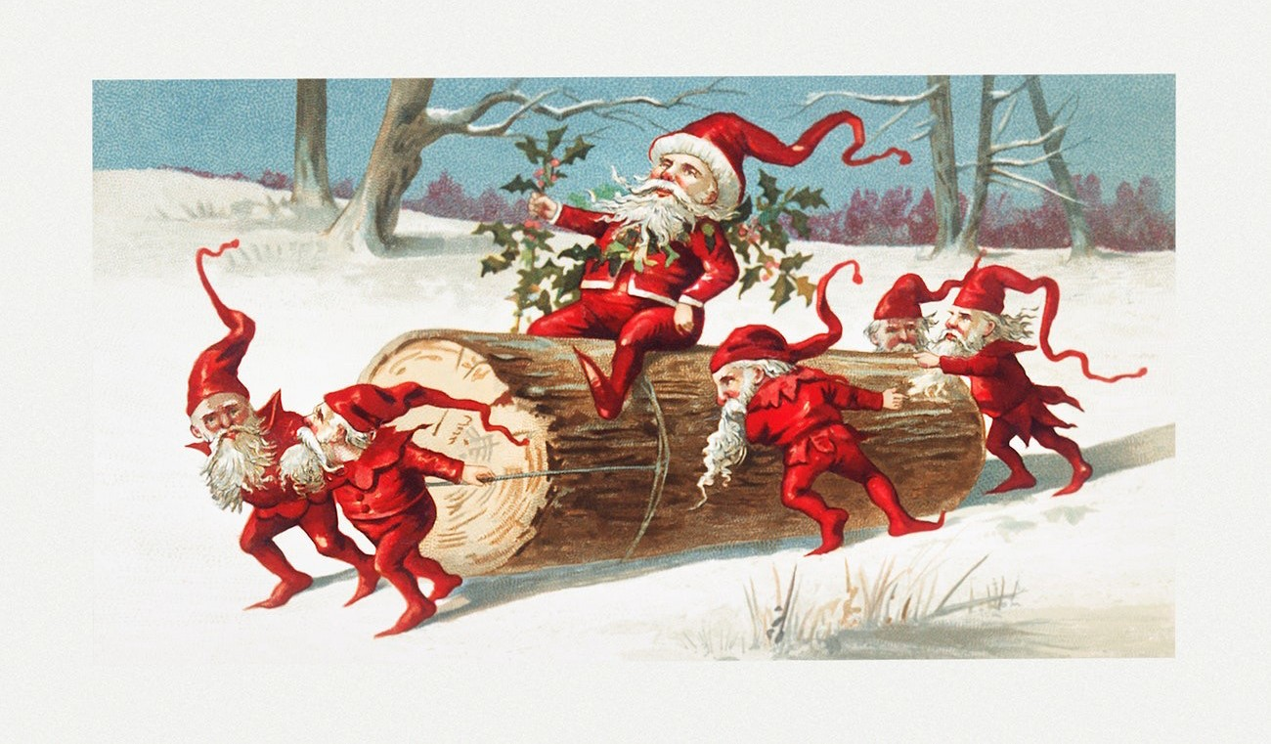


Balancing Supportive Relationships and Developing Independence: an Activity Theory approach to understanding feedback in context for master’s students
[Presented by Neil Lent]

Slide 15

On the 12th day……Dr Mirjam Brady-Van den Bos

Slide 16
How do 1st and 2nd markers reach a decision?

Slide 17
How do 1st and 2nd markers reach a decision?
What is the role of power?

Slide 18
How do 1st and 2nd markers reach a decision?
What is the role of power?
Analysis
Data: Recorded conversations
Method: Conversation analysis

Slide 19
How do 1st and 2nd markers reach a decision?
What is the role of power?
Analysis
Data: Recorded conversations
Method: Conversation analysis
What are the ‘markers’ of power in speech?

Slide 20
How do 1st and 2nd markers reach a decision?
What is the role of power?
Analysis
Data: Recorded conversations
Method: Conversation analysis
What are the ‘markers’ of power in speech?
It’s good.
It’s good, isn’t it? (question tag)
This one is a clear 2:1
This one seems to be a clear 2:1 (hedging)
Interruptions
pauses
It’s the best one.
It’s the best one, I think. (subjective qualifier)
The person who gives their opinion first
The person who goes second
hesitations

Slide 21
How do 1st and 2nd markers reach a decision?
What is the role of power?
Analysis
Data: Recorded conversations
Method: Conversation analysis
Ethics/practicalities
Confidentiality (I cannot do this study in my own School)
Sensitive issues (people discovering things about themselves)
Voice recorder left in the room (without researcher)
What are the ‘markers’ of power in speech?
It’s good.
It’s good, isn’t it? (question tag)
This one is a clear 2:1
This one seems to be a clear 2:1 (hedging)
Interruptions
pauses
It’s the best one.
It’s the best one, I think. (subjective qualifier)
The person who gives their opinion first
The person who goes second
hesitations

Slide 22
How do 1st and 2nd markers reach a decision?
What is the role of power?
Analysis
Data: Recorded conversations
Method: Conversation analysis
Ethics/practicalities
Confidentiality (I cannot do this study in my own School)
Sensitive issues (people discovering things about themselves)
Voice recorder left in the room (without researcher)
What are the ‘markers’ of power in speech?
Who would like to collaborate with me?
It’s good.
It’s good, isn’t it? (question tag)
This one is a clear 2:1
This one seems to be a clear 2:1 (hedging)
Interruptions
pauses
It’s the best one.
It’s the best one, I think. (subjective qualifier)
The person who gives their opinion first
The person who goes second
hesitations
Notes:
+ also ‘disclaimers’: “You know your student best, but….”

Slide 23

Any questions?

Slide 24
Are you working on a pedagogical research project?
The Pedagogical Inquiry Network (PIN) is looking for contributions from staff across the University working on pedagogical research projects. Whether you've written your work up and are looking to practice a presentation for a conference, want to discuss your initial findings, are planning a new project, looking for collaborators or using a method or approach that might be of interest to others – please contact the Centre for Academic Development (cad@abdn.ac.uk).

Slide 25

Thank you for joining us!
This Photo by Unknown Author is licensed under CC BY-SA-NC

