Slide 1


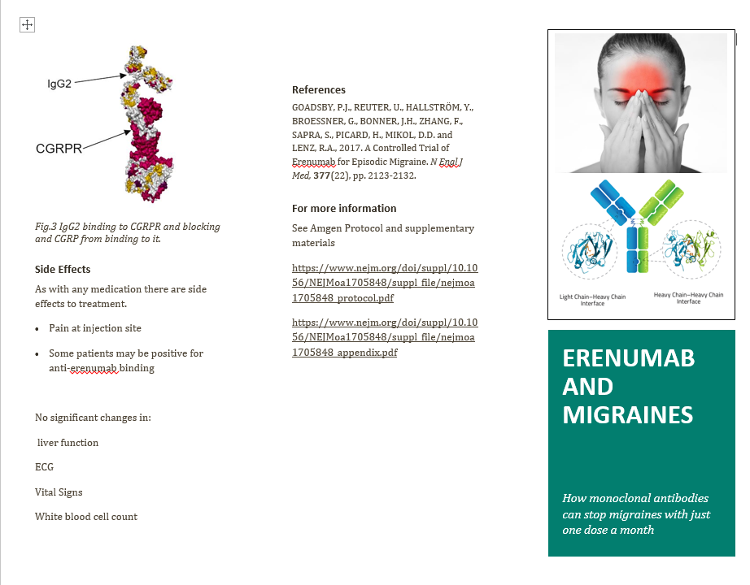
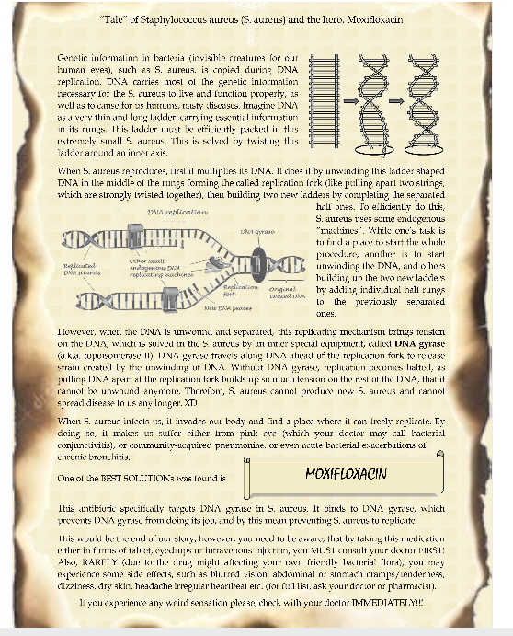
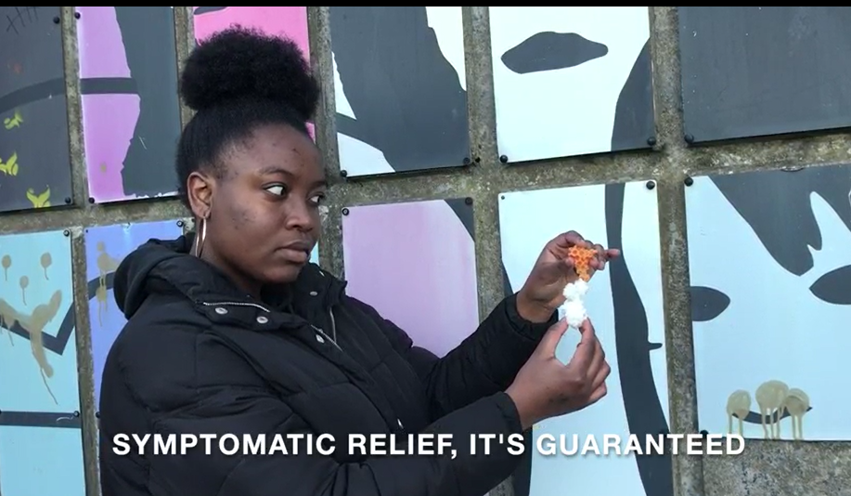
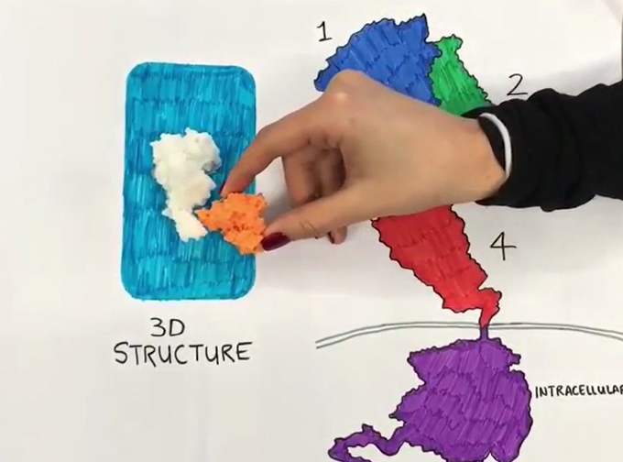
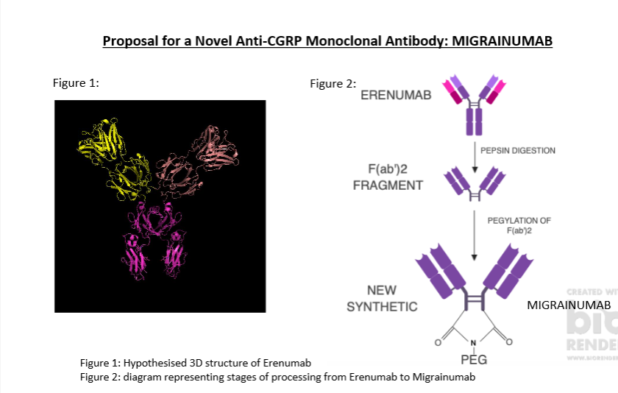
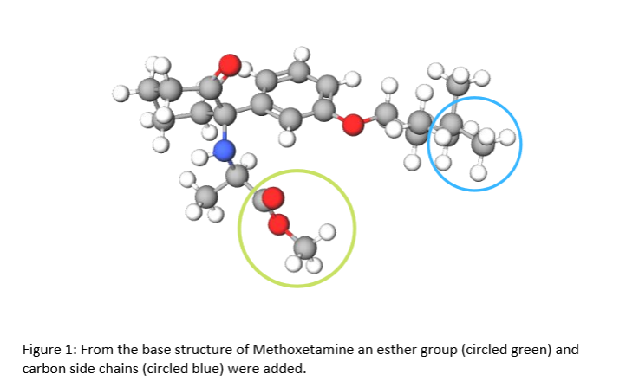
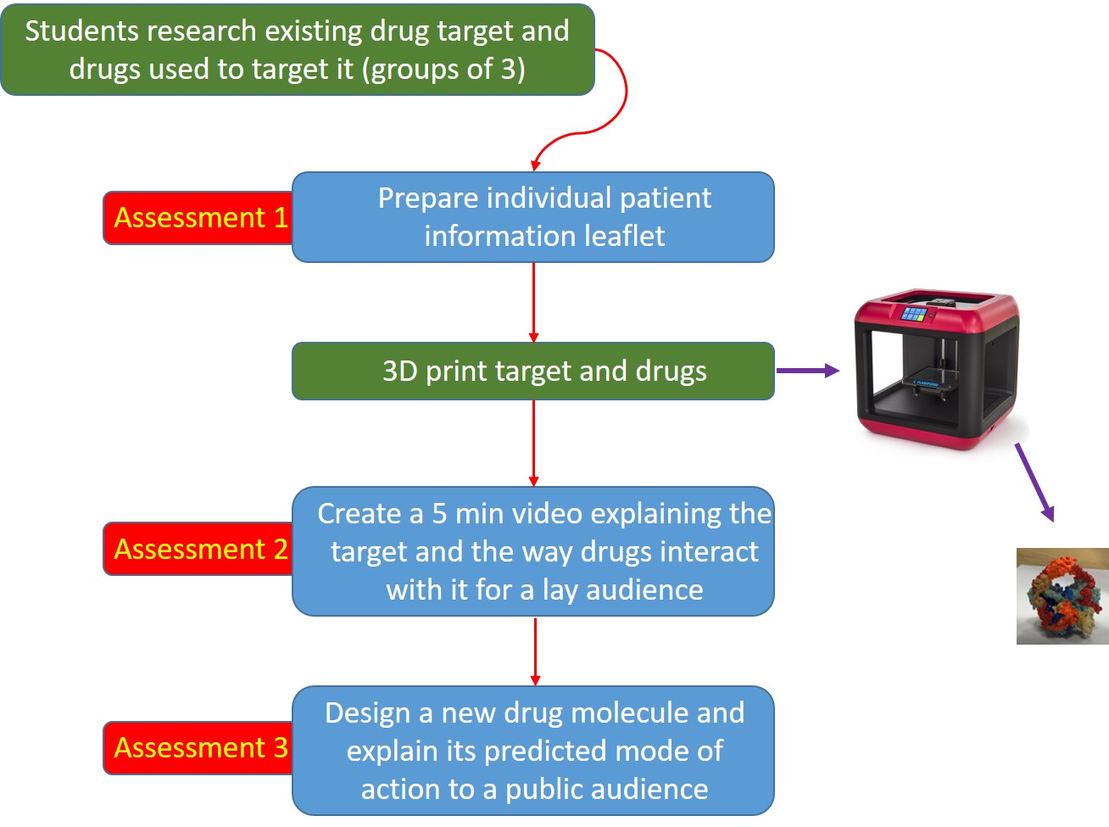
Multimedia approaches to public engagement with pharmacology
SJ Tucker
School of Medicine, Medical Sciences & Nutrition, University of Aberdeen
Background Context
Assessment 1: patient information leaflet
The University of Aberdeen pharmacology syllabus was aligned with the core curriculum for undergraduate pharmacology published by the British Pharmacological Society (BPS) in 2016
This revealed a shortfall in the ways we develop student skills in:
Public engagement
Societal responsibility
With increasing need to engage the public with pharmacology, this was used as a catalyst to develop a new approach to teaching in the final year of the pharmacology programme
Assessment 2: information video
Aim
To create a final year exercise that enriched student skills and appreciation of public engagement with pharmacology
To generate a variety of public engagement resources presented in different media formats specifically for outreach purposes
Assessment 3: new drug design
The public engagement resource project
Outcomes
Focus on developing public engagement skills and communicating complex science to a lay audience
Produces materials for Outreach (from all 3 assessments) – see above
Variety of assessments involving different media assesses specific and transferable skills
Combination of group and individual tasks
Links final year curricula to societal responsibility
New resources have been used in:
nursery visits (3D models, videos)
primary schools (leaflets, 3D models, videos)
secondary schools (3D models, videos, new designs)
University marketing (3D models, leaflets, videos)

