Slide 1
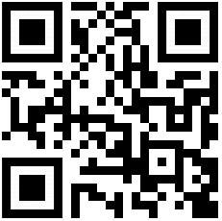
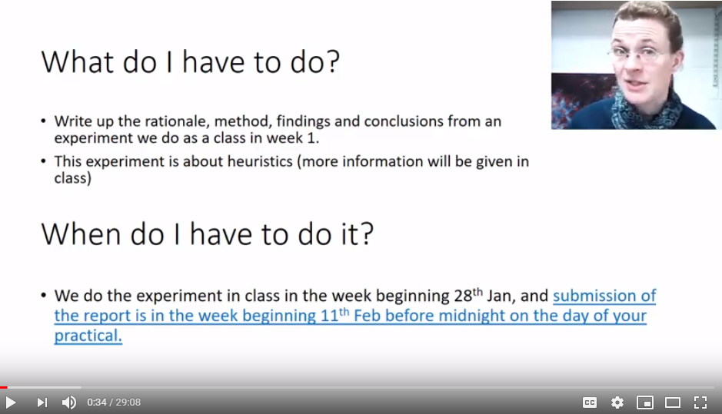


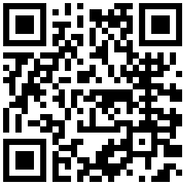
Start here:
I had a problem:
My L1 course has 196 students
Spread over 9 classes
Each with a different tutor
Tutors may give inconsistent assignment instructions
How I solved it:
I created standardization through ‘assignment videos’
The videos not only solved my problem of inconsistency, they also were highly popular with students.
Or view an animated version of the poster:
My face talking over slides
Explains what, why, how of assignments
Current study
Aim: finding out WHY assignment videos are so popular
Participants:
65 1st-year students
Opportunity sampling in class
Written responses
Dr. Mirjam Brady
School of Psychology
mirjam.brady@abdn.ac.uk
https://youtu.be/eESNcDTu8oA
(13 mins)
Watch an example:
Conclusion and ‘sticky’ issues:
Paradoxically, assignment videos enable standardization of instructions, yet create a personalized experience with beneficial effects (see also Cornelius-White)
But: does it make other courses seem ‘less caring’?
But: does it discourage reading (course guides)?
https://youtu.be/AQuL94i2FXE
“It feels like she’s talking to me” Assignment-videos on MyAberdeen
Method 1: rating-scale measures
Attitude towards the videos
Teaching-style preference
(adapted from Trigwell & Prosser)
3. Social adjustment and
attachment to (this) University
Tell me what you think:
Method 2: open questions
Do the videos influence your learning?
Does it matter whether instructions are text or a video?
Does it matter whether the lecturer shows their ‘talking face’?
https://www.surveymonkey.co.uk/r/NBQDZYV
Correlations
How students use the videos
Strategically
“I use them to help me ‘mark’ my work after I’d completed it.”
“Videos are nicer initially, written slides are good to check things later.”
For learning
“I grasp information better when someone is physically telling me.”
“No-one knows if you’ve watched them 20x before you understand.”
Effects of the ‘talking face’
Lecturer motivation is contagious
“It makes me pay attention, maybe because I can see the emotions.”
“I can see they are engaged and wanting to help us.”
Creates connection with lecturer
“It’s as if you know the tutor better, it allows you to feel alright if you need to email them.”
“It makes it more personal, and thus secure.”
Positive attitudes to assignment videos are associated with:
preference for student-centered teaching, r = .325, p = .008
attachment to university, r = .384, p = .006
Thematic analysis
References
Cornelius-White, J. (2007). Learner-centered teacher-student relationships are effective: A meta-analysis. Review of Educational Research, 77(1), 113–143.
Trigwell, K., & Prosser, M. (2004). Development and use of the approaches to teaching inventory. Educational Psychology Review, 16, 409-425.
I prefer teaching staff who:
…encourage us to develop our thinking process
…try to engage us in a conversation
…help me find my own learning resources

