Slide 1
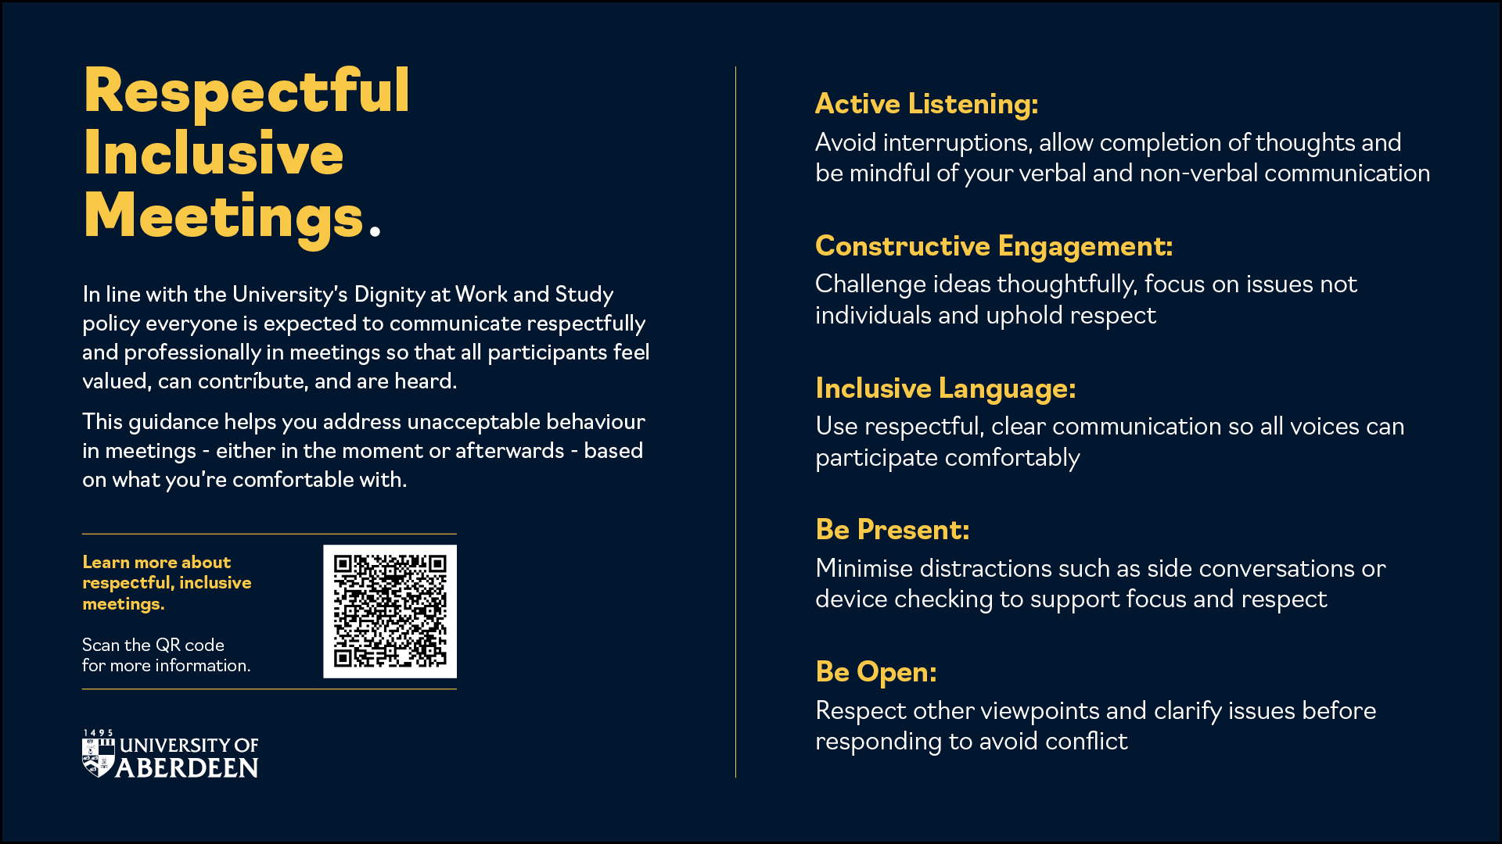
Notes:
Notes to Chair
Please consider using this slide at the start of meetings to help set expectations for positive and respectful behaviour. It can also be helpful to highlight that:
It supports our dignity at work and study policy
Successful meetings rely on open listening, constructive engagement, and treating one another with courtesy and professionalism
The meeting etiquette guidance offers practical advice on contributing to effective meetings and how to respond if behaviours fall short of expectations, including examples of helpful language
Scan the QR code to access the meeting etiquette guidance and Dignity at Work and Study Toolkit.

