Slide 1
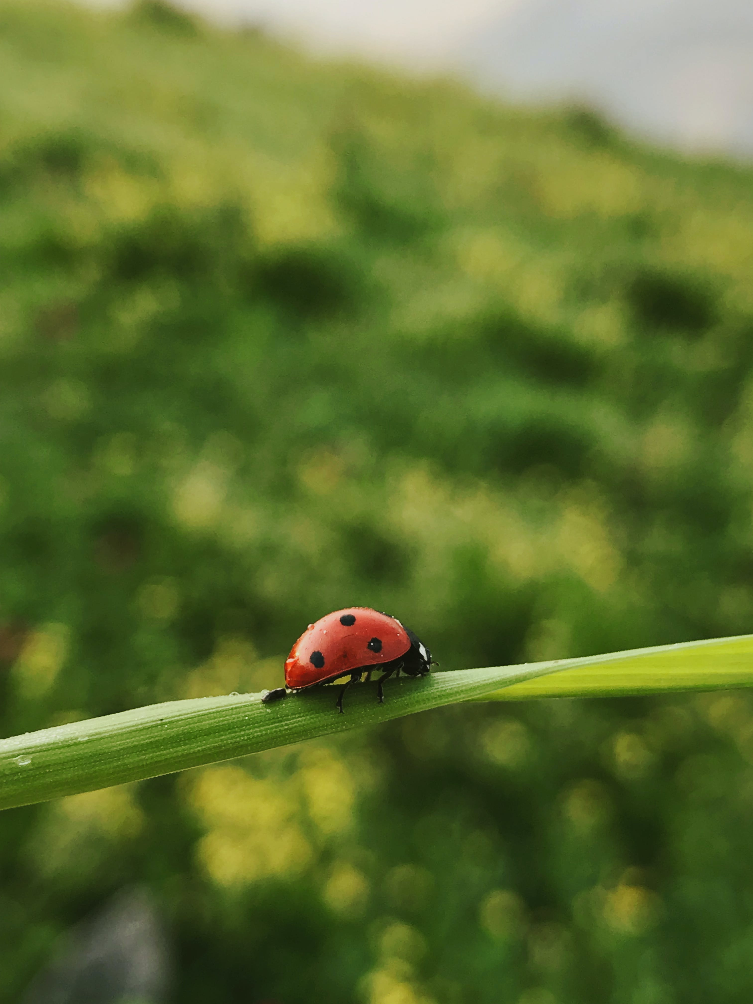
My Presentation Topic!
My name!

Slide 2

Introduction
This is what I am going to tell you about today:
My first point
My second point
My third point

Slide 3
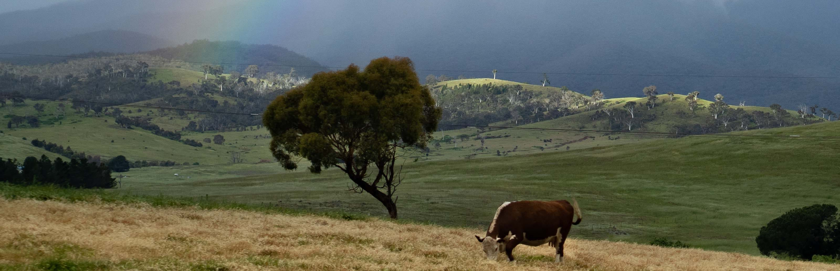
Point 1
[Research topic 1] This is the type of soil it has. This is how I know.
[Research topic 2] This is how it has adapted to its environment. Here are some examples.
Have enough information to talk for 45 seconds.

Slide 4
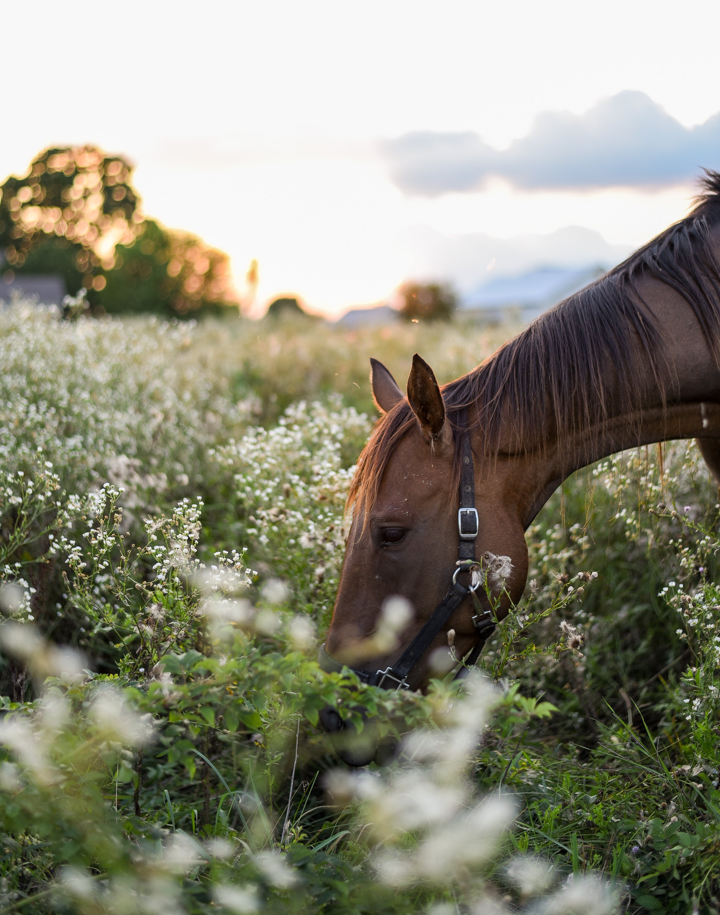
Point 2
[Research topic 1] Here are some examples of the plants and trees that grow in this place.
[Research topic 2] Here are some examples of the food it eats.
Have enough information to talk for 45 seconds.

Slide 5
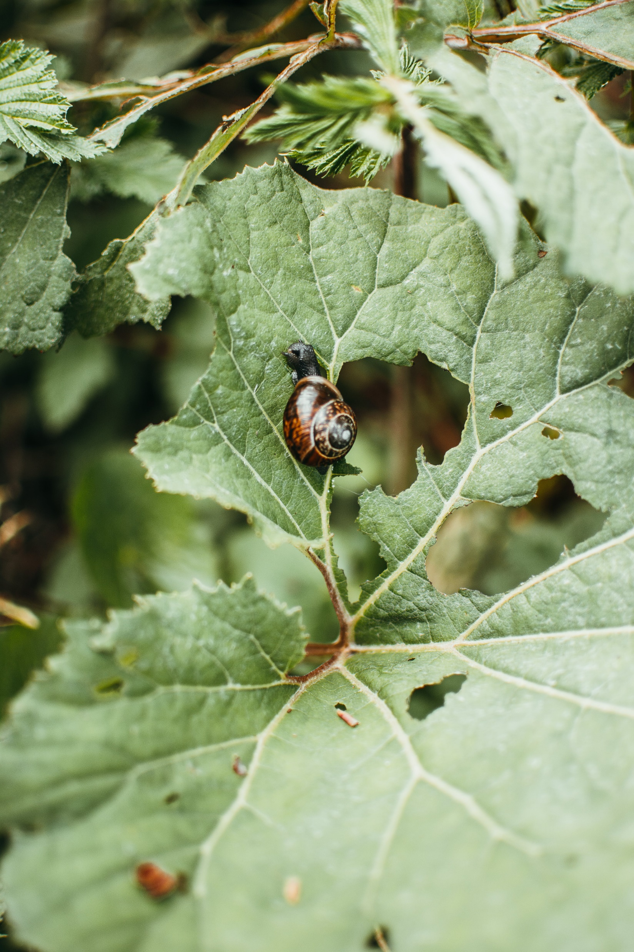
Point 3
[Research topic 1] Here are some examples of the insects and animals it supports.
[Research topic 2] Here are some examples of the threats it faces.
Have enough information to talk for 45 seconds.

Slide 6
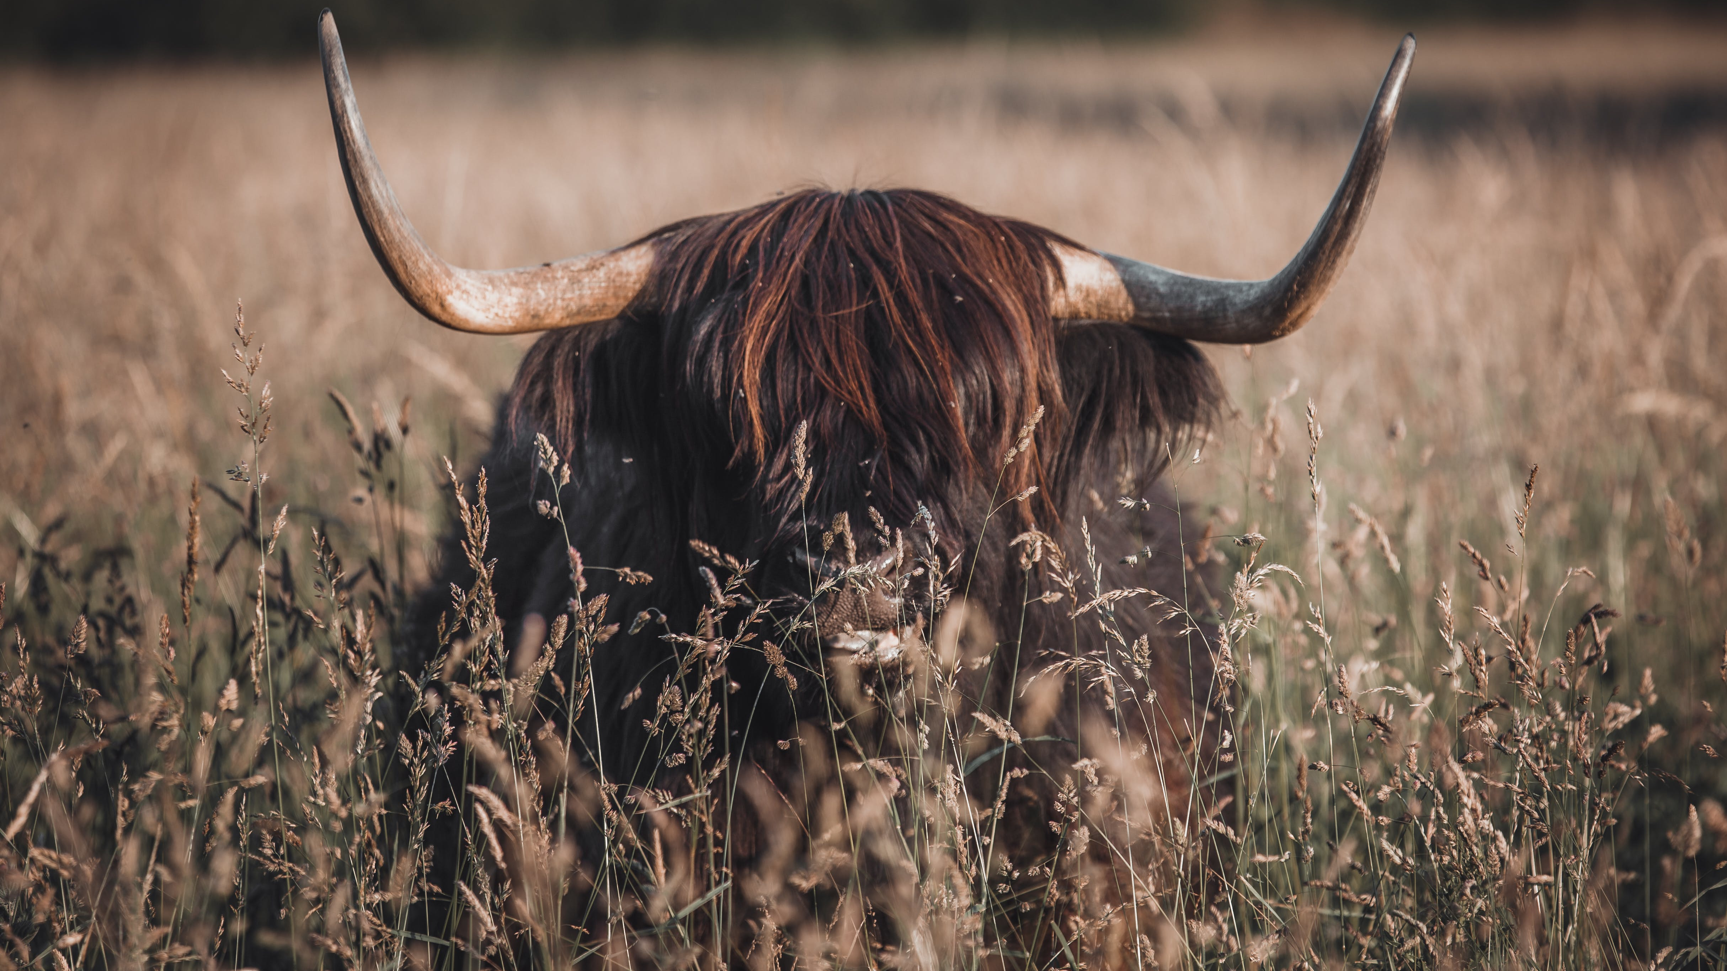
Conclusion
This is a summary of my main points.
This is why this area, animal or bird is interesting.

