Slide 1
Activity 1
Global Greetings – Say ‘Hello’

Slide 2

We are learning to:
Listen to, recognise and use greetings in different languages
Look for similarities and differences between languages
Find out about the languages spoken by people in our class and beyond

Slide 3

Hello
Often when learning a language, the first word you will learn is how to say ‘hello’! This is because it’s a very useful thing to know to make connections with people.

Slide 4
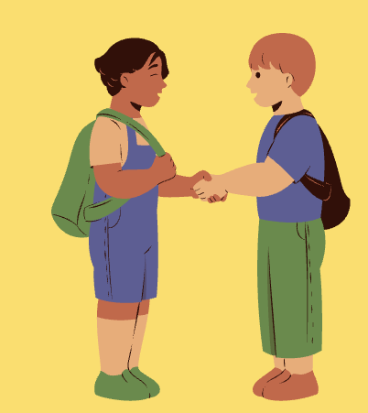
Different ways to greet someone
Starting with English…
How many different ways can we think of to greet someone?

Slide 5
Greeting by person/situation
Starting with English…
Might we use different greetings for different people/different situations?

Slide 6
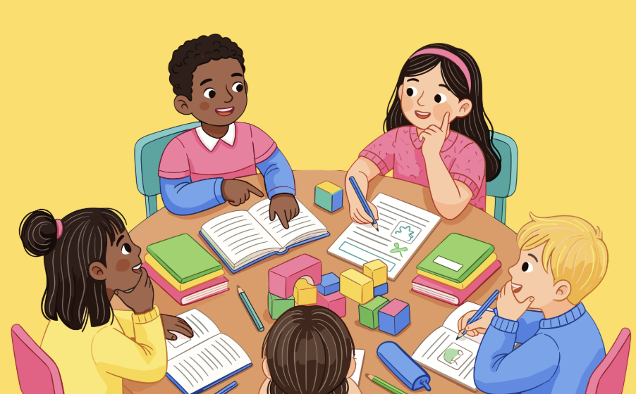
Our hellos
Our class, our languages…
In your group, make a list of all the different ‘hellos’ you know from other languages (not English).
Don’t worry about spelling! If you’re not sure, just write it down as it sounds.

Slide 7
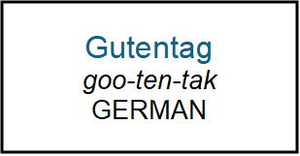
A whole word of hellos
A whole word of ‘hellos’…
Collect a ‘hello’ card from the teacher. You should each have your own card. Each card is different.
how the word is written in the language
a guide for how to say the word out loud
the name of the language

Slide 8
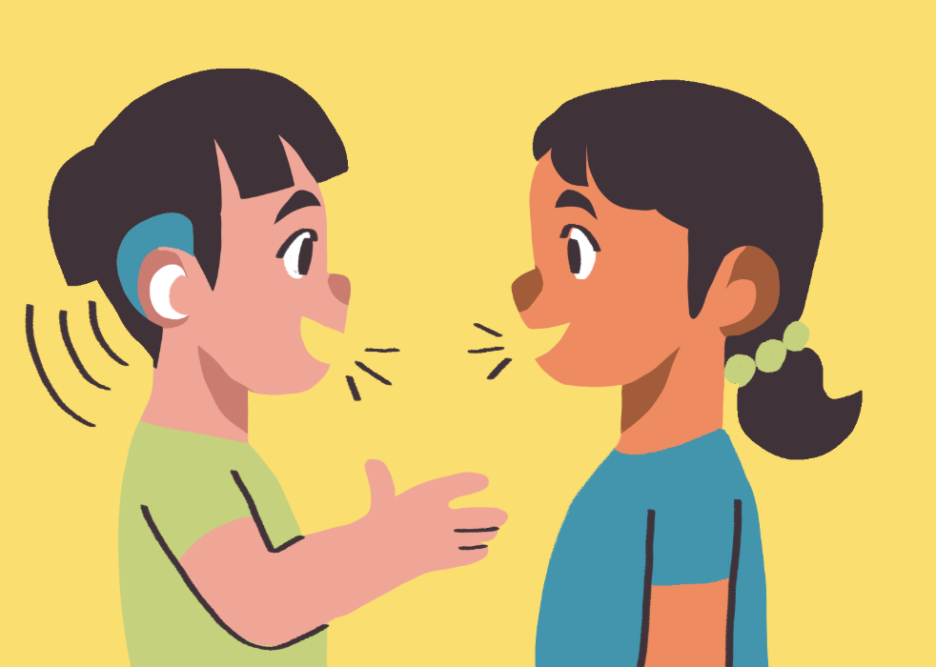
Saying hello
Saying hello…
When you meet a classmate, you must read your ‘hello’ cards to each other and then swap cards.
Try to speak to at least fifteen classmates to learn as many ‘hellos’ as possible.

Slide 9
Guess language
Guess the language…
This time, you will read your ‘hello’ to a classmate and they have to guess which language the ‘hello’ is from. They will then read their ‘hello’ and you must guess the language too.
If you are both incorrect, keep your cards and move on to another classmate.
If one or both of you are correct, swap your cards and move on to another classmate.

Slide 10
Reverse remembering
Reverse Remembering!
This time, you will read the name of the language on your card to a classmate and they have to try to remember how to say ‘hello’ in that language. They will then read their language name and you must try to remember how to say ‘hello’ in that language too.
If you are both incorrect, keep your cards and move on to another classmate.
If one or both of you are correct, swap your cards and move on to another classmate.

Slide 11


Difficulty line up - 1
difficult
easy
The Difficulty Line-Up
Each of you has a card with a different ‘hello’ on it. Arrange yourselves in a line with the most difficult to read aloud word at one end, ranging to the easiest to read aloud word at the other.

Slide 12
Difficulty line up - 2
difficult
easy
The Difficulty Line-Up
Does similarity with English help?
Do you know if the languages you have put at the ‘easy’ end are related to English?

Slide 13
Difficulty line up - 3
difficult
The Difficulty Line-Up
Does it help if we have seen or heard the language before somewhere (like in TV shows, films, music, games, online videos, books, etc.?)
easy

Slide 14
Difficulty line up - 4
difficult
easy
The Difficulty Line-Up
Are certain sounds more difficult for English speakers to try to say?

Slide 15
Difficulty line up – 5
difficult
easy
The Difficulty Line-Up
Does the length of a word/number of syllables make it more difficult to say? If yes, is this always the case?

Slide 16
Difficulty line up - 6
difficult
easy
The Difficulty Line-Up
Does it depend on how many languages you know and which languages you know?

Slide 17
Activity 1 – exit task
What have we learned?
Try to write the most interesting ending to this sentence:
Today, we noticed that languages…

Slide 18
Activity 2
Tell your own language story…

Slide 19
We are learning to:
Examine the languages, words and traditions that make us who we are
Create a museum exhibit that tells our own language story
Compare languages and experiences from across our classroom community

Slide 20


Activity 2 - hook
Everyone has a language story to tell, whether you speak one or ten
languages! As a class, we will build an exhibition of our stories.

Slide 21
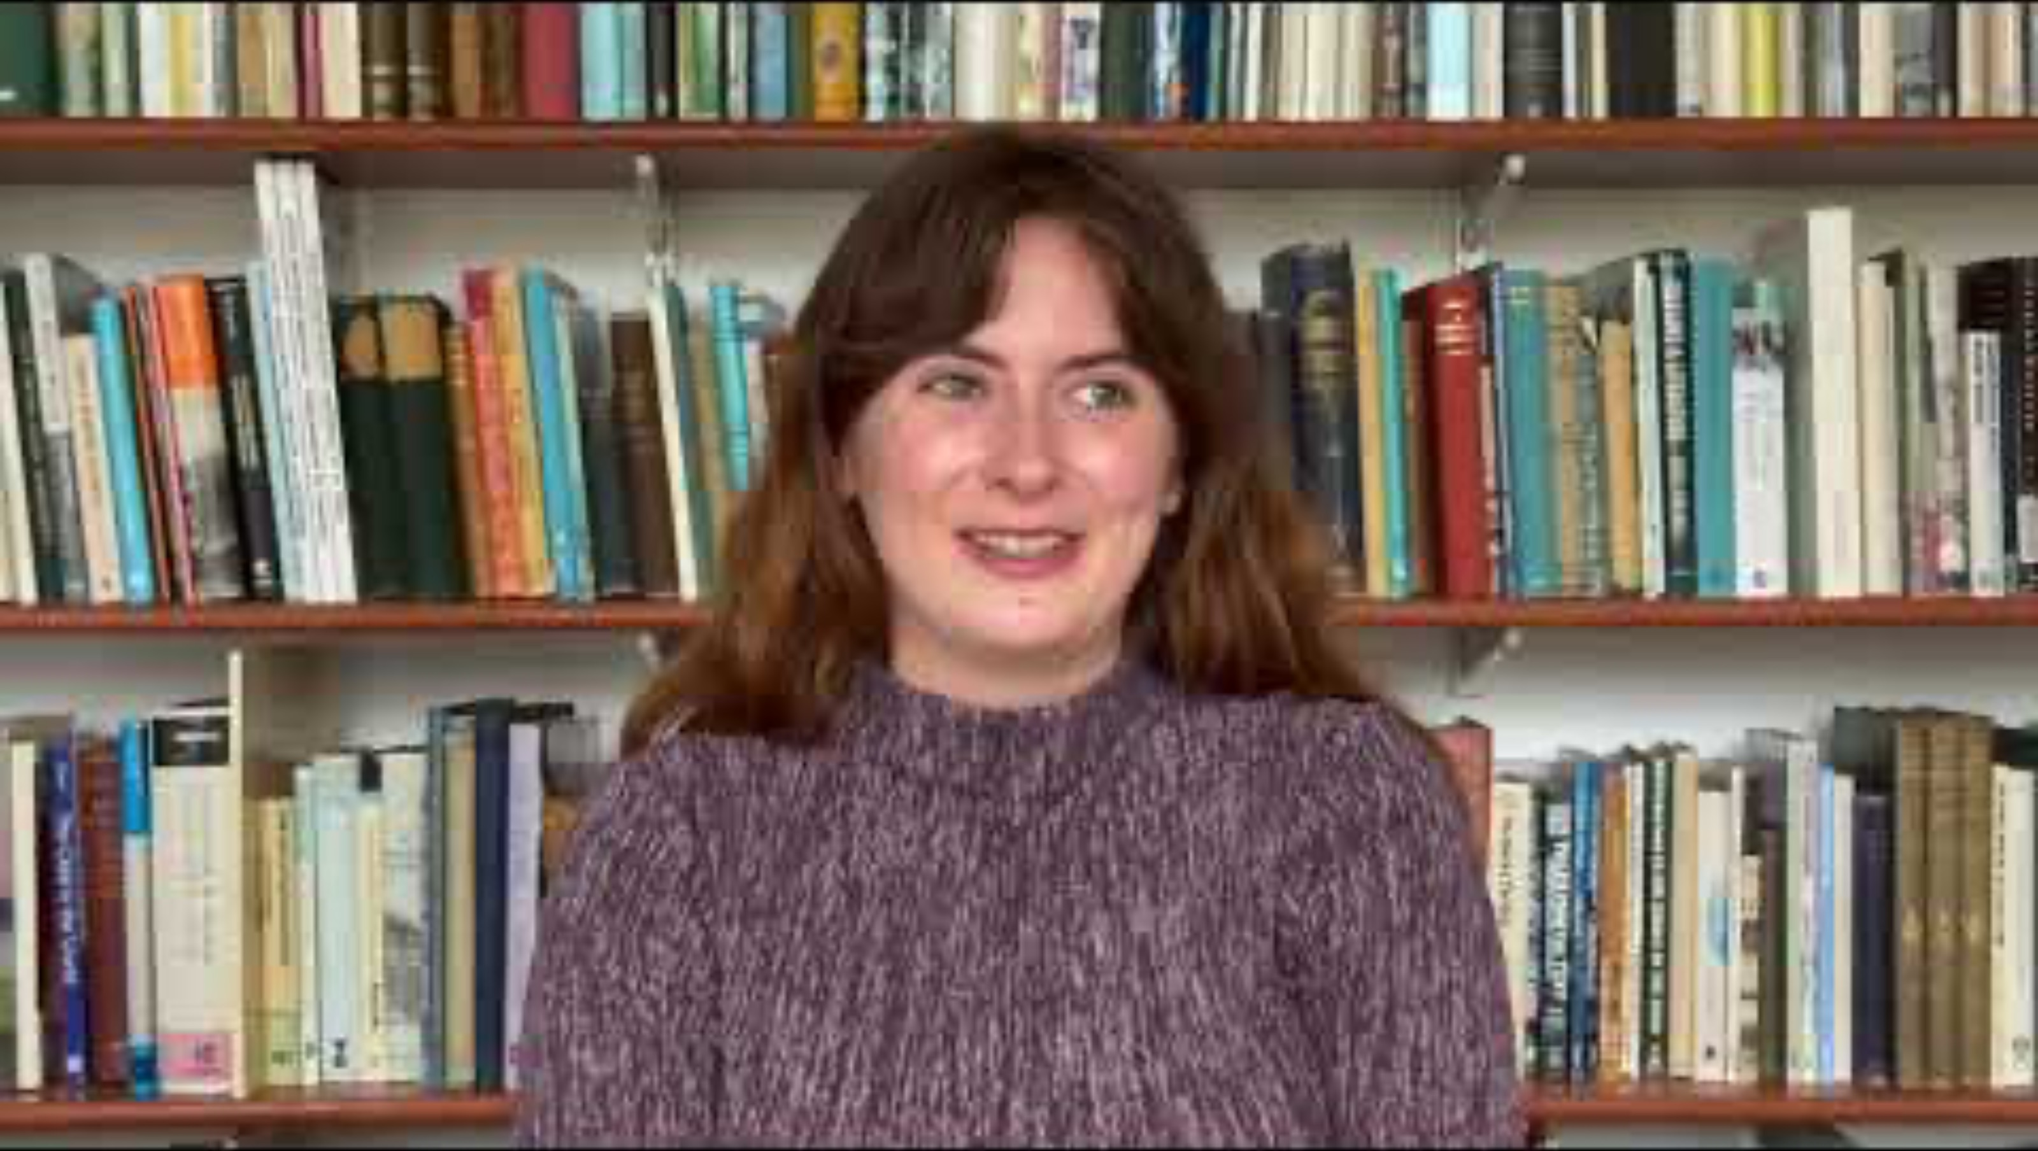
Meet Andrada (Andra for short!)…

Slide 22
Take a look at some of the videos and posters she put together for the Aberlangs online exhibition…. https://abdn.site/aberlangsdigitalexhibition
You also have two paper copies of Andra’s Cartonera to look at.

Slide 23
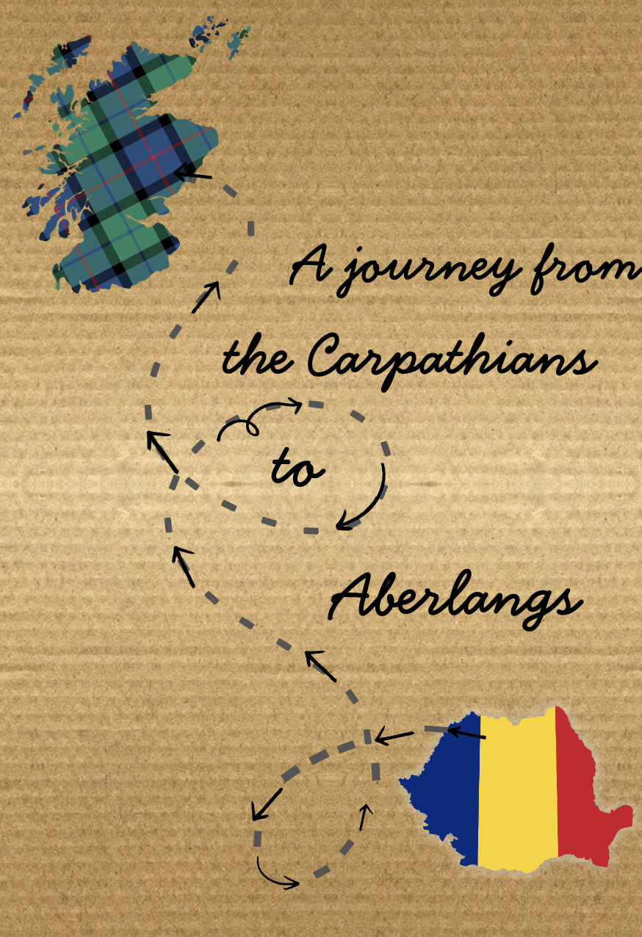
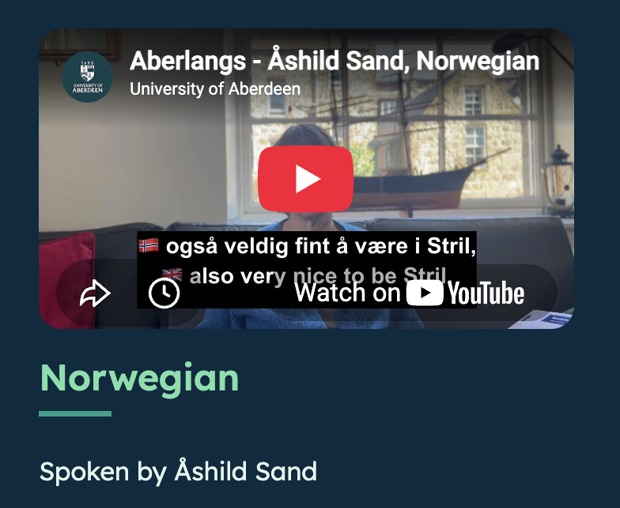
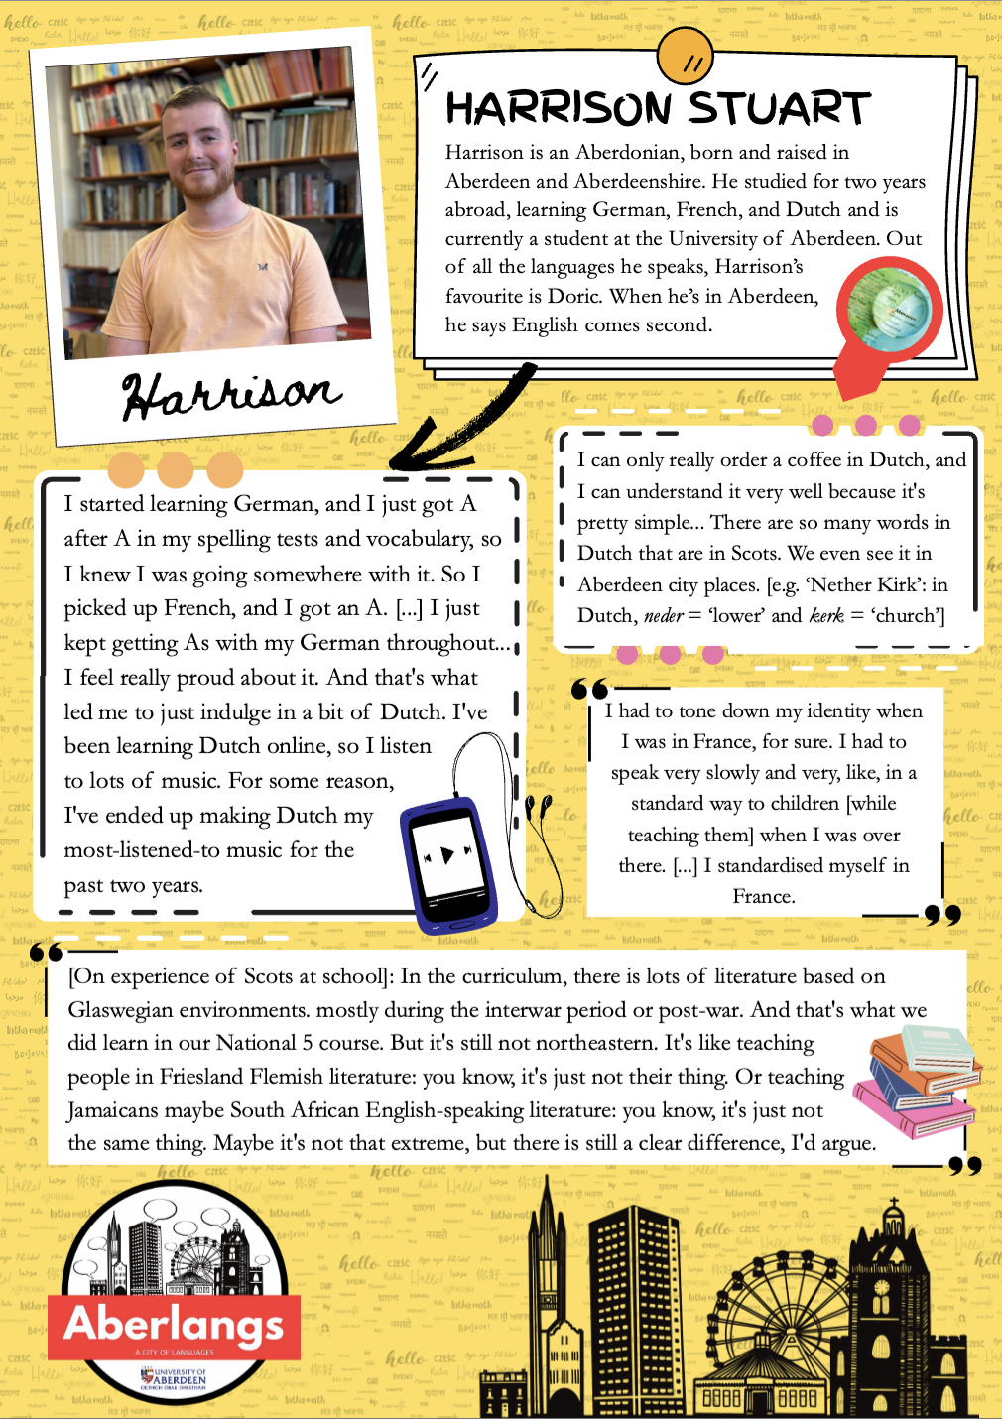
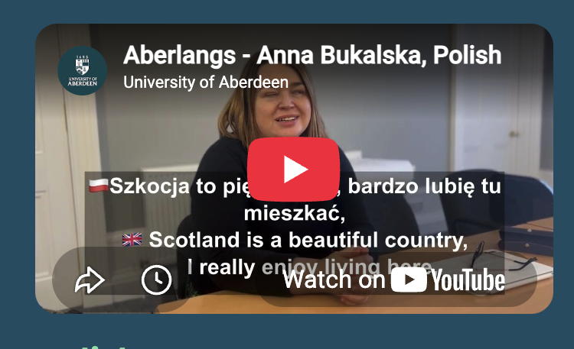
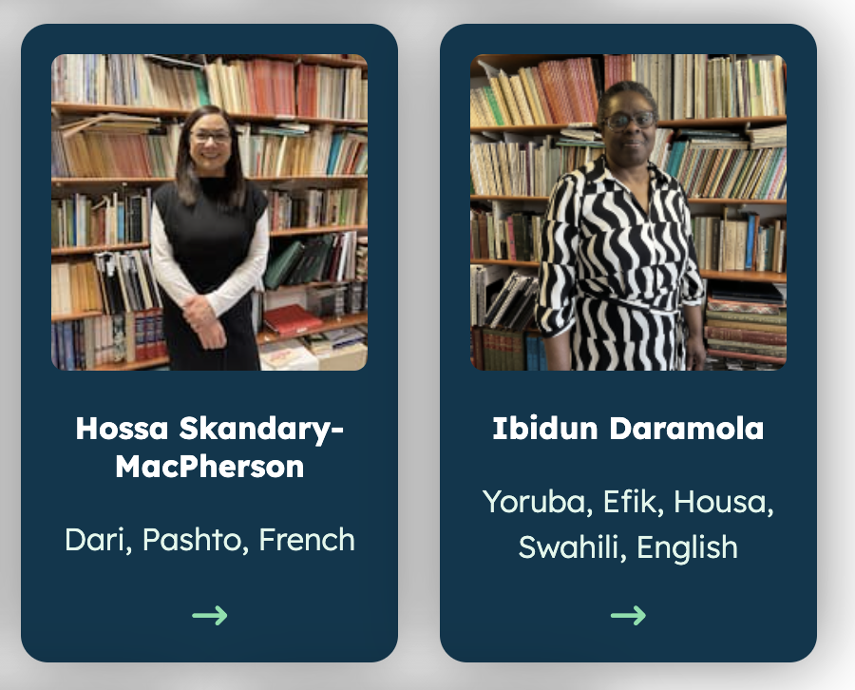
From looking at the online exhibition, what kind of things have Andra and the participants chosen to share about themselves and their languages?

Slide 24

Our languages
Our class, our languages…
Let’s gather our own stories:
Our languages
Which languages do you speak or hear around you? This could be at home, at school or with friends.
Do you know any Scots/Doric?
Do you know any sign language?
Do you talk differently to your friends compared to with a teacher?

Slide 25
Words you love
Our class, our languages…
Let’s gather our own stories:
Words and sayings we love
What is your favourite word in any language, and what does it mean?
Does your family have a favourite saying they use frequently?
Did anyone in your group say a word you had never heard before?

Slide 26
Celebrations
Our class, our languages…
Let’s gather our own stories:
Celebrations and special things!
What holiday, celebration or family tradition do you love most?
What is a food that is special in your family?
Do you have clothes you wear on special days, or an object at home that tells a story?

Slide 27
Looking ahead
Our class, our languages…
Let’s gather our own stories:
Looking ahead…
Is there a language you would love to learn, or a place you would love to go one day?

Slide 28
Time to create
Now it’s time to start building our own classroom Aberlangs exhibition!

Slide 29
Option 1: Create a Cartonera
The cartonera format is a hand-crafted book style emerging from grassroots publishing movements in Latin America.
Using two cardboard covers with paper pages bound by string or treasury tags, you can can fill your cartoneras with drawings, cut-outs, maps, favourite words and anything else related to your language story.

Slide 30
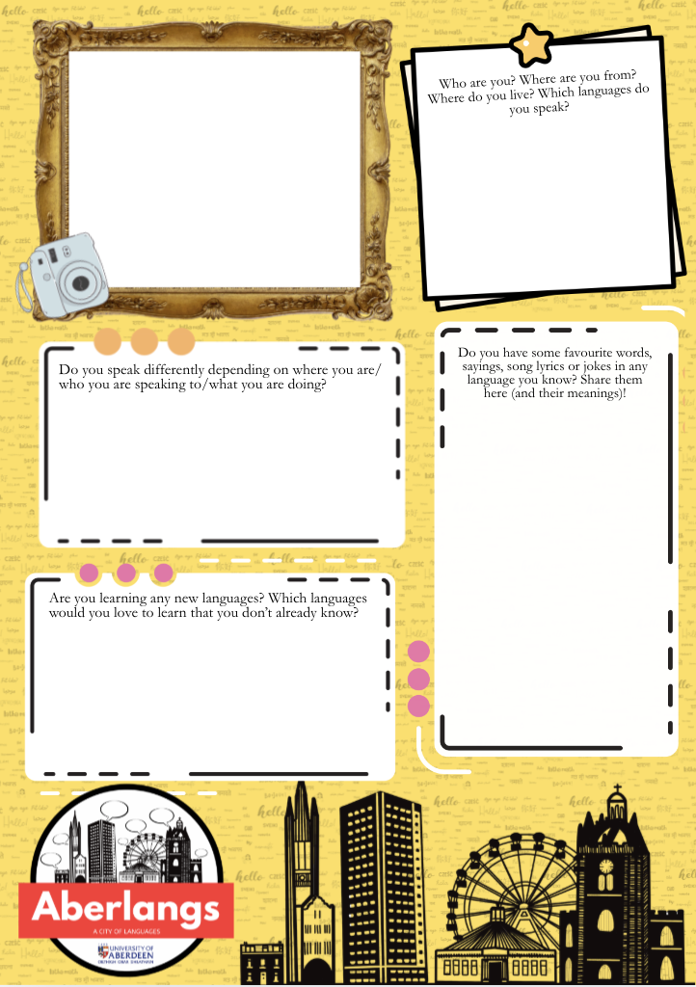
Option 2: Make your own poster
Drawing inspiration from the participant posters in the online Aberlangs exhibition, create your own posters using one (or more) of our blank poster templates.
These templates can be downloaded from the Aberlangs website or you can use the questions to create your own on blank paper.
In the ‘photo frame’ corner, you can either affix a photograph of yourself or draw a self-portrait.

Slide 31
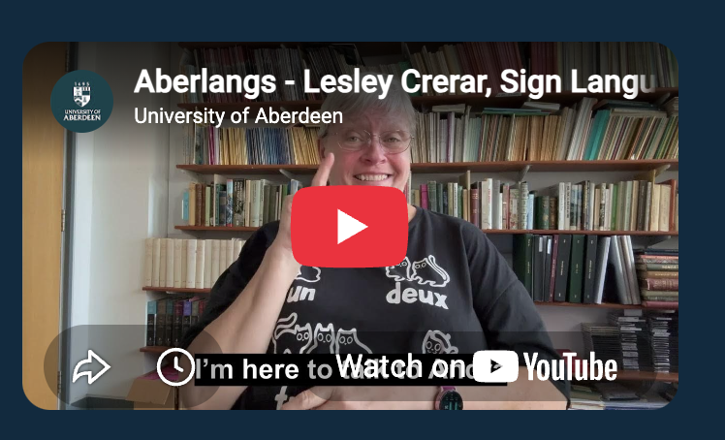
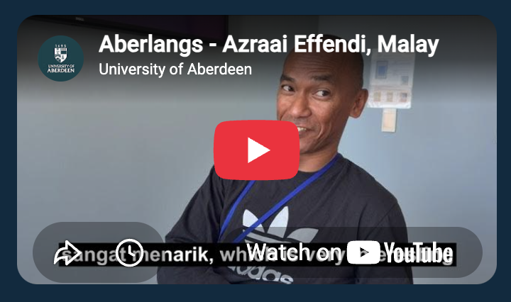

Option 3: Interview each other
Drawing inspiration from the participant video clips in the online Aberlangs exhibition, interview each other and record these to produce either podcast clips or short videos.
The things you discussed previously in your groups are a good place to start for interview questions.
Hold a launch ‘watch party’ once all of the interviews have been completed!

Slide 32
Share
Once you have made your exhibition, we’d love to see it (and maybe even add some of your exhibits to our website)!
You can send photos/videos to us at aberlangs@abdn.ac.uk

Slide 33
Activity 3
Spin the Wheel

Slide 34
We are learning to:
Find the words for specific objects in another language
Use an online or paper dictionary to search for translations
Memorise new words and practise saying them out loud

Slide 35

Activity 3 - hook
Going on holiday is a great chance to hear and try out other languages. But first we need to pack our case...

Slide 36

Finding translations
Finding translations…
Find out what the word for each object would be in the language you are working with.

Slide 37
Remembering translations
Remembering translations…
Now, as a group, try to memorise the words for these objects.

Slide 38

Filling suitcase
Filling your suitcase
Without looking at the words, now try to ‘fill’ your suitcase from memory by writing each object in one of the compartments.

Slide 39
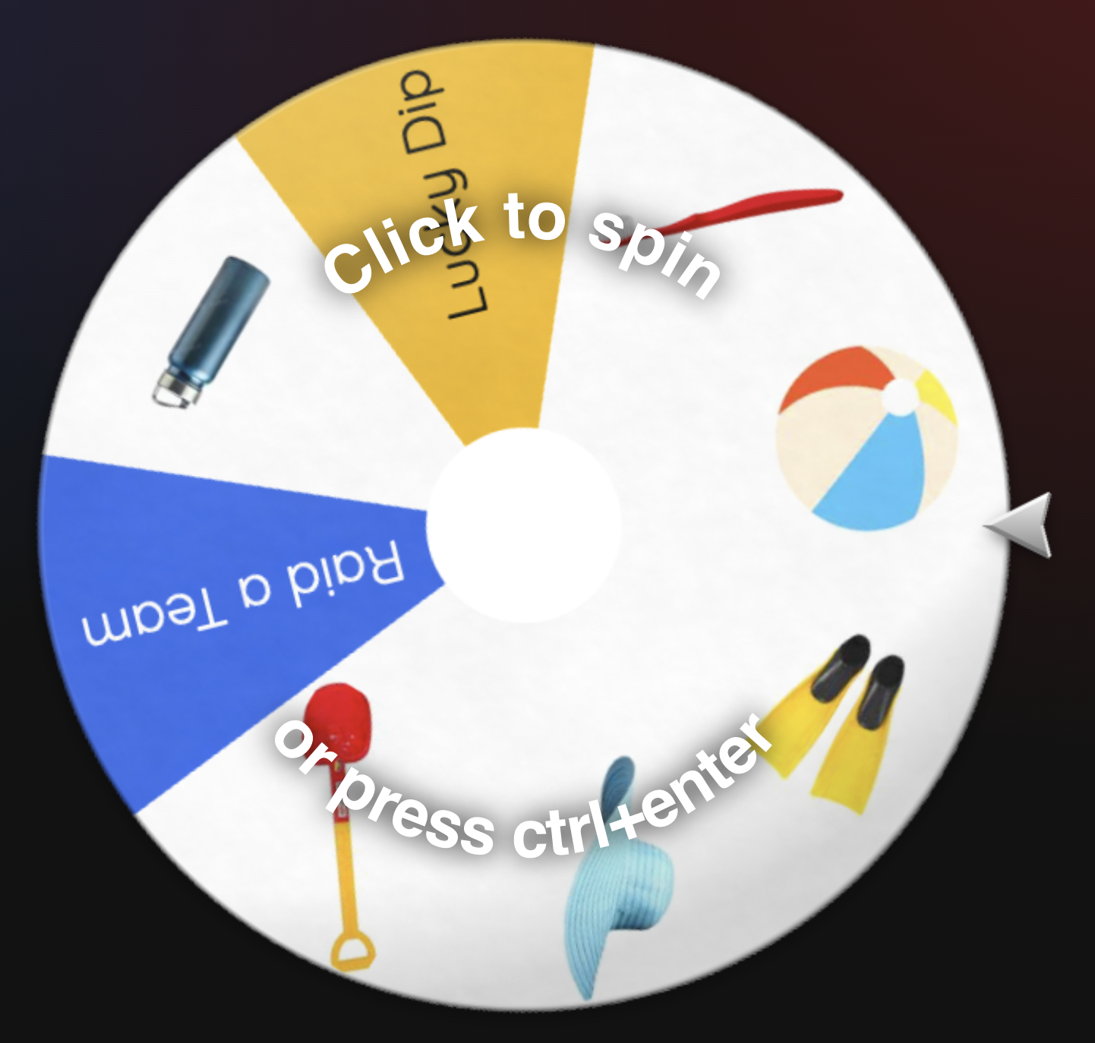
Play the game
Each team will now take in turns to try and win the objects they need to fill their case…
The first team to fill their case wins!
Click here to spin the wheel: https://wheelofnames.com/spt-w9s

Slide 40

Make your own
Make your own version!
Decide on a topic
Create six object cards that fit the topic
Create a worksheet for the object cards to placed on
Create a wheel: https://wheelofnames.com/
Then play it in whichever language you like!

Slide 41
Activity 4
Different Scripts, Different Styles

Slide 42
We are learning to:
Explore the many different writing scripts used around the world
Understand that writing systems work in different ways
Talk about the similarities and differences between different scripts, including the languages spoken by pupils in our own class

Slide 43

Crack the code
This task contains one secret hidden within eighteen kinds of writing. Can you work together to crack the code?

Slide 44
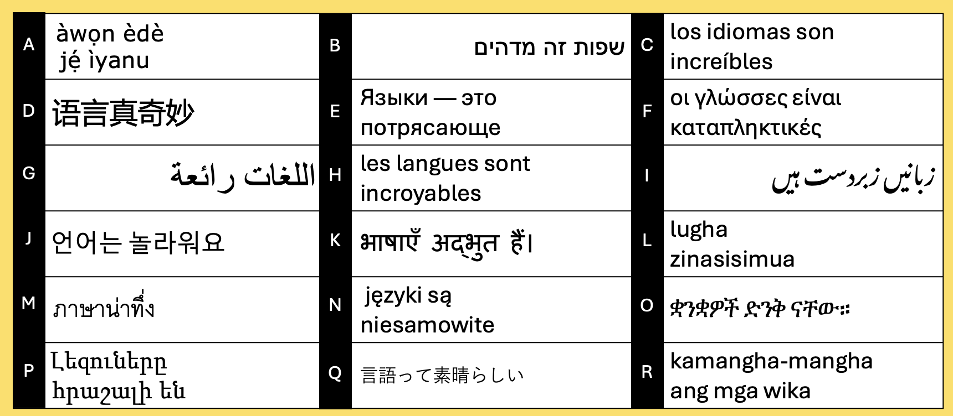
Phrase Detectives
Phrase Detectives
All of these phrases translate to roughly the same idea in English.
Can you work out what it might be?

Slide 45
Phrase Detectives 2
Phrase Detectives
They all mean something like ‘languages are amazing/incredible/great!’

Slide 46
Phrase Detectives 3
Our class, our languages…
Many of these languages are spoken in Aberdeen and Aberdeenshire. Do we recognise any of them? Do we speak them?

Slide 47
Grid answers
Here’s which languages these examples are from. Did we get any right?
Yoruba
Hebrew
Spanish
Chinese
Russian
Greek
Arabic
French
Urdu
Korean
Hindi
Swahili
Thai
Polish
Amharic
Armenian
Japanese
Tagalog

Slide 48
Make two columns in your jotter/on a piece of paper and sort out the examples into what is familiar and unfamiliar:
Writing that uses letters/symbols you already know and use in your own language(s) | Writing that is made up of letters/symbols you do not know
List the examples (e.g. A, B, C) | List the examples (e.g. A, B, C)

Slide 49
Similar to English
Which look similar to English?
Can you see any that use the same alphabet as English?
Yoruba
Hebrew
Spanish
Chinese
Russian
Greek
Arabic
French
Urdu
Korean
Hindi
Swahili
Thai
Polish
Amharic
Armenian
Japanese
Tagalog

Slide 50
Direction
Are they all written in the same direction?
English writes left-to-right. Are they all the same?
Yoruba
Hebrew
Spanish
Chinese
Russian
Greek
Arabic
French
Urdu
Korean
Hindi
Swahili
Thai
Polish
Amharic
Armenian
Japanese
Tagalog

Slide 51
Joined-up
Are any languages using joined-up writing?
Do any of them seem to have letters/symbols that flow into each other?
Yoruba
Hebrew
Spanish
Chinese
Russian
Greek
Arabic
French
Urdu
Korean
Hindi
Swahili
Thai
Polish
Amharic
Armenian
Japanese
Tagalog

Slide 52
Sound or word or syllable
In English, letters relate to sounds.
Can we spot any languages which might work differently?
Yoruba
Hebrew
Spanish
Chinese
Russian
Greek
Arabic
French
Urdu
Korean
Hindi
Swahili
Thai
Polish
Amharic
Armenian
Japanese
Tagalog

Slide 53

Trying writing
Now, it’s your turn to try writing in some of these scripts!
Choose your three favourite ones and try to write the phrases as accurately as possible.

Slide 54
Activity 4 – exit task
What have we learned?
Try to write the most interesting ending to this sentence:
Today, we noticed that writing systems...

Slide 55
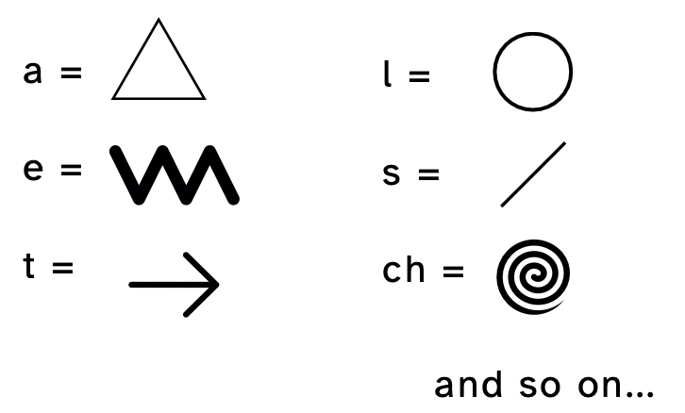
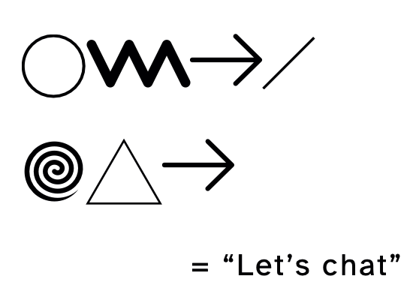
Create a new script for English!
Create a code sheet:
For this, you must create one new symbol per sound of English. These symbols should be...
different to English
quick to write
easy to tell apart.
Then write some secret messages:

Slide 56
Activity 5
The Atlas of Languages

Slide 57

The Atlas of Languages
How languages travel across the world
Some languages are spoken all over the world, often far away from where they started. Many countries have a history of taking over and ruling others. This is known as colonisation. When the powerful languages of colonisers are introduced in a country, smaller languages can fade away.
Find a language in the book that has spread this way, plus one that only has very few speakers left.
What reasons can you think of for trying to keep a language alive?

Slide 58
The Atlas of Languages
Children are language learning superstars
Did you know that children are great when it comes to learning new languages and often learn faster than grown-ups? Find out what the book says about this.
Why do you think it might be easier for you to pick up a language than it might be for an adult to learn one?

Slide 59
The Atlas of Languages
Finding the language family
Languages can be thought of as belonging to language families. These are drawn as a language tree in the book.
Choose some languages from the Aberlangs videos or posters online, or ones spoken in your class.
Then find which tree and which part of the world each one comes from.

Slide 60
The Atlas of Languages
Words that don't translate
The book shares lots of words from different languages, including some that are difficult to translate into English.
Choose your favourite one. What does it tell you about the people who use it, or about the way they see the world?
Can you think of any local Aberdeen (Doric/Scots) words that English does not really have? What’s your favourite difference between English and Doric?

