Slide 1
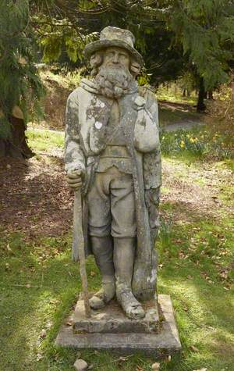
A Short Story by Walter Scott

Slide 2

Starter
What languages do you think are spoken in Scotland?
What languages do you speak?
Photo by Karolina Grabowska: https://www.pexels.com/photo/a-woman-in-beige-long-sleeves-holding-a-globe-8147395/

Slide 3
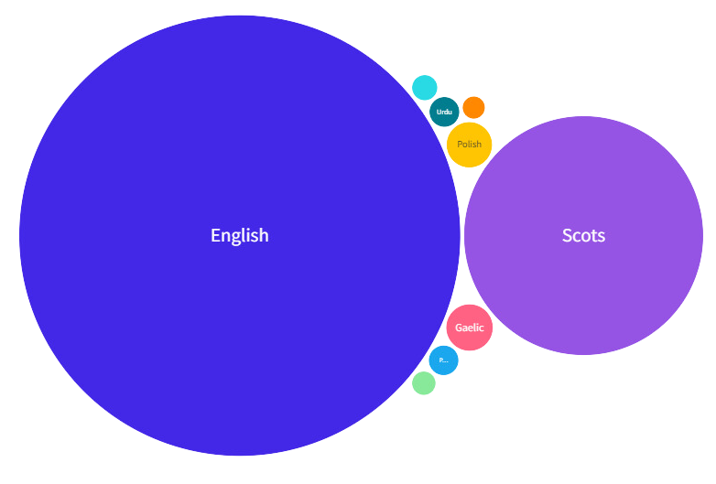
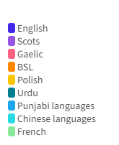
Scotland’s Languages
Challenge:
Say “hello” in as many of these languages as you can!
“Fit like?”
“Ni hao”
“Bonjour”

Slide 4
Discussion
Why do you think it is important to learn languages?
Why do you think it is important to keep your mother tongue alive?
Why is it important for people in Scotland to use and learn Scots?

Slide 5
A Scottish Short Story
We will read a short story by Walter Scott.
The story is from a novel called Redgauntlet. One of the characters tells this story to another one of the characters.
It mixes Scots and English.

