Slide 1
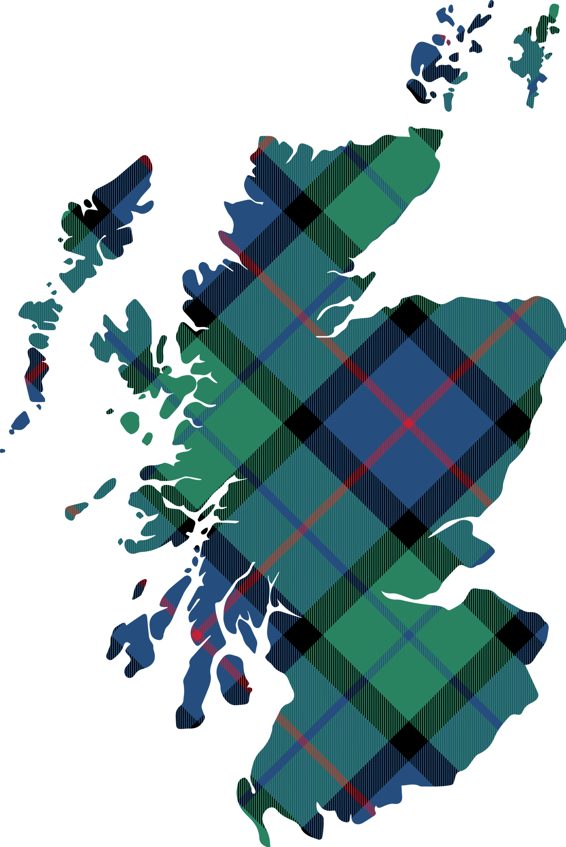

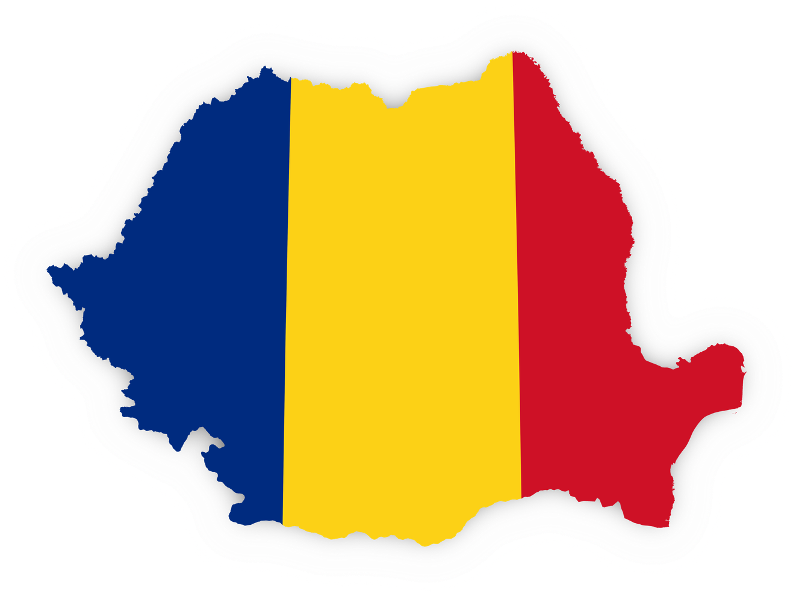
-
A journey from
the Carpathians
to
Aberlangs
-
-
-
-
-
-
-

Slide 2

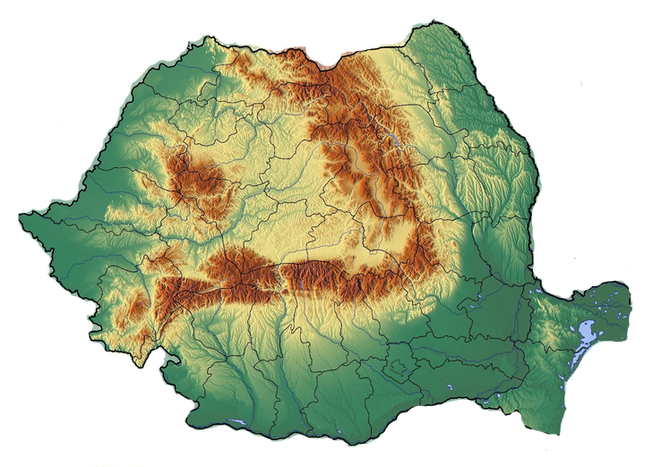

The Map of Romania
Maramureș
(where Andra’s from)
The Carpathian Mountains
The Black Sea
Bucharest
the capital of Romania

Slide 3

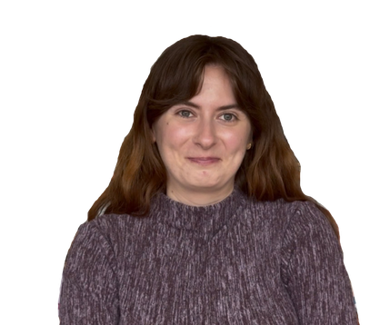
Aberlangs and me
Bună! Numele meu este Andra Mărieș și sunt asistent cercetător în cadrul proiectului Aberlangs!
Hello! My name is Andra Mărieș and I am the research assistant for Aberlangs!
Aberlangs is a project from the University of Aberdeen, that helps people learn about different languages and cultures. It is run by people from the University who work with local communities. The project shows why languages are important and celebrates Aberdeen as a city of languages.
This cardboard book project aims to promote
not only multiculturalism and multilingualism,
but also the creativity and freedom that
comes along with it!
This cardboard book will introduce you to my
background and heritage, but also to the
project and some contributors.

Slide 4
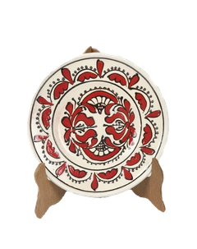
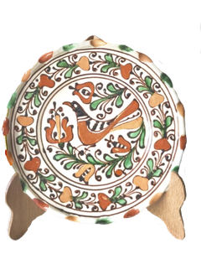
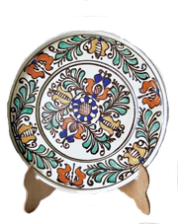
More about me and my background...
I am originally from the North of Romania. Growing up, I spent my summers in the countryside with my grandparents, where we celebrated all holidays and held onto every tradition. Here are some of my favourite ones...
.
Decorating Easter eggs was an important childhood tradition, involving placing small leaves and flowers on eggs to create natural patterns, while some regions use beads for more elaborate designs.
Lady’s Bedstraw flowers are gathered to braid a crown and then throw it over the house roof to predict good fortune or marriage in the coming year. Lady’s Bedstraw is linked to the Sânziene celebration on 24 June, associated with fairy-like women said to dance in meadows on St John the Baptist’s eve.
A few fun facts about Romania....
Just like in Scotland, we also wear our traditional clothing during important events or religious holidays.
We collect our own heritage! Antique shops and car boot sales have varieties of traditional pottery which we collect, not to use, but to display in our homes!

Slide 5

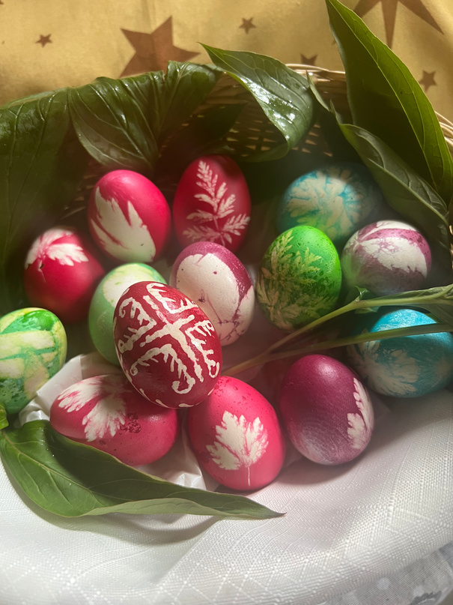
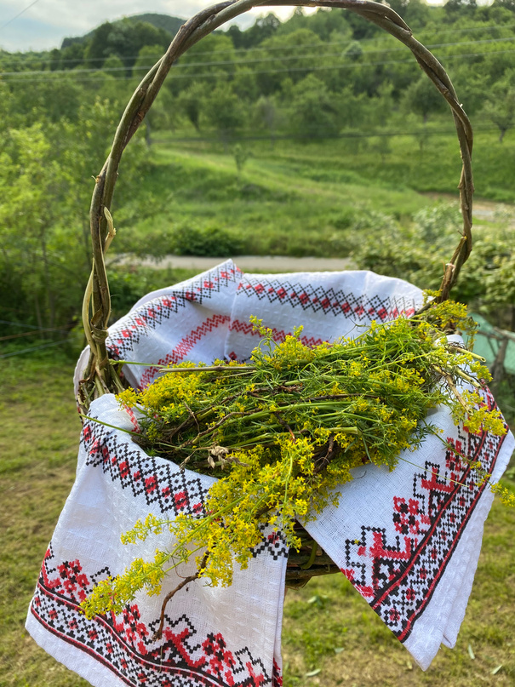
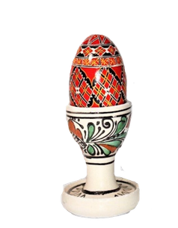
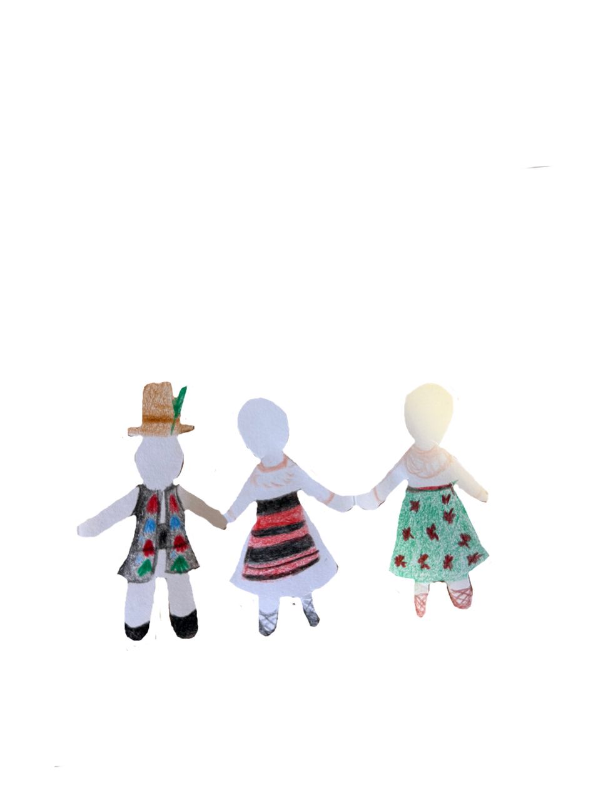
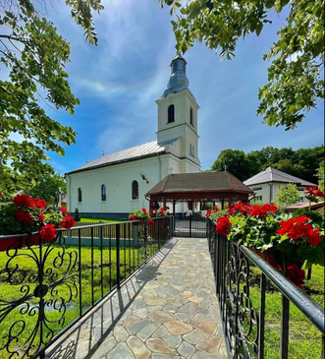
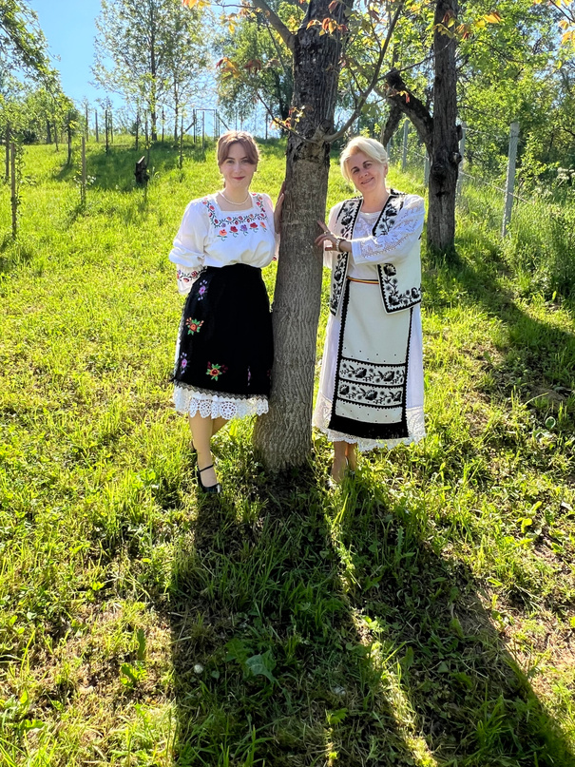
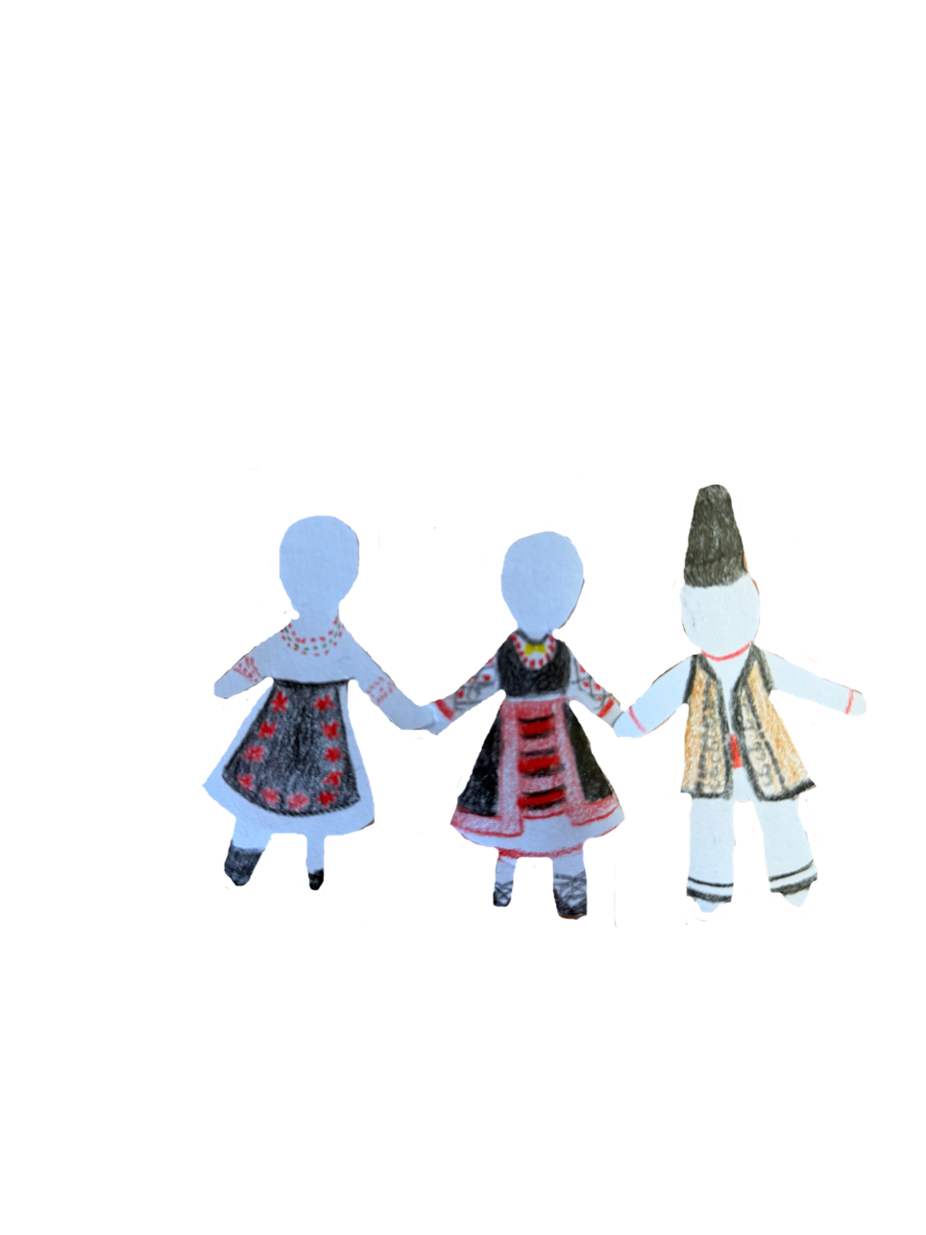
Romanian cultural artefacts
Easter Eggs
Lady’s Bedstraw flowers
The village church with its traditional wooden gate
My mother and I wearing traditional clothing

Slide 6
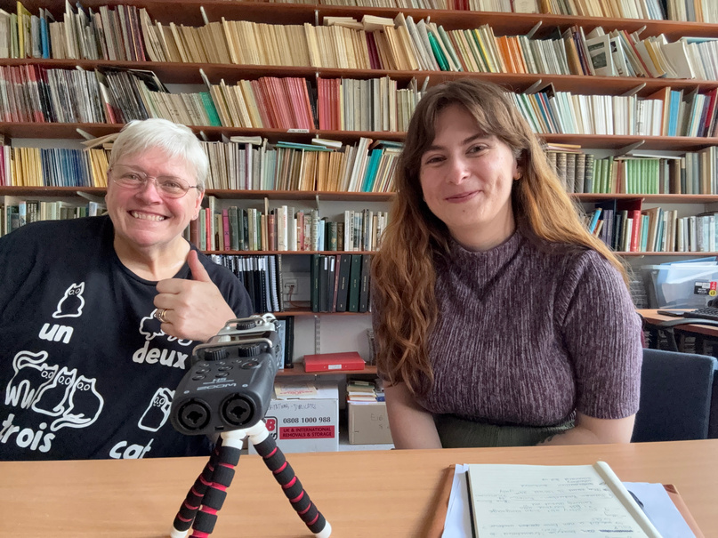
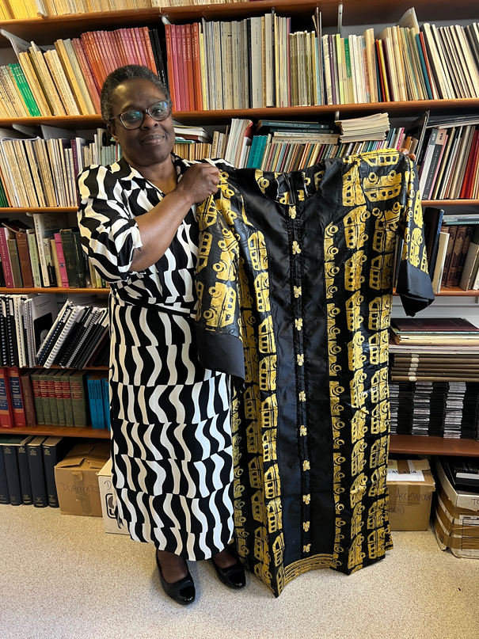
More about Aberlangs...
So far, I have interviewed 14 people from different cultural backgrounds.
Some of the languages I got to hear so far include:
Polish, Housa, Efic, Yoruba, Swahili, Norwegian, Swedish, Lithuanian, Spanish, Farsi, Doric, Scots, British Sign Language (BSL), Malay, Mandarin, Scottish Gaelic, Arabic, German, French, Russian, Dari, and Pashto.
Lesley Crerar
Lesley speaks three languages: Doric, English, and BSL.
She shared how when she first started learning BSL, she felt as if “everyone was talking about me!”.
Ibidun Daramola holding
traditional clothing.
Ibidun came to Aberdeen 15 years ago from Nigeria and speaks Housa, Efic, Yoruba, and Swahili. During our interview, she taught me:
“Mungu ni mwema” in Swahili
which means
“God is good”
Ibidun Daramola

Slide 7
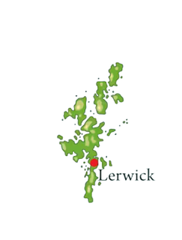
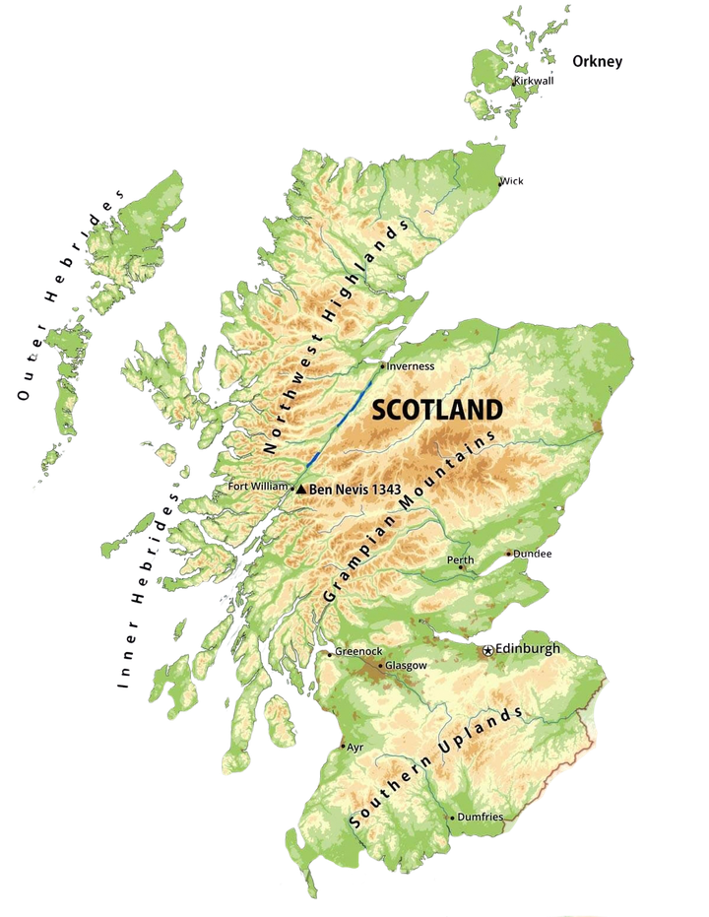
Map of Scotland
Shetland
Isle of Lewis
Isle of Skye
Aberdeen

Slide 8
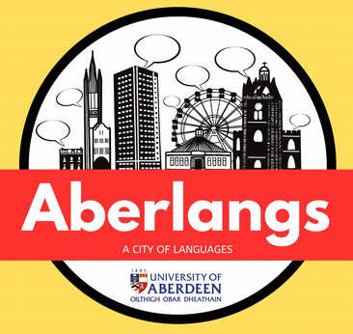
Make your own cardboard book
Liked this Aberlangs cardboard book?
Make your own & share it with us on social media!
All you need is:
  two A5 or A4 sheets of cardboard for your front and back cover
  some A5/A4 blank paper
  and your imagination!
Some questions to get you inspired
How many languages have you heard at school and at home?
What are some traditions or holidays your family celebrates? And which ones are your favourite?
Do you have any favourite words in Scots/Doric, or any other languages you know? Feel free to add these words to your own cardboard book, and write their meaning also.
What is a traditional dish you enjoy eating?
Could you draw it in your cardboard book?
Do you have traditional clothing?
If so, when and where do you wear it?

