Slide 1
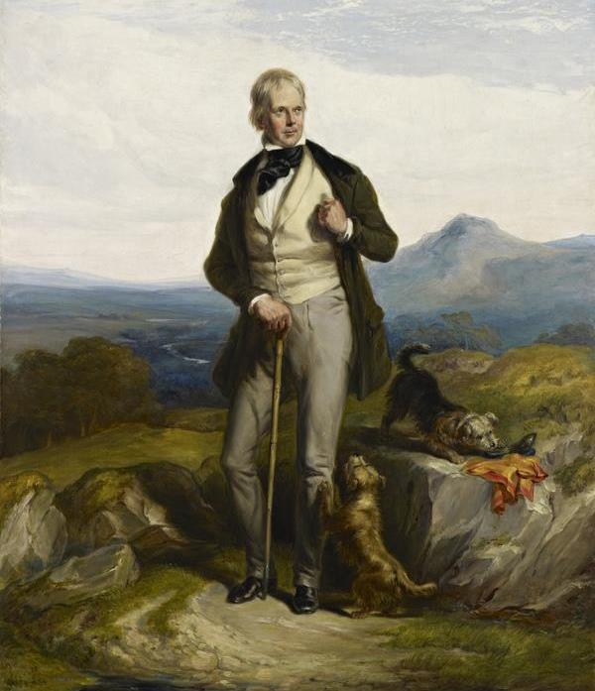
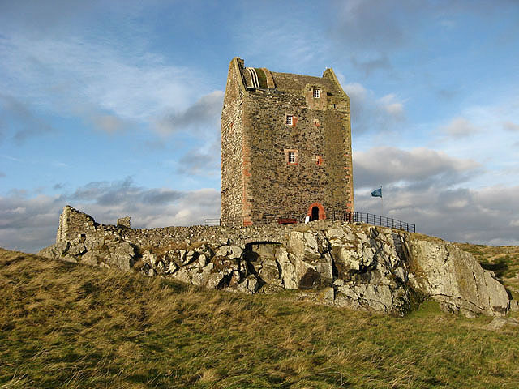
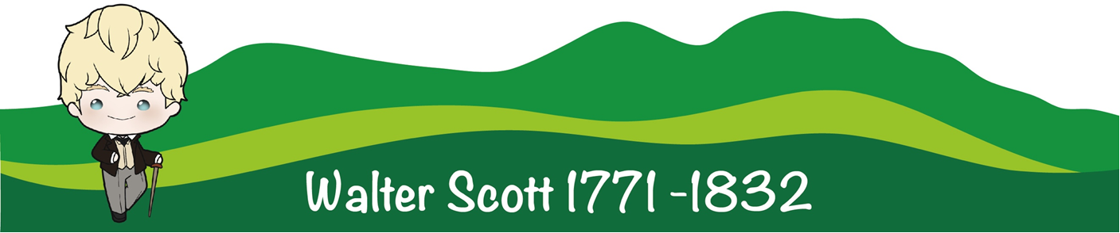

Who was Walter Scott?

Slide 2
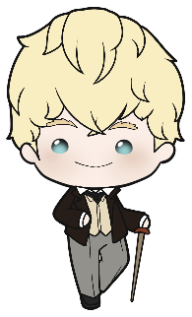
Who was Walter Scott?
Growing up
A famous writer
Adventures
Abbotsford
home

Slide 3
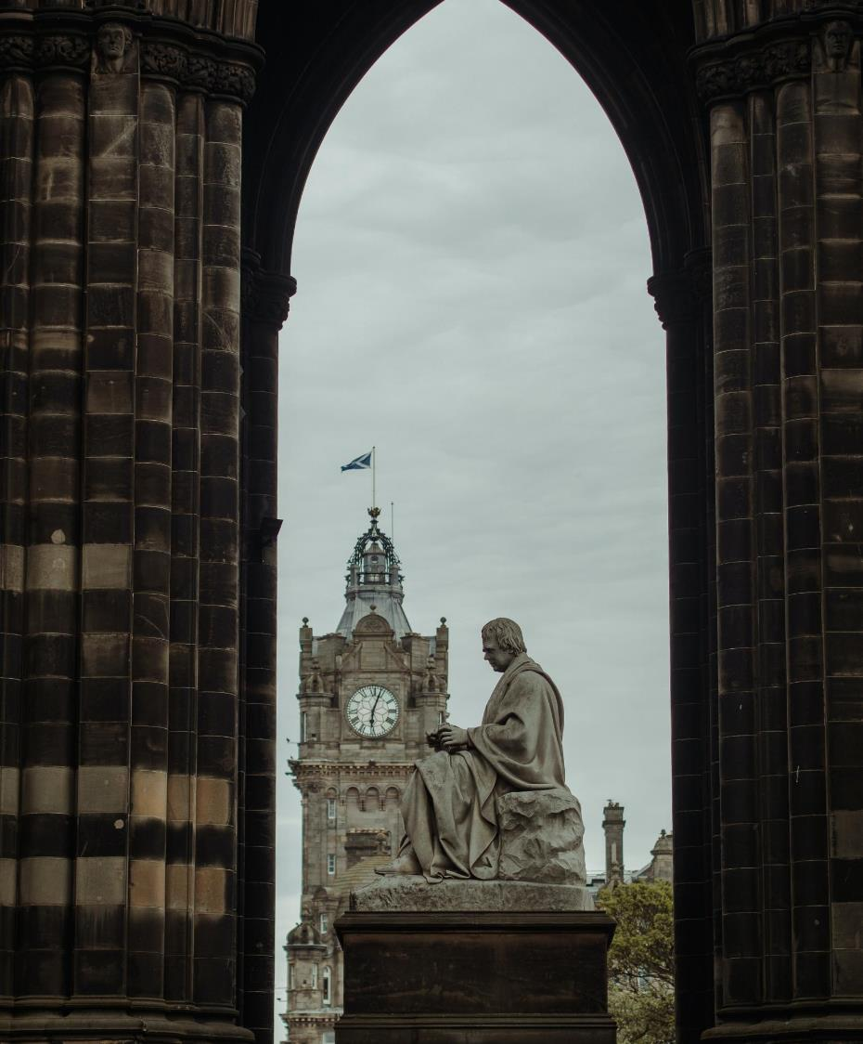
In 1771, a man was born who would ...
revolutionise literature.
become an international best-seller and writing star.
make Scotland a popular tourist destination.
popularise tartan.
find the missing crown jewels of Scotland.
inspire a generation of writers.
save the Scottish banking system.
Walter Scott!
Who was he?
Photo by Anna Urlapova: https://www.pexels.com/photo/side-view-of-the-sir-walter-scott-satatue-2968724/

Slide 4
Who was Walter Scott?
Walter Scott was born in Edinburgh in 1771.
His father worked in law and his mother was a stay-at-home parent.
Scott had a busy and successful writing career.
His poems and novels were bestsellers.
His stories are all around us today – in place names, monuments, and re-tellings.
Sir Walter Scott, 1771-1832. Novelist and poet, 1844, Sir Willian Allan, Creative Commons – CC by NC, National Galleries of Scotland

Slide 5
Growing up
Inspiration
Challenges
Education
home

Slide 6
Inspiration
What is your favourite song? Why do you like it?
What is your favourite story? Can you re-tell it?
Tell your classmates about a time when someone showed you a new story or TV show or book that you liked.
home
growing up

Slide 7
Scott's Inspiration
When Walter Scott was young, he listened to family members sing ballads. You can listen to a ballad by clicking on this link.
Walter Scott also liked to listen to and read all sorts of stories. You can listen to a story by clicking on this link.
home
growing up
Notes:
Ask children:
What are you favourite songs?
What are you favourite stories

Slide 8
Challenges
What do you do when you are sick?
In pairs or groups list things that can help a sick person.
home
growing up

Slide 9
Scott's Challenges
When Walter Scott was young, he caught an illness called polio. He was very ill. It left him with one leg longer than the other.
When he was sick, his parents sent him to Sandyknowe, near Smailholm, in the Borders, to get better.
Walter Baxter / Smailholm Tower / CC BY-SA 2.0
home
growing up

Slide 10

Education
What is your favourite subject in school?
What do you like about it?
Photo by Max Fischer: https://www.pexels.com/photo/children-in-the-classroom-5211446/
home
growing up

Slide 11
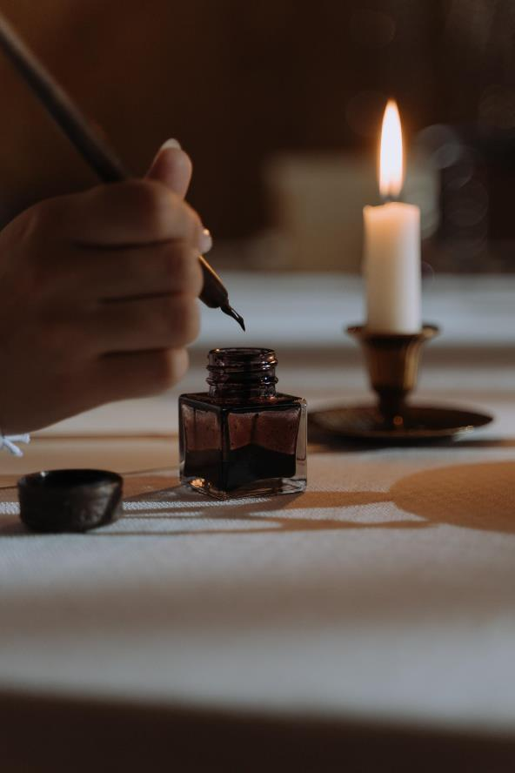
Scott's education
Walter Scott went to school in Edinburgh and then in Kelso. Then he trained in law. He wrote a lot about law in his writings.
Photo by cottonbro studio: https://www.pexels.com/photo/person-dipping-quill-pen-in-an-ink-6752321/
home
growing up

Slide 12
A famous writer
Collections and translations
Poems
Novels
Non-fiction
home

Slide 13

Collections and translations
Think of your favourite song. Write down the lyrics and read them to your partner.
Did you remember all the words? Do you think you made any mistakes?
Photo by Karolina Grabowska: https://www.pexels.com/photo/teenage-girl-with-headphones-on-smiling-and-showing-thumbs-up-8005028/
home
writer

Slide 14
Collections and translations
Walter Scott started his writing career by collecting ballads from people in the Borders. He put these together in a book called Minstrelsy of the Scottish Border. This was published in 1802.
He also translated poems. He particularly liked German poems. Click here for a video of one of Scott’s translations.
home
writer

Slide 15
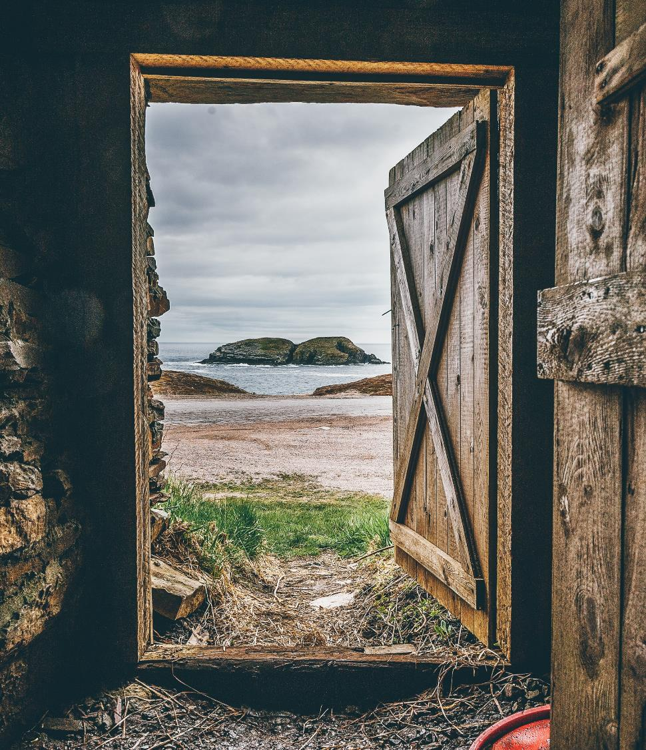
Poems
Poems can either share an emotion or tell a story.
Look at the picture.
Create a few sentences to share an emotion that the picture inspires, or create a few sentences to tell a short story inspired by the picture.
home
Photo by Harrison Haines: https://www.pexels.com/photo/brown-wooden-opened-door-shed-2869565/
writer

Slide 16
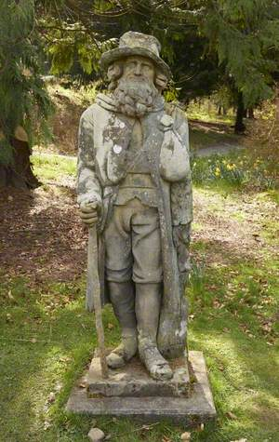
Scott's poems
Scott wrote long and short poems. Each of his long poems tell a story.
His first poem was The Lay of the Last Minstrel. It was published in 1805. It was very popular. Lots of people read it. It made Scott famous.
This statue can be found in Abbotsford, Scott’s house.
home
writer

Slide 17


Novels
Think of a novel that you have read.
Split the plot into six key points.
Draw them on a storyboard.
Add image credit line
home
writer

Slide 18
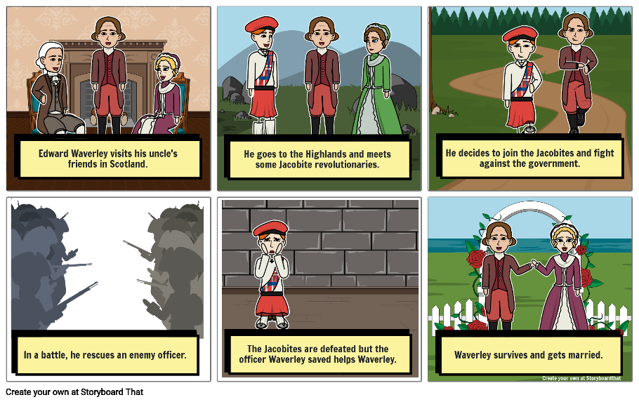
Scott's novels
In 1814, Scott’s first novel was published.
The novel was called Waverley and it followed the adventures of a young man called Waverley, who joined the Jacobites, a group of people who believed that the wrong King was on the throne.
Waverley was an Englishman who went to Scotland, first to the Lowlands and then to the Highlands. For many of Scott’s readers, this was the first time they learnt anything about the Highlands.
Scott did not put his name on the novel. It was anonymous.
Scott wrote lots more novels. They were very popular.
home
writer

Slide 19
Non-fiction
How good are these places for finding information? Rank them from 1 to 10. Explain your answer.
  Librarian
  Wikipedia
  Friends
  Social media
  The BBC
  Teacher
  Museum
  A book
  A blog
  A leaflet handed out on the street
home
writer

Slide 20
Scott's non-fiction
In addition to writing poetry and novels, Scott also wrote non-fiction. He wrote biographies of famous people and information about history. One of his books, Tales of a Grandfather, told the history of Scotland for children.
from
Tales of a Grandfather
A long time since, eighteen hundred years ago and more, there was a brave and warlike people, called the Romans, who undertook to conquer the whole world, and subdue all countries, so as to make their own city of Rome the head of all the nations upon the face of the earth. And after conquering far and near, at last they came to Britain, and made a great war upon the inhabitants, called the British, or Britons, whom they found living there.
home
writer

Slide 21

A life of adventure
Ballad collecting
Finding treasure
The king’s visit
A man of law
home

Slide 22

What is adventure?
Imagine a really adventurous person.
Describe what they are like.
What adventures do they have?
Photo by Nina Uhlikova: https://www.pexels.com/photo/person-standing-on-hand-rails-with-arms-wide-open-facing-the-mountains-and-clouds-725255/
home
adventure

Slide 23
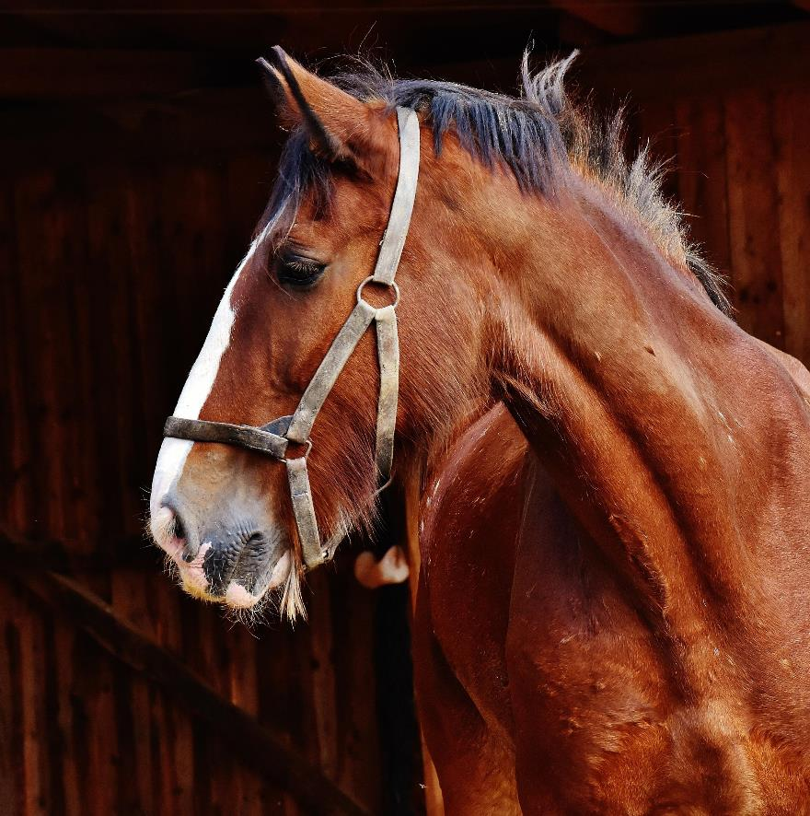
Ballad collecting
When Scott was a young man, he went riding in the Scottish Borders.
He collected ballads from the people he met.
He wrote them down for other people to read.
Photo by Pixabay: https://www.pexels.com/photo/animal-barn-horse-mammal-208866/
home
adventure

Slide 24
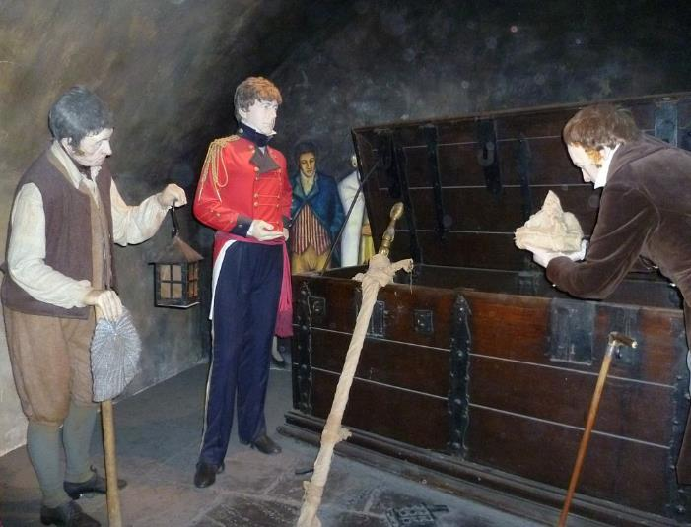
Finding treasure
The Scottish crown jewels had been missing for many years.
Scott, along with some others, looked for the crown jewels…and found them!
By Kim Traynor - Own work, CC BY-SA 3.0, https://commons.wikimedia.org/w/index.php?curid=16651259
home
adventure

Slide 25
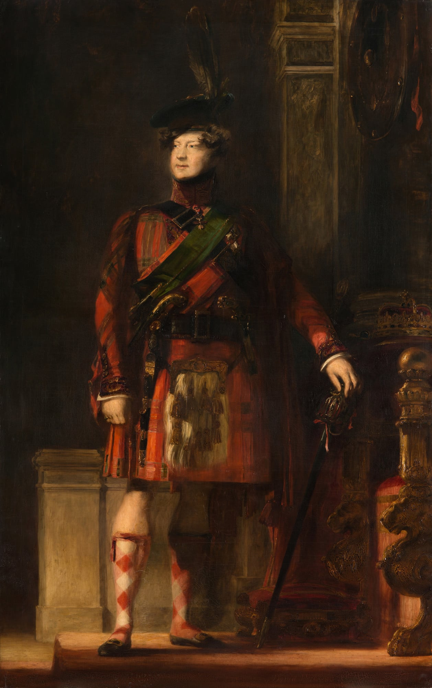
The King's visit
George IV was the first king to visit Scotland in about two hundred years.
Walter Scott organised his visit.
He told everyone to wear tartan, which made it much more popular.
It was a big event, which lots of people attended.
home
adventure
© Royal Collection Enterprises Limited 2026 | Royal Collection Trust

Slide 26
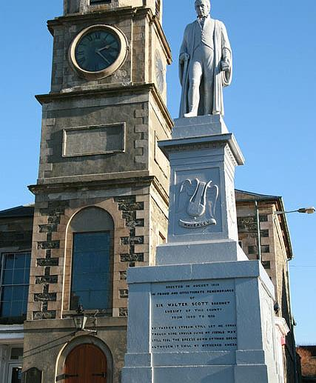
A man of Law
In addition to writing, Scott also worked in the law.
He was the Sheriff Depute of Selkirkshire.
He was clerk to the Court of Session.
He made lots of important decisions.
home
adventure
Walter Baxter / Statue of Sir Walter Scott / CC BY-SA 2.0

Slide 27
A life at Abbotsford
The house he built
Friends and family
Reading
Death
home

Slide 28

Your dream home
Imagine the perfect house.
What does it look like?
What rooms are there?
What would you put in your dream home?
Photo by Oleksandr Pidvalnyi: https://www.pexels.com/photo/person-with-keys-for-real-estate-7599735/
home
house

Slide 29
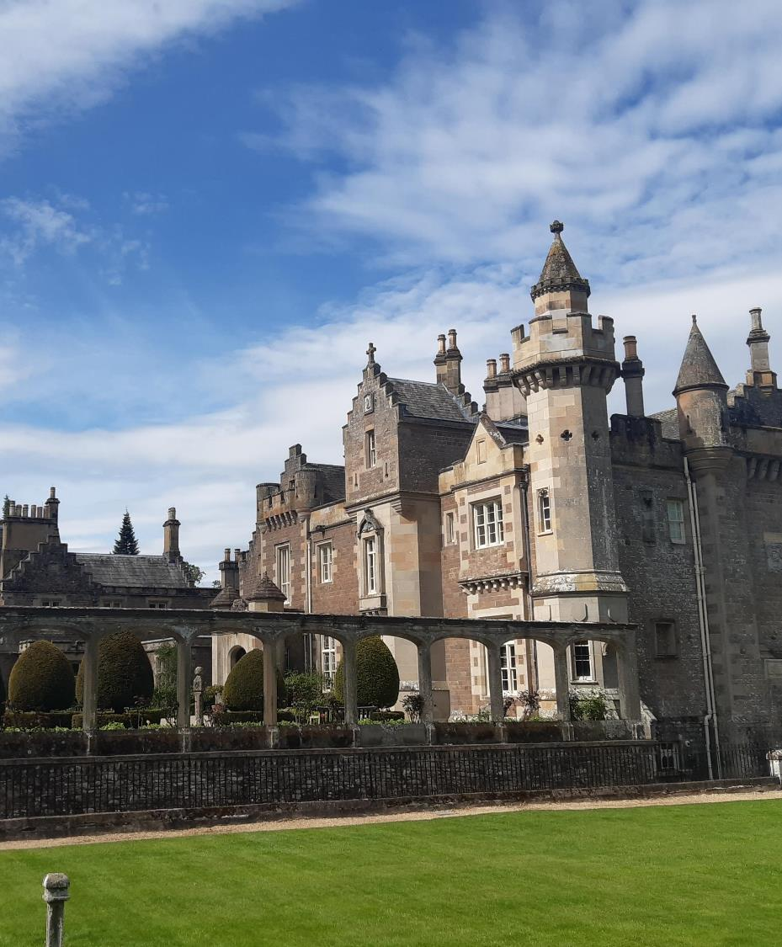
The house he built
When Scott became rich and famous, he built himself a house called Abbotsford.
He filled his house with things that interested him like old armour and other historical artefacts.
home
house

Slide 30
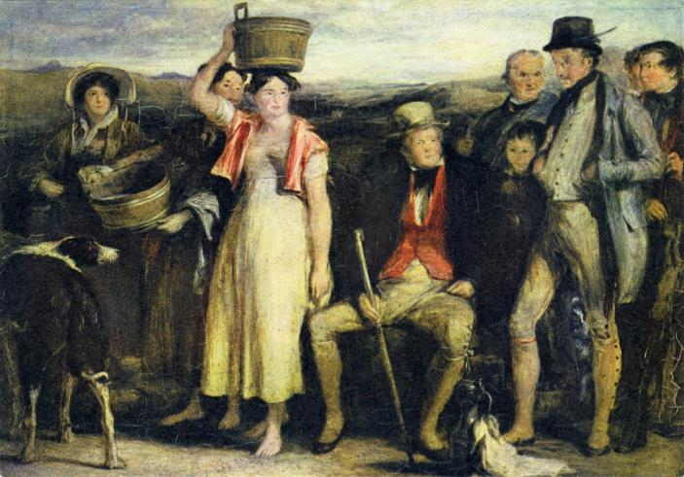
Friends and family
Walter Scott married Charlotte Carpenter.
They had four children.
Family was very important to Scott. He spent a lot of time with his family, and even wrote a book for his grandchildren, called Tales of a Grandfather.
https://www.nationalgalleries.org/art-and-artists/8202/abbotsford-family
Creative Commons CC by NC
home
house

Slide 31
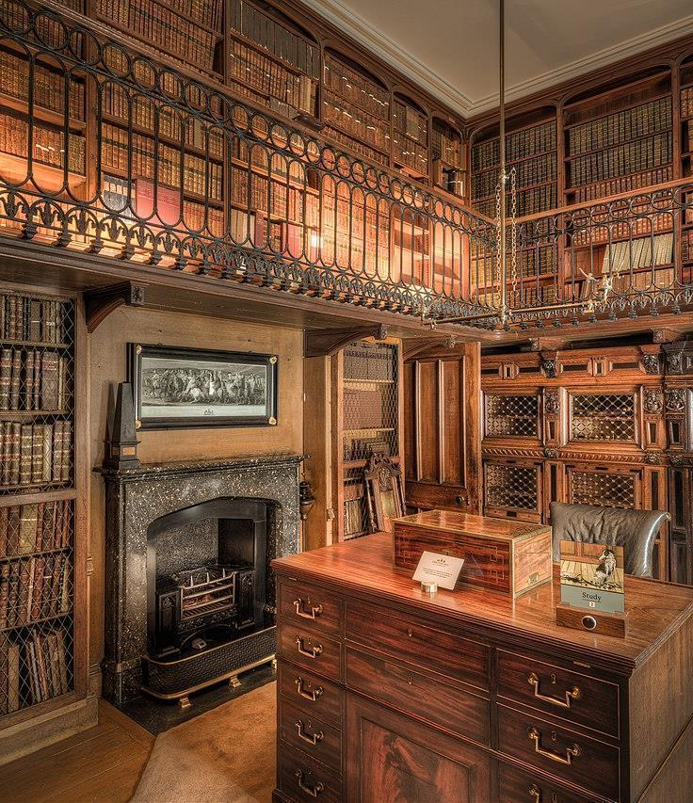
Reading
Good writers love to read.
Scott collected and read hundreds of books.
You can still see his books on display at Abbotsford.
home
house
Reproduced courtesy of the Faculty of Advocates Abbotsford Collection Trust / Abbotsford Trust

Slide 32
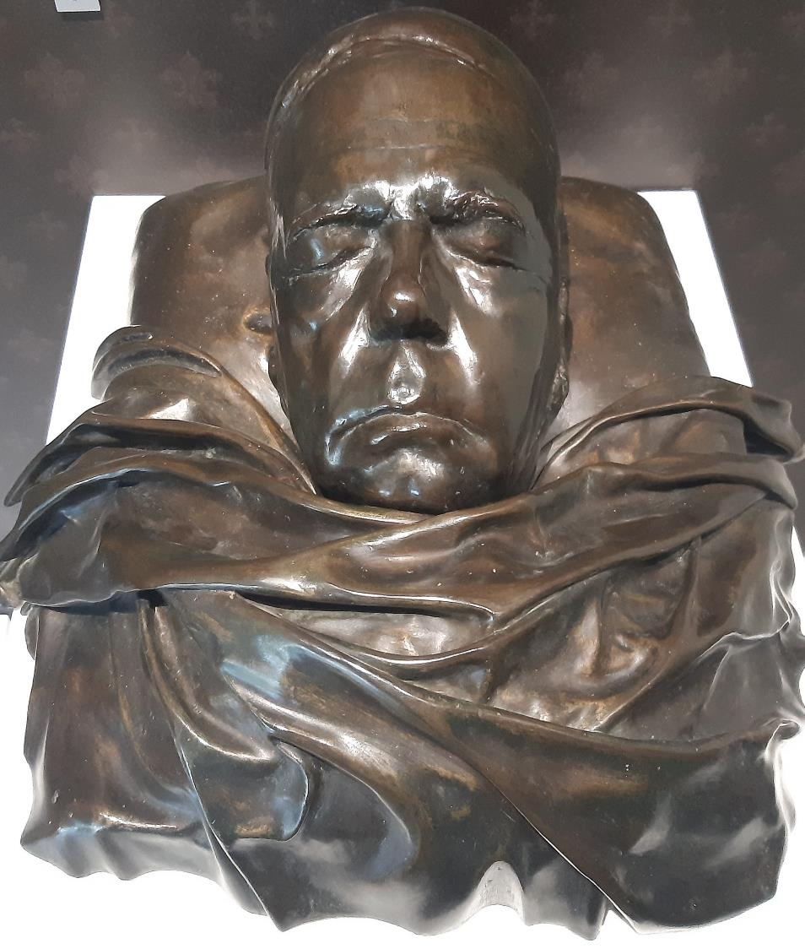
Death
Scott faced a lot of difficulties in his last few years.
In 1825, there was a national banking crisis. Along with lots of others, Scott lost his money.
In 1826, Scott’s wife died.
He then started to get ill.
In 1831, he went overseas to try to get better.
But in 1832, he went home. He died at Abbotsford on the 21 September.
home
house

Slide 33
Quiz
Quiz
What was the name of Scott’s first novel?
What challenge did Scott face when he was a child?
What item of clothing did Scott popularise for the King’s visit?
What language was Scott’s poem, ‘The Mermaid’ translated from?
What did Scott collect in Minstrelsy of the Scottish Border?
What type of literature initially made Scott famous?
What is the name of the house that Scott built?
What does Deloraine dig up in The Lay of the Last Minstrel?
Where was Scott Sheriff Depute?
What treasure did Scott find?

Slide 34
Answers
What was the name of Scott’s first novel? Waverley.
What challenge did Scott face when he was a child? He caught polio.
What did Scott popularise for the King’s visit? Tartan.
What language was Scott’s poem, ‘The Mermaid’ translated from? German.
What did Scott collect in Minstrelsy of the Scottish Border? Ballads.
What type of literature initially made Scott famous? Poetry.
What is the name of the house that Scott built? Abbotsford.
What does Deloraine dig up in The Lay of the Last Minstrel? A magic book.
Where was Scott Sheriff Depute? Selkirkshire.
What treasure did Scott find? The Scottish crown jewels.

