Slide 1
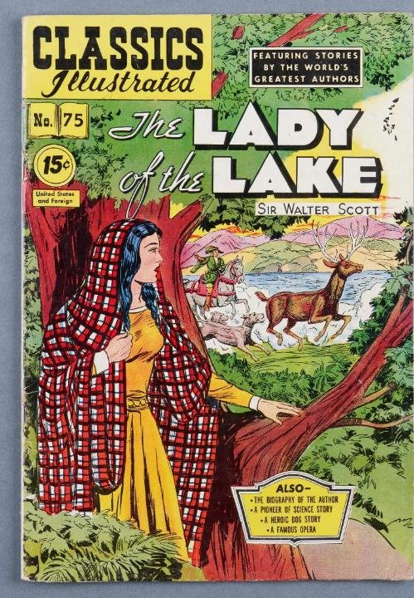
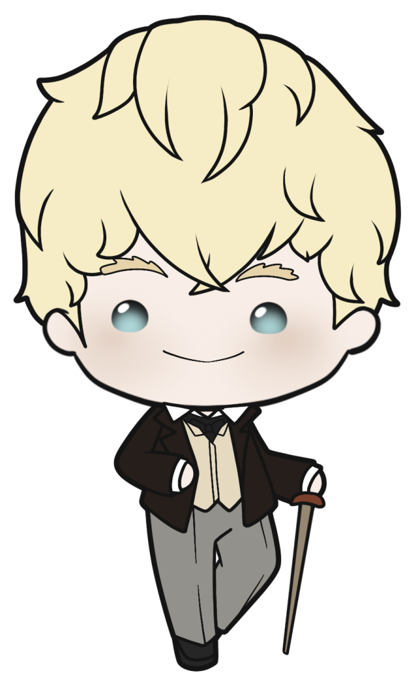
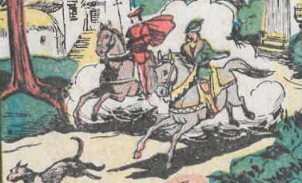


The Hunt
Based on the
Classic Comics version
of Walter Scott's
The Lady of the Lake

Slide 2
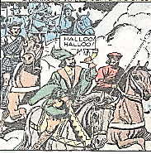
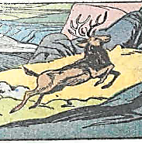
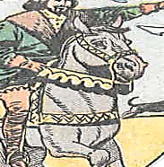
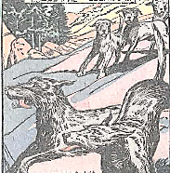
Task 1: Work in four groups
Get a big piece of paper
Draw or write your character in the middle
Write or draw what your character is thinking and feeling at every point in the story
The hunter/knight
The stag
The knight’s horse
The dogs

Slide 3
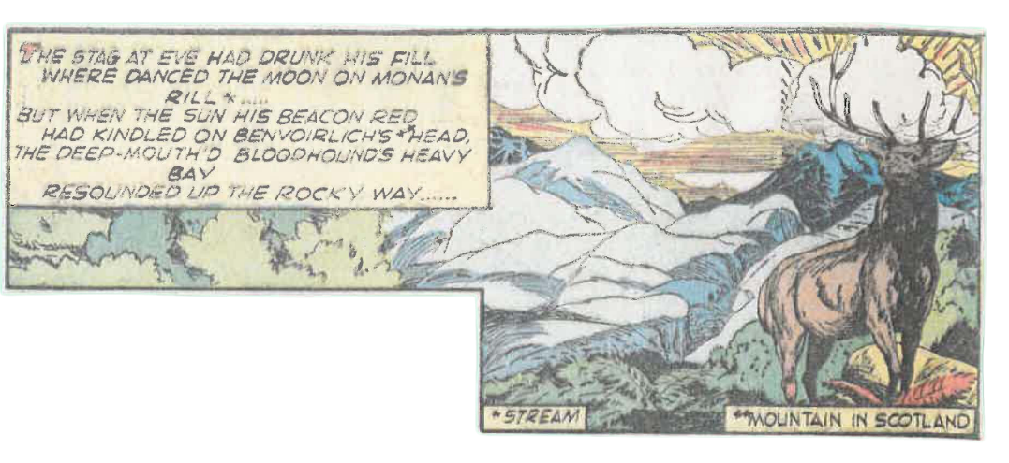
1st page of the comic book
What time of day is it?
What has the stag just done?
What does the stag hear?

Slide 4
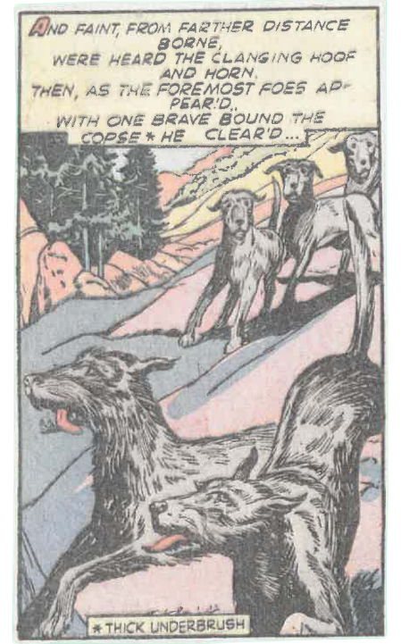
2nd page of the comic book
The stag hears something at a distance. What is it?
When the hunting dogs appear, what does the stag do?

Slide 5
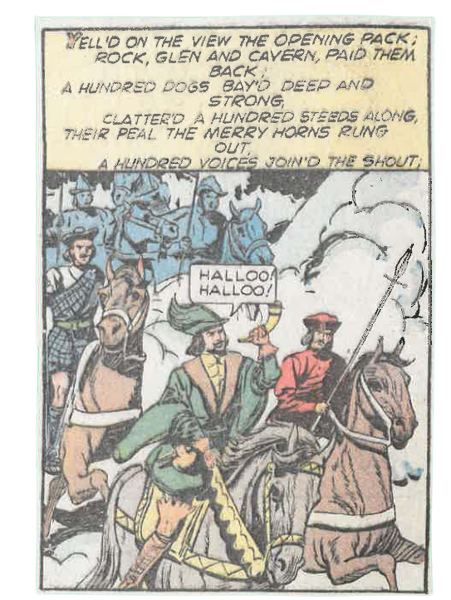
The Hunters are here
Which words tell us that there is an echo?
How many hunters are there?
What animals are with the hunters?

Slide 6
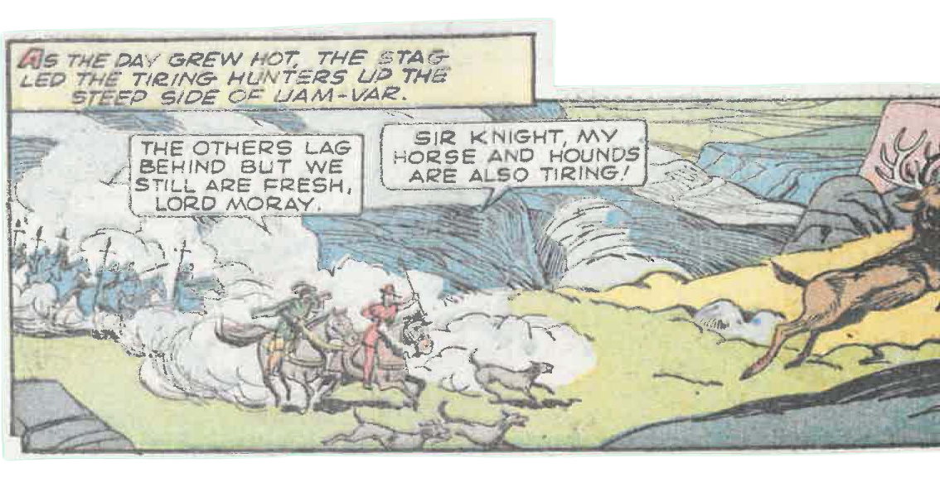
4th page of the comic book

Slide 7
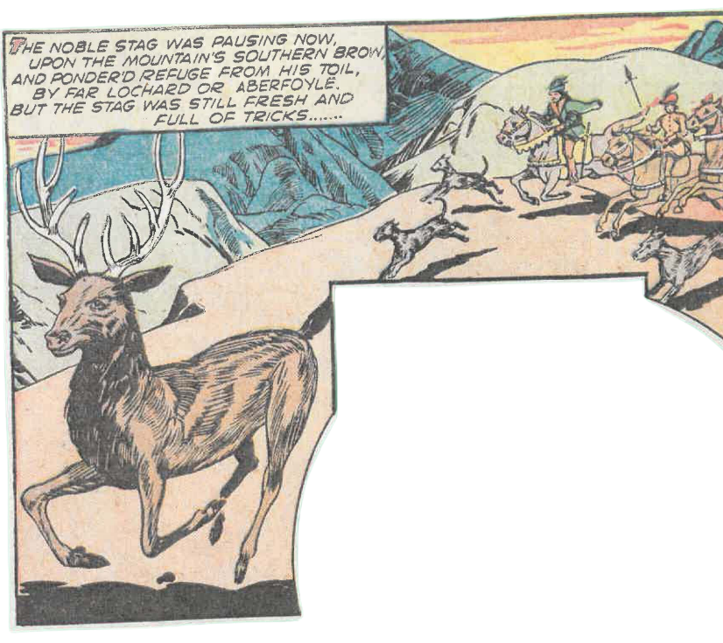

5th page of the comic book
What does ‘ponder’d refuge from his toil’ mean? Look up any words you do not know.
What phrase tells us that the stag is not tired yet?

Slide 8
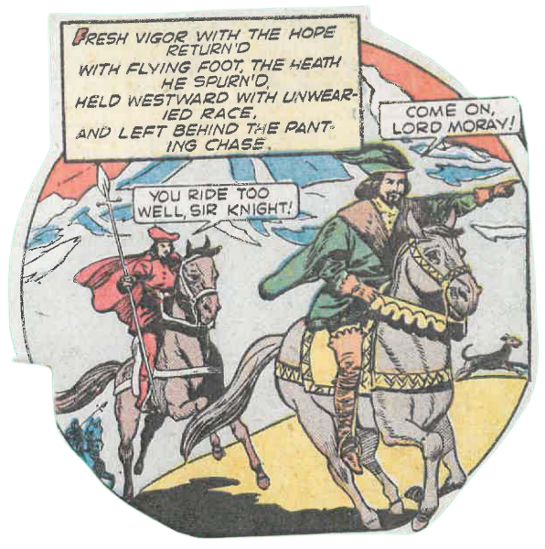
6th page of the comic book
Which way did the stag choose to run?
The ‘chase’ refers to the dogs, hunters, and horses. Why are they panting?

Slide 9

7th page of the comic book
There are only two hunters now. What do you think happened to the others?

Slide 10
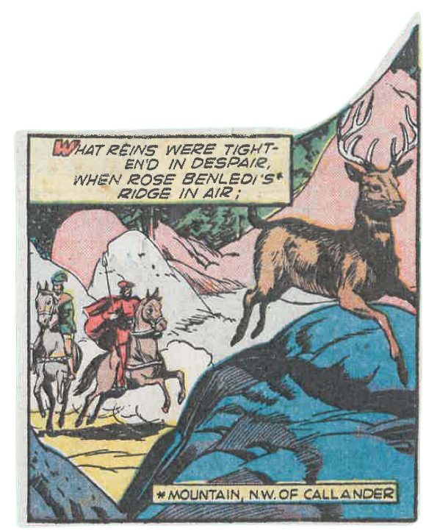
8th page of the comic book
The hunters are beginning to feel ‘despair’. Why is this?
Do you think the stag will get away?

Slide 11
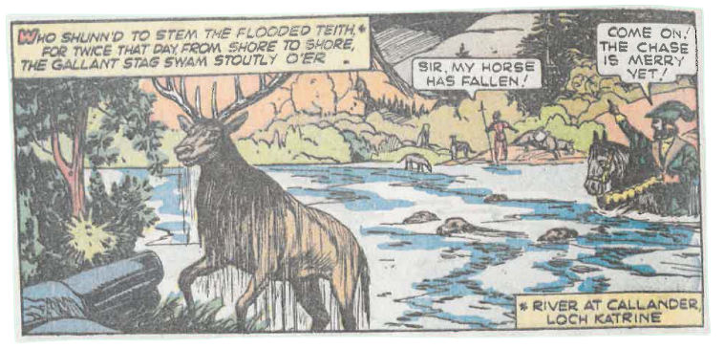
9th page of the comic book
What has the stag done twice today?
Why can Lord Moray not follow the other knight?

Slide 12
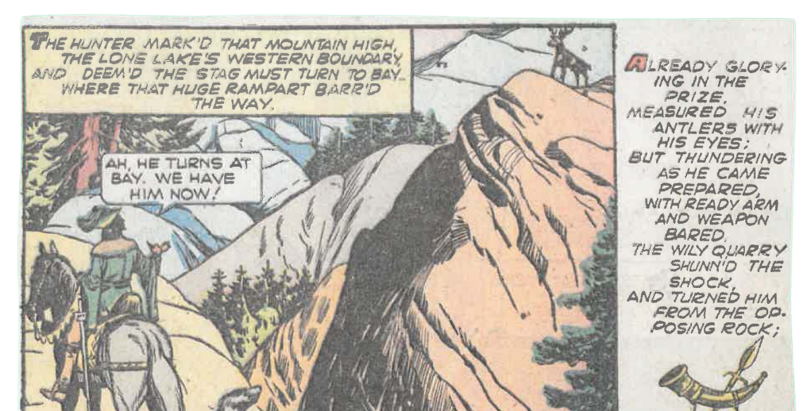
10th page of the comic book
What does the hunter do when he sees a mountain blocking the stag’s way?
What does the stag do?
What does the word ‘wily’ mean? Look it up if you do not know.

Slide 13
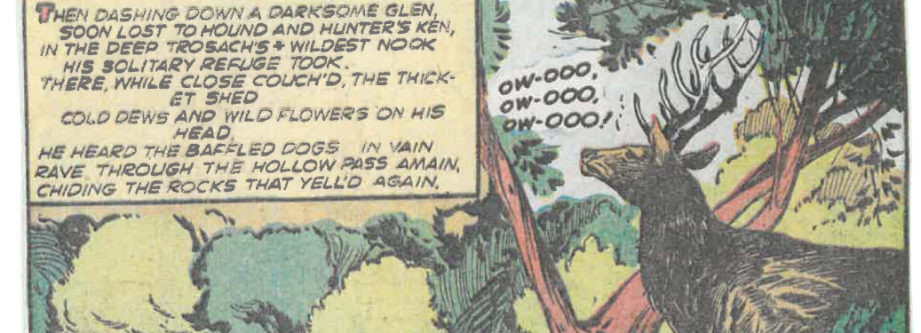
11th page of the comic book
How does the stag escape?
Why are the dogs ‘baffled’?

Slide 14
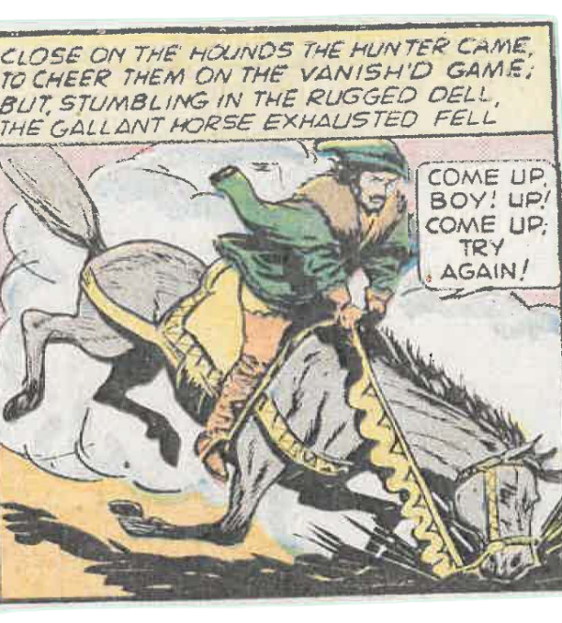
12th page of the comic book
What does the hunter want to do?​
​
What stops him from doing this?​

Slide 15
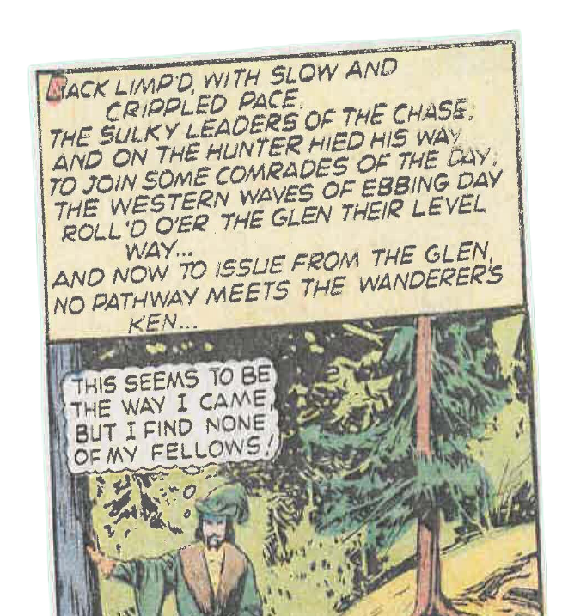
13th page of the comic book
The hunter cannot follow the stag anymore. What is he trying to do now?
What time of day is it now? How long do you think the hunter has been hunting?

Slide 16
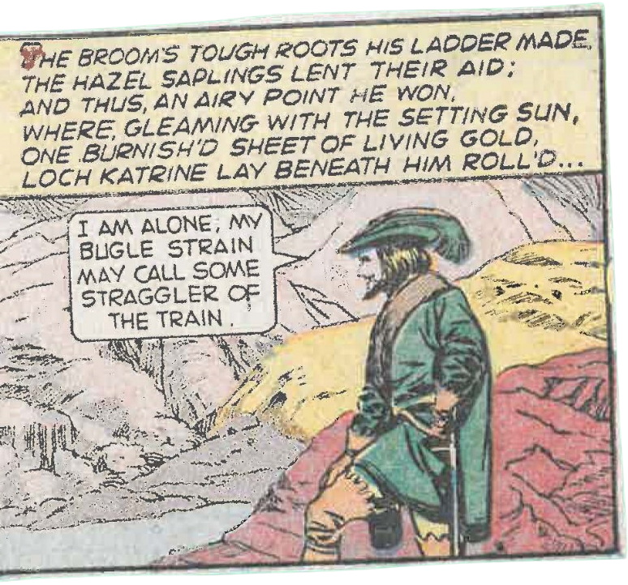
14th page of the comic book
Where has the knight gone now?
What is a ‘bugle strain’ and what does the knight hope it will do?

Slide 17
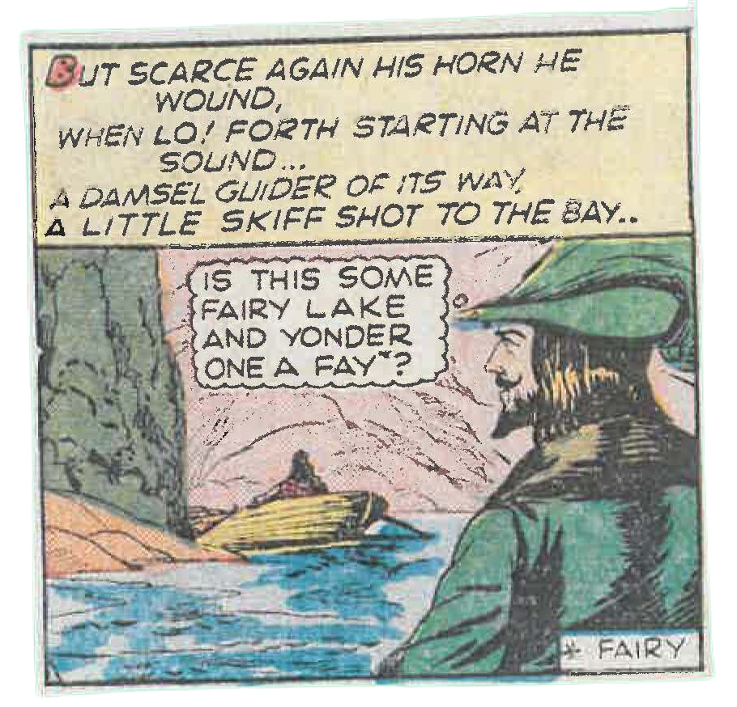
15th page of the comic book
Who, having heard the knight’s bugle, appears?
What does the knight think this person is?

Slide 18
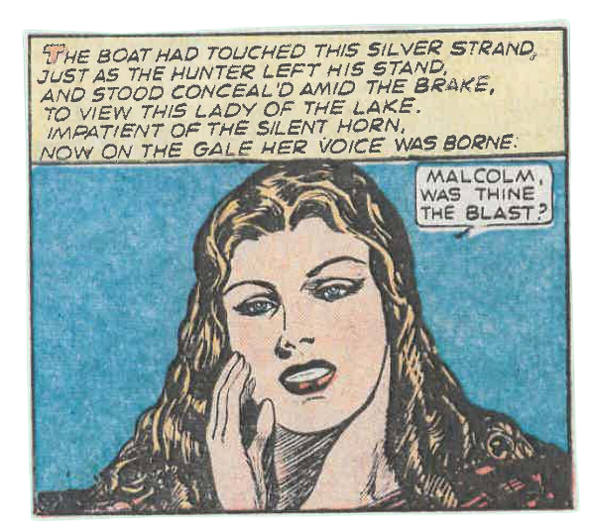
16th page of the comic book
What do you think the ‘silver strand’ is?
What does the lady in the boat say?
Can the lady see the unnamed knight?
What do you think will happen next?

Slide 19
Task 2:
Retell the story from the perspective of your character.
The hunter/knight
The stag
The knight’s horse
The dogs

Slide 20
Task 3
Choose one moment from the story.​
Think about the different sounds that are heard in this moment.​
Try to find one sound for each person in your group.​
Describe the sounds.​
Try to make the sounds yourself.​
In your groups, re-tell that moment of the story, with one person narrating the story, and the others making the different sounds.​

Slide 21
The knight has seen a mysterious lady on a boat.
This is only the beginning of the story.
What do you think happens next?
Task 4

