Slide 1


A Story in Scots
by
Walter Scott

Slide 2
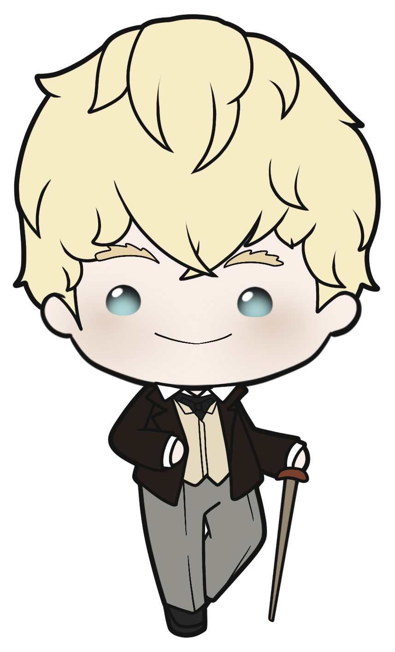
Starter activity
What languages
do you
think are spoken
in Scotland?
What languages
do you
speak?

Slide 3
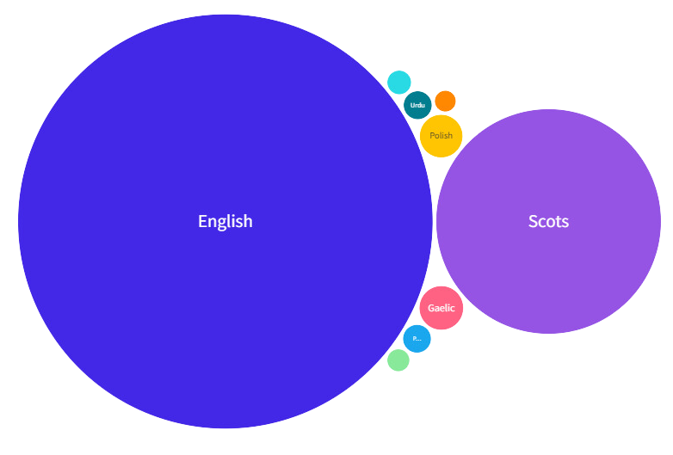
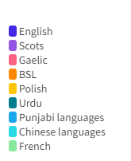
Scotland's languages
Challenge:
Say “hello” in as many of these languages as you can!
“Fit like?”
“Ni hao”
“Bonjour”

Slide 4

Discussion
Why is it important for people in Scotland to use and learn Scots?
Why do you think it is important to keep your mother tongue alive?
Why do you think it is important to learn languages?

Slide 5
A Story in Scots
We will read a short story by Walter Scott.
It mixes Scots and English.
One of the characters tells this story to another one of the characters.
The story is from a novel called Redgauntlet.

