Slide 1
Introduction to OpenAlex
Francesca Soldati
Open Research Team
Notes:
Hi everyone and thank you for coming to this session on OpenAlex

Slide 2
In this session
What is OpenAlex?
Comparison with other databases
Benefits of open-source tools
OpenAlex Demonstration
Part of the content of this session has been sourced from the official YouTube channel and documentation of OpenAlex
www.youtube.com/@OurResearch
Overview | OpenAlex technical documentation
Notes:
This session will serve as an introduction to OpenAlex. We'll begin with an overview of what OpenAlex is. Next, we'll compare OpenAlex with other well-known databases, highlighting its standout feature: being free and open-source. We'll discuss the importance of open-source tools in the community. Finally, I'll provide a practical demonstration of OpenAlex, allowing you to see the platform in action and understand how it works.
I hope this will spark your interest and encourage you to explore it further on your own. There are many valuable resources available online about OpenAlex; part of this presentation's content is sourced from their YouTube channel and website.

Slide 3

What is OpenAlex?
OpenAlex is an open-source citation database, launched in January 2022 by OurReserach.
Journals
Scientific Knowledge Graph (SKG) → organises metadata of entities (authors, institutions, publishers etc.), and concepts, and creates relationships between them.
Publications
Non-profit organisation which aims to make research more open, accessible and reusable
Authors
Topics
Institutions
Notes:
What is is openAlex? Open alex is an open source bibliometric index launched in January 2022 by OurResearch: a non profit organisation, they are the creators of Unpaywall for example.
But what is a citation database, I recently discovered that the technical term for it is scientific knowledge graph.
Knowledge graphs (KGs) organise data from multiple sources, capture information about entities (in this case entities related to a research output- author, institutions, concepts), and create connections between them.
And if this is not clear I just give you some example of other knowledge graph that I’m sure you’ll know and probably you have used

Slide 4
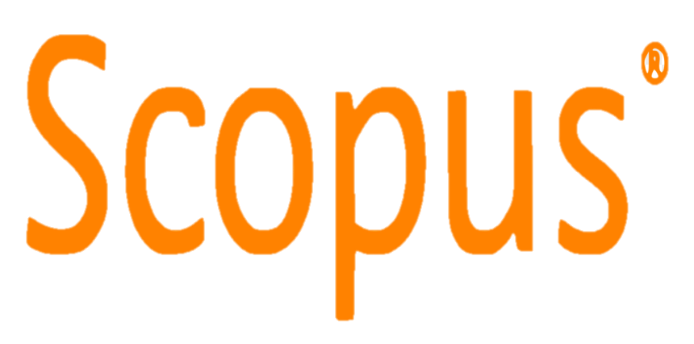
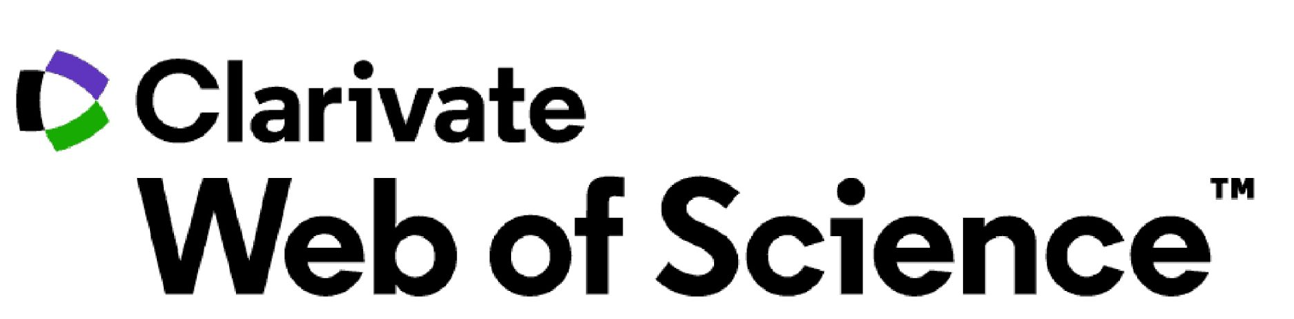

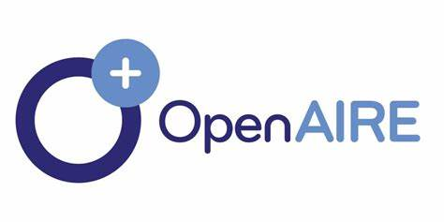
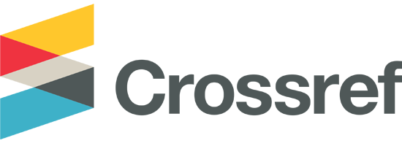
Databases (SKGs)
Use for discovery
Citations
Scholarly outputs on a particular topic
Authors’ work
Patents
Datasets
Used for impact and decision-making
Which countries publish more open access (global north or south)?
Which institutions publish the most on a particular topic?
Notes:
Scopus, WoS and Dimension. Then you can use all the information and connections for research discovery. You can use these databases to gather information and explore connections. For example, if you want to check who has cited your work, find research outputs on a particular topic, or locate the publications of a specific author to initiate a collaboration. At a higher level, institutions and funders use the information from these databases to evaluate research impact and make informed decisions. Additionally, these databases are used in league tables to assess research impact using various citation metrics.
Speak a bit about that the most used and popular SKG are subscription databases, which means you have to pay to access the data, many time what you pay doesn’t allow you full access to the content but to smaller packages. and even if you have access to the data, these are proprietary data, which means they cannot be shared. So let’s say you are doing a research for example looking at whether international collaborations affects citations outcomes, and you use data from subscription databases you won’t be able to share the data. And now this is more problematic with the open research movement and the demand of higher transparency in research (funder mandates that require data used in the study to be open).
Plus you cannot build on data
OpenAlex
Coverage: OpenAlex includes metadata for over 236 million works, 91 million authors, and 108,000 institutions1
.
Data Sources: It integrates data from various sources, including Crossref, ORCID, and PubMed1
.
Accessibility: OpenAlex is completely open and free to use, making it accessible to anyone1
.
Focus: It aims to provide a comprehensive, open catalog of the global research system, including citation indexing2
.
Technology: Uses artificial intelligence and automatic algorithms to index articles2
.
OpenAIRE
Coverage: OpenAIRE covers 193 million publications, 69 million research data items, 647,000 research software items, and 3 million grants1
.
Data Sources: It aggregates data from a wide range of European and international repositories, including institutional repositories, data archives, and funding information1
.
Accessibility: OpenAIRE is also open access, but it has a strong focus on European research outputs1
.
Focus: It emphasizes linking research outputs through citations and semantics, and supports the European Open Science Cloud (EOSC)1
.
Technology: Utilizes a combination of metadata aggregation and semantic linking to provide a rich, interconnected research landscape1
.
Both platforms aim to enhance the accessibility and visibility of research, but OpenAlex has a broader global focus, while OpenAIRE has a strong emphasis on European research and integration with the EOSC.
Crossref
Coverage: Crossref primarily focuses on providing Digital Object Identifiers (DOIs) for scholarly content, ensuring persistent links to digital research3
.
Data Sources: It collects metadata directly from publishers and assigns DOIs to a wide range of content, including journal articles, books, and conference proceedings3
.
Focus: Crossref's main goal is to improve the discoverability and accessibility of research outputs through DOIs and metadata3
.
Accessibility: While Crossref's metadata is openly available, some services and tools may require a subscription or membership3
.
Technology: Utilizes a robust infrastructure to manage and resolve DOIs, ensuring long-term access to digital content3
.
In summary, OpenAlex is a broad, open catalog of research metadata with a focus on citation indexing and integration from multiple sources, while Crossref is dedicated to providing DOIs and metadata to ensure the discoverability and accessibility of scholarly content.

Slide 5




Why being Open is a game changer??
Subscription databases
Costs
No data-sharing option
Less flexibility
Open-Source databases
More inclusive and accessible
Sharing data option (CC0 licence) → Increase transparency, and integrity
Free API access → greater flexibility
Notes:
Many of the most used and popular scientific knowledge bases (SKGs) are subscription databases. This means that access to the data requires a paid subscription. Often, these subscriptions do not provide full access to all content but rather to smaller, specific packages. Even with access, the data is proprietary, meaning it cannot be freely shared.
For instance, if you are conducting research on whether international collaborations affect citation outcomes and you use data from subscription databases, you would not be able to share this data. This restriction poses significant challenges, especially in the context of the open research movement, which advocates for greater transparency and accessibility in research. Many funders now mandate that the data used in studies be openly available, further complicating the use of proprietary data.
Additionally, the inability to share or build upon proprietary data limits the potential for collaborative and cumulative research efforts. Open access to data is crucial for verifying results, replicating studies, and fostering innovation. The demand for open data is growing, driven by the need for higher transparency and the desire to make research more accessible and impactful.

Slide 6
Sustainably open?
Cheap to build→ built upon data of MAG (Microsoft Academic Graph)
Grants →project funded by Arcadia until 2028
Freemium Business Model→ data remains free under CC0 licence, but they sell premium services (e.g. faster data download, premium support)
Notes:
Freemium Business Model: While the core services are free, OpenAlex offers premium subscriptions for enhanced features, providing a revenue stream to support its operations
Grants and Donations: Initial funding from grants, such as from Arcadia, has been crucial. Future sustainability plans include reaching financial independence through paid services by 2028

Slide 7
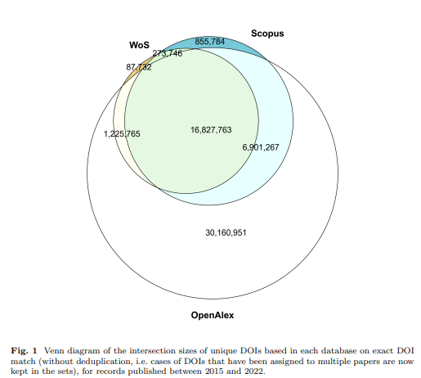
Coverage comparison
 | Records | Books | Venues | Institutions
Scopus | 97M | 368K | 28K | 94K
Web of Science | 92M | 152K | 22K | 11K
Dimensions | 140M | ? | 74K | 100K
OpenAlex | 263M | 5M | 260K | 110K
api.openalex.org/works?group_by=type
api.openalex.org/sources?group_by=type
api.openalex.org/institutions?group_by=type
Reference Coverage Analysis of OpenAlex compared to Web of Science and Scopus DOI: https://doi.org/10.48550/arXiv.2401.16359

Slide 8

OpenAlex coverage: greater inclusivity
Broader indexing, including dissertation, index materials in different languages (with abstract in different languages)
OpenAlex does not apply indexing criteria and Includes journals with no impact factor
OpenAlex aggregates data from a variety of sources, including Crossref, ORCID, PubMed, and institutional repositories
Primary Repositories
arXiv
Dergipark
DOAJ
HAL
OSTI
RePeC
Zenodo
PubMed
CrossRef
Other Repositories
DataCite
You make your own decisions, your own filtering → this can be a positive and negative
Webinar: Finding, tracking, and analyzing research datasets in OpenAlex - YouTube

Slide 9
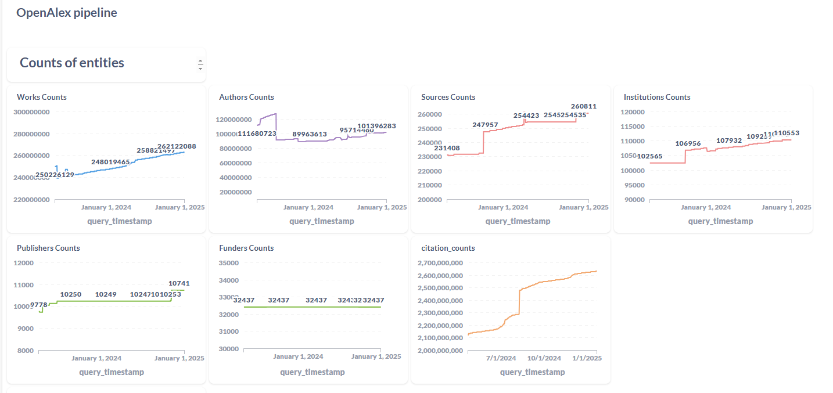
OpenAlex pipeline · Metabase

Slide 10
OpenAlex limitations
Inherit the bias of the data sources
Coverage: no patents are indexed
Stability: work in progress, frequent improvements and updates → data might change

Slide 11
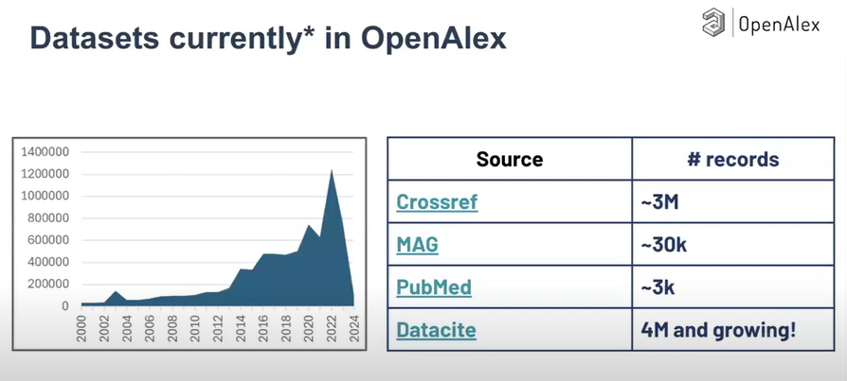
Datasets coverage
Ingesting data from DataCite
Notes:
Yes, DataCite provides extensive information on datasets. They offer services to create and manage DOIs for datasets, making them discoverable and citable. Here are some key points:
Metadata Records: DataCite maintains detailed metadata records for datasets, which include information such as the dataset's title, authors, publication date, and more1
.
Public Data File: DataCite offers a public data file that contains metadata records for all DataCite DOIs in a findable state2
. This file is available in JSON format and can be accessed for comprehensive dataset information.
Search and Discovery: Through DataCite Commons, you can search for datasets by keywords or DOIs, making it easier to find and access relevant research data3
.

Slide 12
OpenAlex entities
Works: papers, datasets, software, etc.
Authors: people who creates work
Venues: journals and repositories that host works
Institutions: affiliations claimed by authors of works
Concepts: what are works about
Source: Introducing OpenAlex: an open and complete index of the global research system - YouTube

Slide 13
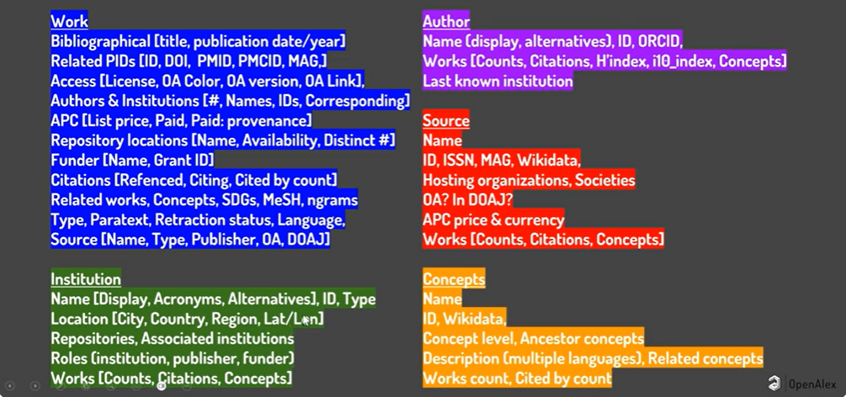
Metadata available
Source: Webinar: Introducing OpenAlex

Slide 14
www.openalex.org
Notes:
Search: University of Aberdeen
Show the interface and how you can modify the dashboard and apply filters
Dependence of killer whale (Orcinus orca) acoustic signals on the type of activity and social context

Slide 15
OpenAlex API Application Programming Interface
It is a programme interacting with the data
Requires some coding skills
It provides much more flexibility (more info than user interface)
It can be integrated with other systems – e.g. automated updates
Overview | OpenAlex technical documentation
Webinar: The OpenAlex API Part 1: Getting Started - YouTube
Notes:
User interfaces usually show what they think are the most requested metrics or feature, but if you need something different you should use the API that gives you access to many more data
Title/abstract ‘killer whale’
Year 2020-2024
Type article
Bibliographic coupling is a method used in bibliometrics to establish a relationship between two documents. It occurs when two documents cite a common third document in their bibliographies. The more references two documents share, the stronger their bibliographic coupling is considered to be.
This technique is often used to identify related research papers, track the development of scientific fields, and analyze the structure of academic literature. It's particularly useful in understanding how knowledge spreads and evolves over time.
Co-occurrence refers to the frequency with which two or more items appear together in a given context. This concept is widely used in various fields such as linguistics, data mining, and bibliometrics.
api.openalex.org/counts

Slide 16
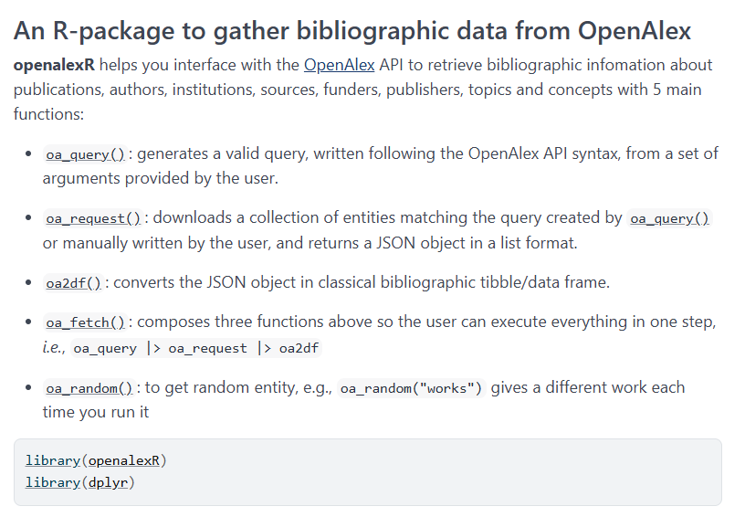
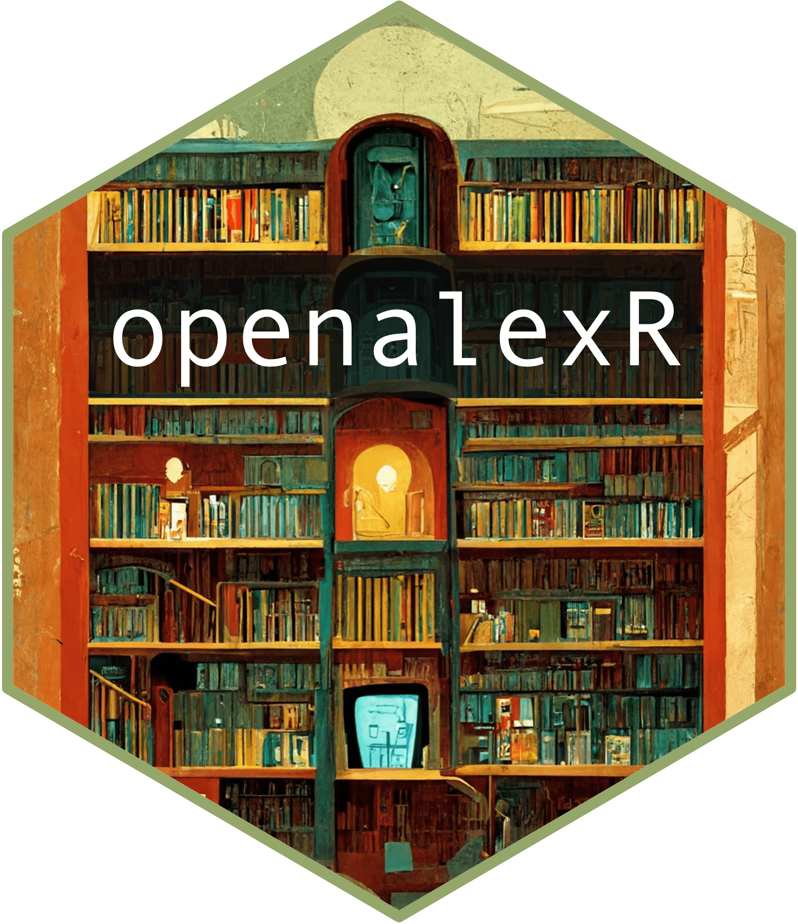
Packages to use API
openalexR (R)
OpenAlex2Pajek (R)
PyAlex (Python)
diophila (Python)
OpenAlexAPI (Python)
VosViewer

Slide 17
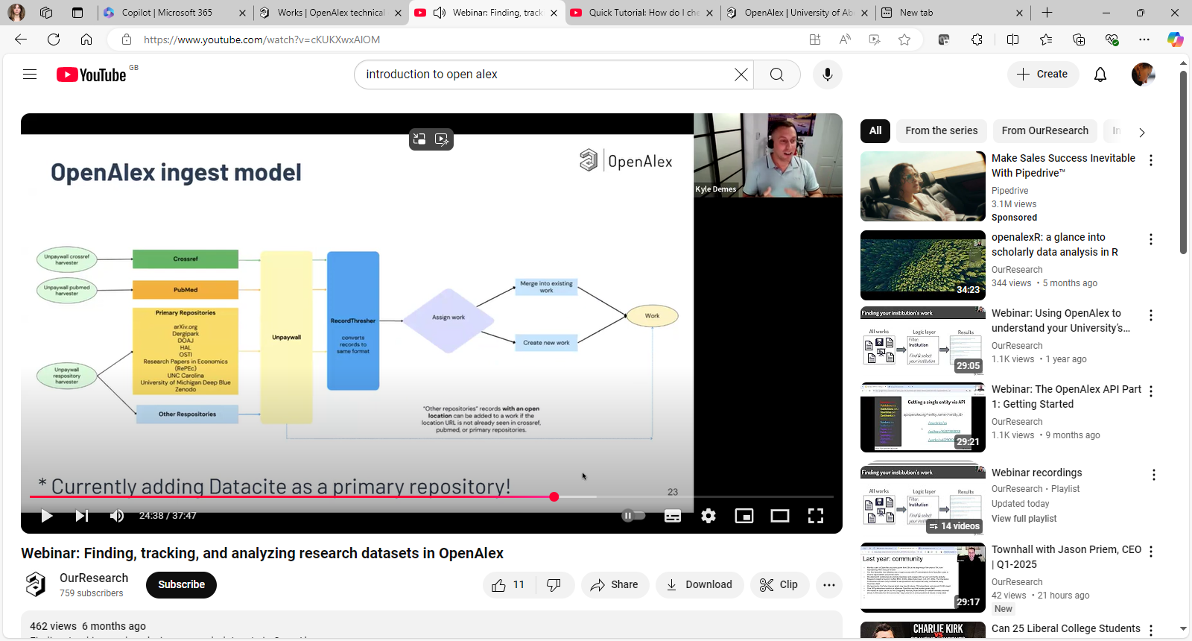
Notes:
Webinar: Finding, tracking, and analyzing research datasets in OpenAlex - YouTube

Slide 18
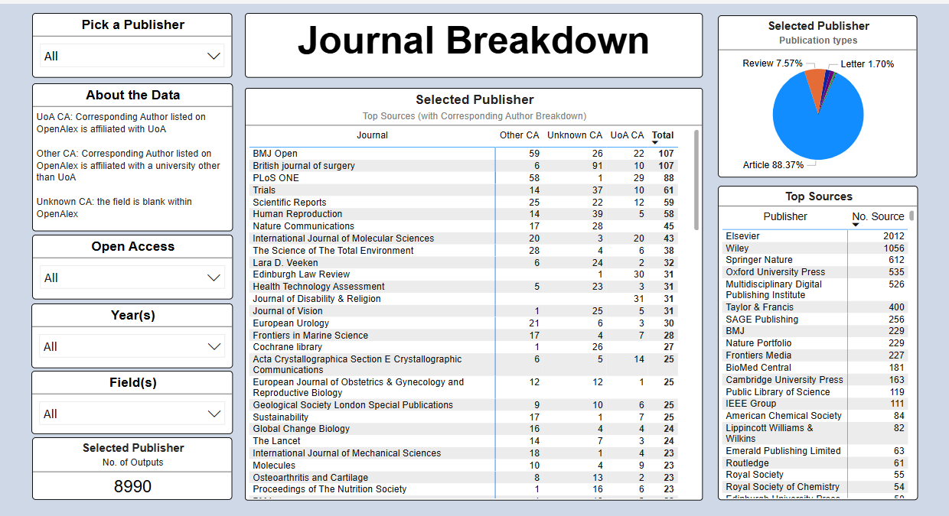

Slide 19
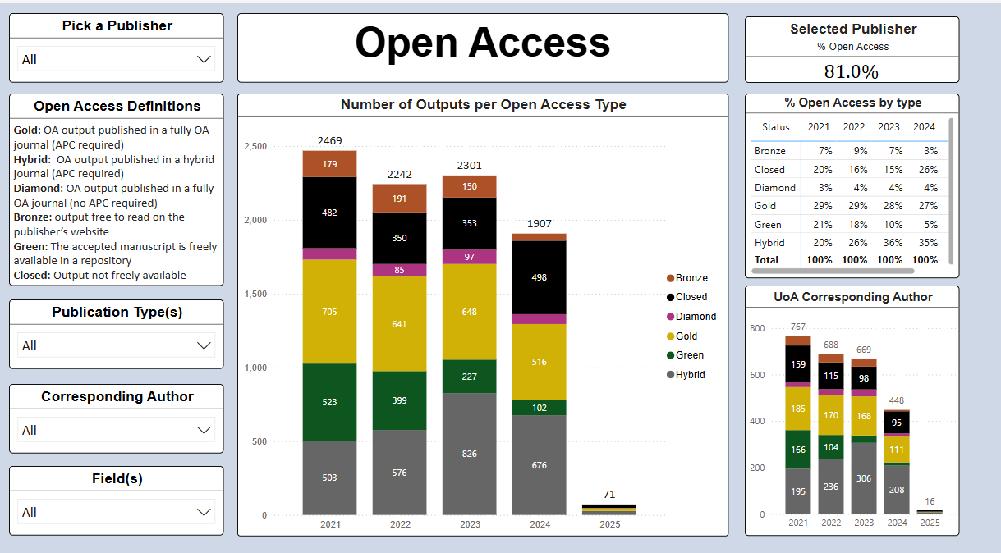

Slide 20
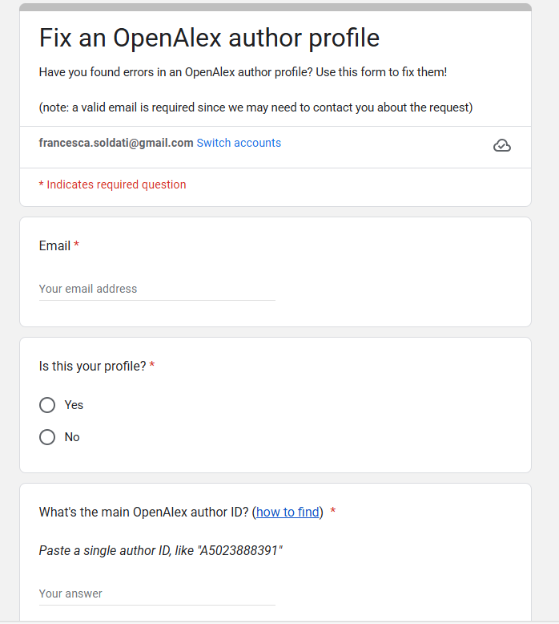
Authors’ curation
Authors can request changes on their OpenAlex Profile by using an online form.
Update your preferred name
Merge multiple author profiles
Add or remove publications
Fixing errors in OpenAlex author profiles - YouTube
How can I fix errors in an OpenAlex author profile? – OpenAlex

Slide 21
Increase the accuracy of your Researcher profiles: Adopt and use ORCID ID!!
www.orcid.org
A free unique persistent identifier that allows for clear distinction among researchers.
It enables:
More accurate publication attribution
Reduce administrative tasks → facilitate data sharing between systems and support auto-fill record function.

Slide 22
Resources
www.openalex.org
www.youtube.com/@OurResearch
Webinar: The OpenAlex API Part 1: Getting Started - YouTube
Overview | OpenAlex technical documentation
Fixing errors in OpenAlex author profiles - YouTube
Welcome to the OpenAlex help center – OpenAlex
www.orcid.org

Slide 23
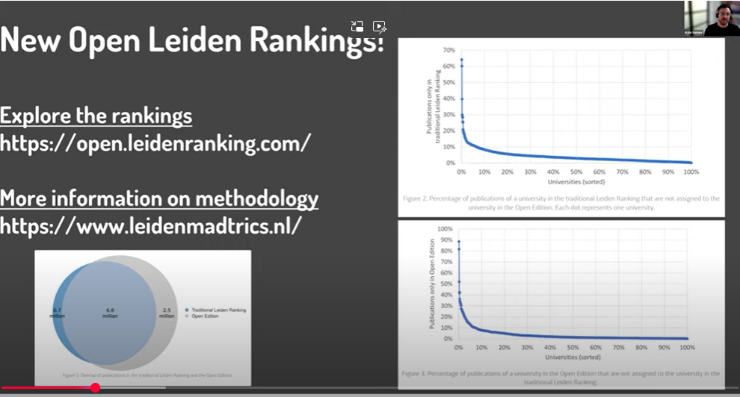
Leiden ranking and OpenAlex
First open ranking it uses Open Alex data, open data, open methodology max transparency
They
How to curate institutional profile (show institutional profile on openalex)
Notes:
Check blog
Check the Ror of the university of Aberdeen to check if it is correct
One exercise that would be useful is to see how many of our publications are on OpenAlex Webinar: Institutional Profiles and Affiliation Curation in OpenAlex - YouTube

