Slide 1

ExplORe: REF and Funder Open Access Policies
Joanna Adams, Open Research Team

Slide 2

Contents
  What is Open Access (OA)?
  Routes to OA
  Rights Retention
  Creative Commons Licences
  Funder OA Requirements
  OA Policies for publications
  Block Grant
  OA Publisher Agreements
  Open Access for Data

Slide 3
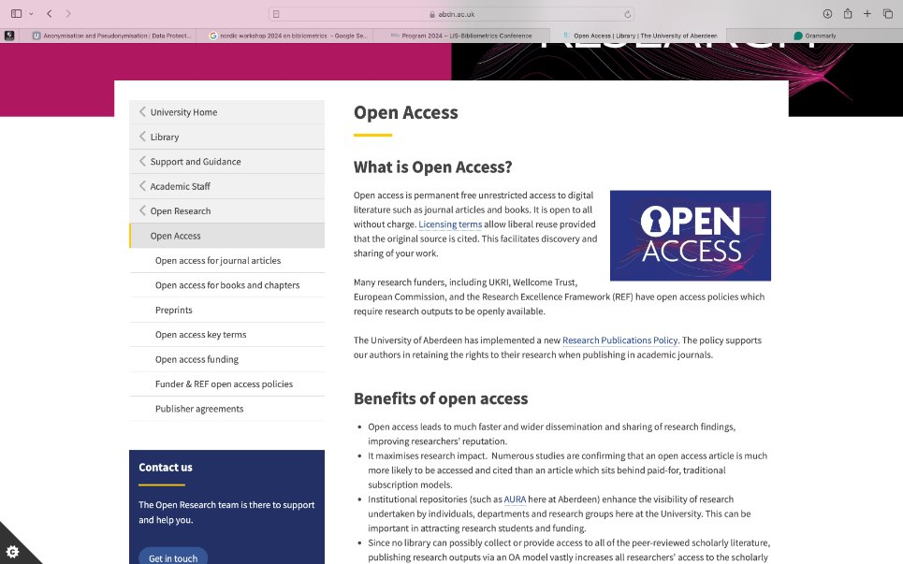

Slide 4
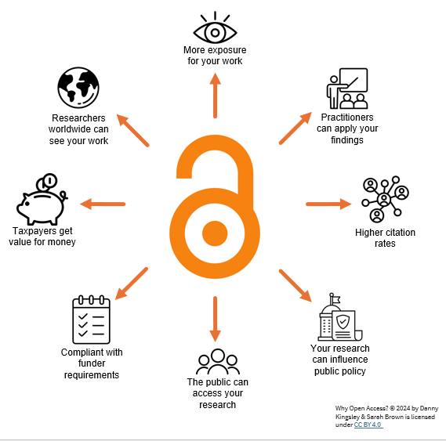
Open Access
Why is Open Access Important?
  Benefits society as a whole
  REF Open Access Policy
  Funder Open Access Requirements
  Find out more on Open Access Policies on our Webpages
  Colours of Open Access
www.abdn.ac.uk/open-research | openresearch@abdn.ac.uk | @OpenResearchUoA

Slide 5
Routes to Open Access
  Publish your final article open access (Gold/Diamond/OA Agreement)
  Publish behind a paywall in a subscription journal and deposit accepted manuscript (AM) open access in a repository (Green)
  Both compliant with funder and REF open access requirements
  Publisher Agreements allow open access for the final published article in participating journals with APC covered
  Not all journals are covered by the agreements
  Same principles apply to books and chapters

Slide 6
Open Access
Gold Open Access
  Publish your article in a fully open access journal or
  A subscription journal with an option to pay to make selected articles open access
  Author pays to publish – Article Processing Charge (APC) or
  Institution pays for an Agreement to cover APCs for their researchers
  The article is published immediately online free for anyone to read without charge
  An open licence allows sharing and reuse under certain conditions (Creative Commons Licence)
  Expensive, inequitable, unsustainable – not everyone has funds to pay for open access
www.abdn.ac.uk/open-research | openresearch@abdn.ac.uk | @OpenResearchUoA

Slide 7
Open Access
Diamond Open Access
  Publish your article in a fully open access journal
  Publisher covers the publication costs (usually a University or Society Press)
  No charge to author or reader
  The article is published immediately online free for anyone to read without charge
  An open licence allows sharing and reuse under certain conditions (Creative Commons Licence)
  Sustainable – different methods of funding e.g. crowdsourcing, community, sponsor
  Ethical – open to all
www.abdn.ac.uk/open-research | openresearch@abdn.ac.uk | @OpenResearchUoA

Slide 8
Open Access
Green Open Access
  Publish your article in a subscription journal
  University pays for their members to read
  No charge for author to publish
  Author deposits version of the article in their institutional repository (Pure/AURA)
  Usually, the author's final draft including corrections after peer-review but before publisher formatting has been applied
  Include the Rights Retention Statement with submissions to ensure open access
www.abdn.ac.uk/open-research | openresearch@abdn.ac.uk | @OpenResearchUoA

Slide 9
Open Access
Rights Retention
  Typically, researchers' hand over their rights to publishers when they sign a licence to publish
  When publishing in a hybrid journal
  Retain your rights
  University of Aberdeen Research Publications Policy supports researchers
  Include the Rights Retention statement with submissions in the acknowledgements and with any covering letter
    "For the purpose of open access, the author has applied a Creative Commons Attribution (CC BY) licence* to any Author Accepted Manuscript version arising". *or other permitted licence
  Email paperaccepted@abdn.ac.uk with a copy of the accepted manuscript and confirmation of acceptance from the publisher for deposit to Pure
www.abdn.ac.uk/open-research | openresearch@abdn.ac.uk | @OpenResearchUoA

Slide 10



Creative Commons Licences
Creative Commons Licences
Distribute, remix, adapt
Credit must be given to the creator
Distribute, remix, adapt
Credit must be given to the creator
Non-commercial purposes only
Copy and distribute only
No derivatives
Credit must be given to the creator
The CC BY licence is usually mandated by funders!
Apply for an exception to use CC BY-ND

Slide 11
Funder Open Access Policies
Funder Open Access Policies been around for a while
Aligned 2012/13
UKRI (formerly RCUK)
Wellcome firmed up existing guidance to policy
COAF
Block grants introduced
Aim was to transition to open access
Too slow
New funder policies from 2021
Jisc working with publishers to accelerate OA transition

Slide 12








Funder Open Access Policies
Check your contract for other funders and contact openresearch@abdn.ac.uk
www.abdn.ac.uk/open-research | openresearch@abdn.ac.uk | @OpenResearchUoA

Slide 13
Funder & REF Open Access Policies
  Research funders have requirements grant holders must meet
  Research Excellence Framework (REF2029)
  Immediate OA under an open licence via gold or green route
  Always choose the CC BY Creative Commons license
  Open Government Licence (OGL) if subject to Crown Copyright
  CC BY-ND by exception
  OA funds depends on funder - Limited funds in Block Grants
  Publisher agreements aid compliance

Slide 14
Research Excellence Framework (REF)
REF2021 submitted 31 March 2021
New REF2029 policy expected to be announced Winter 2024. Follow REF2021 OA policy until further notice
Applies to journal articles and conference papers published with ISSN
Repository-Based Open Access (Green)
Deposit Accepted Manuscript (AAM) in institutional or subject repository within 3 months of acceptance
  Email paperaccepted@abdn.ac.uk
Exception - Deposit within 3 months of 1st online publication
Publisher open access (Gold)
VoR immediately available is compliant
Publisher agreements allow compliance
Must permit reuse
  CC-BY-NC-ND licence allowed
There will be no open access mandate for open access books in REF2029.
There will be an open access requirement for longform after REF2029. Details tbc.
www.abdn.ac.uk/open-research | openresearch@abdn.ac.uk | @OpenResearchUoA

Slide 15
UKRI Open Access Policy – Articles
Journal articles
Applies to articles & conference papers with an ISSN submitted from 1st of April 2022
UKRI requires immediate open access on publication either by
Version of Record (VoR) published in a journal or on a publisher platform
Author’s Accepted Manuscript (AAM) deposited in an institutional or subject repository
Data Access Statement required explain how to access associated research materials
Payment of an APC for articles in hybrid journals not compliant unless covered by a transitional agreement
Licence requirement – use Rights Retention statement for hybrid journals
CC BY licence required for both VoR and AAM - CC BY ND by exception.
Embargo: No embargo permitted
www.abdn.ac.uk/open-research | openresearch@abdn.ac.uk | @OpenResearchUoA

Slide 16
Open Access
Block Grant
  UKRI, Wellcome, British Heart Foundation provide a block grant
  Research articles only
  Article Processing Charges (APCs) - No page or colour charges
  Pure Open Access Journals only – No hybrid
  PI or Corresponding Author affiliated to University
  Current grants or expired within last 5 years
  Check availability and eligibility with OR Team before submission
  Other funders mechanisms differ
  No central budget for unfunded research – go green or use agreements
www.abdn.ac.uk/open-research | openresearch@abdn.ac.uk | @OpenResearchUoA

Slide 17
UKRI Open Access Policy - Longform
Monographs
Applies to monographs & chapters published from 1st of January 2024
Key requirements of the new policy for monographs & chapters published on or after 1 January 2024 include:
the final version of a publication or accepted manuscript being made open access via a publisher’s website, platform or repository, within a maximum of 12 months of publication
CC BY licence preferred, but NC and ND licences are permitted
May be funding for immediate open access
Use Research Publications Policy but speak to your editor
https://www.ukri.org/publications/ukri-open-access-policy/
www.abdn.ac.uk/open-research | openresearch@abdn.ac.uk | @OpenResearchUoA

Slide 18
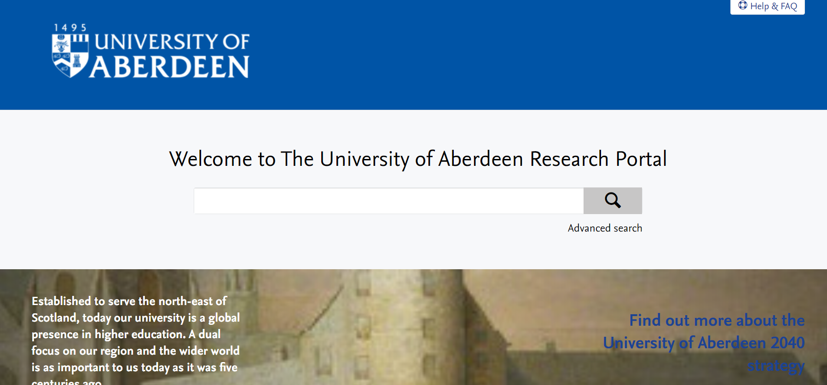
Open Access
Pure/AURA
  Pure is the University's Research Information System
  Accessible by staff and research post grads (not taught PG)
  AURA is the institutional repository where the full text of outputs is made open
  Public Research Portal is where all the info is freely available
  Email paperaccepted@abdn.ac.uk when you have an article accepted
  Or if you have data to be recorded openresearch@abdn.ac.uk
  Add Activities/Awards/Prizes to your own Pure account
  New researchers import your publications
  Set up automated search for publications in online sources
  Use ORCID
www.abdn.ac.uk/open-research | openresearch@abdn.ac.uk | @OpenResearchUoA

Slide 19
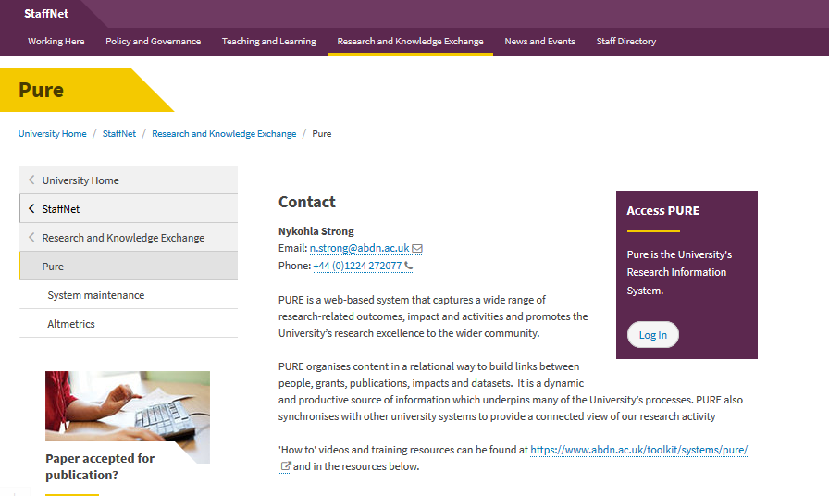
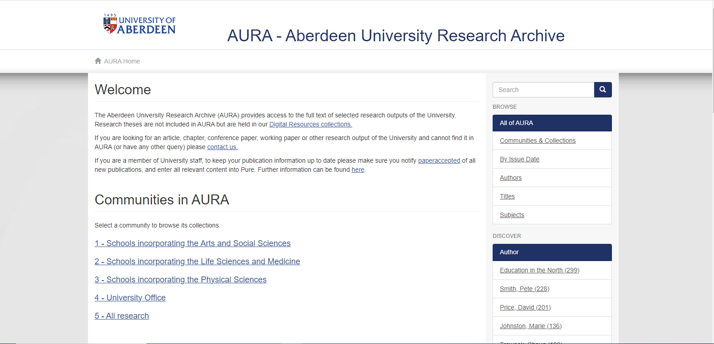
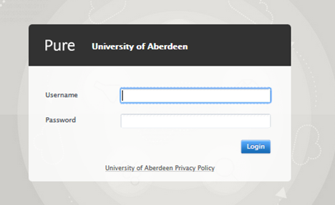
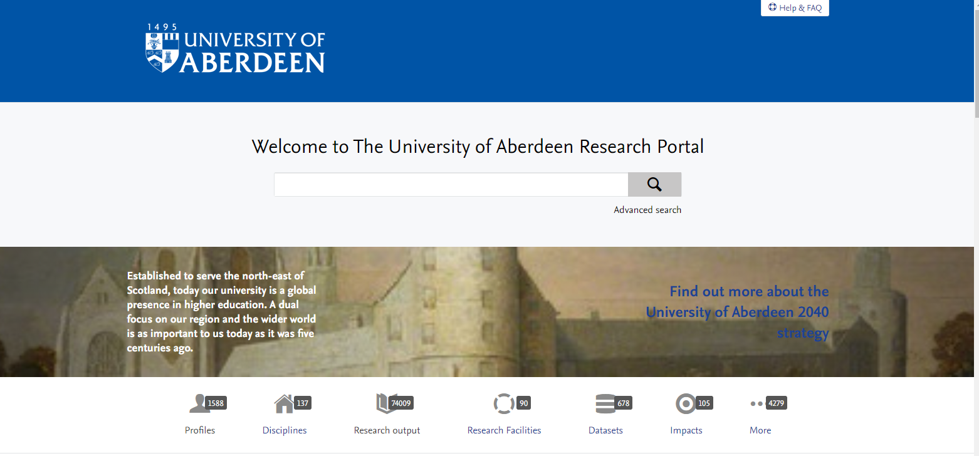
Pure/AURA

Slide 20
Open Access
Open Access Agreements
  We have agreements with 20 publishers
  Includes Elsevier, Springer Nature, Wiley and more
  Corresponding authors affiliated to the University of Aberdeen
  Not all agreements the same
  Some include subscription (hybrid) titles only e.g. Elsevier/Springer
  Others include subscription and fully open access titles e.g. Wiley, Oxford University Press
  Use your University of Aberdeen email address
  Research type articles covered
  Check out our Explore session – Open Access Publisher Agreements
www.abdn.ac.uk/open-research | openresearch@abdn.ac.uk | @OpenResearchUoA

Slide 21

Open Access
Predatory Publishers
  Normal practice to pay Article Processing Charges for open access
  However, has led to some opportunist predatory publishers who seek to extort funds for services they can't or won't provide
  Think. Check. Submit.
  A checklist to help you evaluate a publisher before you decide
  Same principles apply to open access books and paying to attend conferences
www.abdn.ac.uk/open-research | openresearch@abdn.ac.uk | @OpenResearchUoA

Slide 22
Summary
  Make your research open access
  Funder open access requirements for some researchers
  REF Open Access Requirements for all
  Use the open access agreements for OA at no extra cost for articles
  Apply Research Publications Policy/Rights Retention
  Meets OA requirements
  Deposit all accepted papers in Pure/AURA
    Includes books and chapters
  Contact the Open Research Team for help and advice

Slide 23
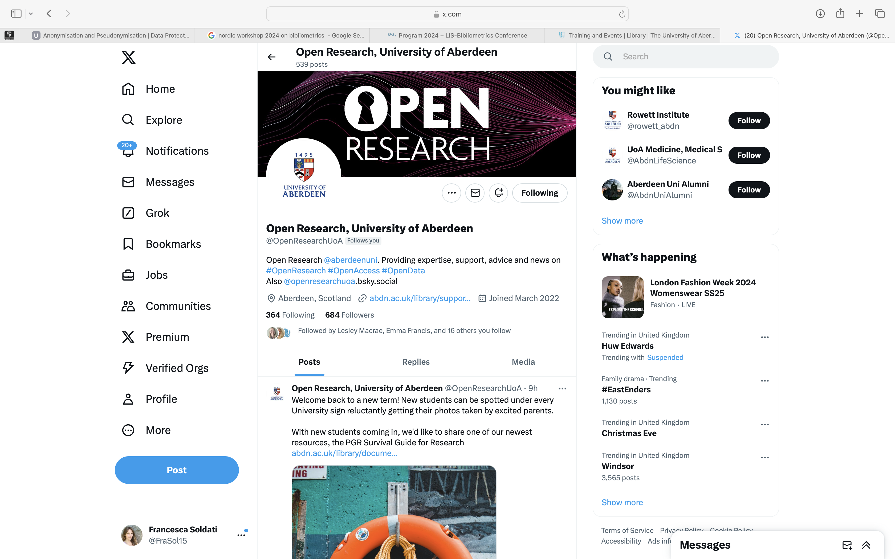

Bluesky: @openresearchuoa.bsky.social
www.abdn.ac.uk/open-research | openresearch@abdn.ac.uk | @OpenResearchUoA

Slide 24
Any Questions?
Joanna Adams
Open Research Team
openresearch@abdn.ac.uk
paperaccepted@abdn.ac.uk

