Slide 1


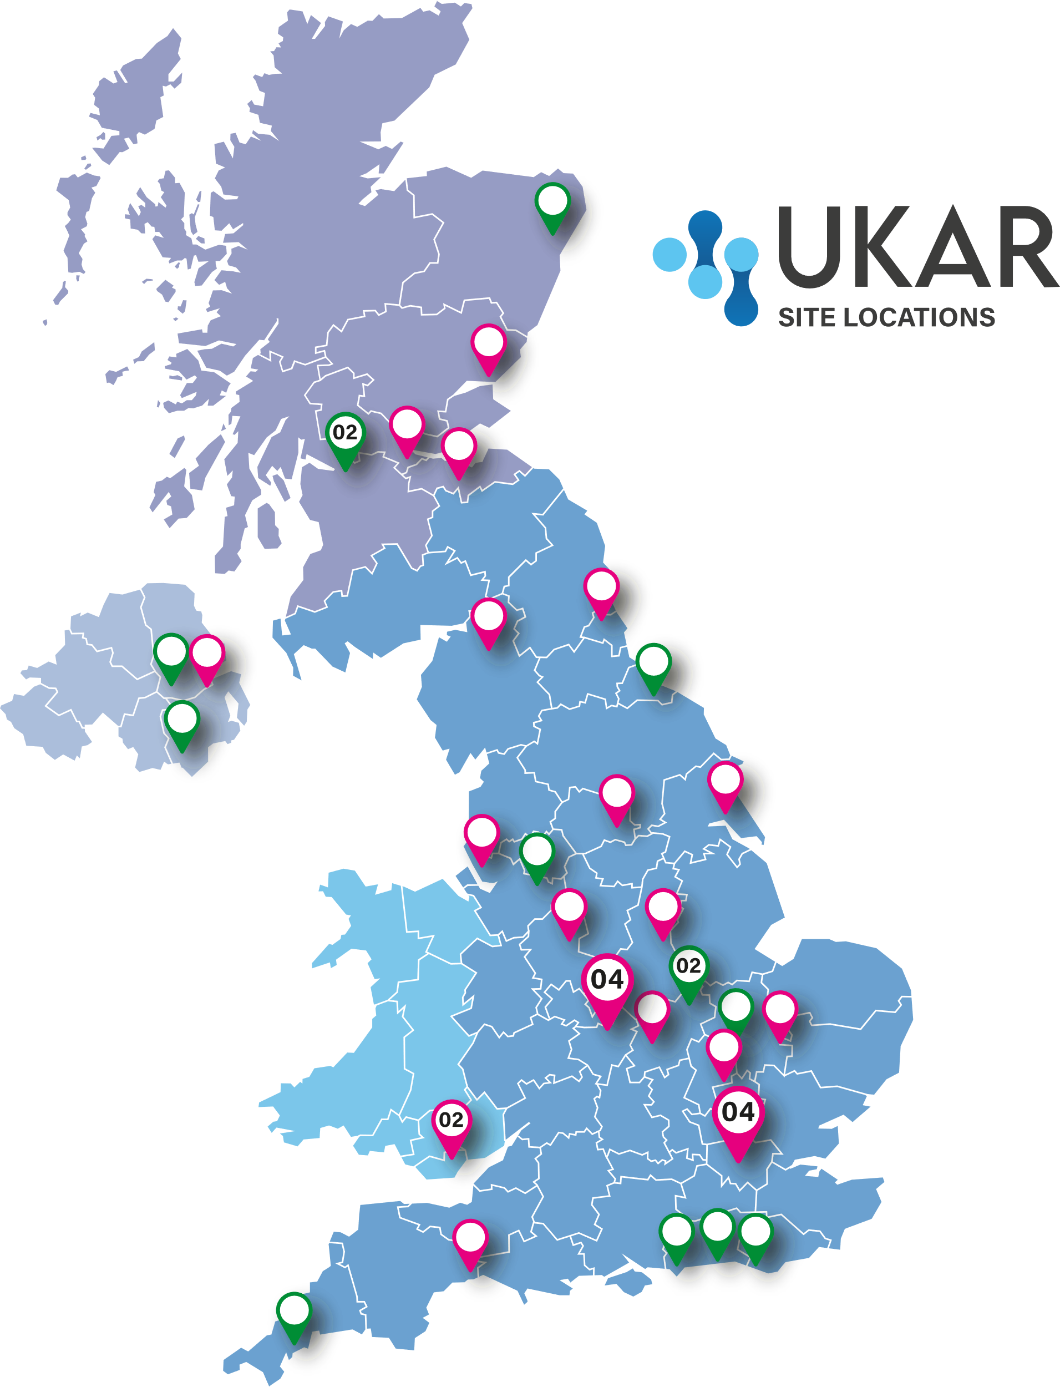






Rebecca Parr¹, Jay Woods¹, Gareth T Jones¹, Gary J Macfarlane¹, Jacqueline Sneddon², Laura J Moir¹
¹Epidemiology Group, School of Medicine, Medical Sciences and Nutrition, University of Aberdeen, Aberdeen, UK.
²British Society for Antimicrobial Chemotherapy, Birmingham, UK
UK Antimicrobial Registry (UKAR) Study: Progress to date
UK Antimicrobial Registry
Drug registry coordinated by the University of Aberdeen on behalf of BSAC Supported by UKAR Steering Committee and industry partners (currently Menarini, Pfizer & Shionogi) Aims to provide data to describe effectiveness and safety of recently licensed antimicrobials Supports antimicrobial stewardship of new agents and contributes to NICE subscription model pilot for antimicrobials
#
Open for recruitment (9)
Methods
Open to recruitment from May 2023 Started with pilot phase – assess feasibility of study in a few sites Relevant clinical data collected from patient notes; information about infection, microbiology lab results, use of eligible study drug(s) and other antimicrobials prescribed
#
Sites in set-up (22)
Inclusion criteria | Exclusion criteria
Patient prescribed any eligible study drug during their current hospital stay. Person consenting (patient or proxy) able understand the consent process | Prescription of study drug was more than 60 days prior to recruitment. Patient was aged less than 18 years old on the first day of prescription with study drug.
#Number of NHS Health Trusts/Boards
in the area
Withdrawal criteria
Although prescribed a study drug, the patient does not start treatment. Treatment with the study drug is actively withdrawn after less than 24 hours
Progress to date
Sites* 9 sites actively recruiting participants 22 sites in set-up phase 15 sites in discussion about feasibility Participants^{ǂ} 52 patients consented to participate 5 of 11 study drugs represented Majority of participants prescribed Dalbavancin (N = 29) Infection Bone and Joint infection (33%) Lower Respiratory Tract infection (33%) Skin and subcutaneous tissue infection (21%) *As of 13th November 2023 ^{ǂ}As of 1st November 2023
Study Drug | N (%) | Median (range) age (years) | %Female
GRAM POSITIVE AGENTS | - | - | -
Ceftaroline | - | - | -
Ceftobiprole | - | - | -
Dalbavancin | 29 (56) | 59 (34-87) | 59
Delafloxacin | - | - | -
Oritavancin | - | - | -
GRAM NEGATIVE AGENTS
Cefiderocol | 6 (12) | 73 (49-75) | 50
Ceftazidime/avibactam | 10 (19) | 68.5 (39-92) | 50
Ceftolozane/tazobactam | 6 (12) | 44 (25-72) | 50
Eravacycline | - | - | -
Imipenem/cilastatin/relebactam | 1 (2) | 32 (32) | 0
Meropenem/vaborbactam | - | - | -
Discussion
Growing number of sites across the UKAR are joining the study
Minor feasibility issues highlighted during pilot phase have been addressed
To learn more and register your interest, please contact the UKAR team: ukar@abdn.ac.uk

