Slide 1




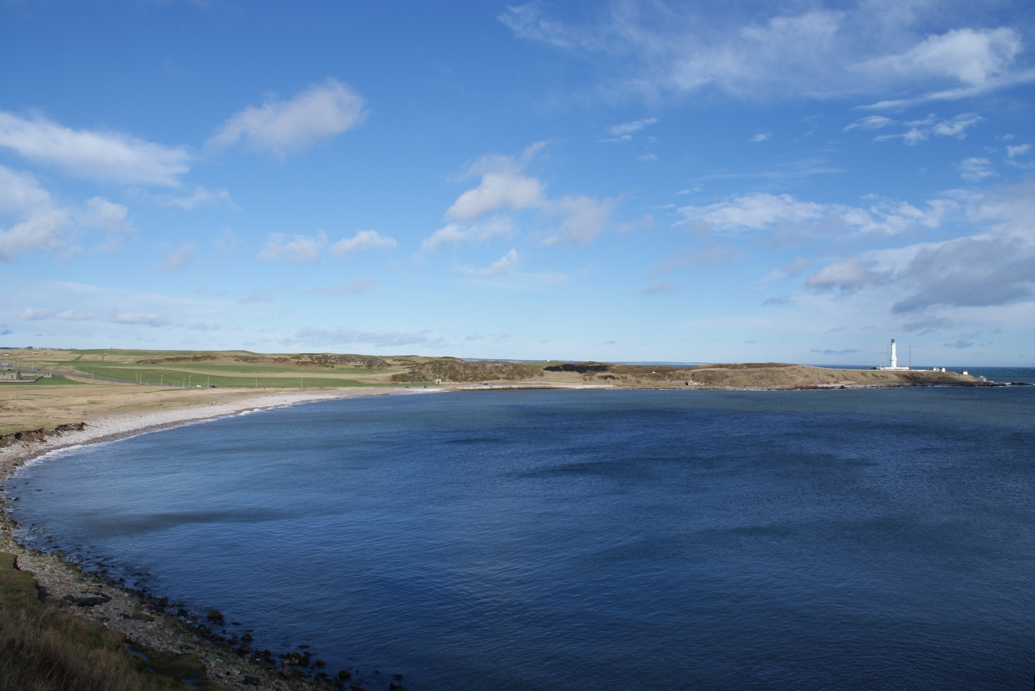
Study Site Presentation – NIGG BAY
TORRY REGENERATION PROJECT
NIGG BAY
Barry Bleichner – Univ. of Aberdeen
Peter Inglis – Aberdeen City Council

Slide 2
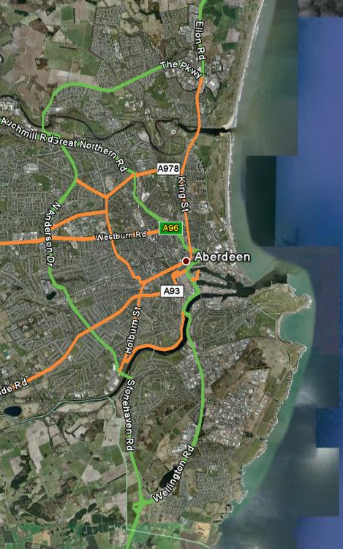
Geographical location
Study Site Presentation – NIGG BAY
Torry – neighbourhood south of Aberdeen along bank of River Dee
Project centered on Nigg Bay
Torry managed by South Aberdeen section of Aberdeen City Council
Population approx. 8800
Unemployment high relative to rest of Aberdeen
Nigg Bay suffers from large quantity of debris and low water quality
Sewage treatment plant and landfill located on or near Nigg Bay

Slide 3
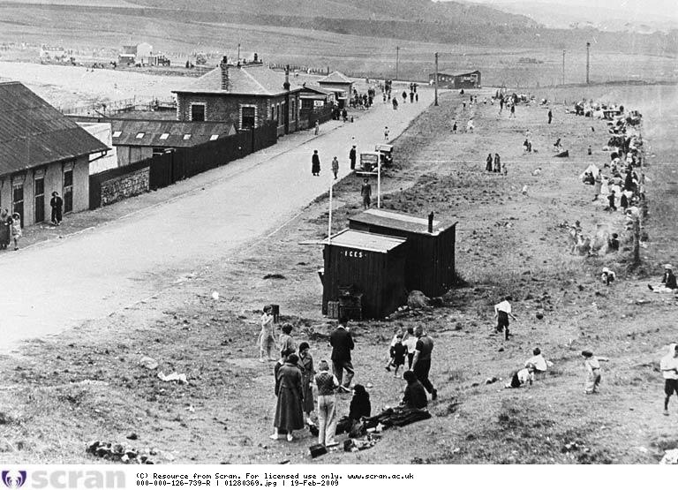
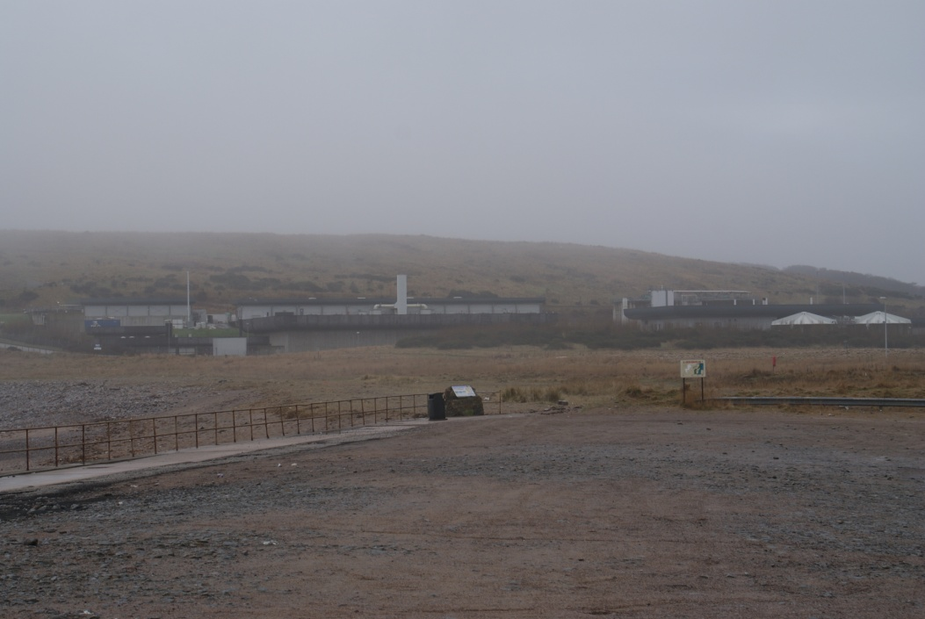
Torry Regeneration Project
Study Site Presentation – NIGG BAY
Nigg Bay in 1934
Nigg Bay in 2009

Slide 4
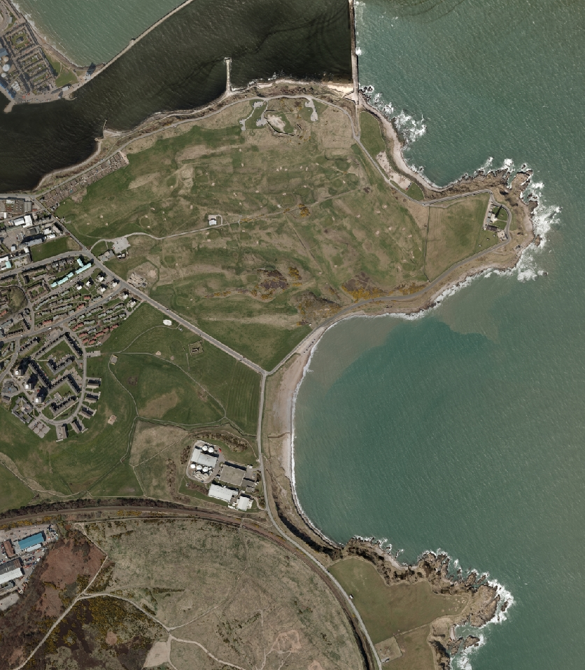
Approaches to coastal management
Study Site Presentation – NIGG BAY
ACC and Univ. Of Aberdeen have collaborated since October 2007 on waterfront regeneration project
Issues:
  Sea level rise
  Maritime education (lack of)
  Pollution
  Lack of data
  Lack of funding
  Local apathy to project

Slide 5
Drivers for climate change and related issues
Study Site Presentation – NIGG BAY
Potential climate changes issues affecting Aberdeen and NE Scotland
  Sea level rise, biodiversity, health, economics, changes in sea surface temperature and currents
  Two most significant climate change issues affecting regeneration project is increased storm activity = increased pollution incidents; and effect on North Atlantic Drift
Effects of climate change will factor in spatial planning and location of project features

Slide 6
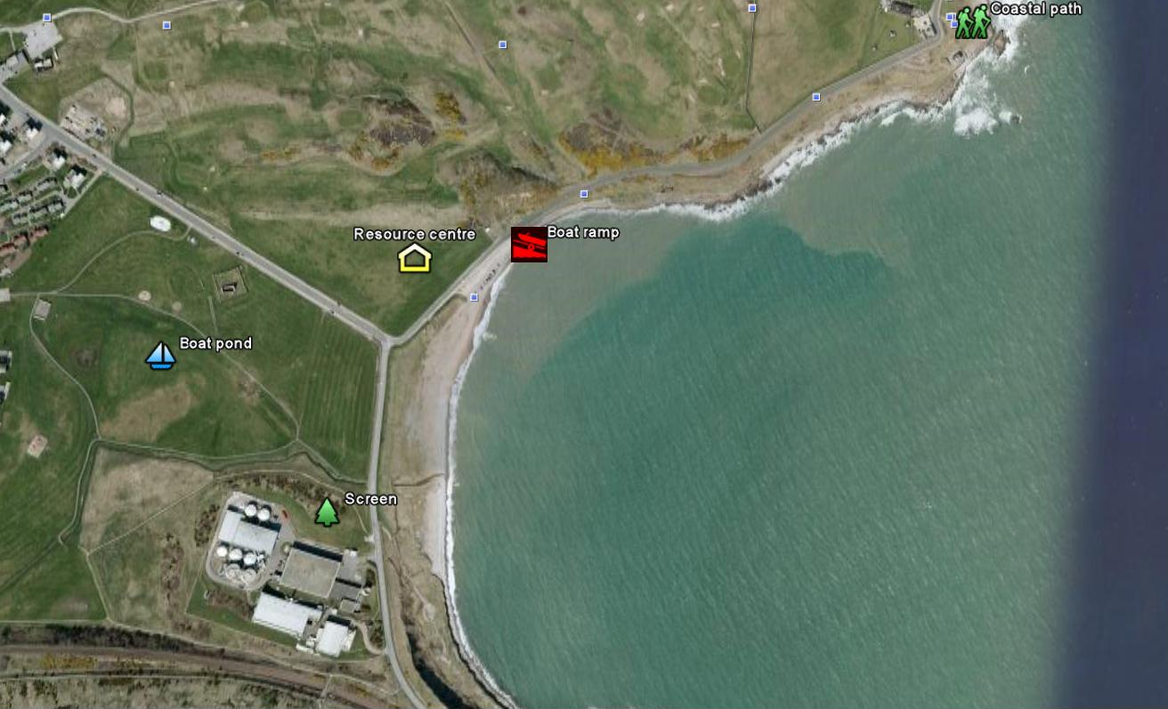
Proposed project
Study Site Presentation – NIGG BAY

Slide 7
Drivers for climate change and related issues
Study Site Presentation – NIGG BAY
Wave buoy at Nigg Bay to collect data on wave energy
Ultimate goal of project is to establish Marine/Coastal Resource Centre at Nigg Bay
  Planning for climate change will be featured in educational courses
  Possible sea level rise will inform placement of structures around Nigg Bay
Issues: Impacts of climate change sometimes viewed as too speculative to warrant serious consideration in planning

Slide 8
Future scenario building
Study Site Presentation – NIGG BAY
Future scenarios for marine recreation are of primary importance to Nigg Bay project
Local issues/considerations:
  Marine spatial planning, community involvement and participation, sustainability of project
Visualisation – GIS, Google Earth, Google Ocean, and VR simulations (Virtual Reality)
Local schoolchildren introduced to GIS and geospatial technologies
  Goal is to educate new generation about spatial planning
A digital database and Internet GIS will be produced as component of Coastal Atlas

Slide 9
Learning to adapt
Study Site Presentation – NIGG BAY
The GIS and visualisation tools will be used in future workshops devoted to project planning and adaptation.
University of Aberdeen has produced maps and other visualisations for workshops and committee meetings
Aberdeen’s ECN has personnel with expertise in policy and legislation interpretation and available to consult with other partners
Open to other sites’ experiences relative to community participation and education on climate change issues

Slide 10
Influencing change
Study Site Presentation – NIGG BAY
The Torry Regeneration Project has been reported on several times through various media and discussed at community events. One workshop has been conducted with Torry residents
Project website is being developed which will link to IMCORE
IMCORE has been discussed in multiple steering committee meetings. An IMCORE poster summarising project to be presented at ICZM stakeholder conference
Adaptive management strategy to be made available through project website

