Slide 1


Webinar 3: Future of space exploration and In-Situ Resource Utilization, comparison of MOXIE on board Perseverance and HABIT onboard ExoMars, producing O2 and H2O
Miracle Israel Nazarious

Slide 2
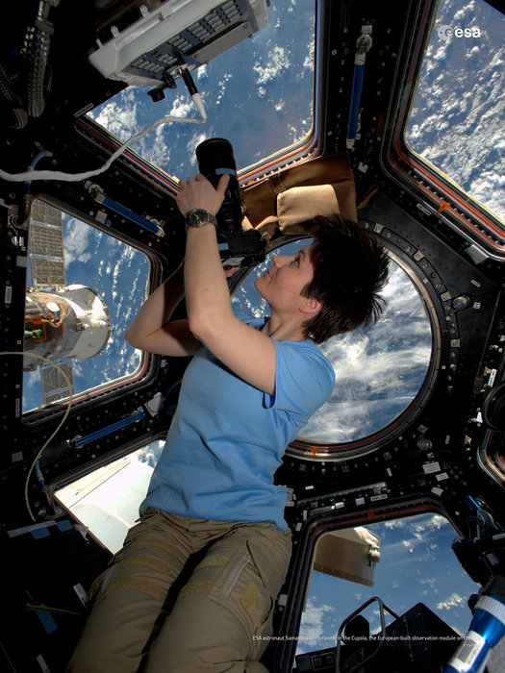
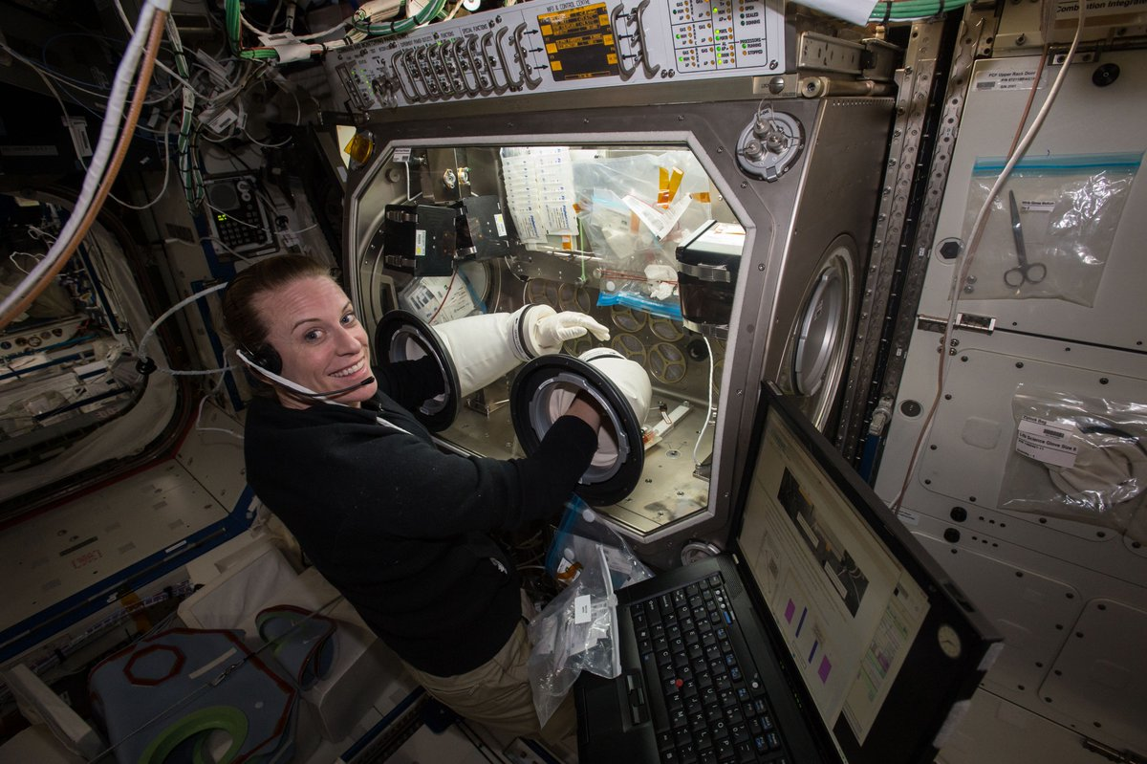
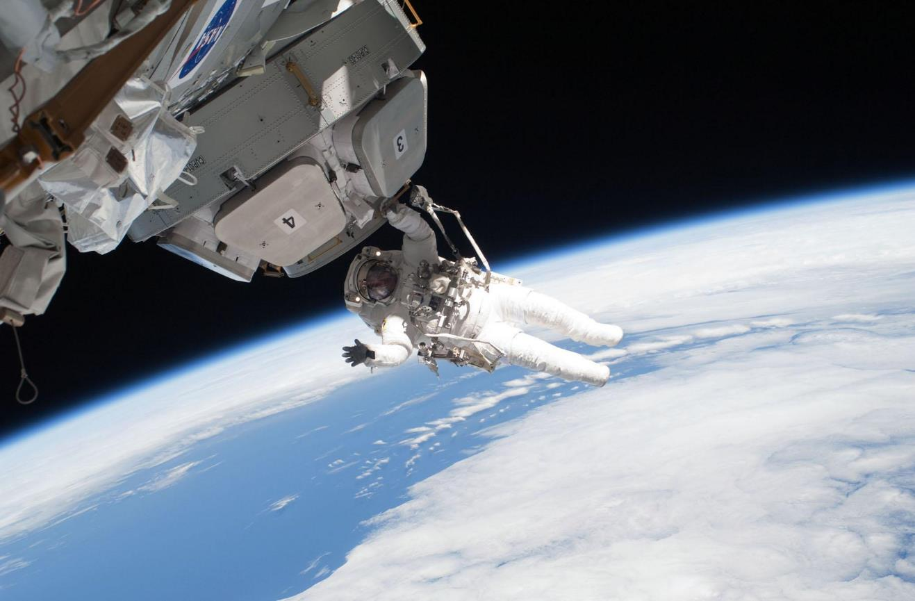
International space station (ISS)
Credit: ESA
Credit: NASA

Slide 3
International space station (ISS)
Credit: ESA
Credit: NASA

Slide 4
Future of Space Exploration
Department of Planetary Sciences

Slide 5
Deep Space Exploration Roadmap

Slide 6
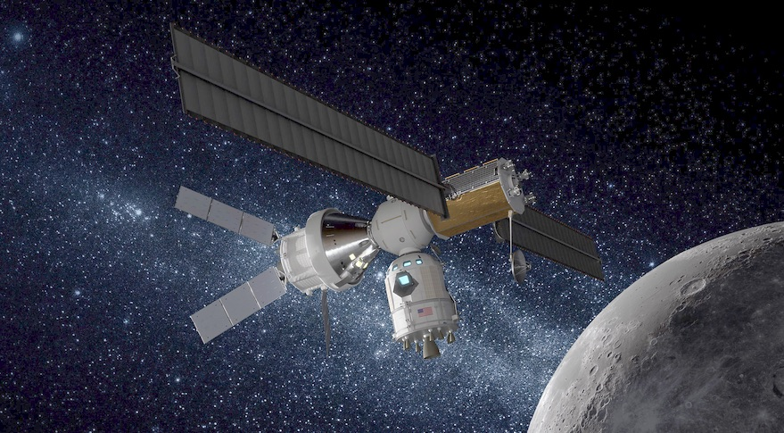
Moon: 2024?
Credit: Lockheed Martin

Slide 7
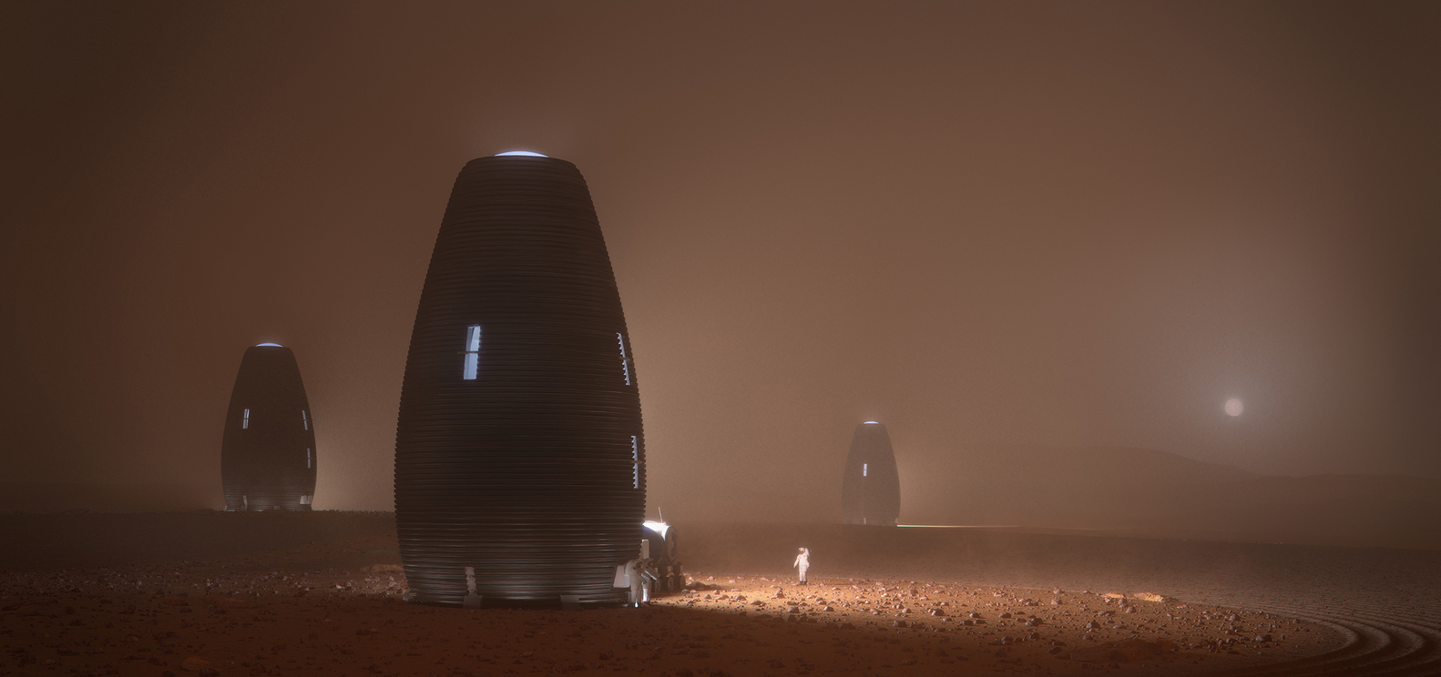
Journey to Mars: 2030s?
Credit: AI SpaceFactory

Slide 8
In-Situ Resource Utilization (ISRU)
Department of Planetary Sciences

Slide 9




Slide 10
Mars Oxygen In-Situ Resource Utilization Experiment (MOXIE – Perseverence)
Department of Planetary Sciences

Slide 11
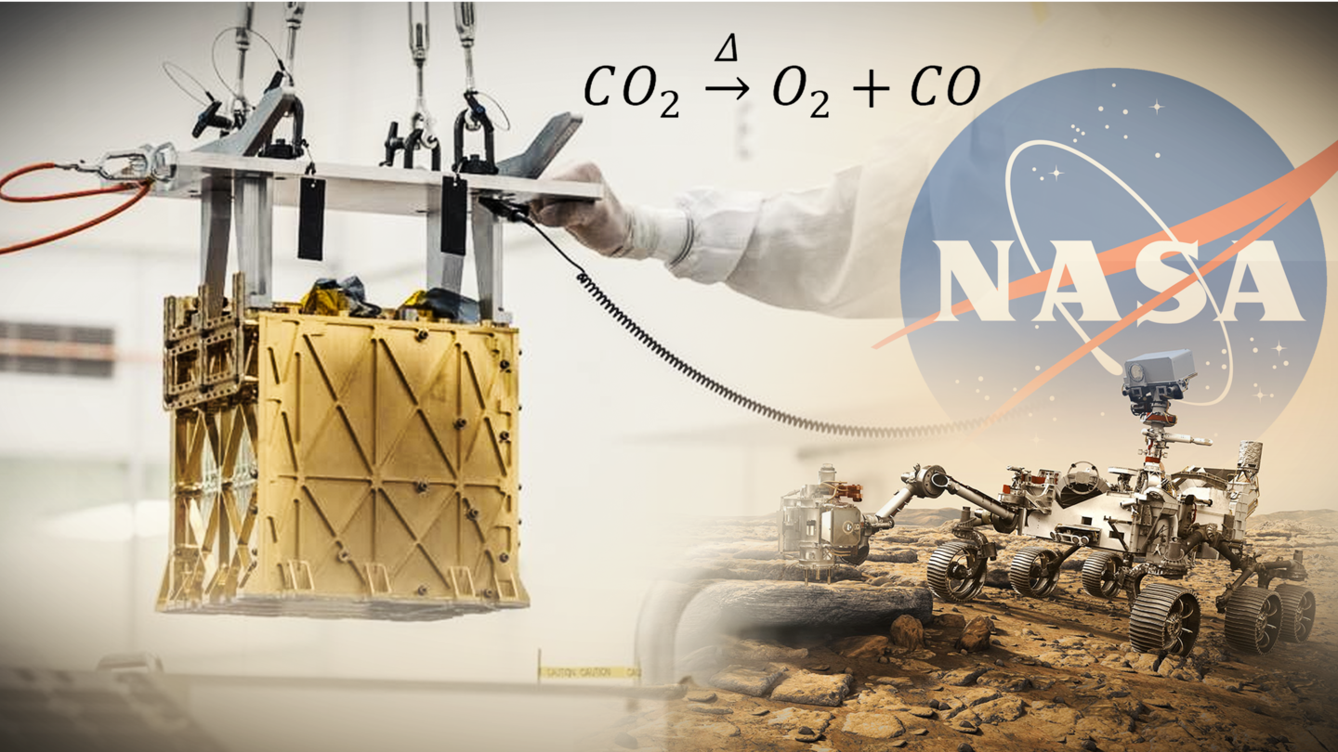
Successfully demonstrated the solid oxide electrolysis technology for converting the Martian atmosphere to oxygen 5.4 g of oxygen in an hour Maximum production: 12 g an hour

Slide 12
HabitAbility: Brines, Irradiation and Temperature (HABIT – ExoMars)
Department of Planetary Sciences

Slide 13
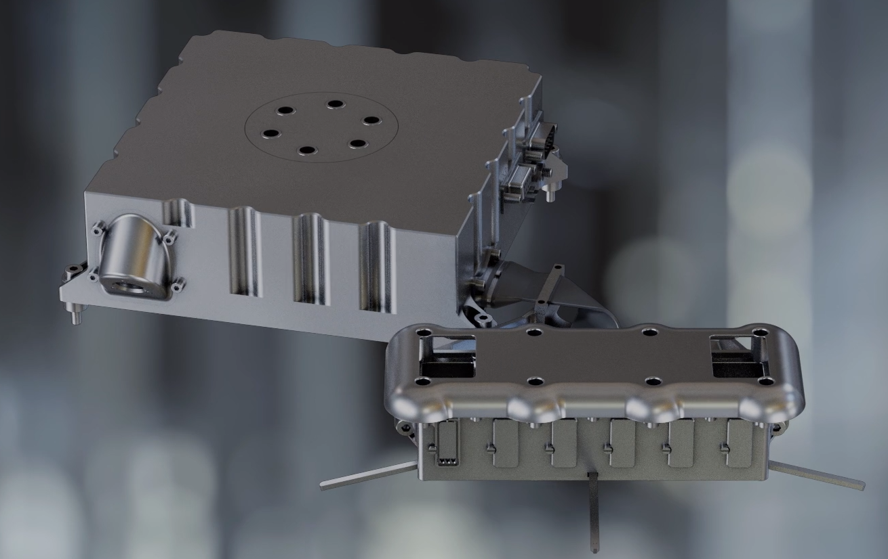
ENVPACK
Environmental Package
BOTTLE
Brine Observation Transition To Liquid Experiment

Slide 14
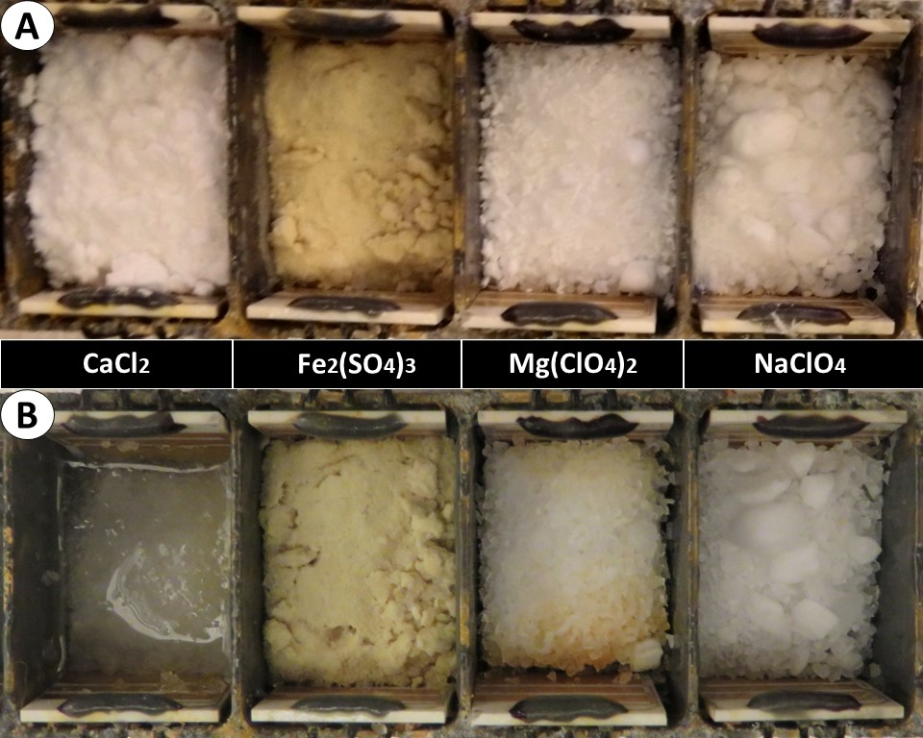
Direct deliquescence from atmospheric moisture

Slide 15
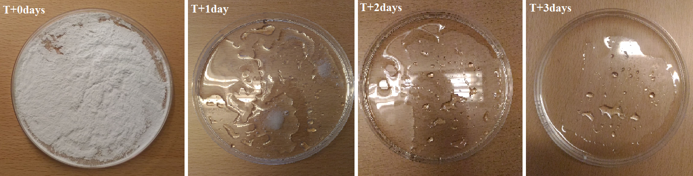
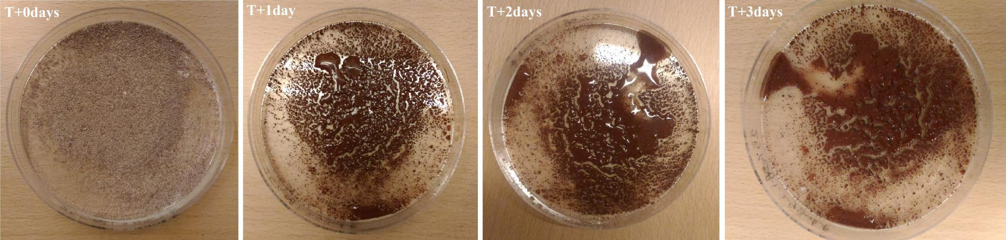
3.7 g of captured by 1.2 g of calcium chloride salt

Slide 16
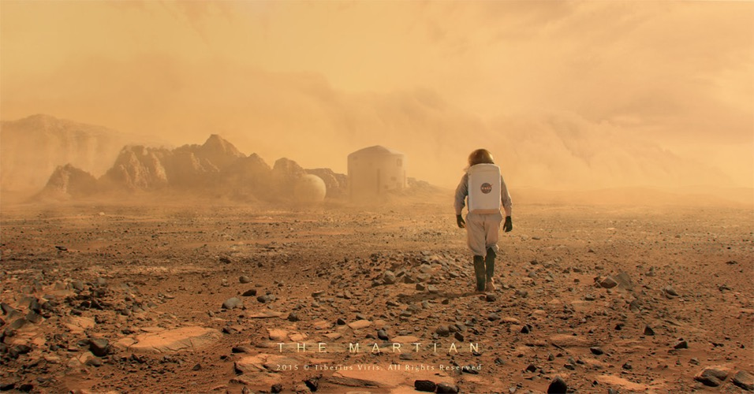
Questions?
miracle.nazarious@abdn.ac.uk
LinkedIn: @miracleisraelnazarious

Slide 17
Up Next…
Testing in space simulation facilities and comparison with the different stages of space missions (launch, cruise, operations)

