Slide 1
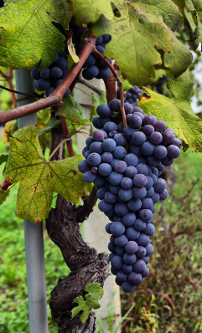
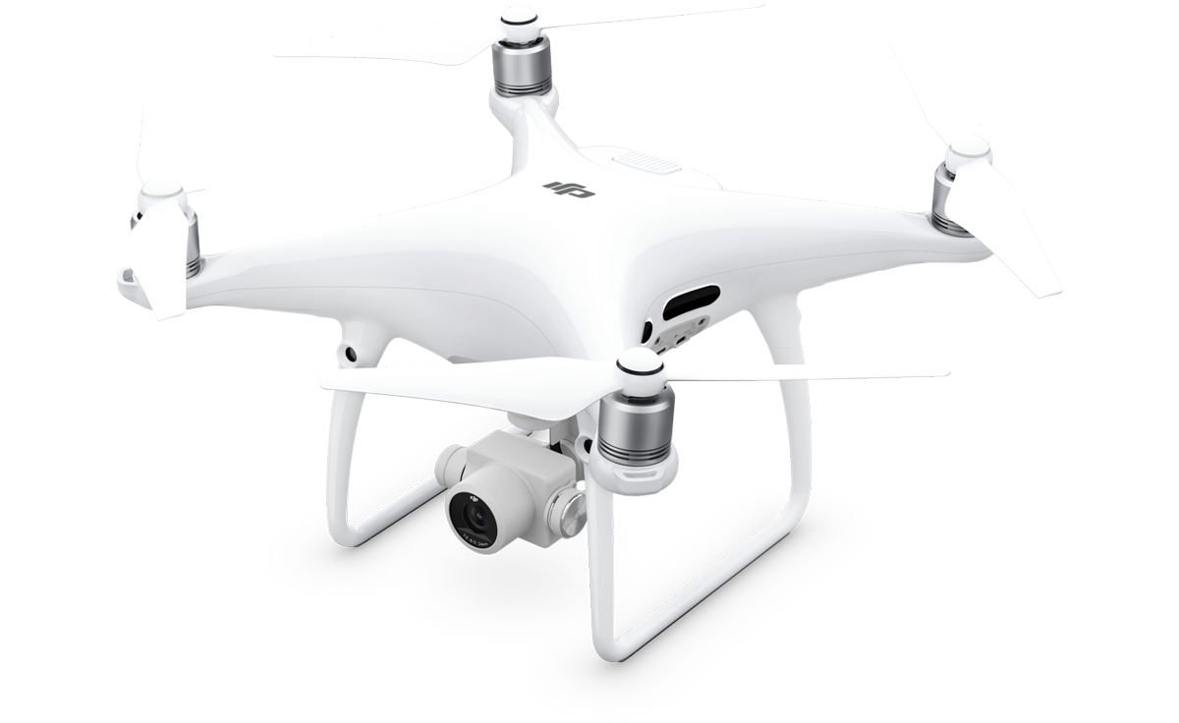
Santander Mobility Awards
Cornell University – USA &
Brock University - Canada
September 2015
2) Harvard University, University of
New Hampshire, & Maine
September 2018
David R. Green
UCEMM - Department of Geography and Environment
University of Aberdeen

Slide 2
Santander Mobility Awards
1
Study Visit to Cornell University & Brock University
One of my current areas of research interest is Precision Viticulture (PV) - using GIS and remote sensing to aid in the monitoring, mapping, management and modeling of vineyards - and specifically the use of UAVs (Unmanned Airborne/Aerial Vehicles) to acquire hi-resolution remotely sensed data and imagery of vineyards e.g. Multispectral, Hyperspectral, Thermal, and Lidar.
The USA is very advanced in this area of research, and Cornell University in particular has a very well-established research capability in Viticulture and Vineyard Management, with extensive areas of grapevines (The Finger Lakes Region), and involvement in a unique scientific and educational Extension Service.
The proximity of Syracuse to Canada also allowed me to renew my existing viticultural research contacts at Vineland, Guelph University, and Brock University in Ontario, Canada.
Reason

Slide 3
Santander Mobility Awards
Study Visit to Cornell University & Brock University
My visit to Cornell allowed me to gain further insight into the wider and practical use of drones by scientists and practitioners for vineyard monitoring, management and modeling and to engage with current PV research in Vineland, at Guelph University, and Brock University.
This was a unique opportunity to work alongside scientists and practitioners to further my research into rapidly evolving UAV technologies and their role in Precision Viticulture, and to gain a better knowledge of their use to help understand the spatial variability and relationships that exist between grapevine canopies, phenology, and the vineyard environment.
The visit also allowed me to acquire new field data and to explore new UAV capabilities including Hyperspectral, Multispectral, and Lidar sensors. And to undertake further research to establish the relationship between vine canopy status and UAV-based remote sensing data/imagery, Precision Viticulture (PV), field data collection, and plant canopy reflectance modeling.
Benefit

Slide 4
Santander Mobility Awards
Study Visit to Cornell University & Brock University
This study visit has been of long-term value to both UCEMM (UAV Centre for Environmental Monitoring and Mapping) and myself, as well as providing new input to teaching and research in the MSc in GIS degree programme at the University of Aberdeen, further development of academic research networks, and the potential for scientific research proposals. A number of scientific conference and journal publications have resulted from this study visit together with the purchase of some new UAV hardware, software and sensors.
New MSc in GIS module – UAV Remote Sensing, Monitoring and Mapping
UG module: The Geography of Vine and Wine (L3/L4)
2017 - Research Funding: Zhaw/UoA/University of Wageningen - EU Funding – C-IPM 2nd Call / DEFRA (UK) Automated Airborne Pest Monitoring AAPM of Drosophila suzukii in Crops and Natural Habitats Total = Euro 283,000.
2015 - Physiological Differences in Highly Fragmented Vineyards Using NIR/RGB UAV Photography. Proceedings of GIESCO, 19th GiESCO Day 31st May 2015 to 5th June 2015, Gruissan – France.(with Johannes Fahrentrapp, Martin Häfele, Peter Schumacher, Cristina Gomez).
Outcome

Slide 5
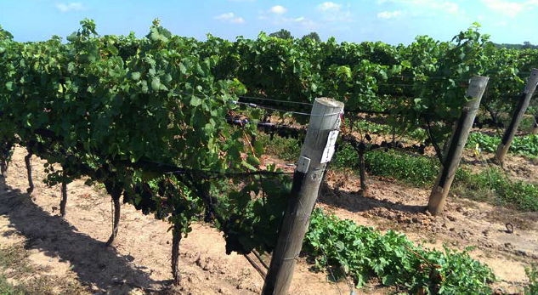
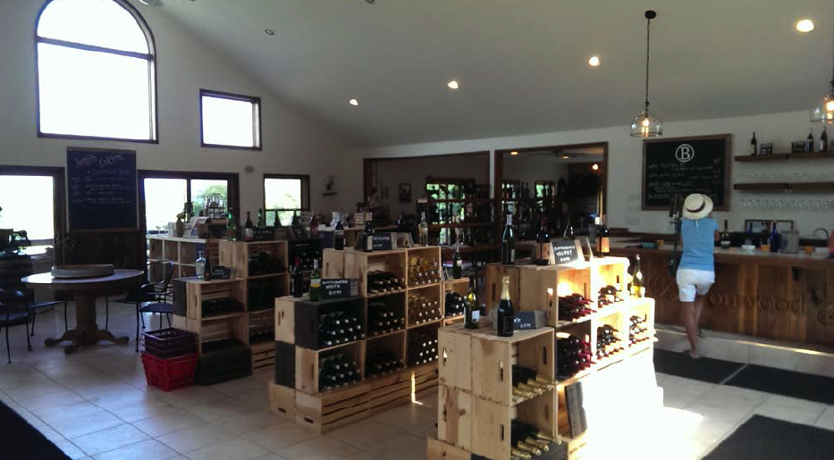
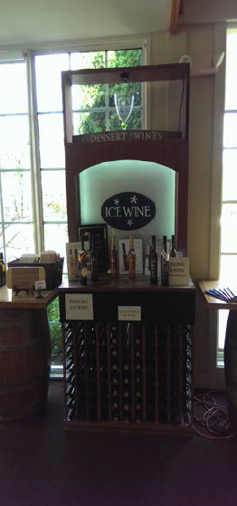
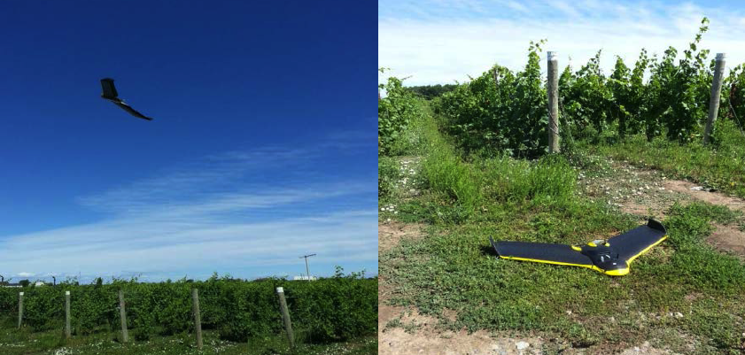
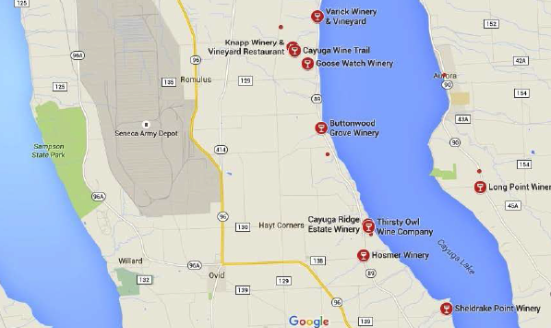
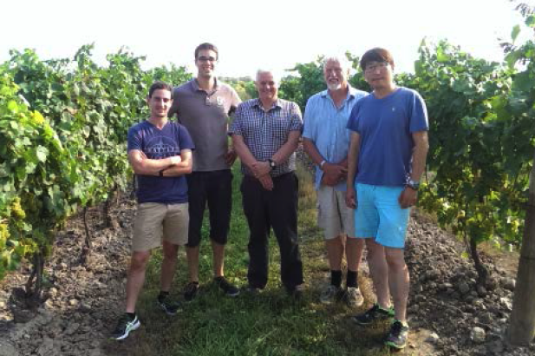
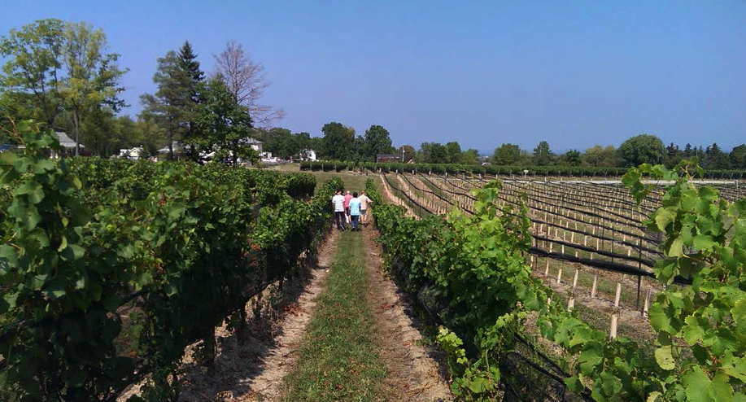
Santander Mobility Awards
Study Visit to Cornell University & Brock University

Slide 6
Santander Mobility Awards
2
Study Visit to Harvard University, University of New
Hampshire & Maine
This research study sought to examine – through both online research – and visits/interviews - some of the main developments in drone platforms and sensors in the USA, and the legislation.
Informal interviews were conducted with a number of different individuals and organisations to ascertain what people view as the main areas of development in emerging Drone Technology their influence n the potential applications of drone technology in the next five years.
Interviews with people from Clark Labs, Harvard University, University of New Hampshire…..
Reason

Slide 7
Santander Mobility Awards
Study Visit to Harvard University, University of New
Hampshire & Maine
One interest was to explore the extent to which UAVs or drones are currently available to the public and where these are being made available.
Secondly, to see what different makes and types of drones are being marketed to the public, and the extent to which information pertaining to ‘educational’ advice is being provided in an attempt to raise the awareness of the rules and regulations e.g. from the Federal Aviation Authority (FAA) being promoted to emphasise responsible use and flying of the lower-cost recreational drones.
A number of shopping outlets were visited and - where possible - the sales team/owner was informally interviewed.
Three different types of outlet were targeted 1) a Model Shop, 2) a supermarket, and 3) a professional photographic shop.
Benefit

Slide 8
Santander Mobility Awards
Study Visit to Harvard University, University of New
Hampshire & Maine
Unmanned Aerial Remote Sensing: UAS for Environmental Applications
David R. Green and Billy J. Gregory - (Eds.) - Taylor and Francis (CRC Press) - 2019.
One element of the book is the evolution of UAV technology. Part of the research undertaken involved interviewing UAV specialists as well as some online research to ascertain what aspects of drone technology are developing and what the impacts of these developments will have on the potential applications of UAVs to a range of environmental work.
Outcome

Slide 9
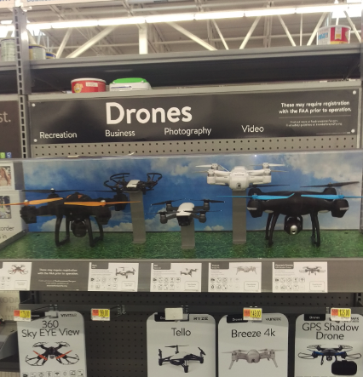
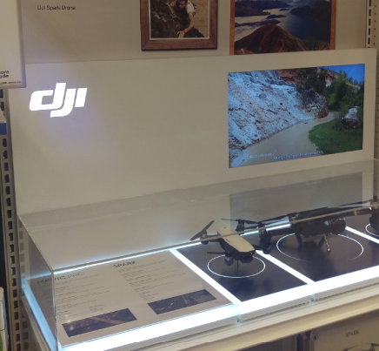
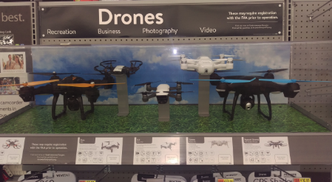
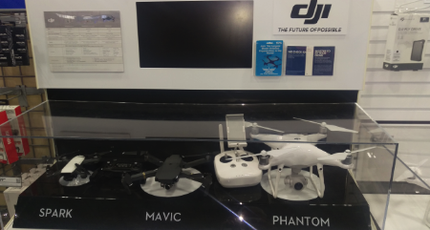
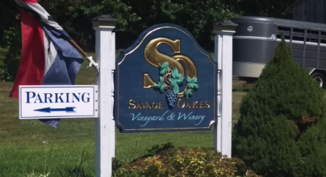
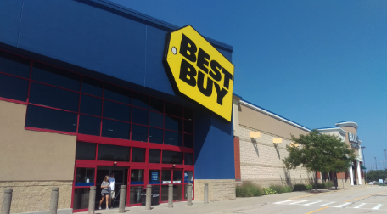
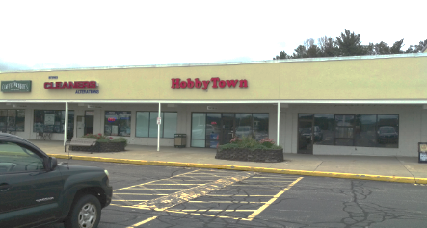
Santander Mobility Awards
Study Visit to Harvard University, University of New
Hampshire & Maine

Slide 10

Santander Mobility Awards
David R. Green
G10 - St. Mary's UCEMM
Department of Geography and Environment
School of Geosciences - College of Physical Sciences
University of Aberdeen - AB24 3UF- Scotland - UK
Tel. +44 01224272324 Email. d.r.green@abdn.ac.uk
Internet. www.abdn.ac.uk/research/ucemm
Thank You

