Slide 1

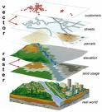
Geographical Information System (GIS) Software to store, access, and visualise geographical data and information
Introduce you to………………………….

Slide 2


ESRI Map Explorer Free Software UK Data Simple tools to: e.g. identify, search, retrieve information
Introduce you to………………………….
Introduce you to………………………….

Slide 3


Learn to use the software – Navigation e.g. open a dataset, pan and zoom Use the GIS software to answer geographical questions e.g. What, Why, Where?
Aims and Objectives………

