Slide 1

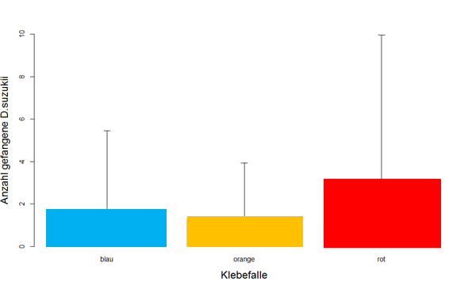
Partner(s) (ZHAW)
Johannes Fahrentrapp
Irene Bühlmann
Trap Colour Evaluation
Three colours tested
Red selected for all further trials.
DEFRA presentation – 20th November 2017
SWD presentation – 24th January 2018

Slide 2
Partner(s) (ZHAW)
 |  | Samples size | Sticky traps Colour |  |  | Significance Kruskal-Wallis
Location | Crop species |  | blue | orange | red
All locations |  | n=1356 | 1 (0, 2) a | 0 (0,1) a | 1 (0, 3) b | ja, p = 5.011e-10
Iten | plum | n=42 | 0 (0, 0) | 0 (0,0) | 0 (0, 0) | nein, p = 0.1698
Schluecht | plum | n=126 | 0 (0,2) ab | 0 (0,1) a | 1 (0, 3) b | ja, p = 0.0033
Horat | plum | n=30 | 0 (0, 0.75) | 0 (0, 0.75) | 0 (0, 1) | nein, p = 0.8903
Boog | blackberry | n=192 | 0 (0, 1.25) | 1 (0, 1.25) | 1 (0, 2) | nein, p = 0.1226
Boog | blueberry | n=150 | 1 (0, 2) b | 0 (0, 1) a | 2 (1, 3) b | ja, p = 0.0025
Boog | raspberry | n=60 | 0 (0, 1) | 0 (0, 1) | 0 (0, 1) | nein, p = 0.5617
Boog | strawberry | n= 114 | 1 (0, 2.75) ab | 1 (0, 2) a | 2 (1, 4) b | ja, p = 0.0332
Landolt | plum | n=18 | 0 (0, 0) | 0 (0, 0) | 0.5 (0, 1) | nein, p = 0.1612
Landolt | raspberry | n=168 | 0 (0, 0) | 0 (0, 0) | 0 (0, 0) | nein, p = 0.1155
Biohof | mini kiwi | n=165 | 3 (1, 7) a | 3 (1, 5.5) a | 6 (2.5, 15.5) b | ja, p = 5.752e-05
Biohof | blackberry | n=42 | 3.5 (2, 8.75) ab | 3 (1.25, 5.25) a | 10.5 (4.25, 21.75) b | ja, p = 0.01702
Biohof | blueberry | n=24 | 0 (0, 0) | 0 (0, 0) | 0.75 (0, 1) | nein, p = 0.0556
Biohof | raspberry | n=36 | 3 (1.75, 3.25) | 3.5 (1.75, 6) | 3.5 (2.75, 7.25) | nein, p = 0.6082
Au | grape | n=150 | 0 (0,1) a | 0 (0,0) a | 1 (0,1) b | ja, p=0.0014
Lorzen | wild blackberry | n=24 | 0 (0,1) | 0 (0,1) | 0 (0,0) | nein, p=0.8269
Ösch | wild blackberry | n=15 | 0 (0,1) | 0 (0,0) | 0 (0,0) | nein, p=0.3778
Mediane, welche sich nach Pairwise Wilcoxon Rank Sum Test p<0.05 signifikant unterscheiden sind durch Buchstaben gekennzeichnet
DEFRA presentation – 20th November 2017
SWD presentation – 24th January 2018

Slide 3
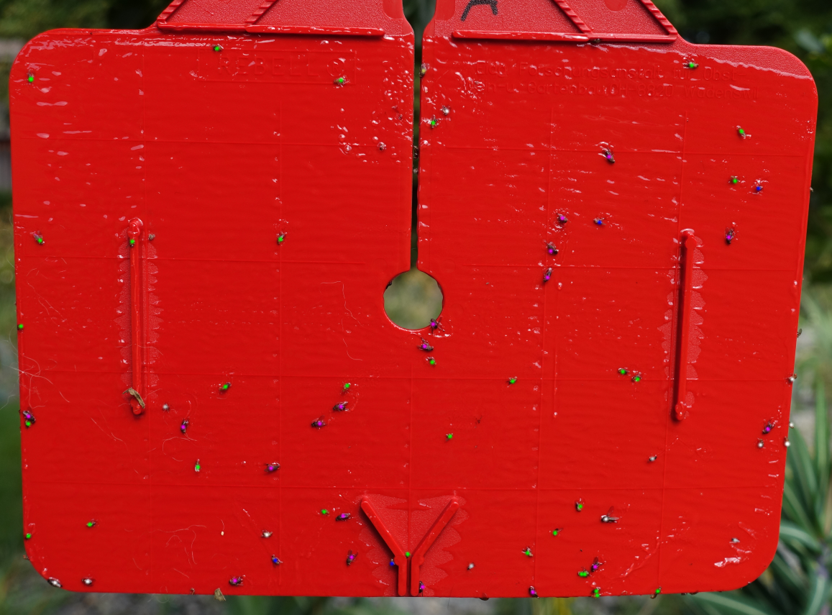
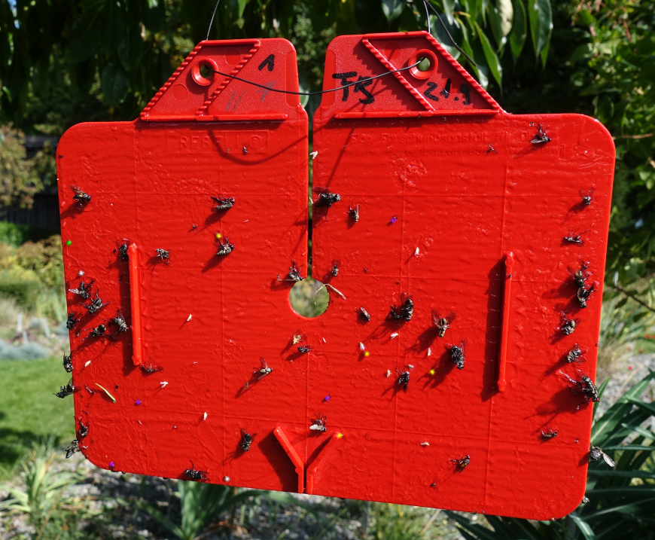
Partner(s) (ZHAW)
Trap Preparation for Automated Species Identification
Artificial trap, only Drosophila species, no SWD; D. melanogaster, green; D. hydei, pink; D. buskii, blue.
Trap with bycatch, SWD = arrow, marked with yellow dots
DEFRA presentation – 20th November 2017
SWD presentation – 24th January 2018

Slide 4
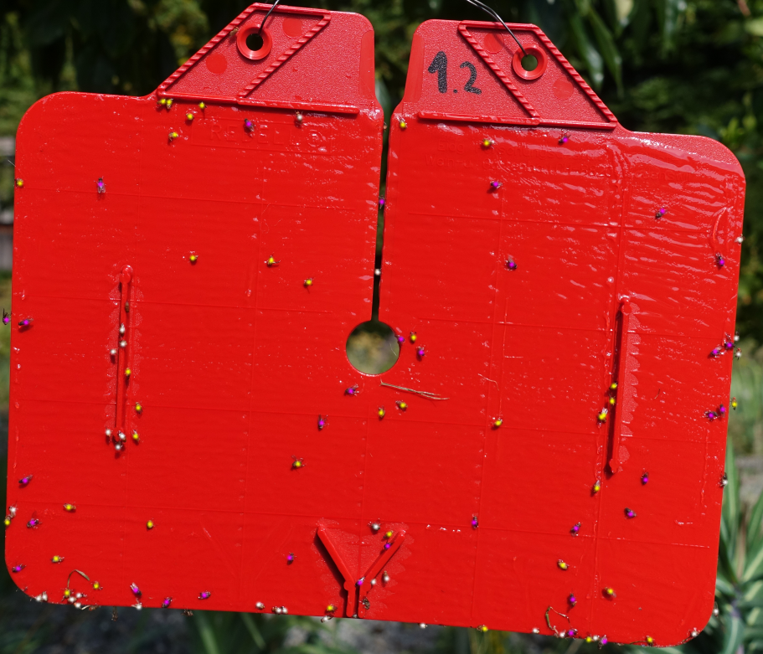
Partner(s) (ZHAW)
Continued ….
Two Drosophila species traps: SWD, yellow; D. hydei, pink.
DEFRA presentation – 20th November 2017
SWD presentation – 24th January 2018

Slide 5
Partner(s) (ZHAW)
Tangle trap, standard glue on most commercially available traps (The Scotts Company LLC, tangle foot, Marysville, OH, USA) (see video – previous slide)
Tropen tangle trap (The Scotts Company LLC, tangle foot, Marysville, OH, USA)
Aurum (W. Neudorf GmbH, Emmertha, Switzerland)
Fleigenleim (Finito, Mislin & Balthasar, Hochdorf, Switzerland)
 |  | Fangquote 1
 |  | Versuch 1.1 | Versuch 1.2 | Versuch 1.3 | Total
Tangle Trap |  | 0.06666667 | 0.5 | 0.14285714 | 0.23650794
Tropen Tangle Trap |  | 0.06666667 | 0.17647059 | 0.33333333 | 0.19215686
Aurum Insektenleim |  | 0.125 | 0 | 0 | 0.04166667
Fliegenfalle Finito |  | 0.07692308 | 0 | 0.15 | 0.07564103
Fangquote 1: Number of 3 h watching; Number flies on trap / Number flies left trap again. Anzahl Fliegen auf Falle/Anzahl Fliegen entkommen
Glue pre-trials
DEFRA presentation – 20th November 2017
SWD presentation – 24th January 2018

Slide 6
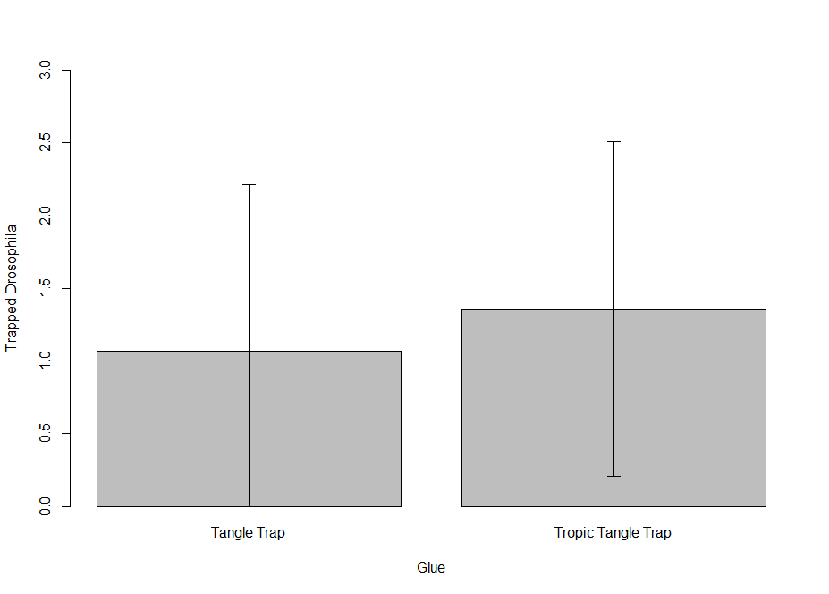
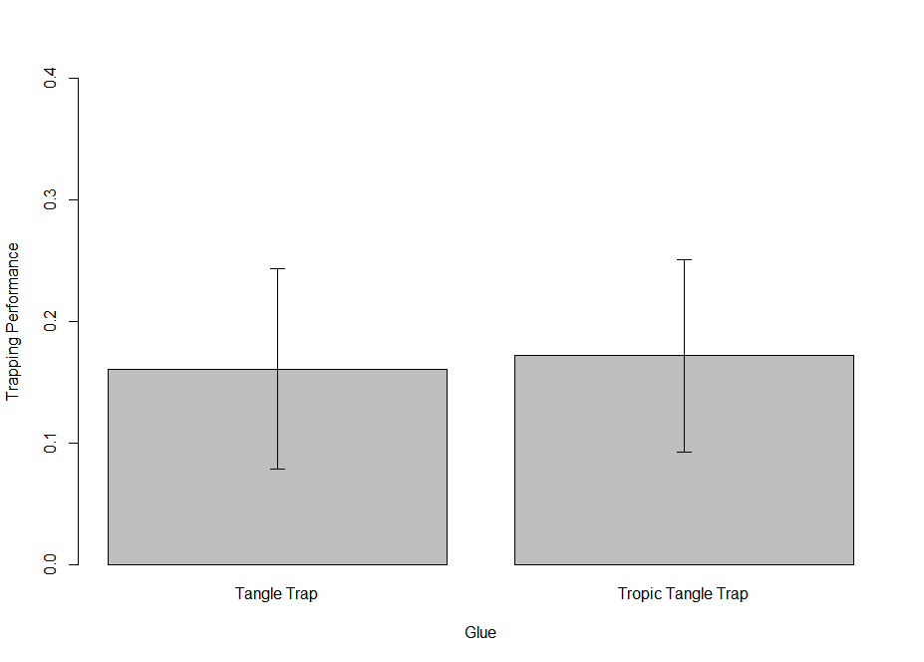
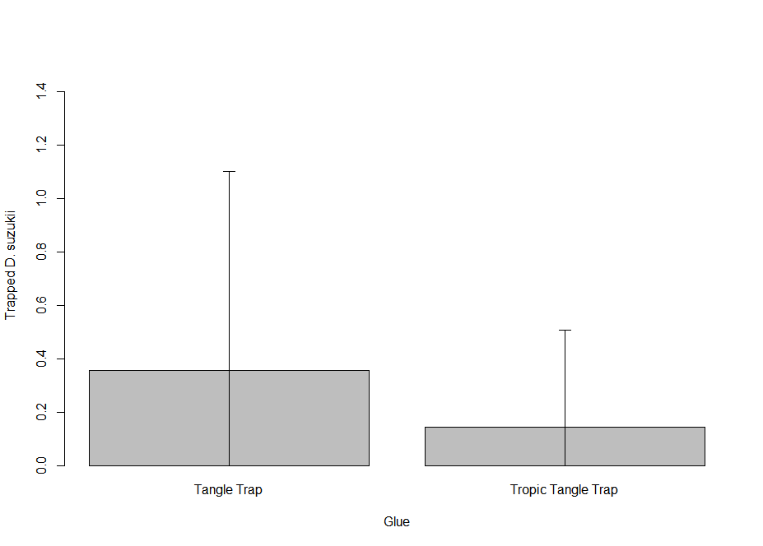
Partner(s) (ZHAW)
Tangle Performance
Field
No significance!
Laboratory
DEFRA presentation – 20th November 2017
SWD presentation – 24th January 2018

Slide 7
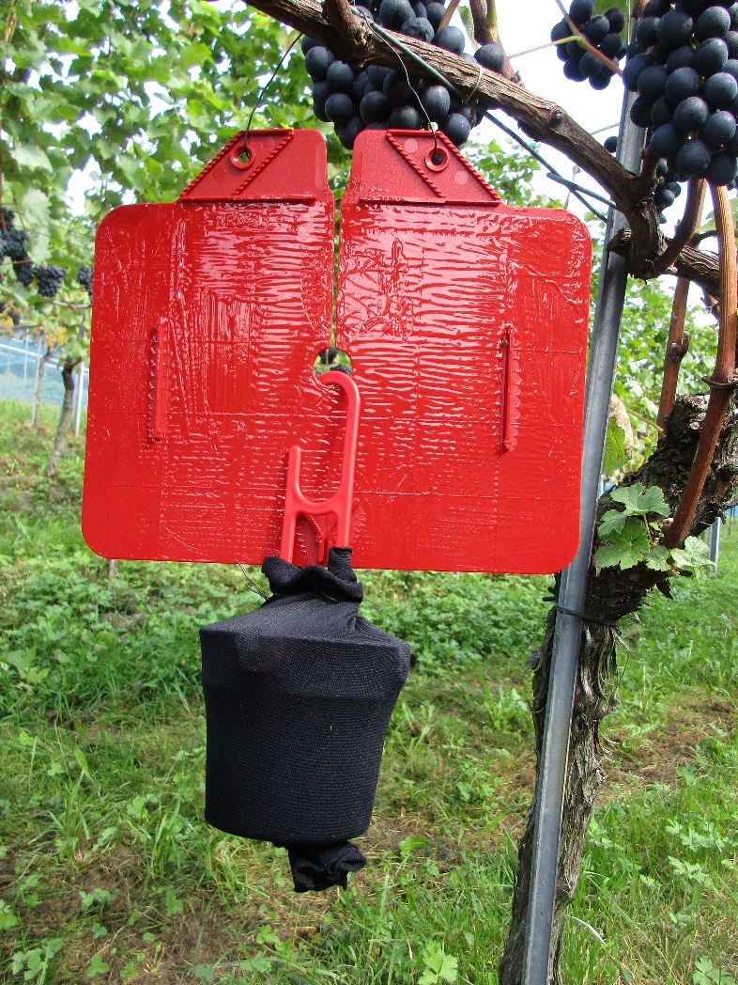
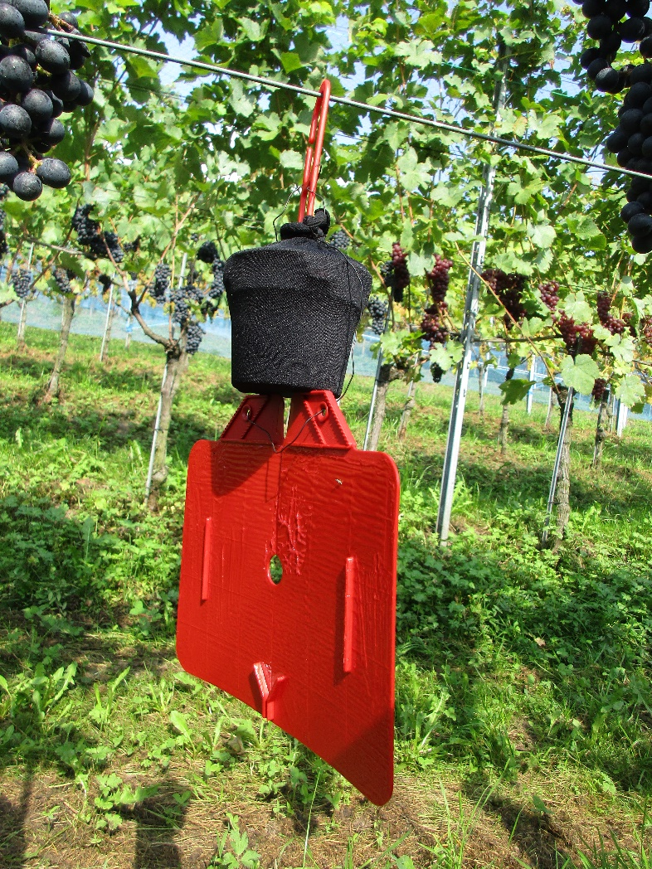
Partner(s) (ZHAW)
Prototype Baited Sticky Trap
Bait: standardized, commercially provided wine-vinegar mixture, Riga AG Switzerland
Bait provided in Profatec cup trap (profatec AG, Switzerland) covered with nylon
DEFRA presentation – 20th November 2017
SWD presentation – 24th January 2018

Slide 8
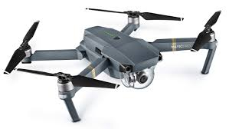
Plans (UoA)
Further Autonomous Flight Tests with DJI MAVIC
Camera Tests with DJI MAVIC
Meeting with SWD in London (January 2018)
DEFRA presentation – 20th November 2017
SWD presentation – 24th January 2018

Slide 9
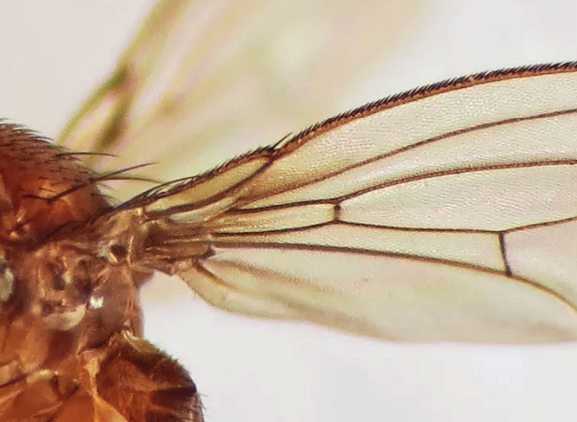
Thank You ….
www.aapmproject.eu
aapmproject@gmail.com
www.abdn.ac.uk/research/ucemm | d.r.green@abdn.ac.uk
DEFRA presentation – 20th November 2017
SWD presentation – 24th January 2018

