Slide 1

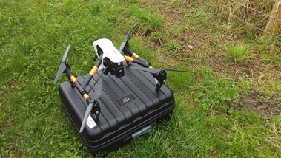
Field Experiment
DJI Inspire 1 – Small, Affordable, RTF (Ready To Fly)
Simulated Fly Traps (vertical), colours (from Journal Paper reference) using random
image/shape generation – different sizes/patterns
Placed on a flat support & short aluminium pole (approx. 5 feet) pegged into the ground
DEFRA presentation – 20th November 2017
SWD presentation – 24th January 2018

Slide 2
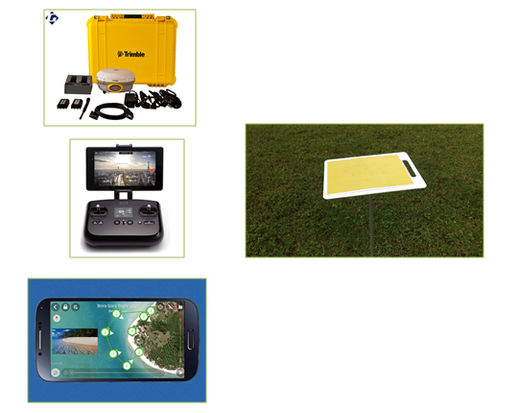
Field Experiment
GPS Location
Auto Take Off/Landing
Autonomous Flight
DEFRA presentation – 20th November 2017
SWD presentation – 24th January 2018

