Slide 1
Explorathon 2022
8 June 2022

Slide 2

Why do it?
Notes:
Leverages additional funding
impact - REF
Writing for different audiences, Leadership, Networking and collaboration
It’s fun and rewarding!

Slide 3

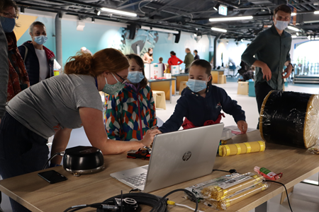
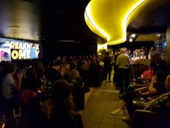


Explorathon 2022-2023
26th September – 1st October 2022
Notes:
Dates and partners
Key stats on activities and audience
Background – European Researchers Night to Scottish Researchers Night
Key audiences – families, being not traditionally engaged with research and universities

Slide 4
Explorathon 2022-2023
Pre-organised opportunities
Pecha Kucha talks
Café Sci
Researcher-led opportunities
Funding available for researchers with their own ideas
Schools opportunities
Training available
Bright Club
Takeover day at Aberdeen Science Centre
Activities with TechFest
Scottish Research Showcase
PERU will support organisation and marketing of event
Focus on interdisciplinary challenges
Opportunities to engage with schools locally and nationally
Register as a STEM Ambassador
Deliver teacher CPD
Notes:
Talk about AI event as part of researcher-led opportunities
Highlight opportunities to collaborate internationally

Slide 5


Keep in touch!
peru@abdn.ac.uk www.abdn.ac.uk/engage
@PEatUoA @UoA_WhatsOn
Check your emails for our ebytes and the main University weekly ezine

Slide 6
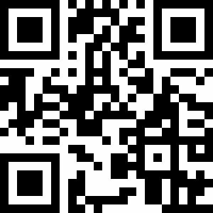
Register to take part

