Slide 1


Transforming Pupils’ Wellbeing through a
Whole School Mindfulness Intervention
Pamela Abbott University of Rwanda 4th Education Conference: Re-shaping Education for Sustainable Development
June 2026

Slide 2
CR Synesthesis of Evaluations of SBMIs
CR Scoping Review of Theories of Mindfulness
CR Synesthesis of Evaluations of School Environment on Mental Wellbeing
Questionnaire Study and Psychometric Tools
Economic Evaluation
Dissemination
Peer Review Journal Articles
To Measure the Outcomes of the SBMI
To Understand the Costs and Benefits of the Intervention
Programme Theory
Policy Briefs & Project Reports
To find out what is known to Inform the Programme Theory
CM+PM+A=O
Programme Mechanisms
PHASE 2
Analysis
Research Findings
Impact on CAs Mental Wellbeing
PHASE 1
Contextual Mechanisms
Transforming pupils’ wellbeing through a whole school mindfulness intervention
PEA
Participant Interviews
Community workshops
Agency
Policy Stakeholder
Interviews & Workshops
To Understand the Context for the Intervention
Outcomes
To Identify the Mechanisms that Produce the Outcomes
PAR
To Understand the Policy Context for the Intervention and the Mechanisms that Impact on CAs Mental Wellbeing
Policy Stakeholder workshops
To understand the Cultural Context for the Intervention and the Mechanisms that Impact on CAs’ Mental Wellbeing
Social Media
Development of the Mindfulness Intervention
Delivery of the Mindfulness Intervention

Slide 3
Critical Realism – Bhaskar and Archer
Philosophy of science- what the nature of what we are studying is (ontology) and how we can study it (epistemology).
CR – depth ontology – the empirical (the evidence that we as researchers’ collect), the actual (what is happening whether we are aware of it or not) and the real (the structures and mechanisms that they contain) which enable and constrain our agency.
CR – structure and agency – we are conditioned by structures (material and biological, intrapersonal, interpersonal and social structures and culture), but these can be changed by purposeful agency.
Emergence and the laminated system
Research for improving people’s lives
Explanation – why and how things happen

Slide 4
What is Mindfulness
Mindfulness is an emergent mental capacity consisting of the ability to voluntarily regulate attention emotion and behaviour by activating specific neurophysiological mechanisms of awareness, inhibition and reflective monitoring.
It exists independently of our knowledge
It is an emergent property of the developing mind-brain system
When activated it changes how a person attends, feels and acts
It is unevenly developed across populations because development depends on social-structural conditions , not only individual traits.

Slide 5
Why Mindfulness Matters in School
Normative expectation of behaviour (e.g. attention, wait, inhibit impulses, tolerate frustration) presupposes children can develop the relevant capacities.
Many children, especially those with ACEs have not had the development conditions that allow these capacities to develop.
Mindfulness practices train the underlying mechanisms (attention control, interoceptive awareness, inhibitory control, reflective monitoring ).
Once these mechanisms are strengthened pupils can comply with school norms not through coercion but through enhanced agency.

Slide 6
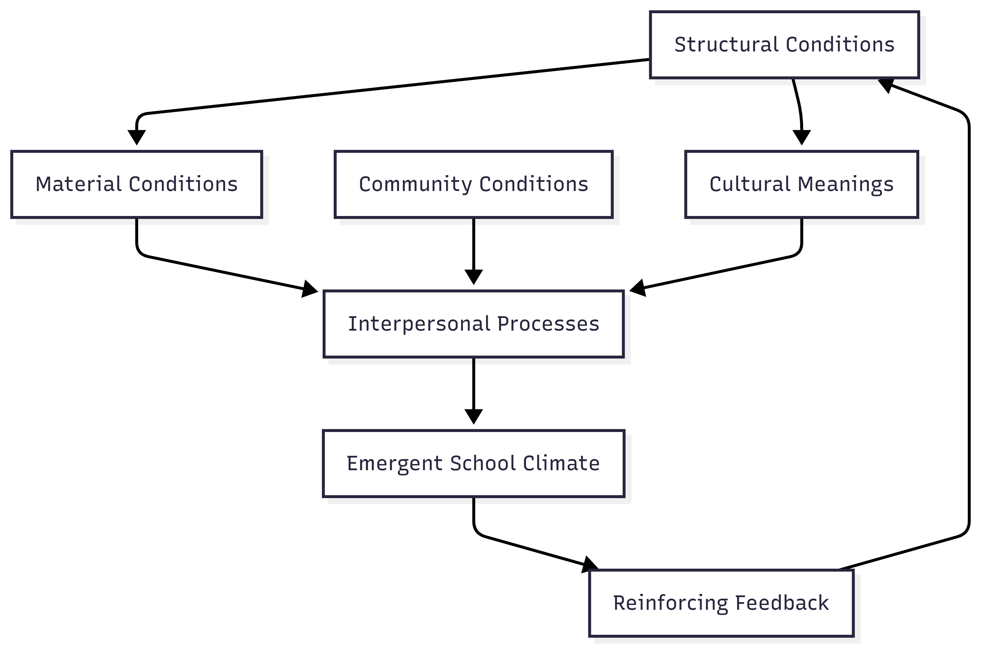

Slide 7
Macro
Broader societal, cultural, and global structures
Discipline
Multidisciplinary /Teamwork Phase
Discipline
Meso
Institutional and organisational structures
Discipline
Epistemic
Emergence
Integrated Transitive Knowledge of
SBMIs
Discipline
Micro
Interactions and relationships
between individuals
Discipline
Discipline
Sub-individual
Psychological and biological processes
Discipline
Transdisciplinary
Teamwork Phase
Transfactual theorising
Intergraded
Understanding
of How, for Whom and Under What Circumstances a SBMI transforms the school climate and Promotes Pupils’ Wellbeing
Disciplinary phase
Disciplinary understanding
Multidisciplinary
Phase
Cross disciplinary
Laminated
System

Slide 8
Schools
Intervention
Mechanisms Triggered by Agency/Assets Developed
Outcome
Internal Factors
Agency
Acceptability
Uptake
Pupils’ and Teachers’ Responsiveness
Improved Teacher-pupil relations
Supportive and Caring School
School Size
Teacher/Pupil Ratio
Funding
Leadership
Rules and Regulations
School Environment
Teaching Practices
Teacher/Pupil Relations
Peer/Peer Relations
Positive School Environment
Emotional Support
Reduction in Bullying and Harassment
Emotional Regulation
Improved Social & Emotional Skills
Improved Communication
Enhanced Empathy
Increased
Attention and Focus
Mindfulness
Curriculum
School
Reduced Anxiety
& Stress
School
Improved Mental Wellbeing of Pupils
Increase in Motivation
Individual
External Factors
Emotional Wellbeing
Family Relations
Local Community Relations
Peer/Peer Relations
Cultural Values
Education Policy
Education Funding
Health Funding
Health Service
Improvement in Quality of Education
Improved Attainment
Reperceiving/
decentering
Enhanced Self Awareness
Improved Behaviour
Increased Teacher wellbeing
Culture of Respect
Positive Classroom Environment
Positive Learning Environment
Intervention Mechanisms
Facilitators (teachers/other)
Training of Facilitators
Mindfulness Curriculum
Fidelity
Amount/Dose
Quality
Reach
Mindful Environment &
Communication

Slide 9
How School Climate is Reproduced
T1 Structural and cultural conditioning
T2 Everyday social interaction shaped by
T3 Structural and elaboration and reproduction
Feedback to next cycle
01
02
03
04
Stress and norms
Conflict cycles and mistrust
Coping strategies (avoidance, harsh discipline)
→ These interactions reinforce the existing culture
Resource constraints, Staffing instability, Community adversity
Dominant expectations and norms
→ These conditions shape how teachers and pupils interact
Reinforces initial structural and cultural meanings
Mostly reproduction
Occasional small improvements by specific agents
→ System feeds back into the next cycle

Slide 10
Breaking the Morphogenetic Cycle: Creating the Conditions for Study
Early Adversity
Poverty
Hunger
Harsh discipline
Household instability
BIOLOGICAL UNREADINESS TO LEARN
Can’t sustain attention
Can’t regulate emotions
Can’t settle to study
Easily overwhelmed
Mindfulness
Self –Regulation
Calmer physiology
Improved emotional control
Cognitive Readiness
Better attention
Greater working memory capacity
Studying Becomes Possible
Can settle and study
Longer task persistence
Better retention
Improved performance
Neurobiological Effects
Hyper-arousal
Impaired executive functions
Reduced working memory
The Cognitive Impact
Difficulty concentrating
Emotional reactivity
Low persistence
Struggles with studying

Slide 11
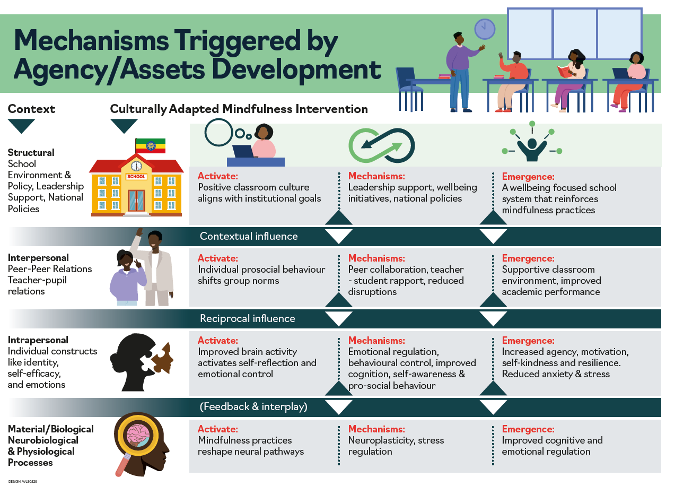
Notes:
A whole school SBMI is most likely to have a positive impact, that is, to promote the mental wellbeing of pupils and transform the structure and culture of the school so that improvements in wellbeing are sustained.

Slide 12
Mindfulness an Educational Intervention to Enable Pupils to Develop their Full potential
Schools fail pupils from deprived backgrounds because there is a contradiction between how schools operate and the needs of pupils from deprived homes.
Schools can make adaptations, so they are better able meet the needs of all their pupils.
School feeding programmes address biological and material preconditions
Student-centred learning – weakens framing, increases agency
Non-punitive discipline – reduces conflict between school norms and pupils’ developmental tendencies.
Mindfulness – strengthens the underlaying capacities for attention, emotional regulation, and behaviour inhibition developmental tendencies that enable pupils to navigate the regulatory order of the school contributing to emergent changes in the classroom climate that improves wellbeing for pupils and teachers.
Mindfulness stabilises the regulatory order - it is an essential early stage mechanism that enables deprived pupils to meet the behavuioual demands of the school and creates the conditions undwewyhich more ambitious pedagogic reforms can succeed.

Slide 13
Project Website
NIHR Global Health Research Group on promoting children's and adolescent's mental wellbeing in sub-Saharan Africa | Education | The University of Aberdeen

Slide 14


Acknowledgement
Funding: The author(s) declare financial support was received for the research, authorship, and/or publication of this article. This research was funded by the National Institute for Health and Care Research (NIHR 133712) using UK aid from the UK Government to support global health research.
Disclaimer: The views expressed in this publication are those of the author(s) and not necessarily those of the NIHR or the UK government, the Court of the University of Aberdeen, the Board of Directors of the University of Rwanda, the Board of Directors of Addis Ababa University, or our International Advisory Board.
Copyright: This is an open-access PPT distributed under the terms of the Creative Commons Attribution License, which permits unrestricted use, distribution, and reproduction in any medium, provided the original author and source are credited.

